Slide 1
National Flag Biscuits
Making biscuits with national flags

Slide 2
Stay safe
Whether you are a scientist researching a new medicine or an engineer solving climate change, safety always comes first. An adult must always be around and supervising when doing this activity. You are responsible for:
ensuring that any equipment used for this activity is in good working condition
behaving sensibly and following any safety instructions so as not to hurt or injure yourself or others
Please note that in the absence of any negligence or other breach of duty by us, this activity is carried out at your own risk. It is important to take extra care at the stages marked with this symbol: ⚠

Slide 3
Brief
The men’s 2022 football World Cup is to be played in November and December 2022 in Qatar
Your task is to create a biscuit that shows the national flag of a World Cup country

Slide 4
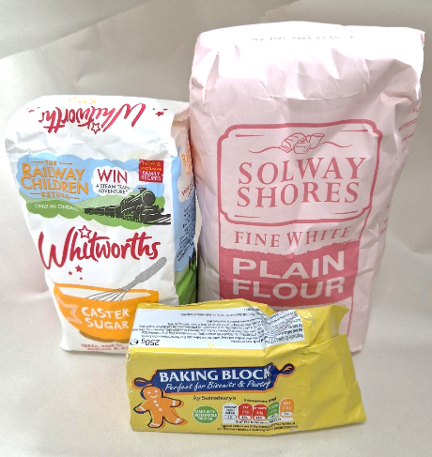
Resources and equipment (biscuits)
25 g caster sugar
50 g soft butter
75 g plain flour
Mixing bowl
Rolling pin (optional)
Table knife
Baking tray and baking paper (lined tray)
Cooling rack
Notes:
Make biscuits for 1 student, can work as a pair if needed and scale the recipe accordingly.
Ideally you would make these in the AM session or the day before the icing to allow for cooling of the biscuits.
This recipe for shortbread can be scaled up:
2 people: 50 g caster sugar, 100 g soft butter, 150 g plain flour
3 people: 75 g caster sugar, 150 g Soft butter, 225 g plain flour
4 people: 100 g caster sugar, 150 g soft butter, 300 g plain flour
**Could colour the biscuit mixture to theme for the selected countries

Slide 5
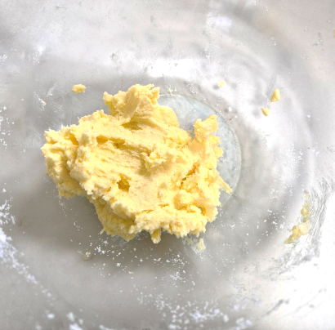
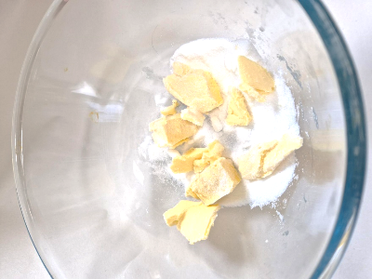
Step 1
Line a baking tray with baking paper
Rub together the butter and sugar, by hand until pale and smooth
Notes:
The supervising adult needs to preheat the oven to 160 degrees/140 degrees Fan/Gas 3.
Line the baking tray or grease with fat.
‘Rub’ the fat into the sugar by rubbing both the ingredients together between the fingertips.

Slide 6
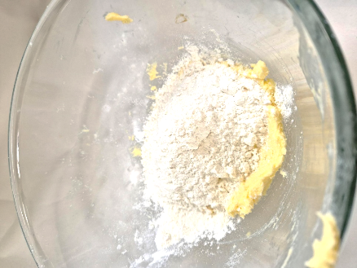
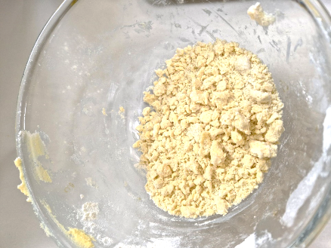
Step 2
Gently rub in the flour until completely combined
Try not to work the flour too much or the biscuits will not be so crumbly
Notes:
Rubbing the ingredients together between the fingertips until the mixture resembles breadcrumbs.

Slide 7
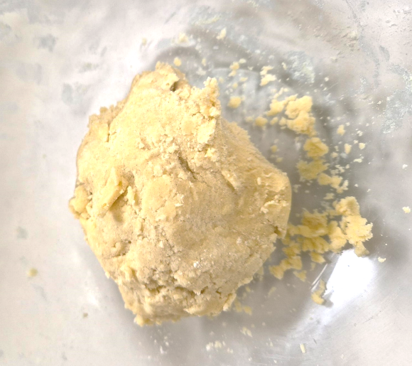
Step 3
Using your hands, squeeze the mixture together into a ball of dough
Notes:
The heat of your hands will create the ball as the fat starts to melt. There be small bits of mixture left in the bowl.

Slide 8
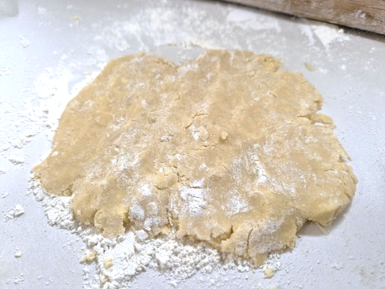
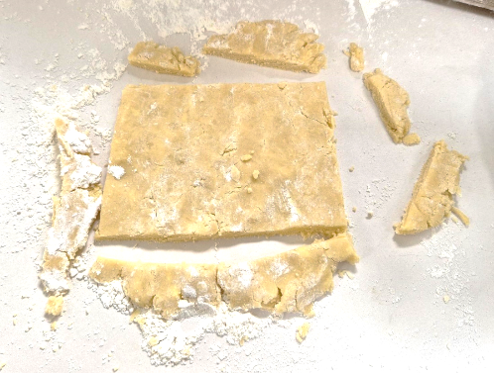
Step 4
Gently pat out the dough to about 5 mm (¼ inch) thick (dust the work surface with a little flour if the dough sticks)
Cut into rectangles (flag shapes)
Notes:
The small mixture size will make rolling out with a rolling pin difficult, if the mixture has been scaled up then it will be easier.
Trim the edges to create a ‘rectangle’, then cut into 2/3 pieces.

Slide 9
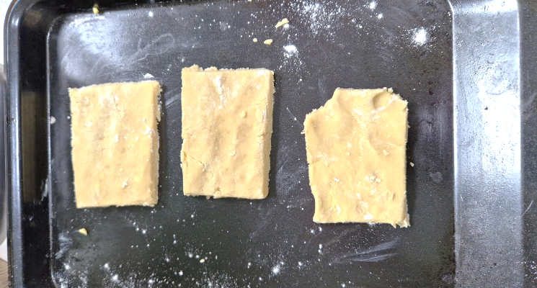
Step 5
Transfer the biscuits onto the baking tray and chill in the fridge for 15 minutes to rest
Notes:
You my need to label the trays so they do not get mixed up.

Slide 10
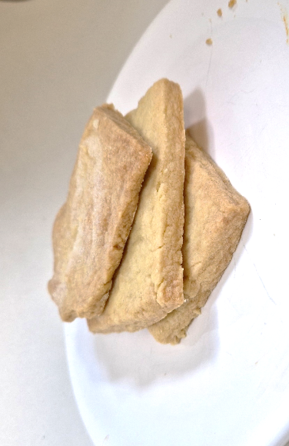
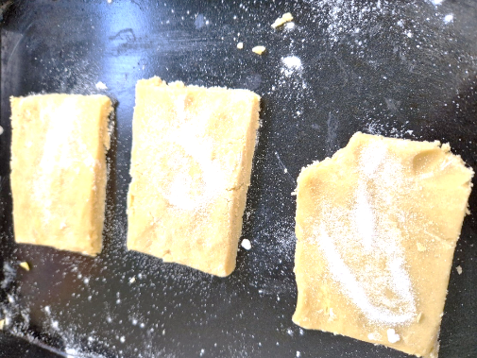
Step 6 ⚠
Sprinkle each biscuit with a pinch of sugar
Bake for 15–20 minutes, or until pale golden brown ⚠
Notes:
The cooking time may take longer/shorter than stated due to each oven varying slightly.

Slide 11
Finished biscuit example
Notes:
The cooled biscuits before we decorate.

Slide 12
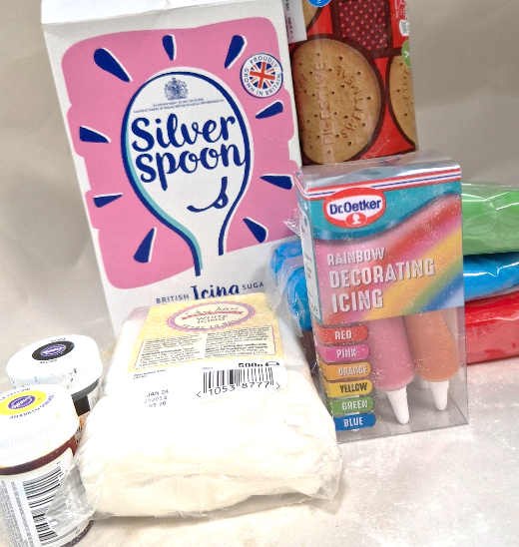
Resources and equipment (icing)
Biscuits
Icing sugar
Food colouring
Ready made fondant icing (optional)
Icing pens (optional)
Mixing bowls
Sieve
Spoons
Icing bags (optional)
Notes:
ICING BISCUITS ONLY
Food colouring can be as a liquid or a gel. The gels provide a stronger colour. REMEMBER to wear gloves when handling food colouring as it may stain your hands.
The small pots in the picture are gel food colourings.

Slide 13
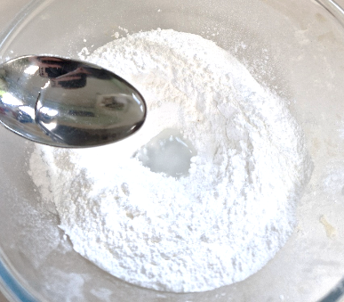
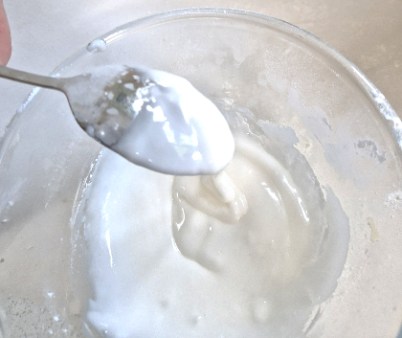
Option 1 – Making glace icing
Use 125 g icing sugar, 15 ml water
Sift the icing sugar into a bowl
Gradually add the water until the icing becomes thick enough to coat the back of a spoon
Notes:
Glace Icing is smooth, runny and glossy and is ideal for biscuits as it sets hard.
**If necessary, add more water (a drop at a time) or icing sugar to adjust the consistency.
This is to make the topping base for the biscuits.

Slide 14
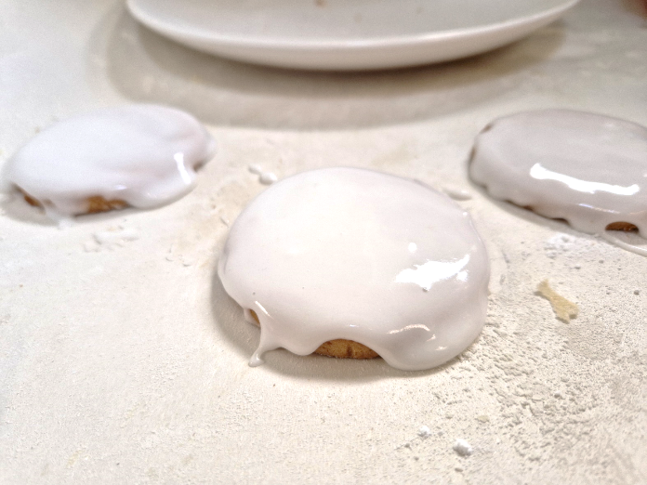
Option 1 – Applying the glace icing
Using glace icing:
Cover the biscuit with white icing to create a ‘base’
Notes:
Glace Icing is smooth, runny and glossy and is ideal for biscuits as it sets hard.
This is to make the topping base for the biscuits.
Then ice the desired pattern with icing pens/piping bag with glace icing.

Slide 15
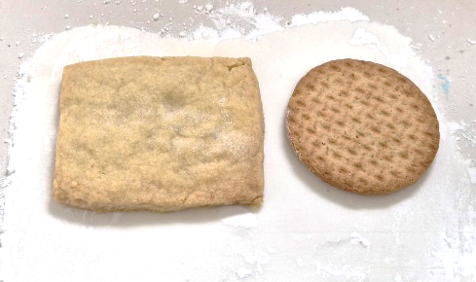
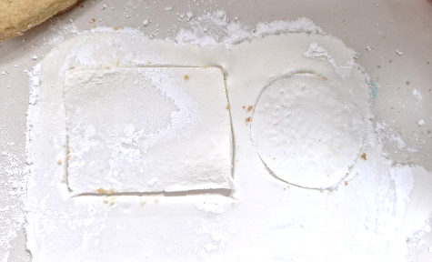
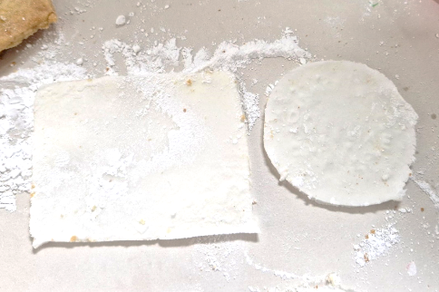
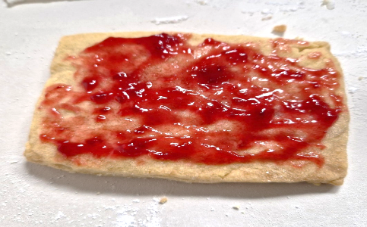
Option 2 – Applying fondant icing
Using fondant icing:
Cut out the required shapes for the parts of the flag
Use warm jam to ‘attach’ the icing to the biscuit
Notes:
Fondant icing is made of icing sugar, water, and corn syrup or dried glucose syrup. This gives you a smooth, glossy, soft iced finish which is perfect for icing cupcakes, sponges or biscuits. You can even use it to create edible cake decorations.

Slide 16
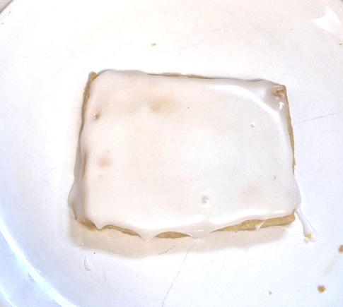
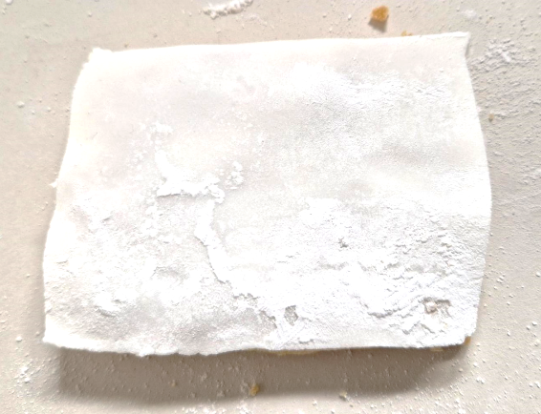
Step 2 - Decorate the biscuits
Glace/fondant icing bases:
Glace base
Fondant base
Notes:
Glace and fondant based biscuits

Slide 17
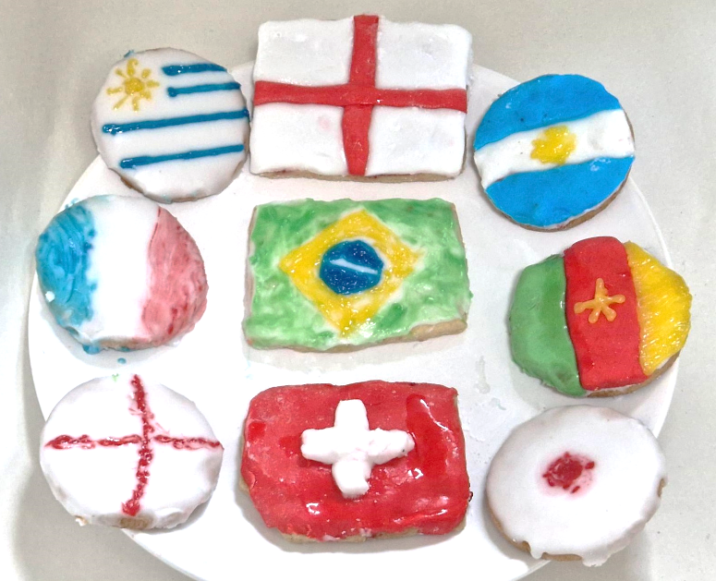
Examples of finished products

Slide 18
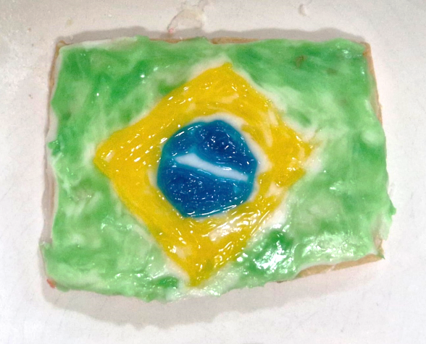
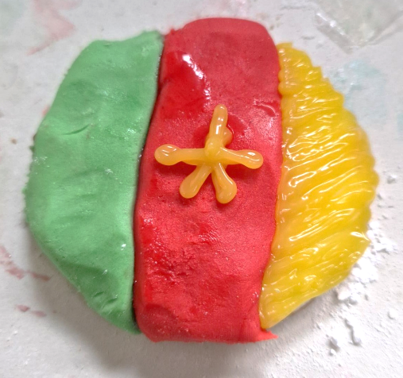
Examples of finished products
Brazil
Fondant base
Icing pens for design
Cameroon
Fondant green/red
Icing pens for yellow

Slide 19
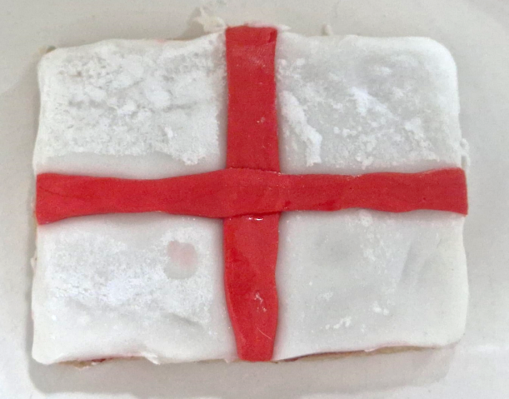
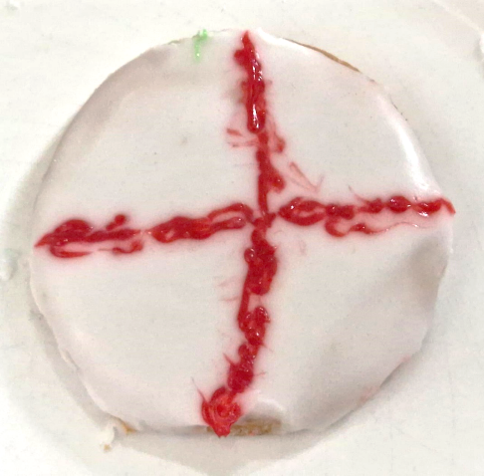
Examples of finished products
England
Fondant icing
England
Glace icing

Slide 20
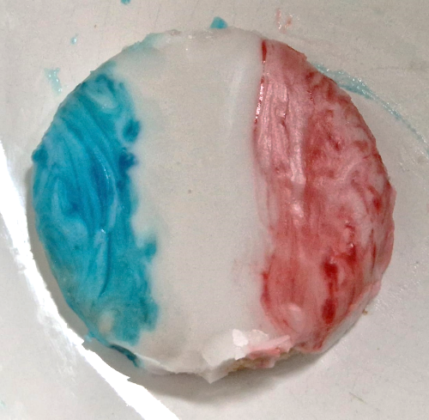
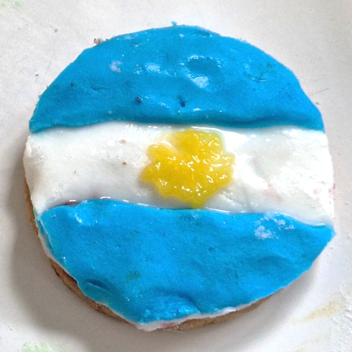
Examples of finished products
France
Glace icing
Argentina
Fondant icing blue/white
Icing pen yellow

Slide 21
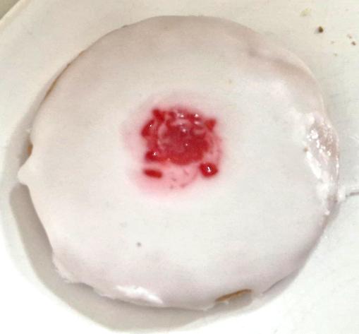
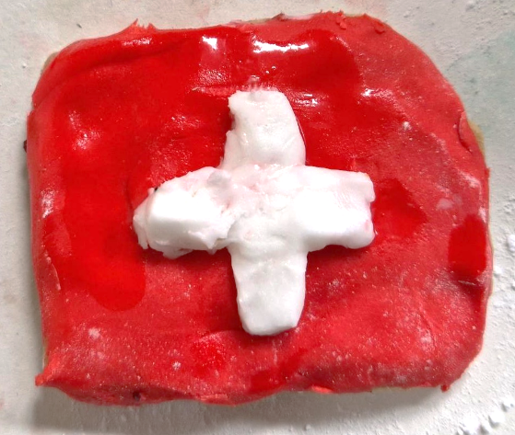
Examples of finished products
Japan
Glace icing
Switzerland
Fondant icing red/white

Slide 22
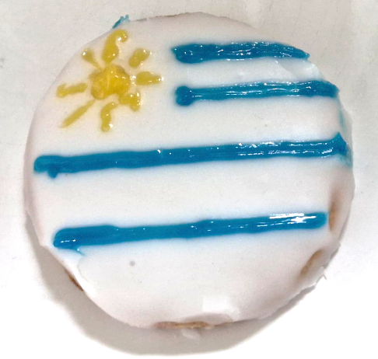
Examples of finished products
Uruguay
Glace icing
Icing pen blue

Slide 23
Please do share your learning highlights and final creations with us so we can display it for other students to see.
Share them with us on social media @IETeducation or send them via email to IETEducation@theiet.org

