Slide 1
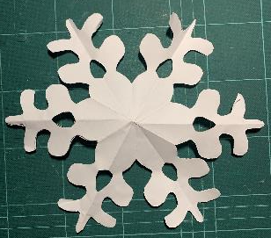
Science of snowflakes
Why has a snowflake got 6 sides?

Slide 2
Science of snowflakes
Stay safe
Whether you are a scientist researching a new medicine or an engineer solving climate change, safety always comes first. An adult must always be around and supervising when doing this activity. You are responsible for:
ensuring that any equipment used for this activity is in good working condition
behaving sensibly and following any safety instructions so as not to hurt or injure yourself or others
Please note that in the absence of any negligence or other breach of duty by us, this activity is carried out at your own risk. It is important to take extra care at the stages marked with this symbol: ⚠

Slide 3
Snowflakes
They are always flat with 6 sides
They are made from H₂O (Water):
2 molecules of hydrogen
1 molecule of oxygen
Their molecules move freely above 4ºC
Below 4ºC the molecules freeze in the air, making hexagon shapes

Slide 4
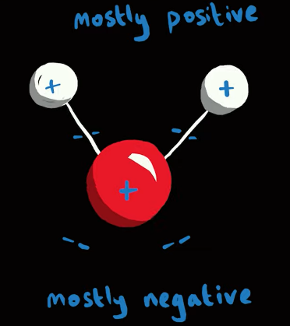
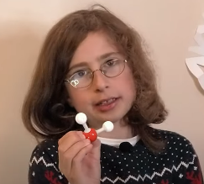
Snowflakes – why a hexagon shape?
1 of 3
There are electrons and protons in the oxygen and hydrogen molecules
This creates a polar charge

Slide 5
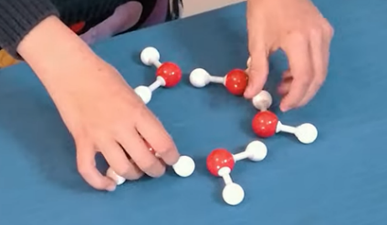
Snowflakes – why a hexagon shape?
2 of 3
The hydrogen molecules are attracted to the oxygen molecules
This is called hydrogen bonding
So below 4ºC the hydrogen
bonds crystallise to form snow, snowflakes and ice

Slide 6
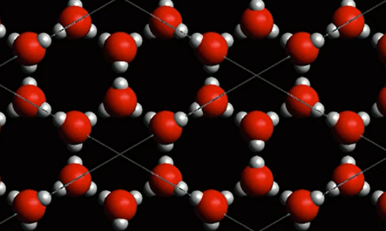
Snowflakes – why a hexagon shape?
3 of 3
The polar charge holds the molecules together
As they crystallise, they create a hexagon lattice
The hexagons then tesselate to make snow, snowflakes and ice

Slide 7
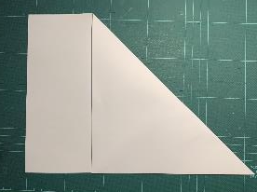
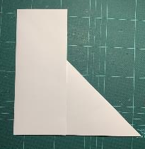
Snowflake activity - make a snowflake
Step 1- Make a square
Fold one corner of A4 paper
Fold over one end of the paper
Cut off at the fold ⚠

Slide 8
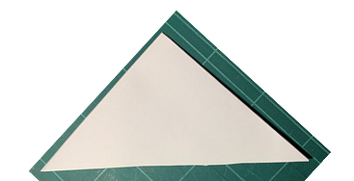
Snowflake activity - make a snowflake
Step 2
Place the triangle in the position shown
Fold the right side as shown
Fold the left side as shown

Slide 9
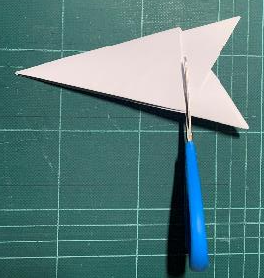
Snowflake activity - make a snowflake
Step 3
Cut the 2 folds on the bottom ⚠
Draw a design on the triangle

Slide 10
Snowflake activity - make a snowflake
Step 4
Cut out the pattern ⚠
Unfold the paper to reveal your snowflake

