Slide 1
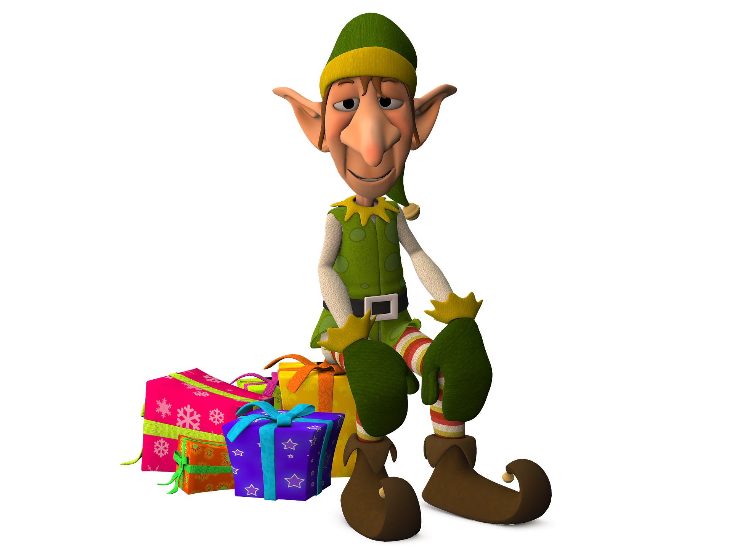
Dress the Elf
A Dress-the-Elf activity
to work out the number of combinations possible with clothes

Slide 2
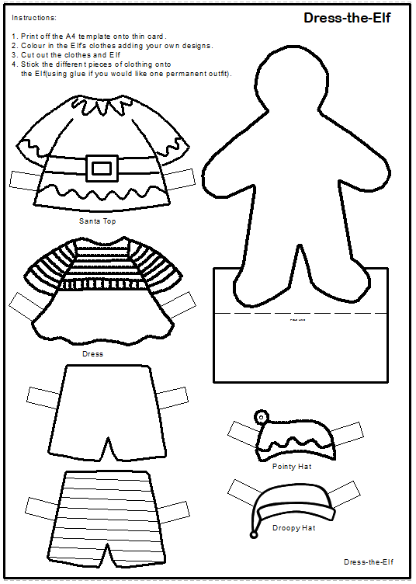
Step 1
Get the Dress-the-Elf handout

Slide 3
Step 2
Colour in the Elf’s clothes
Add your own designs
Cut out the clothes and Elf safely with scissors
Stick the clothing onto the Elf

Slide 4
How many ways can the Elf get dressed?
Step 3
The model has a set number of clothes:
2 hats, a pointy hat and a droopy hat
2 tops, one Santa one dress
2 pairs of shorts, one plain one stripy.
Using Multiplication this could be worked out as:
2 x 2 x 2 = 8
So there are 8 ways the Elf could get dressed.

Slide 5
Dressing-the-Elf Table
This is how many ways to Dress-the-Elf in an information table:
 | 1 | 2 | 3 | 4 | 5 | 6 | 7 | 8
Hat | Pointy | Pointy | Pointy | Pointy | Droopy | Droopy | Droopy | Droopy
Top | Santa | Santa | Dress | Dress | Santa | Santa | Dress | Dress
Shorts | Plain | Stripy | Plain | Stripy | Plain | Stripy | Plain | Stripy

