Slide 1
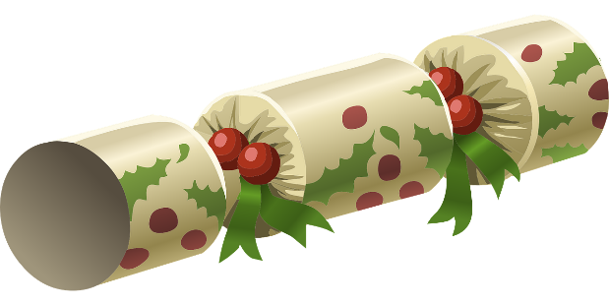
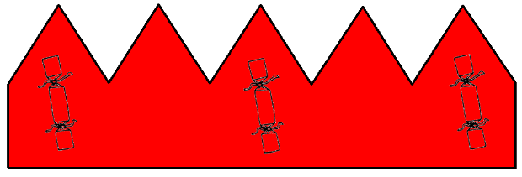
Christmas Crackers
Making a Christmas cracker and hat

Slide 2
Stay safe
Whether you are a scientist researching a new medicine or an engineer solving climate change, safety always comes first. An adult must always be around and supervising when doing this activity. You are responsible for:
ensuring that any equipment used for this activity is in good working condition
behaving sensibly and following any safety instructions so as not to hurt or injure yourself or others
Please note that in the absence of any negligence or other breach of duty by us, this activity is carried out at your own risk. It is important to take extra care at the stages marked with this symbol: ⚠

Slide 3
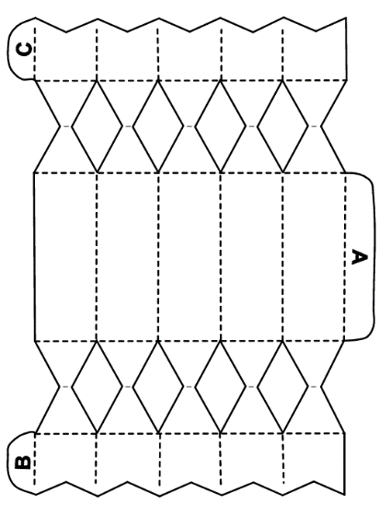
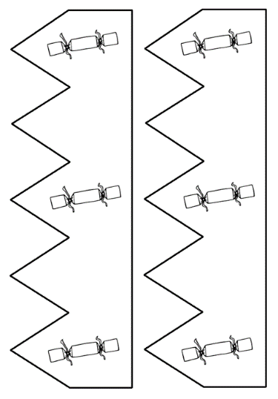
Resources
You will need:
Christmas cracker and
hat nets
Scissors ⚠
Paper
Glue stick

Slide 4
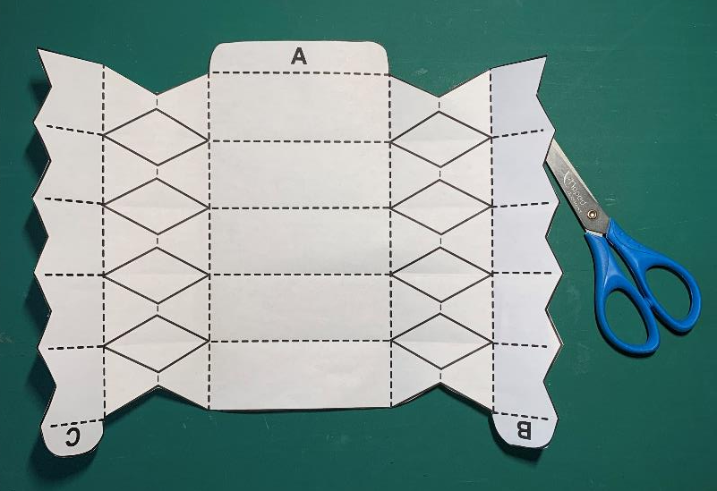
Step 1 – Cut out the cracker
Decorate the cracker
Carefully cut along all the solid outlines ⚠
Score and fold the dotted lines ⚠

Slide 5
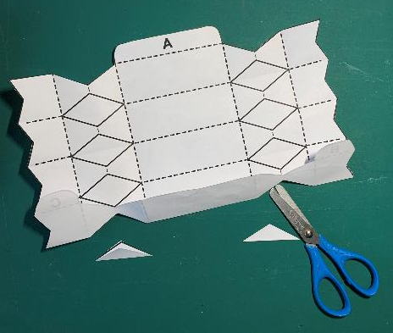
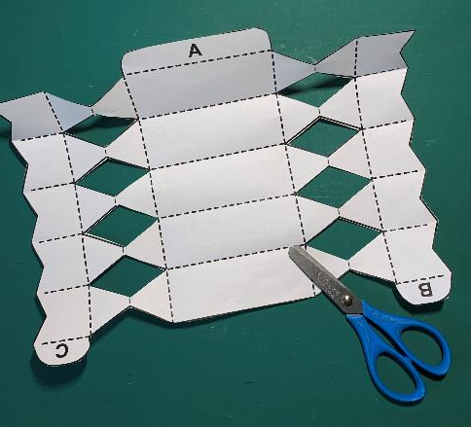
Step 2 – Cut out the diamond shapes
Fold each line that crosses the diamond shapes
Carefully cut out the diamond shapes ⚠

Slide 6
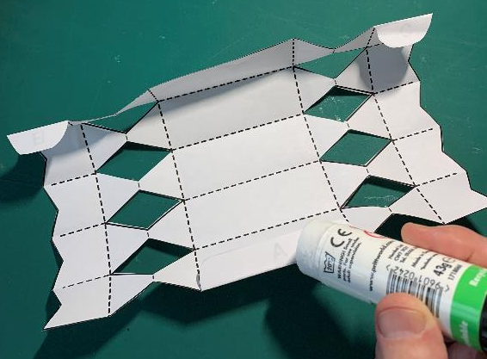
Step 3 – Fold and Glue Tabs A B C
Glue tabs A, B and C
Stick tab A to its opposite edge on the centre of the cracker
Stick tabs B and C to form the top and bottom
GLUE

Slide 7
Step 4 – Tie the cracker
Tie the bottom of the cracker with ribbon or thin string

Slide 8
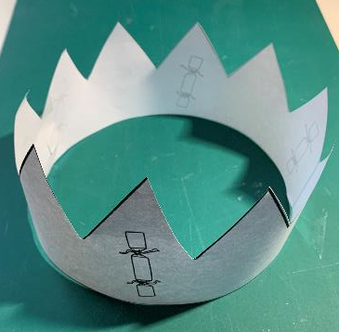
Step 5 – Cut out and make the hat
STICKY TAPE
Carefully cut out the hat net ⚠
Use sticky tape to join the hat sides together

Slide 9
Step 6 – Fill the cracker
Fold the hat and put it in the cracker
You may wish to put a small gift inside the cracker too
Tie the top of the cracker and give it to a friend

