Slide 1
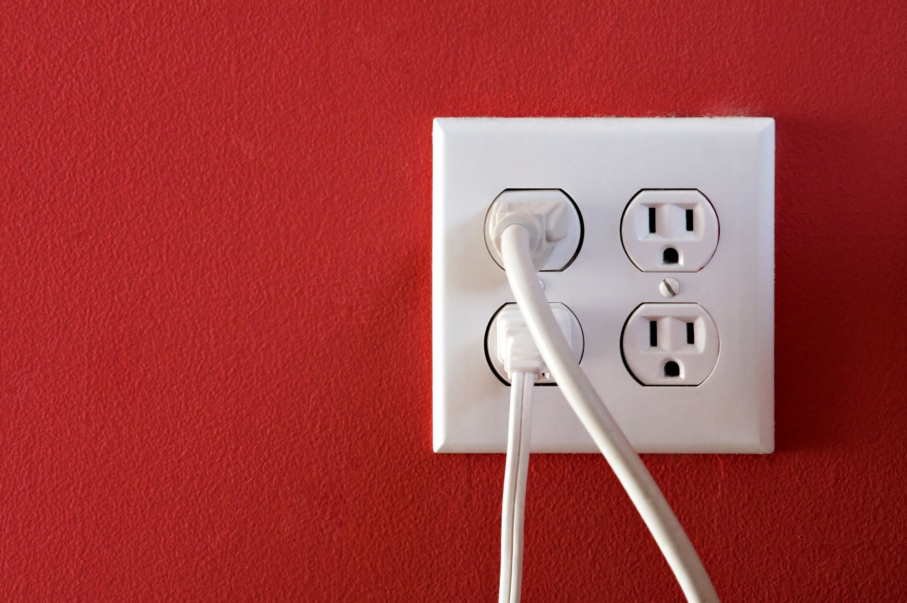



SESSION 4
Energy Consumption

Slide 2
Guiding Questions
How does the carousel consume energy?
What else consumes energy at a fun fair or amusement park?
Outcomes
The team will build the carousel and connect it to the energy storage model.
The team will identify different ways energy is consumed.
What uses energy/electricity in your home?
What examples of energy consumption are in our community?
What is being done to reduce energy consumption?
Why is being sustainable and preserving the Earth important?
Notes:
Each session has Guiding Questions that can be shared to frame the session.
Session Tips
The team will need Book 3 and Bag 3 located in the Explore Set.
The team will need the assembled energy storage model from the previous session.
Have the team explain how the carousel is using the energy that was stored in the energy storage model.
The team will motorize the carousel/wind turbine in Session 6.
Additional examples of energy consumption on the mat include the car, farm, and fun fair.
There are open spaces where the team could build additional energy consumers like an apartment building and grocery store.
​

Slide 3



Introduction – Let’s Innovate
Examples of Innovation
Ask the students to provide examples of Innovation and record them here
Example of Innovation
Example of Innovation
We used creativity and persistence to solve problems.
Extension
Notes:
Introduction
Let’s Innovate
(10 minutes)
Read the definition for innovation to the team.(see page 5)
Talk about what innovation is. Have the team provide examples of this Core Value.
Extension: Have everyone draw a picture of an example of innovation on the Core Values page in their Engineering Notebook.

Slide 4
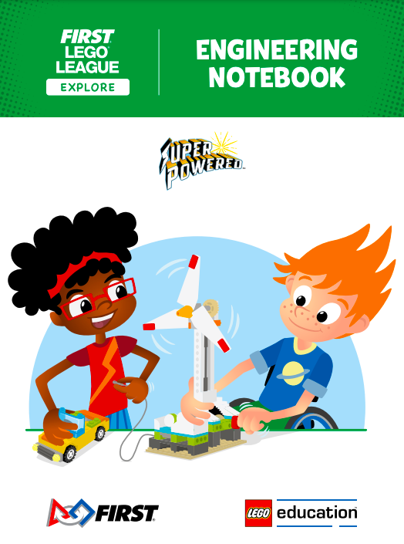
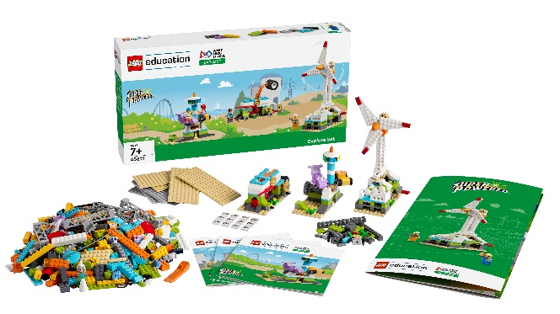
Task 1
You need…
Follow the building instructions in Book 3 to make the carousel from the Explore Set.
Connect the carousel to the energy storage model.
Notes:
Tasks (20 minutes)
Follow the building instructions in Book 3 to make the carousel.
Connect the carousel to the energy storage model.
Load energy units into the energy storage slot (A).
Release the stored energy by lifting the release lever (B) to power the carousel.
Discuss how these models represent how energy is stored and consumed.

Slide 5
Task 1
You need…
Load energy units into the energy storage slot.
Release the stored energy by lifting the release lever to power the carousel.
Discuss how these models represent how energy is stored and consumed.
Notes:
Tasks (20 minutes)
Follow the building instructions in Book 3 to make the carousel.
Connect the carousel to the energy storage model.
Load energy units into the energy storage slot (A).
Release the stored energy by lifting the release lever (B) to power the carousel.
Discuss how these models represent how energy is stored and consumed.

Slide 6
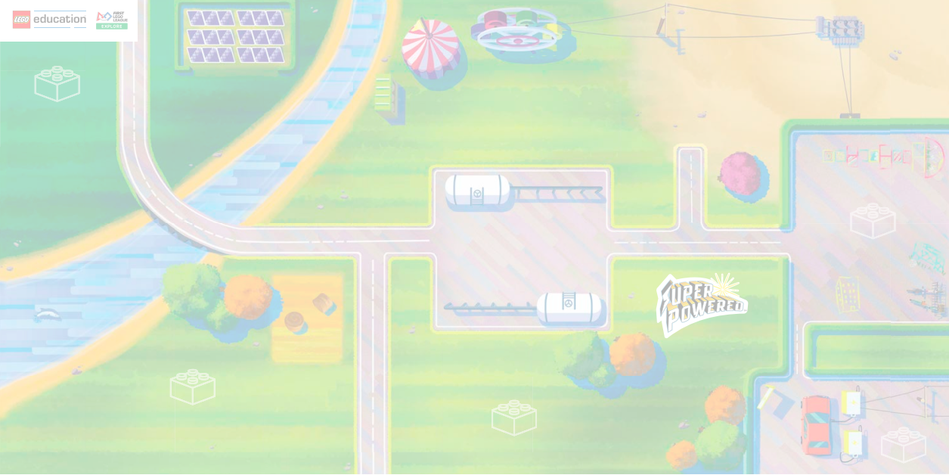
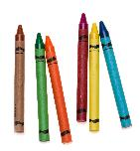
Task 2
You need…
Circle examples of energy consumption on the mat image.
Notes:
Tasks (20 minutes)
Circle examples of energy consumption on the mat image.
Identify examples of energy consumption in your community.
Challenge
Build examples of energy consumption using the prototyping pieces.
Place your builds on the mat. You could use the LEGO® brick icons as building locations.
Share your builds and explain how what you built uses energy.

Slide 7
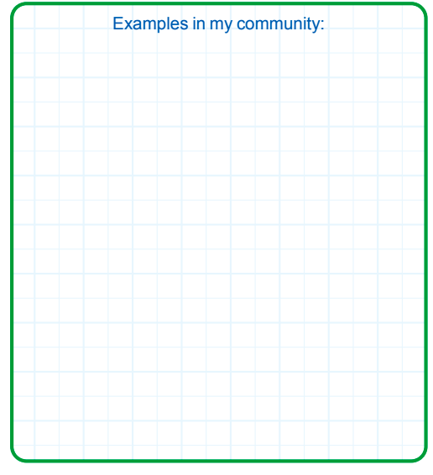
Capture Your Inventive Ideas!
Identify examples of energy consumption in your community.
Notes:
Tasks (20 minutes)
Circle examples of energy consumption on the mat image.
Identify examples of energy consumption in your community.
Challenge
Build examples of energy consumption using the prototyping pieces.
Place your builds on the mat. You could use the LEGO® brick icons as building locations.
Share your builds and explain how what you built uses energy.

Slide 8
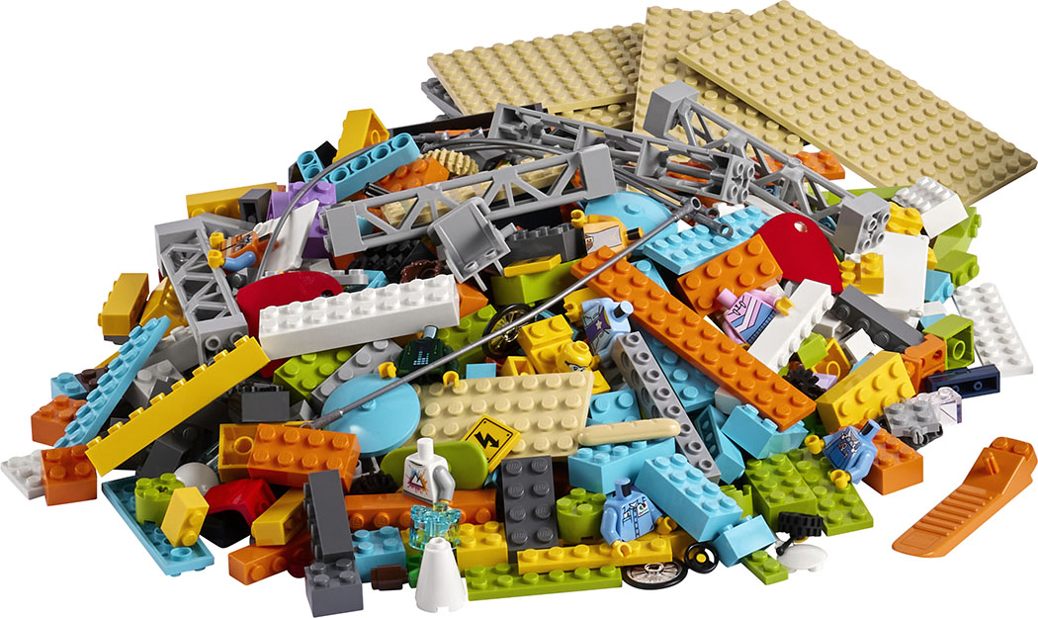
Task 2
Challenge
Build examples of energy consumption using the prototyping pieces.
Place your builds on the mat. You could use the LEGO® brick icons as building locations.
Share your builds and explain how what you built uses energy.
Notes:
Tasks (20 minutes)
Circle examples of energy consumption on the mat image.
Identify examples of energy consumption in your community.
Challenge
Build examples of energy consumption using the prototyping pieces.
Place your builds on the mat. You could use the LEGO® brick icons as building locations.
Share your builds and explain how what you built uses energy.

Slide 9

Share
Share what you did in the session.
Demonstrate how the carousel works.
Explain what an energy consumer is and provide examples.
Show different examples of energy consumption on the mat.
What have you discovered? Share with your team!
Notes:
Share (10 minutes)
Have the team:
• Share what they did in the session.
• Demonstrate how the carousel works.
• Explain what an energy consumer is and provide examples.
• Show the different examples of energy consumption on the mat.

Slide 10

Optional Video:
You may wish to embed a relevant, age-appropriate video for your students here. See the Notes for an example.
Notes:
Choose a relevant, age-appropriate video for your students.
Here is one example from Mashable Deals on a solar-powered theme park: https://www.youtube.com/watch?v=fUt4P867tAI&feature=youtu.be

Slide 11
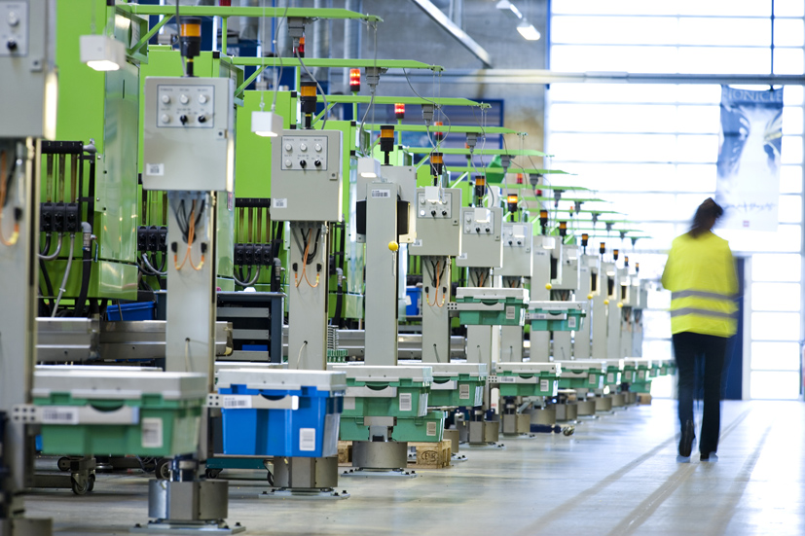
Career Connections
Sustainability
Lead
Role:
Looks for ways to use renewable energies and produce less waste to create LEGO® products in the LEGO factories.
Notes:
Ask the children to reflect on what parts of the energy journey they might like to design as a sustainability lead.

Slide 12

Clean Up
Notes:
You may wish to play a video or song during clean up time Link on GoNoodle: https://family.gonoodle.com/activities/clean-up. Link on YouTube Kids: https://www.youtubekids.com/watch?v=ZJFk87ZsHn0 . Link on Youtube: https://youtu.be/ZJFk87ZsHn0
Cleanup Pointers
• Both the carousel and energy storage model should stay assembled, but they can be stored separately.
• Anything built with the prototyping pieces should be taken apart.

Slide 13

LEGO, the LEGO logo and the SPIKE logo are trademarks of the/sont des marques de commerce du/son marcas registradas de LEGO Group. ©2022 The LEGO Group. All rights reserved/Tous droits réservés/Todos los derechos reservados. FIRST®, the FIRST® logo, and FIRST® ENERGIZESM are registered trademarks of For Inspiration and Recognition of Science and Technology (FIRST). LEGO® is a registered trademark of the LEGO Group. FIRST® LEGO® League and SUPERPOWEREDSM are jointly held trademarks of FIRST and the LEGO Group. ©2022 FIRST and the LEGO Group. All rights reserved.

