Slide 1
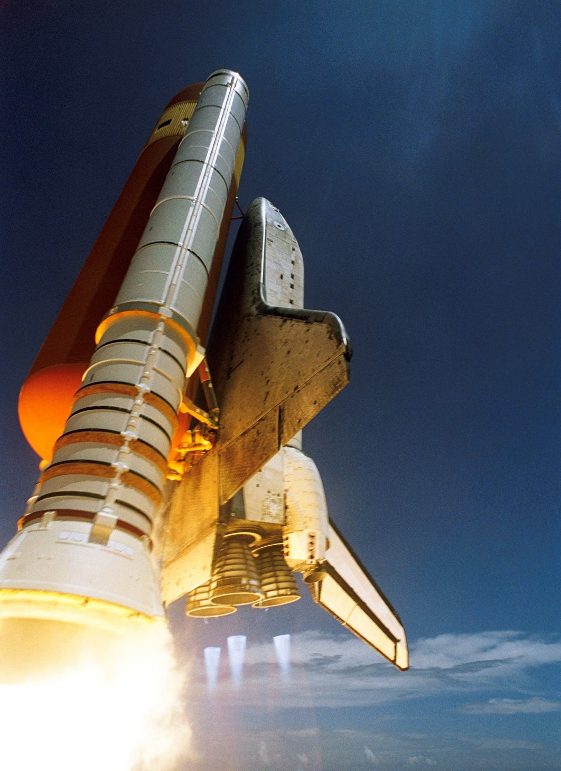
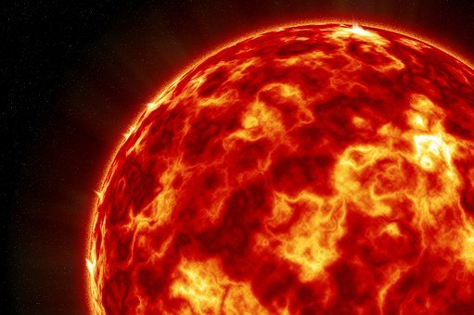
Heat Shield
Selecting the material for a heat shield to prevent a piece of chocolate from melting

Slide 2
Stay safe
Whether you are a scientist researching a new medicine or an engineer solving climate change, safety always comes first. An adult must always be around and supervising when doing this activity. You are responsible for:
ensuring that any equipment used for this activity is in good working condition
behaving sensibly and following any safety instructions so as not to hurt or injure yourself or others
Please note that in the absence of any negligence or other breach of duty by us, this activity is carried out at your own risk. It is important to take extra care at the stages marked with this symbol: ⚠

Slide 3
Situation
The Solar Orbiter mission aims to measure the properties of the Sun. It will help us understand how the solar system works.
“The sun has a surface temperature of nearly 6000ºC”
The Solar Orbiter has to get very close to the Sun’s surface.
It needs a heat shield so its systems do not get too hot, melt and stop working.
Notes:
Discuss the context/situation with learners. Have they heard of this mission? What do they think we can learn from it?

Slide 4
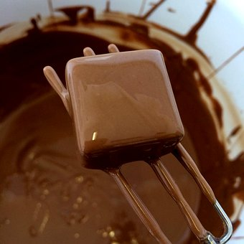
Design Brief
Select the best material for a heat shield to protect a square of chocolate from a heat source.
You must test different materials to see which would be the best to use.
Notes:
Discuss the brief with learners.
The chocolate will represent the systems on the orbiter that need to be protected from the heat.

Slide 5
Resources and equipment
Polystyrene cups
Scissors
Materials for heat shields (e.g. milk bottle plastic, cardboard, metal foil, metal mesh)
Chocolate pieces
Hairdryer
Heat mats
Stopwatch or timer
Notes:
Polystyrene cups were cut down to 4 cm height for the example experiments shown in this presentation.
Each shield is 10 cm x 10 cm.
Shields could include cardboard from a box, tin foil, plastic cut from a milk bottle container and wire mesh.
Chocolate should be cut into equal pieces *note* only use the same MILK CHOCOLATE for ALL tests, e.g. all same brand. White/dark/filled chocolates all have different melting points that would alter the tests.
Heat shields:
Learners could pick from a selection of materials that can include metal foil, plastic, e.g. milk bottle, heat resistant gauze, fabric, newspaper, wood.
Hairdryer:
Medium heat on a medium setting was used in the examples shown in this presentation. Variations of heat (power) from the hairdryers need taking into consideration. Risk assessments should take into account electrical safety and potential hazards from heat.
Additional equipment that could be used:
Thermometer
Ruler
Timer
Heat mats to place polystyrene cups on
Oven gloves/cloths/tongs – if learners are to hold containers while they are heated, although this should be avoided if possible.

Slide 6
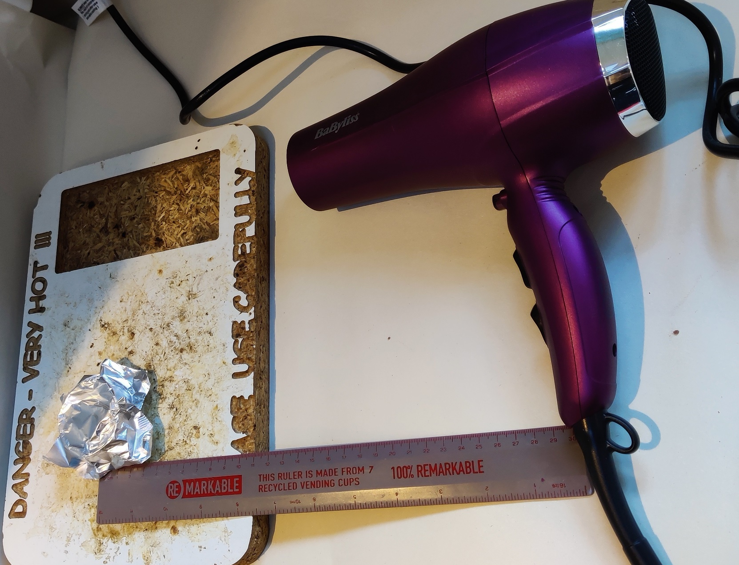
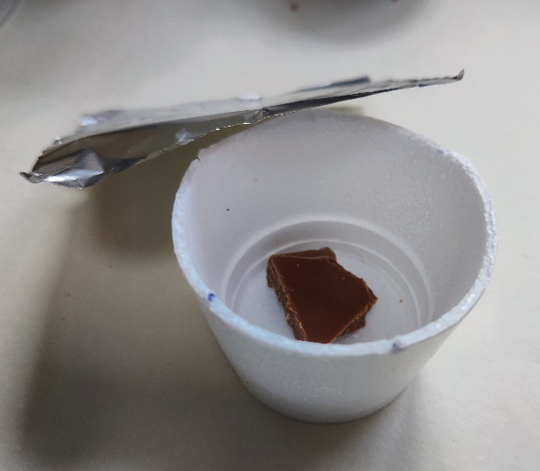
Step 1
Place a piece of chocolate in a cup
Place the heat shield material over the top of the cup and secure
Polystyrene cup and heat shield
Hairdryer to be held 30 cm from the chocolate
Heat mat
Notes:
Cups can be cut to about a third of their size to make heating the chocolate easier. Learners could do this using scissors or the teacher cut pre-cut them.
The hairdryer should be held over the top of the protected chocolate, around 30 cm away.
Tin foil can be moulded round cup to prevent it moving during heating.
When using plastic or cardboard this may need tape to hold in place while heating.

Slide 7
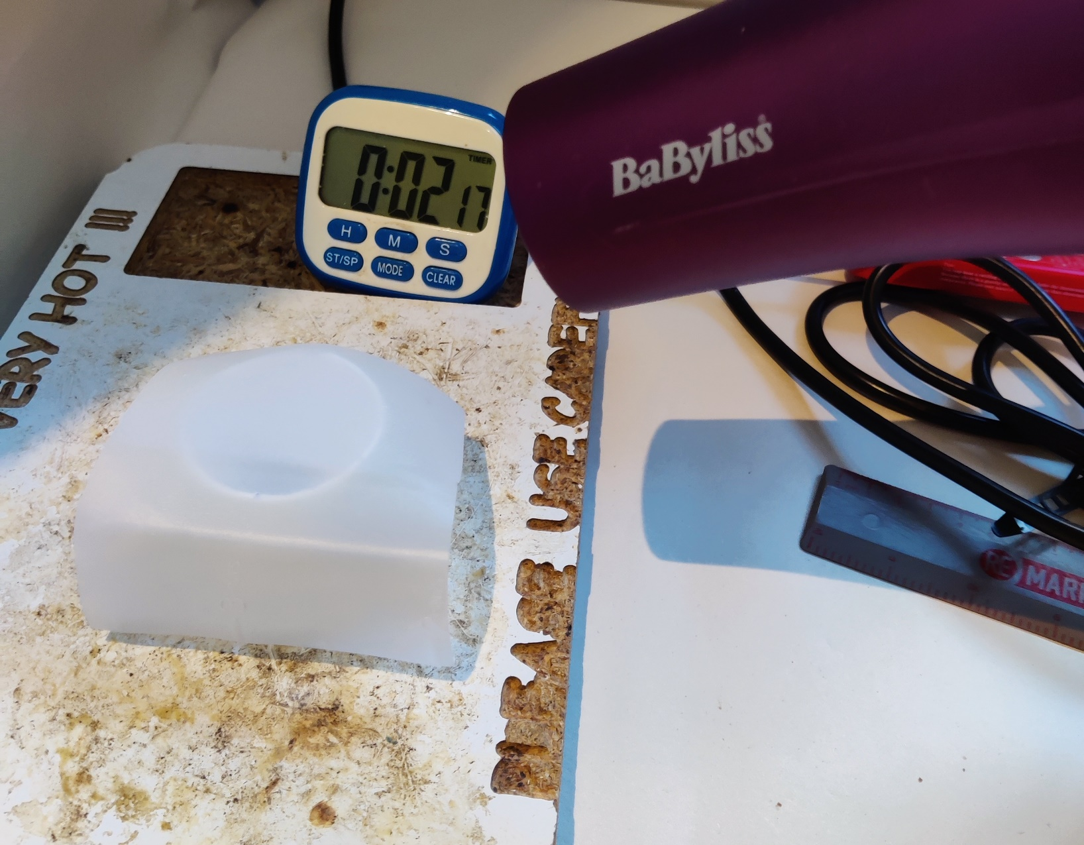
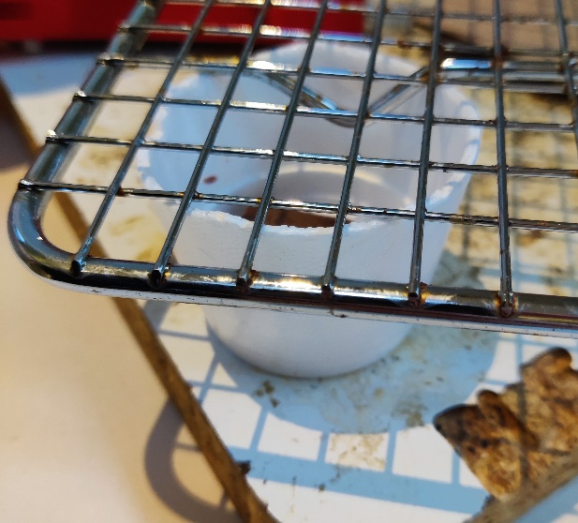
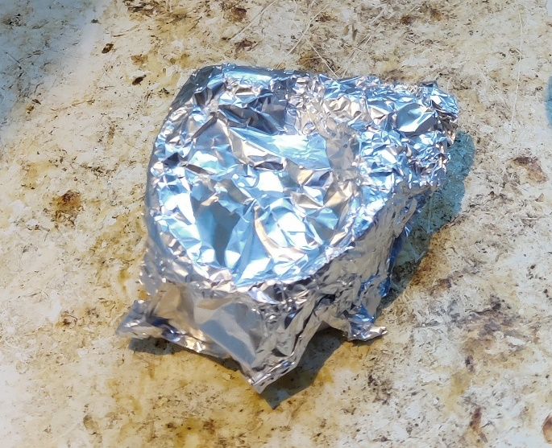
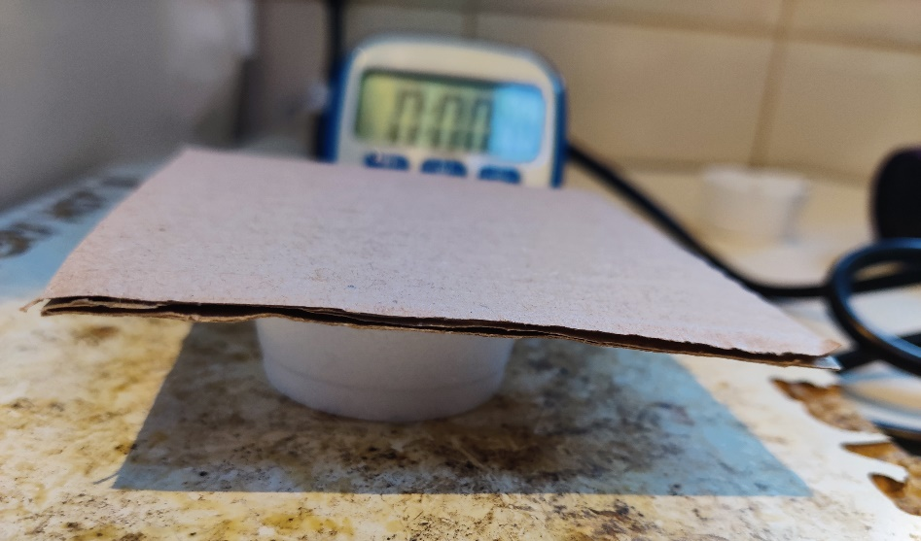
Step 2
⚠
Heat the shielded chocolate for three minutes
Remove the shield and see how melted the chocolate is
Test three different heat shield materials
Notes:
Control chocolate test: one team or person can heat one sample without any shield to compare as control sample.
The following heat shield materials could be tested:
Milk bottle plastic
Cardboard from a delivery box
Metal foil
Metal mesh
All heat shield materials should be cut to the same size and shape – around the size of the top of the cup. The same amount of chocolate should be used for each material tested.
Tips:
If in teams, allow different students to hold the hairdryer for each individual test.
Keep the same hairdryer and settings for each test to ensure fairness.
If individual task, heating of chocolate will be fairer as same equipment/person used each time.
Take care to avoid burns when using hairdryer and ensure it is electrically safe prior to use.

Slide 8
Step 3
Record your results
Shield material | Chocolate state e.g. solid/liquid | Melted? | Notes
Notes:
Results
Photographs could be taken of the test results and annotated.
Results can be written in the table (this slide could be printed or learners could draw it in their exercise books), or presented as a PowerPoint or other type of presentation.

Slide 9
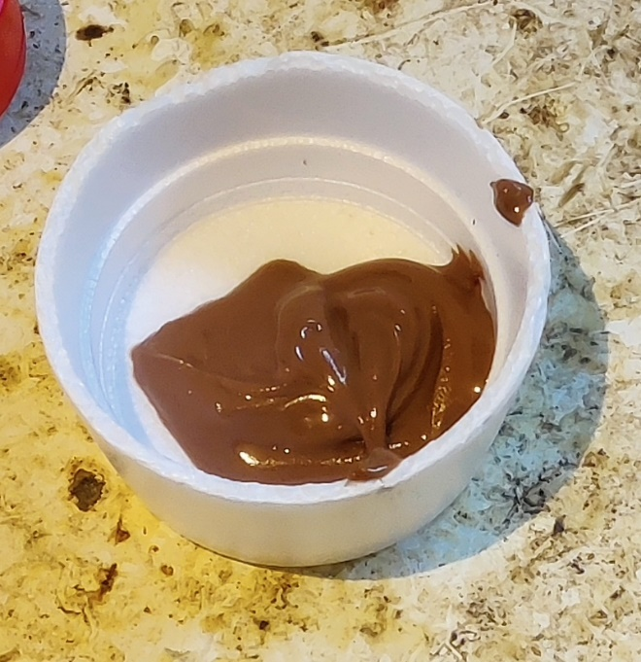
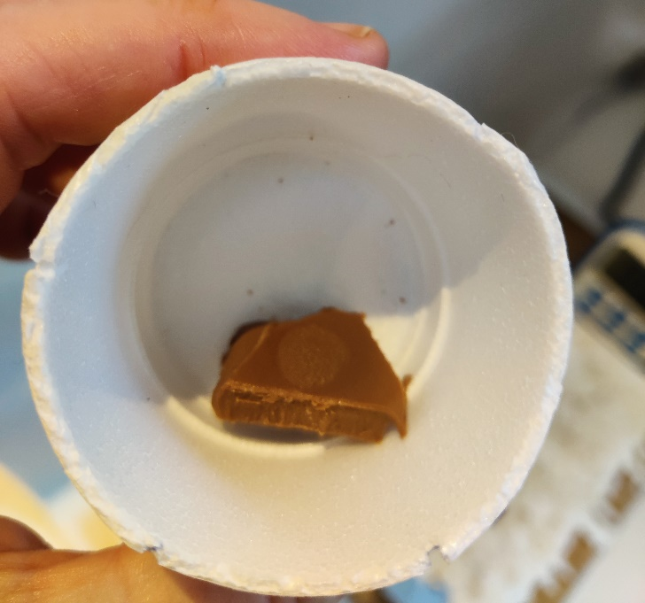
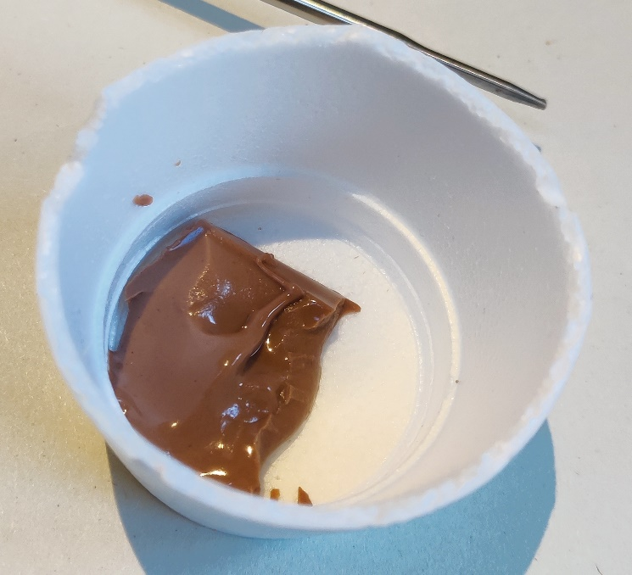
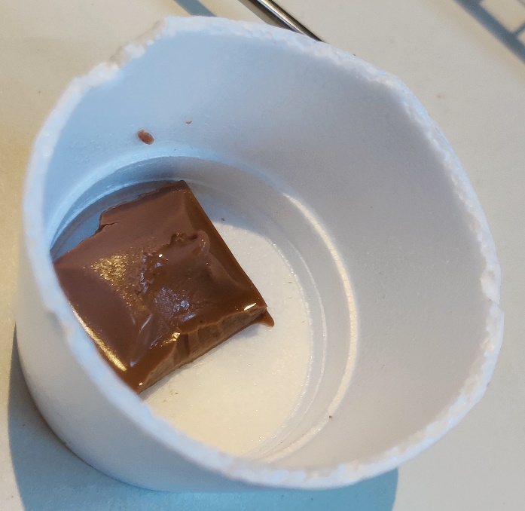
Example results
No shield
Thick liquid
Cardboard
Solid, finger print on surface
Metal mesh
Solid with liquid edges
Milk bottle plastic
Mainly solid, started to liquify on very top
Notes:
Discuss results with learners. E.g.:
Results after 3 minutes with medium setting:
No shield – no protection, thick liquid chocolate that returns to solid state when cool.
Cardboard – good protection, chocolate still solid, heated enough a clear fingerprint can be left on top of the piece.
Metal mesh – chocolate is still solid on 3 sides, melted into liquid on one side and in the middle. **metal with holes lets heat through, need solid sheet to protect**
Milk bottle plastic – mainly solid, slight liquid started on top of piece.
Best insulator from the experiment (3 minutes on medium setting): Cardboard

Slide 10
Choosing a heat shield material
For each shield tested, decide if it a GOOD or a BAD insulator.
Has the chocolate melted?
If yes, how much? E.g. soft to touch, melted lump, liquid.
If no, the shield is acting as a good insulator.
Which insulator worked best? Why?
Which heat shield material would you use to protect your chocolate in space?
Notes:
Discuss with learners:
Which material would you use to protect your chocolate?
Ask for a reason from each learner/group – depth of answer depends on individual learners
Were they good/bad insulators? Why?
How could they change/improve each heat shield?
Do they all agree on the best materials?
Did anything surprise them?

Slide 11
Shield e.g. cardboard | Chocolate state e.g. solid/liquid | Melted? | Notes
NO SHIELD
Notes:
Worksheet example 1 for printing
Each team/individual needs to test three shields, 4th row is for the test sample.

Slide 12
Shield | Chocolate state e.g. solid/liquid | Melted? | Notes
Notes:
Worksheet example 2 for printing
Each team/individual needs to test three shields, 4th row is for the test sample.

Slide 13
Shield e.g. cardboard | Chocolate state e.g. solid/liquid | Temperature 1 | Temperature 2 | Temperature 3 | Notes
Notes:
Extension Worksheet for printing
Temperature readings for start, three minutes and one more reading.
If doing more readings, learners could work on reverse of the sheet or in their books.

