Slide 1
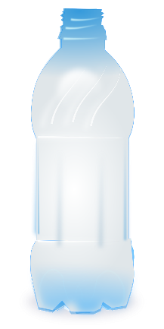
Hero Engine
A project to make a water powered ‘hero’ rotary engine

Slide 2
Stay safe
Whether you are a scientist researching a new medicine or an engineer solving climate change, safety always comes first. An adult must always be around and supervising when doing this activity. You are responsible for:
ensuring that any equipment used for this activity is in good working condition
behaving sensibly and following any safety instructions so as not to hurt or injure yourself or others
Please note that in the absence of any negligence or other breach of duty by us, this activity is carried out at your own risk. It is important to take extra care at the stages marked with this symbol: ⚠

Slide 3
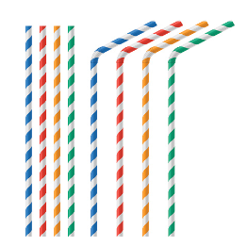
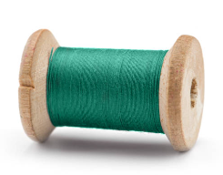
Resources and equipment
Empty one litre plastic bottle
String or thread
Sticky tack
A stiff straw
Felt tipped pen
Sharp point
Ruler
Scissors
⚠

Slide 4
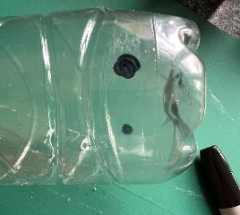
Step 1 – Make two holes ⚠
At the bottom of the bottle mark two small circles on opposite sides with a felt tip
Get an adult to help you carefully use a sharp point to pierce the two marked holes
⚠

Slide 5
Step 2 – Attach the straws ⚠
Use scissors to carefully cut two 30 mm lengths of straw
Cut one end at 45 degrees ⚠
⚠

Slide 6
Step 3 – Attach the straws
Poke the straws into both holes. The end with the angle should be outside the bottle.
The straws should point straight out of the bottle, but at 45 degrees to the hole.
Roll a small snake of sticky tack. Place this around the straw to stop leaks.
⚠

Slide 7
Step 4 – Angle the straws ⚠
Make sure each straw is angled in the hole
The two straws must point in opposite directions to each other
Use the sticky tack to keep the straws in place
Angle the straw

Slide 8
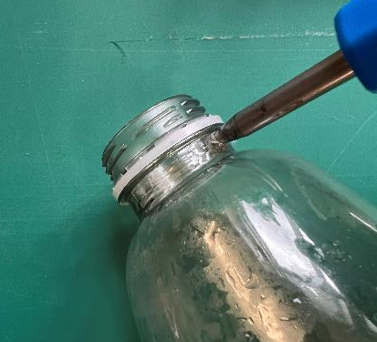
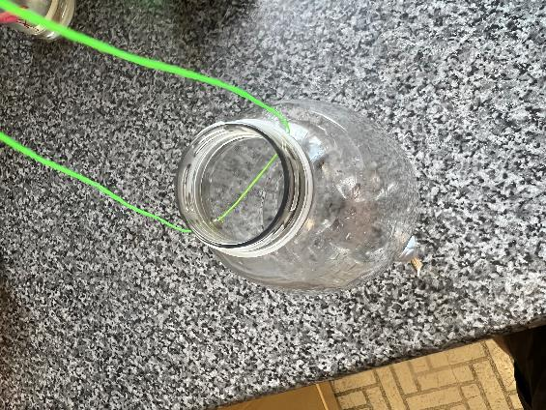
Step 5 – Attach the thread
Get an adult to help you carefully use a sharp point to make two holes in the top of the bottle
Attach string through the holes and tie in a knot to make a loop
⚠

Slide 9
Step 6 – Fill with water and watch it spin
Fill the bottle with water, then hold the bottle and lift with the string
As the water ejects the bottle will spin
Video: Hero engine in action

