Slide 1
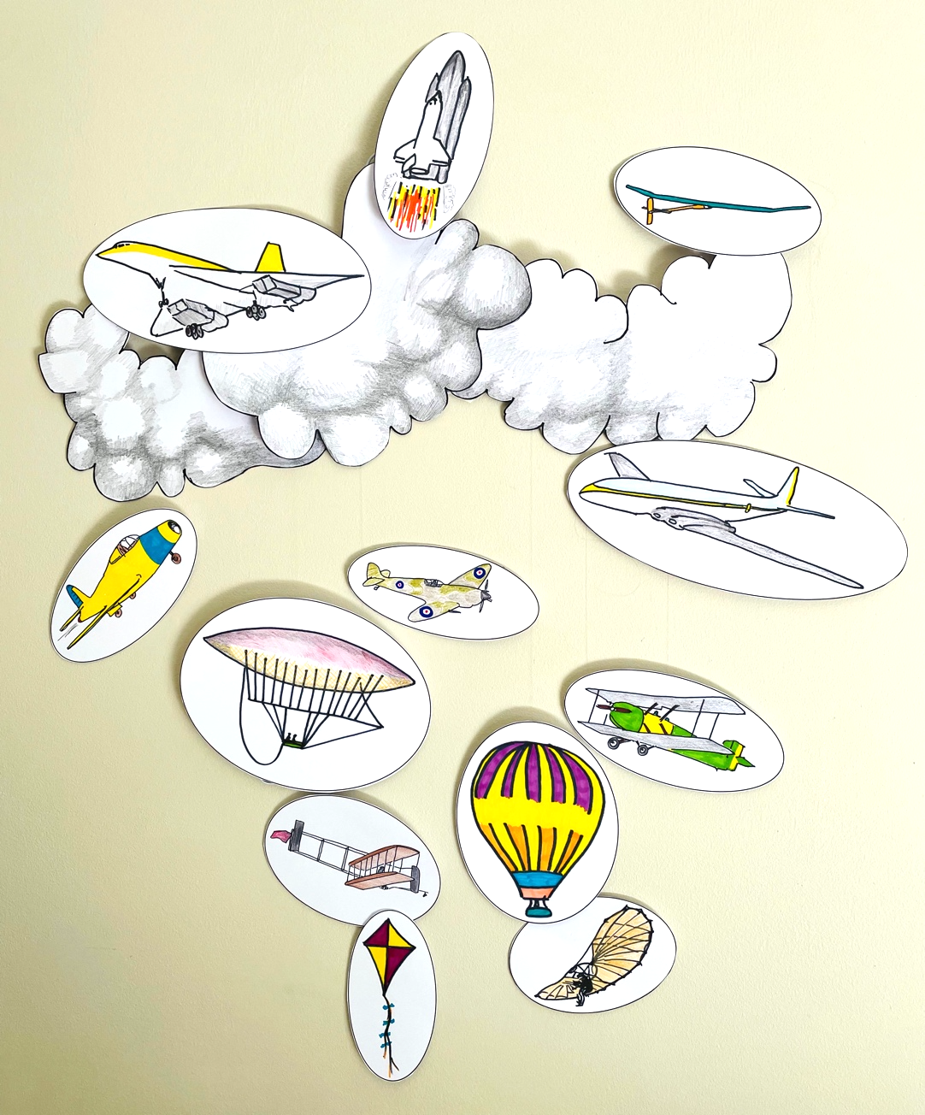
The History Of Flight
Making a hanging-mobile timeline of the history of flight

Slide 2
Stay safe
Whether you are a scientist researching a new medicine or an engineer solving climate change, safety always comes first. An adult must always be around and supervising when doing this activity. You are responsible for:
ensuring that any equipment used for this activity is in good working condition
behaving sensibly and following any safety instructions so as not to hurt or injure yourself or others
Please note that in the absence of any negligence or other breach of duty by us, this activity is carried out at your own risk. It is important to take extra care at the stages marked with this symbol: ⚠

Slide 3
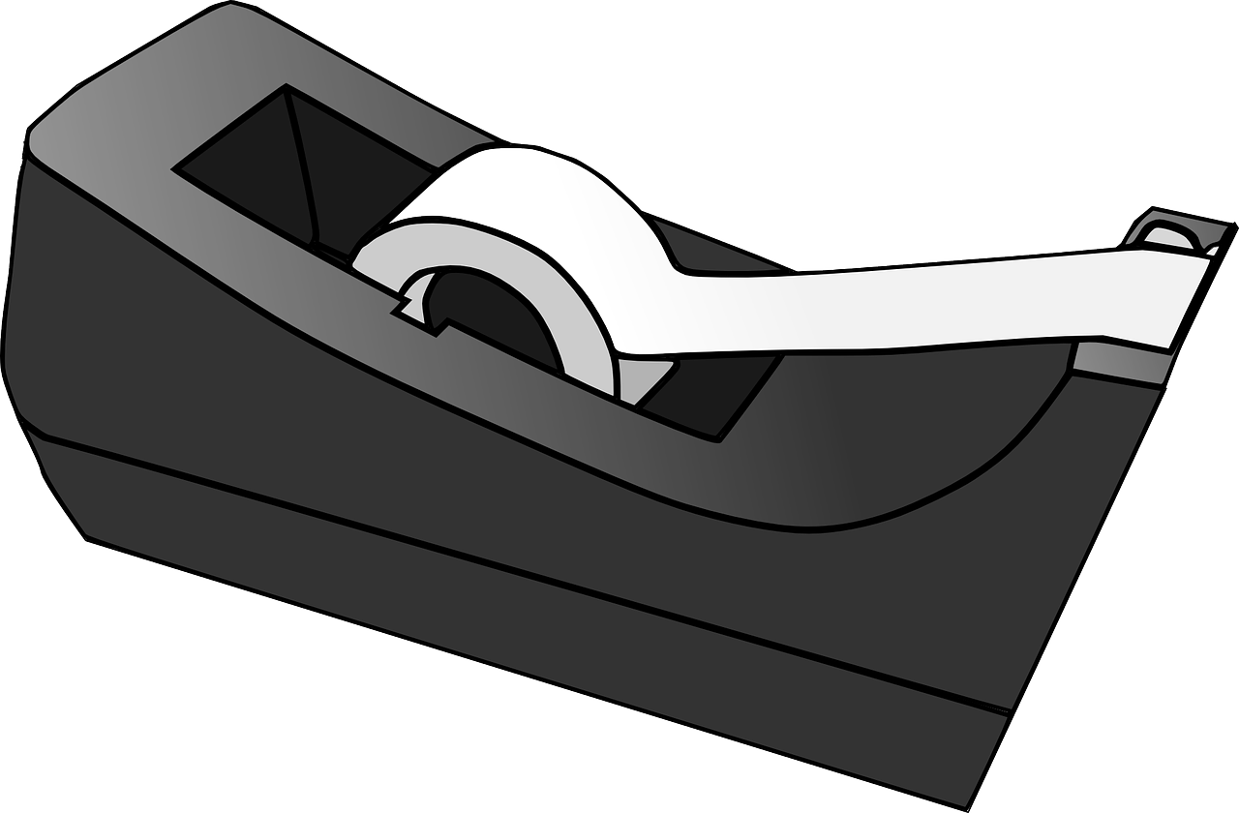
Equipment and resources
Card
Pencil & pens
Scissors
Sticky tape
Cotton or string
Coat hanger

Slide 4
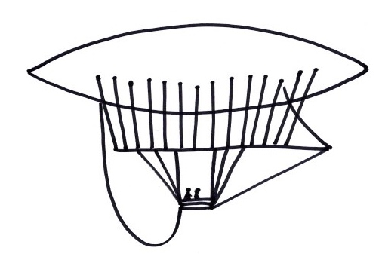
Selected highlights from history of crewed flight
450-200 BC: kites invented in China
1763: the French Montgolfier brothers invented balloon flights
1852: The first hydrogen airship flew

Slide 5
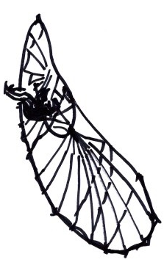
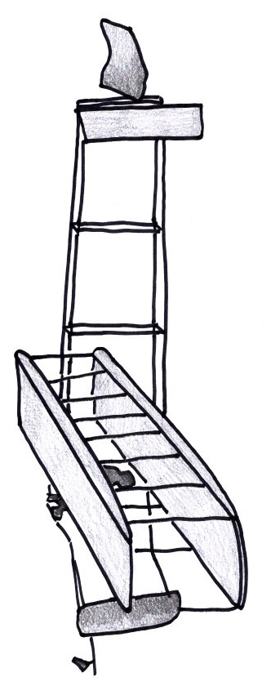
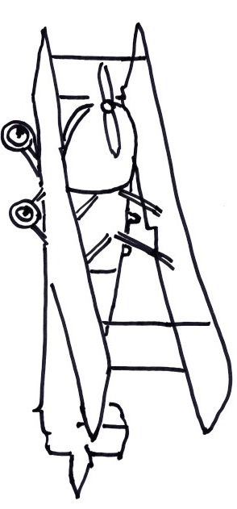
1891: Otto Lithenthal flew the first glider
1903: the Wright brothers famously achieved the first motor-powered flight
1924: first round the world flight

Slide 6
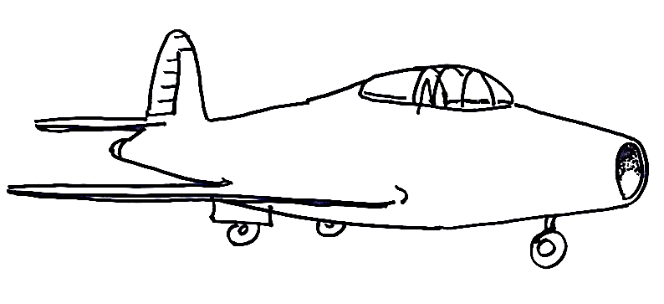
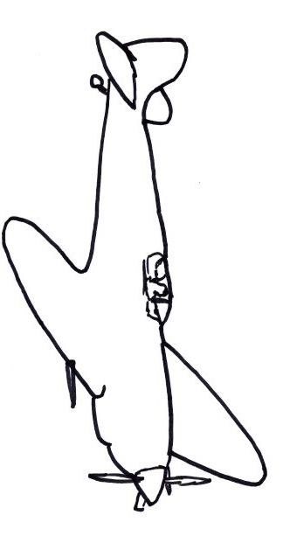
1930: the jet engine was designed by British engineer Frank Whittle, followed by the first jet powered plane in 1939
1939-45: During the battle of Britain in the II world war the Spitfire became a national icon

Slide 7
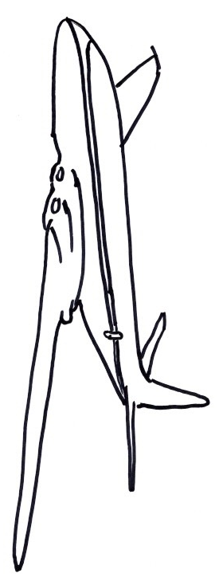
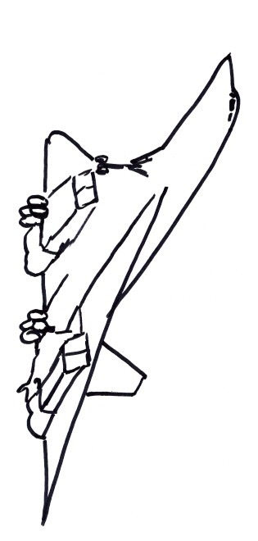
1949: the first commercial jet passenger flights
1969: the first supersonic Concorde flight

Slide 8
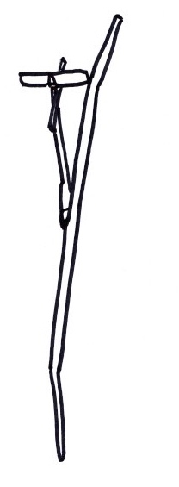
1981: The shuttle makes the trip to space and back
2016: First solar plane flies around the world

Slide 9
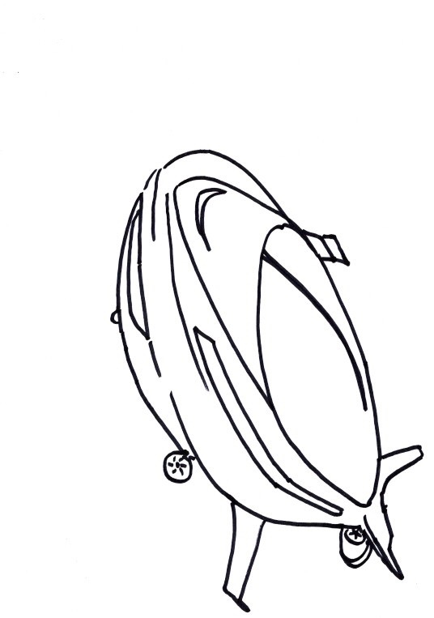
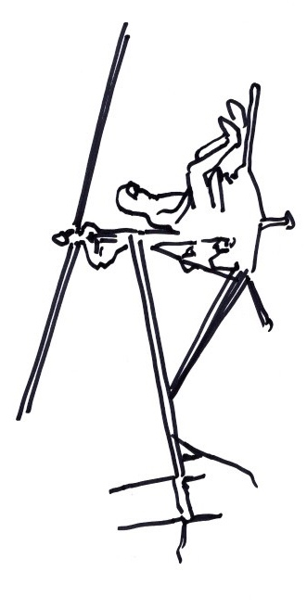
Future flights – what next?
Some ideas could include:
Pilotless passenger planes?
A return to luxury airships?
Commercial flights to the Moon or Mars?
Electric helicopters?
What do you think?

Slide 10
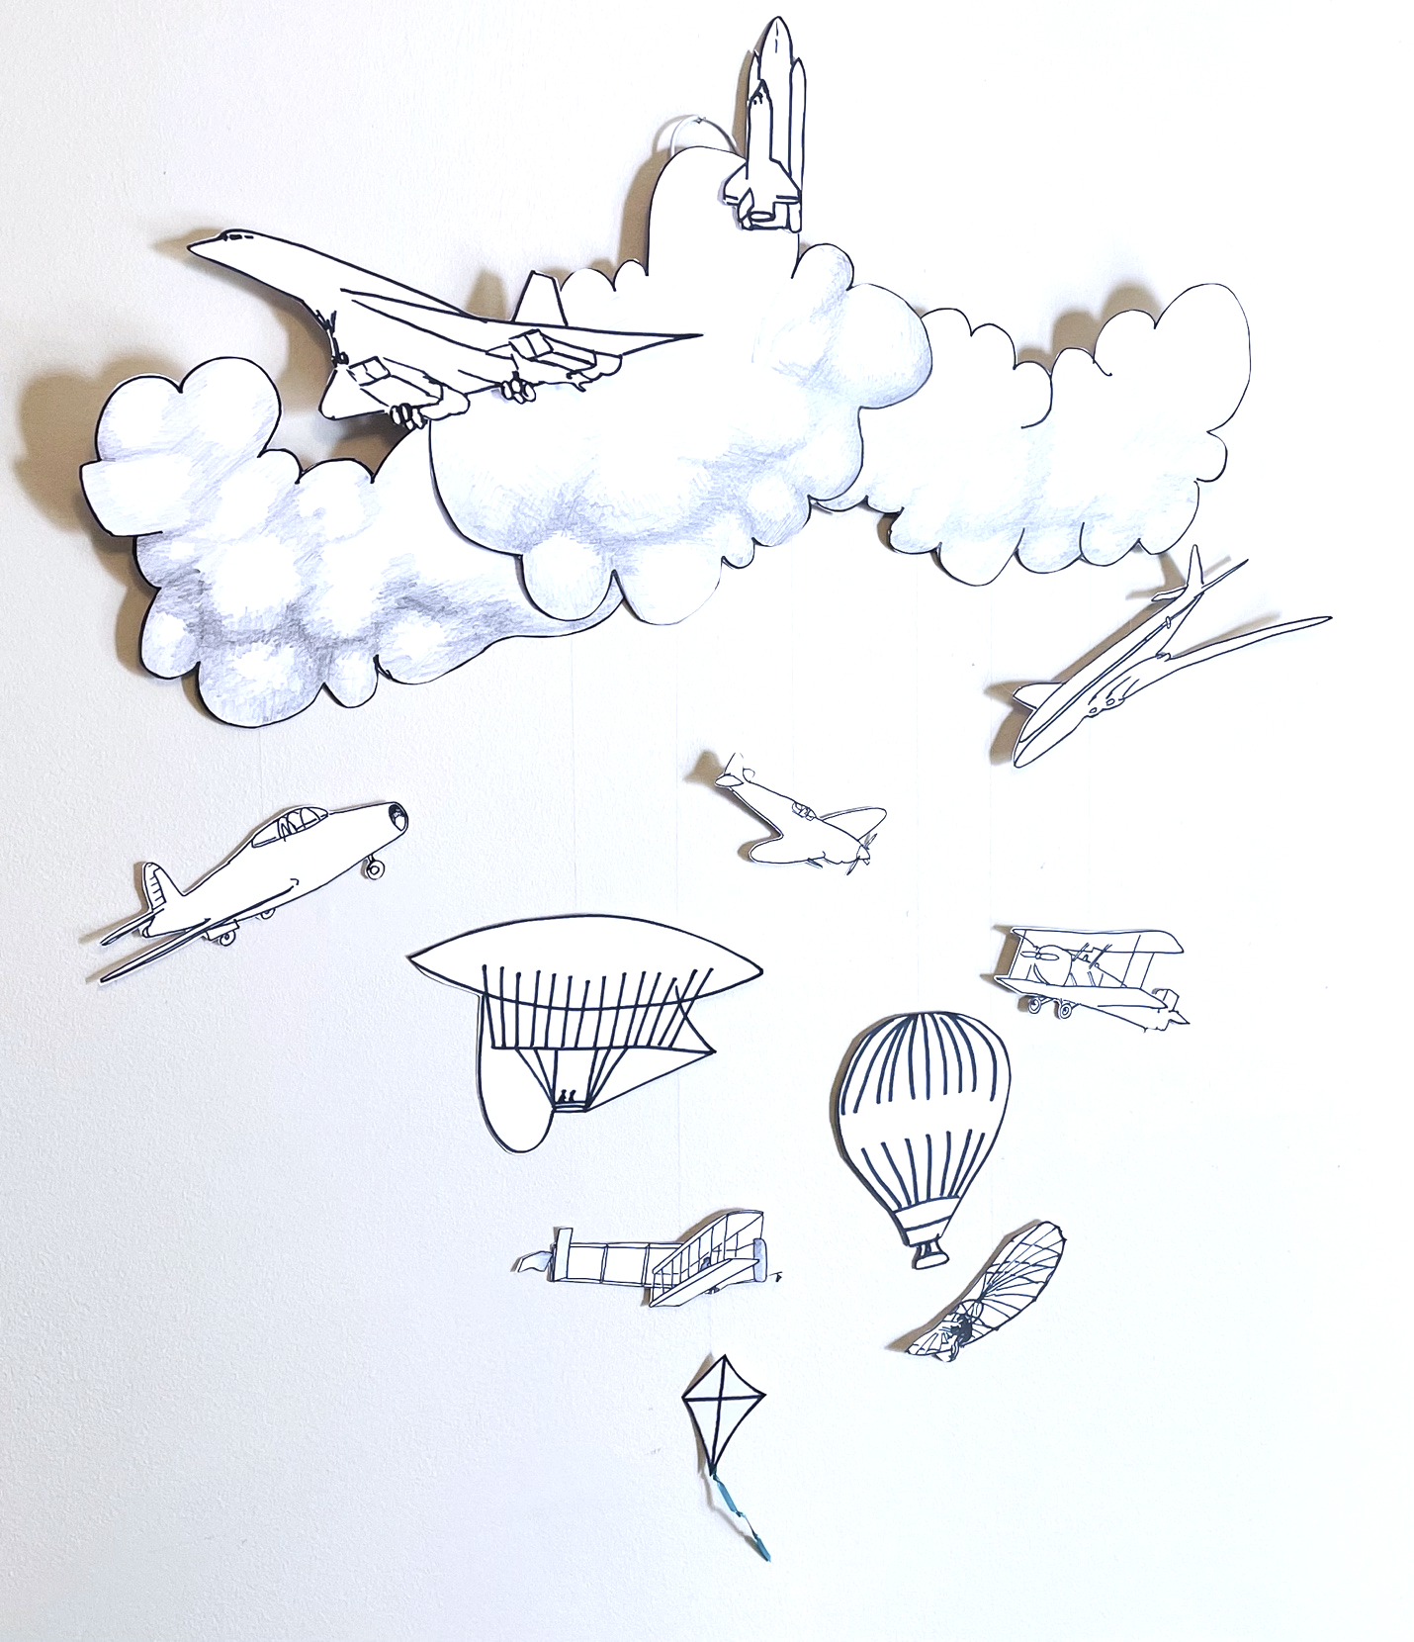
Making a history of flight mobile
We are going to make a timeline of the history of flight
BUT – we are going to make this as a hanging-mobile
The oldest developments could be at the bottom, with the future at the top – or you could order them by how high they flew

Slide 11
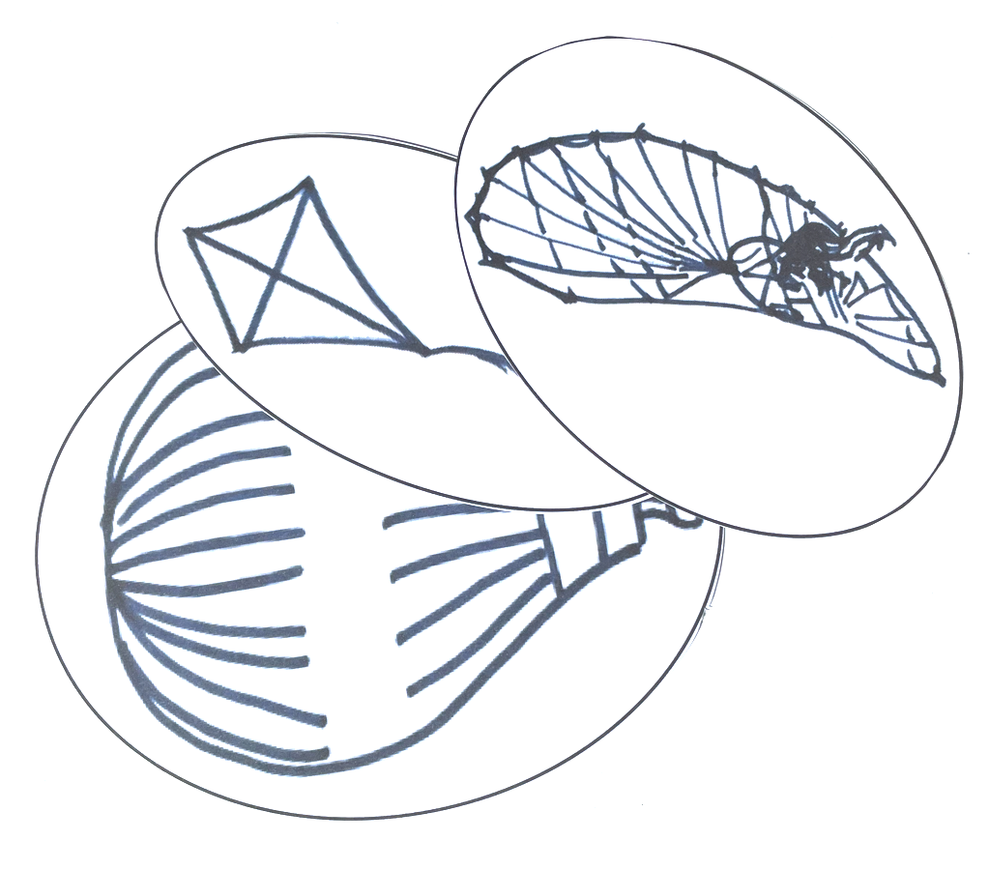
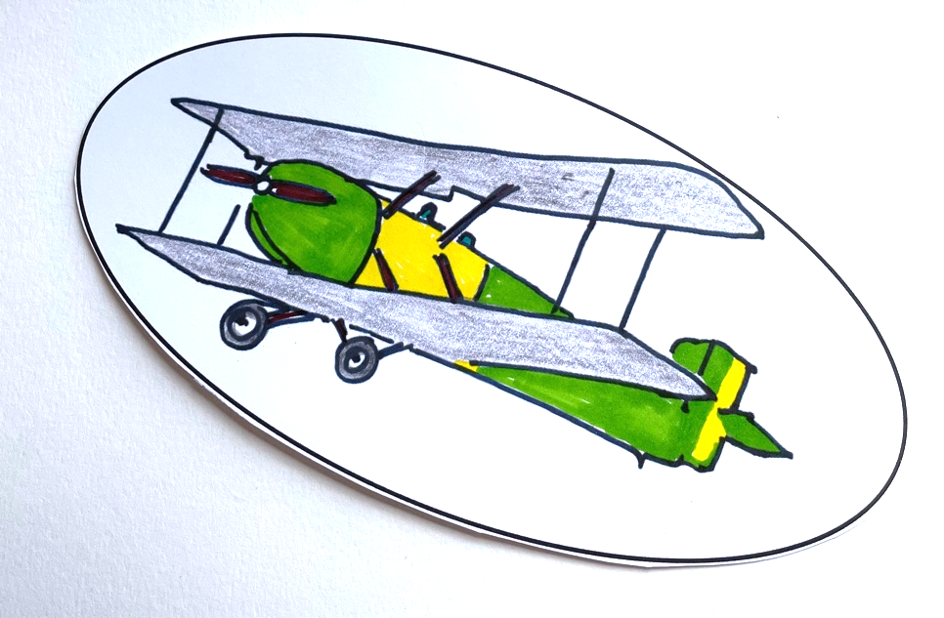
Step 1 – Decide what should be shown ⚠
You could research which steps in the history of flight you want to use
Printout or copy the aircraft you want to show and cut them out ⚠
You could also use the templates in the handout or draw your own designs for future aircraft
You could add colour to your images

Slide 12
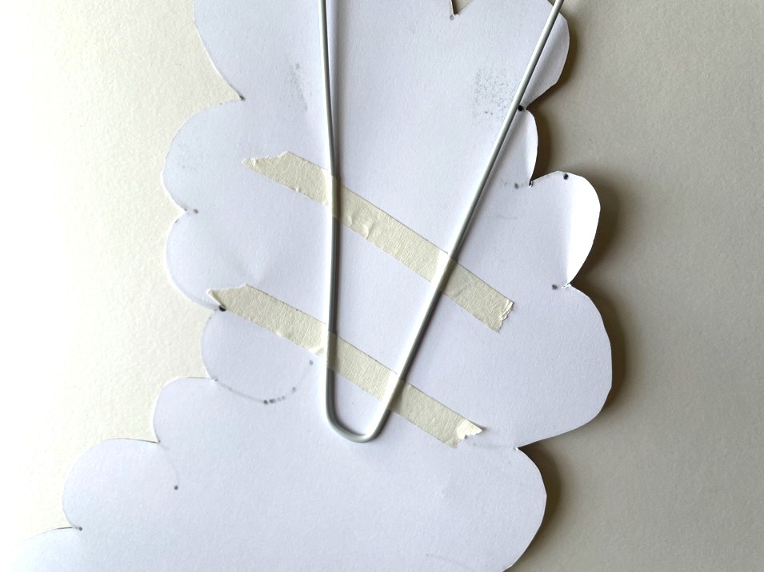
Step 2 – Making the support structure ⚠
Draw large cloud shapes onto card
Cut out and if you want to add shading ⚠
Stick onto your coat hanger using tape
The hangar should be completely covered with clouds

Slide 13
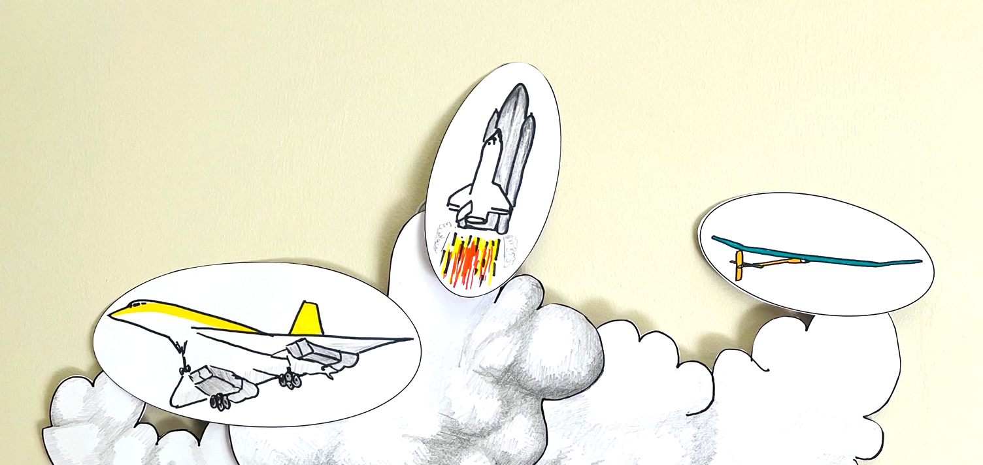
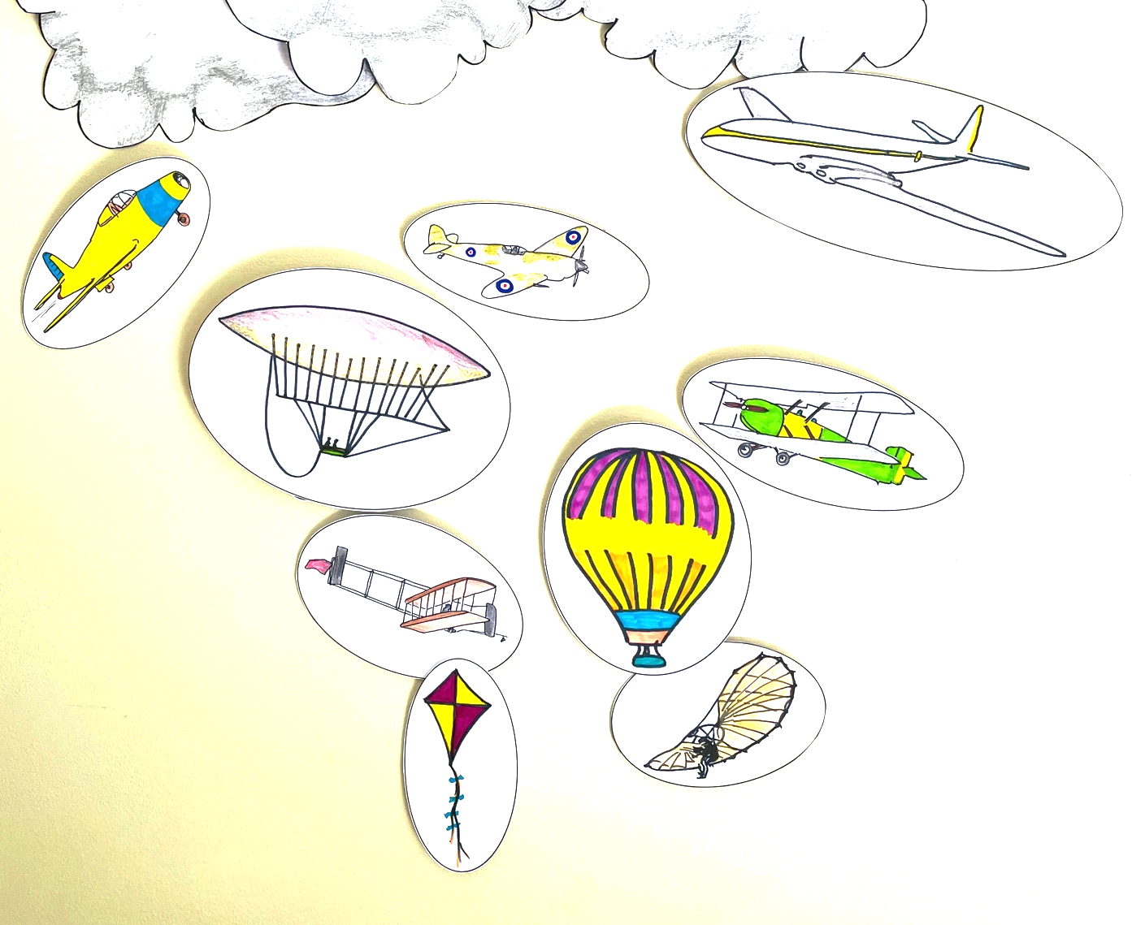
Step 3 – Assemble your mobile
Tape cotton to the back of each image – then tape the other end of the cotton to the back of the cloud
Use different lengths of cotton to hang the aircraft at different heights representing how far back in the past it was or how high they flew
You could tape the most modern or the future to the clouds
Hang your finished mobile on the wall!

Slide 14
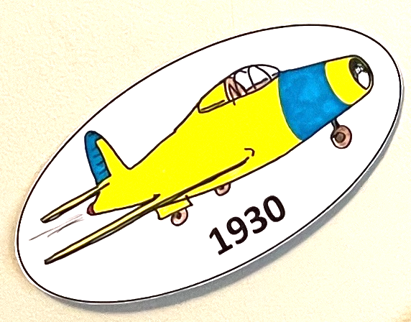
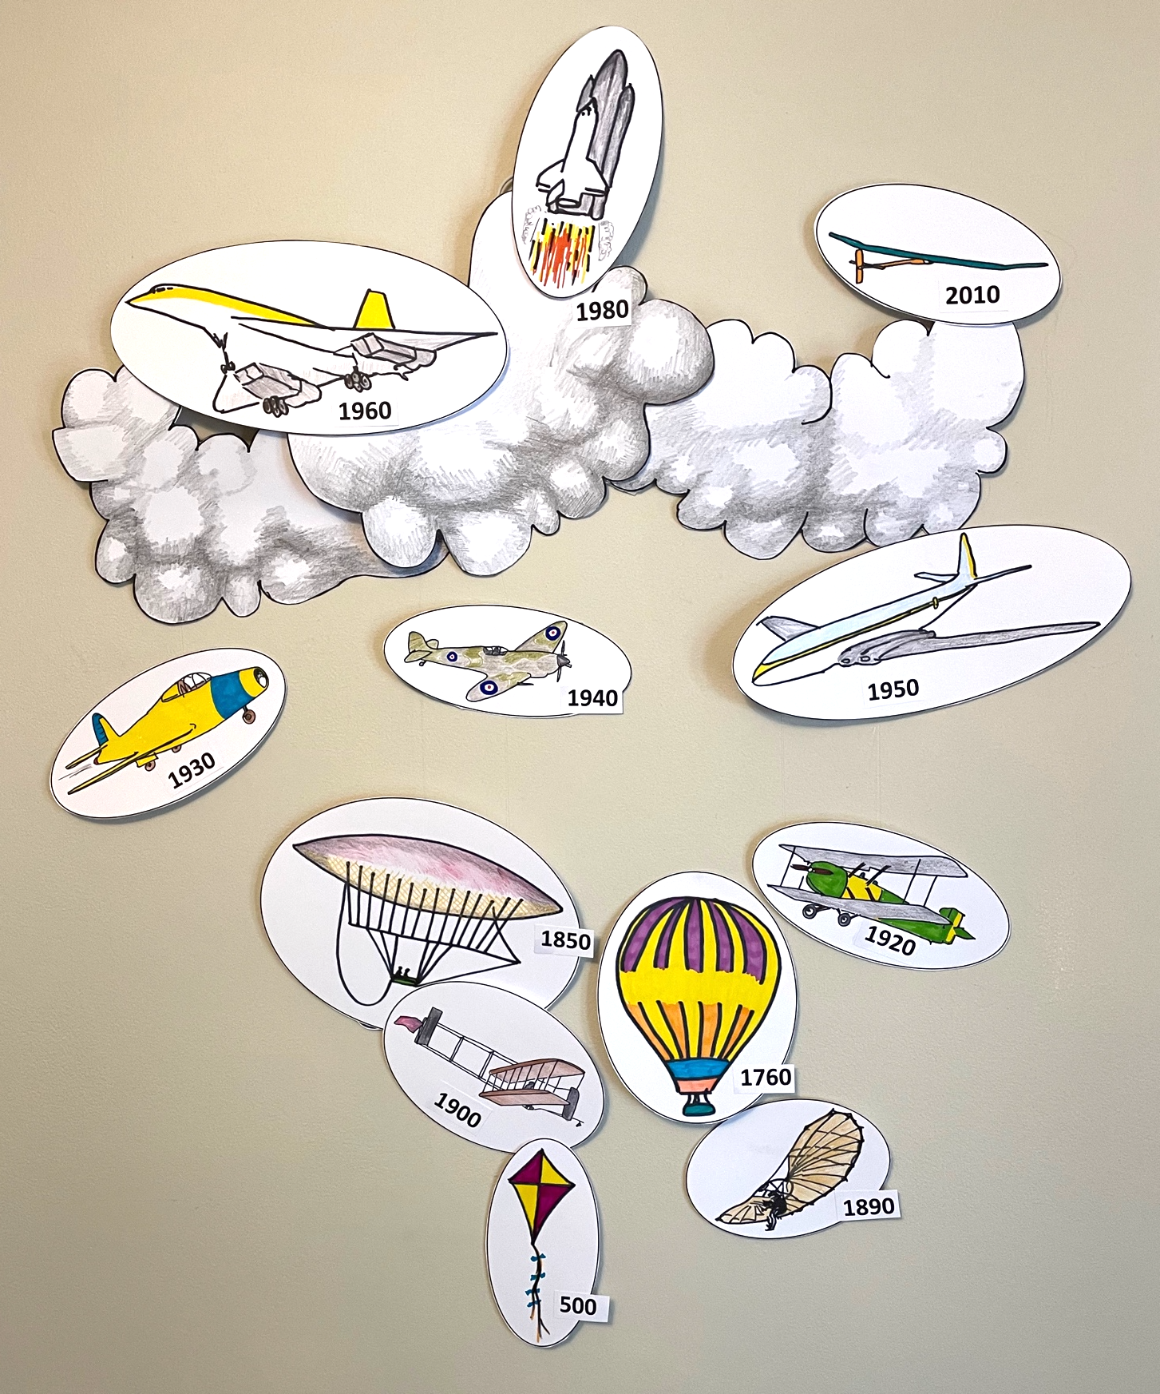
Extension
Add dates to
the images to show how flight has changed over time
Use your imagination to design an aircraft of the future and add to your mobile
Cut out around the outline of the aircraft to add style to your mobile

