Slide 1
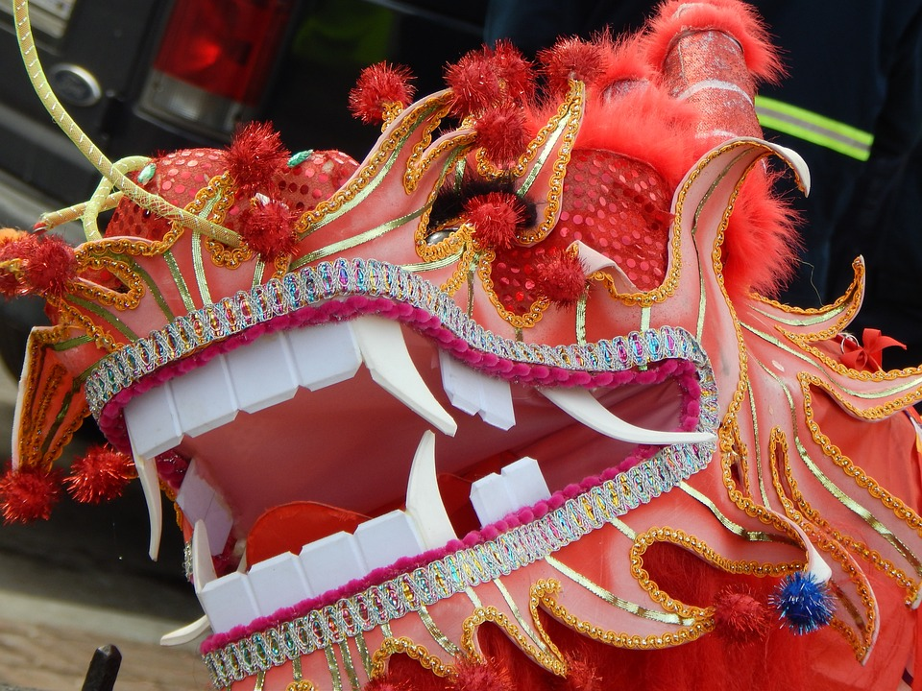
Chinese Dragon
Designing and making dragon masks

Slide 2
Stay safe
Whether you are a scientist researching a new medicine or an engineer solving climate change, safety always comes first. An adult must always be around and supervising when doing this activity. You are responsible for:
ensuring that any equipment used for this activity is in good working condition
behaving sensibly and following any safety instructions so as not to hurt or injure yourself or others
Please note that in the absence of any negligence or other breach of duty by us, this activity is carried out at your own risk. It is important to take extra care at the stages marked with this symbol: ⚠

Slide 3

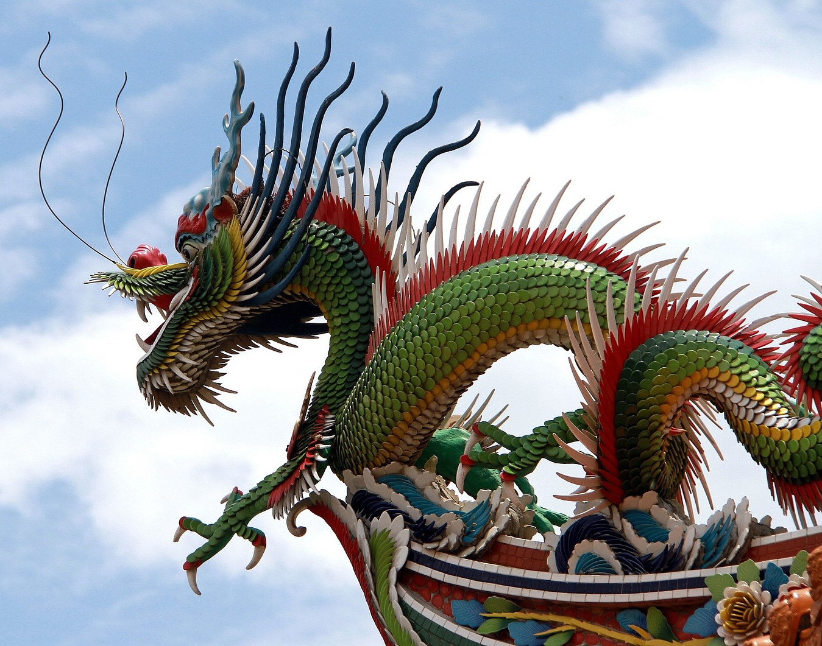

Meaning of Colours
Colours have certain meanings in China:
Red – love, joy, wealth and happiness
Yellow – pleasant, happy
Green – life, vitality, dependability
Purple – love, nobility
Black – darkness, glory
White – death, bad luck
Notes:
Explain that dragons play an important role in Chinese culture, such as the zodiac, dragon dances, art, the dragon boat festival etc.

Slide 4
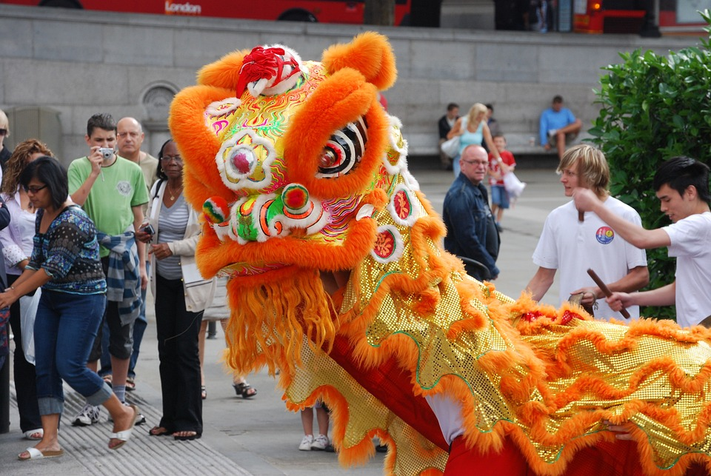
Chinese Dragons
Chinese dragons are mythological creatures in Chinese culture
They have very long snake-like bodies and small legs
They are often drawn without wings
A popular tradition is the dragon dance, where people dance a large dragon puppet through crowds
Notes:
Explain that dragons play an important role in Chinese culture, such as the zodiac, dragon dances, art, the dragon boat festival etc.

Slide 5

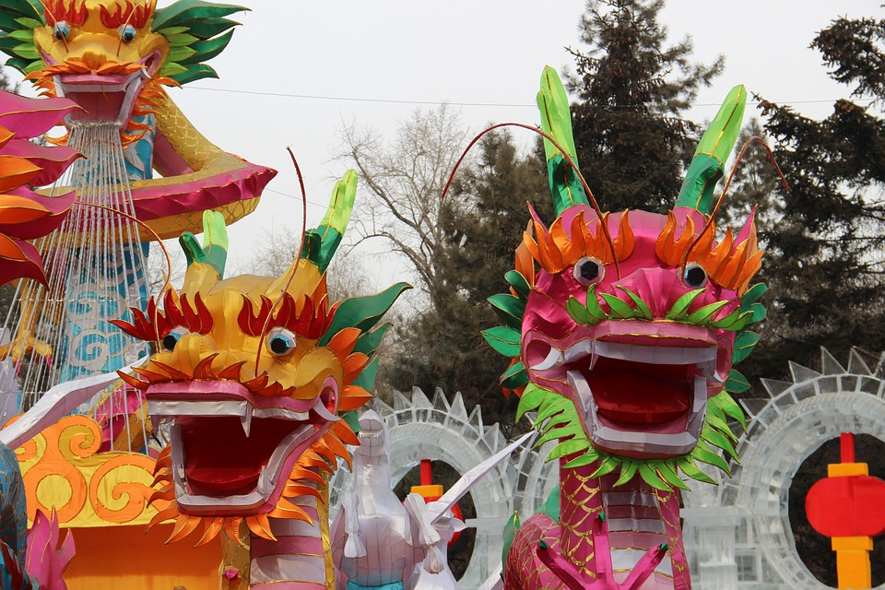
Good Fortune
In ancient China’s legends, “Shennong” the ‘Divine Farmer’ was the son of a dragon and a beautiful princess
The dragon is considered to bring good fortune, harvest, and prosperity
Red is the colour of good fortune and wealth
Chinese dragons are symbolic of being lucky, powerful and noble
Notes:
Teacher could ask learners to use the internet to find out more about Shennong, and why he is important to Chinese culture.
Could also explain that the dragon is one of 12 Chinese zodiac signs – what are the others?

Slide 6
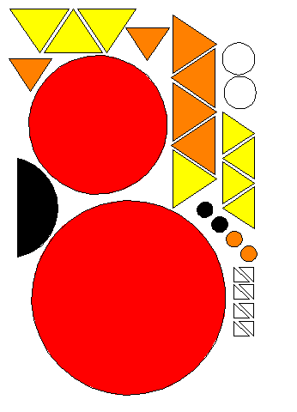
Design Activity ⚠
Cut out the coloured shapes on the worksheet
Stick together in any layout you want
Create your Chinese dragon with the shapes
Remember – they are not meant to be scary!
Notes:
Take care when using scissors or any other sharp objects for cutting out.

Slide 7
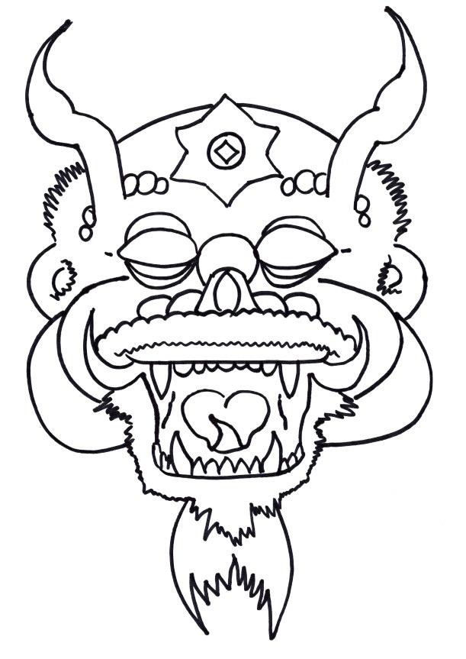
Mask Design ⚠
Create your own wearable dragon mask
Use colours associated with China and the Chinese new year
Use the templates to help you design it
Be creative!

