Slide 1
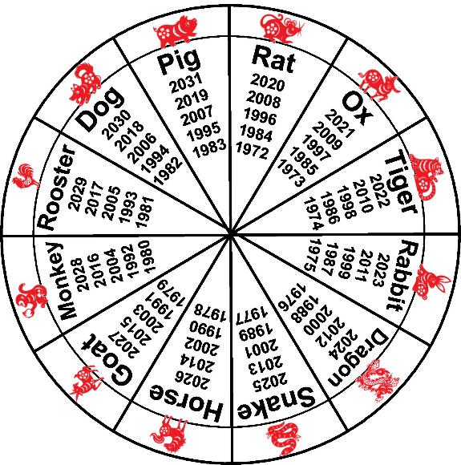
Chinese Zodiac Animal Wheel
Making a Chinese zodiac animal wheel

Slide 2
Stay safe
Whether you are a scientist researching a new medicine or an engineer solving climate change, safety always comes first. An adult must always be around and supervising when doing this activity. You are responsible for:
ensuring that any equipment used for this activity is in good working condition
behaving sensibly and following any safety instructions so as not to hurt or injure yourself or others
Please note that in the absence of any negligence or other breach of duty by us, this activity is carried out at your own risk. It is important to take extra care at the stages marked with this symbol: ⚠

Slide 3
Chinese Zodiac Animals
Each year is linked to a zodiac animal
Each zodiac animal’s year comes around every 12 years
Each animal has a different personality
For example:
Rat
Quick witted, resourceful and kind.

Slide 4
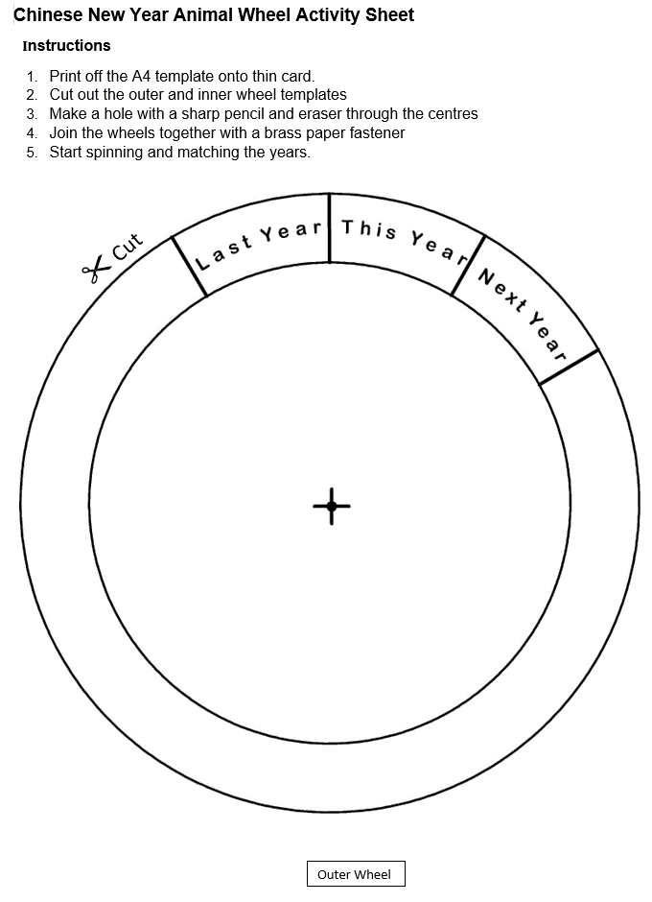
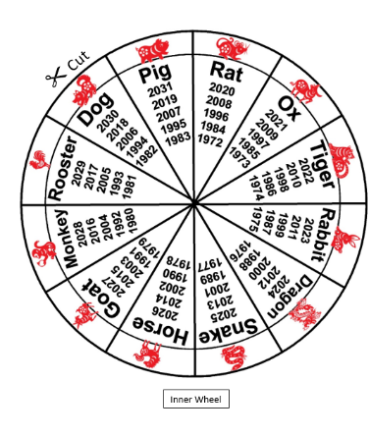
Step 1 Cutting Out ⚠
Print the templates onto card
Safely cut out the outer and inner wheels with scissors

Slide 5
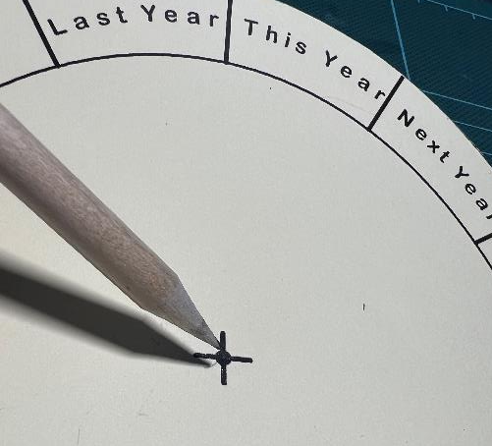
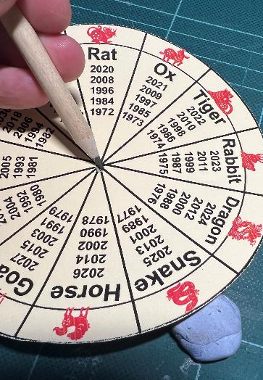
Step 2 Making the Hole ⚠
Make holes in the centre of each wheel with a sharp pencil and sticky tack
Outer wheel
Sticky tack
Inner wheel

Slide 6
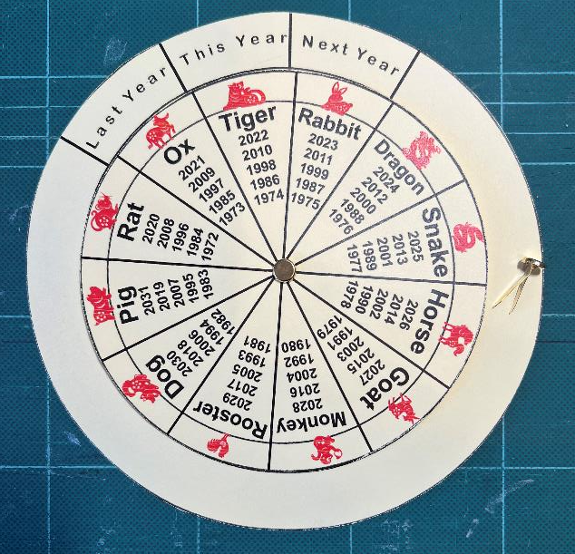
Step 3 Assembly
Join the outer and inner wheels with a brass paper fastener
Start turning the wheel and matching the years!
Paper fastener

Slide 7
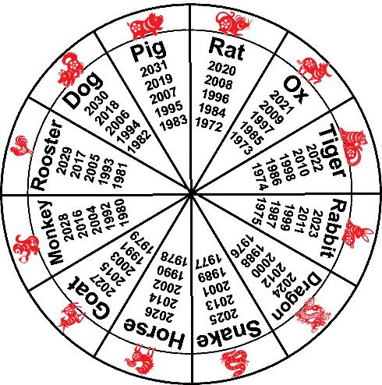
Extension
Investigate the personalities of the zodiac animals
Find out which animals your relatives are!

