Slide 1
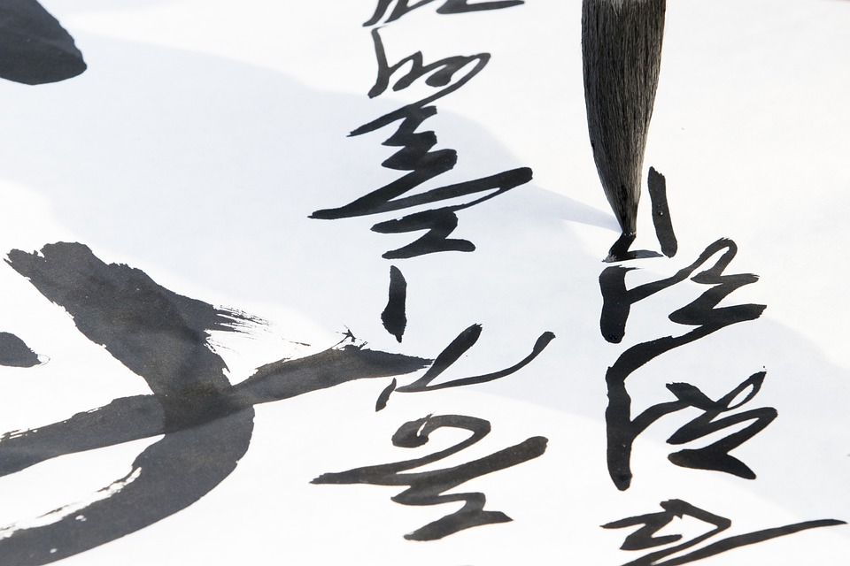
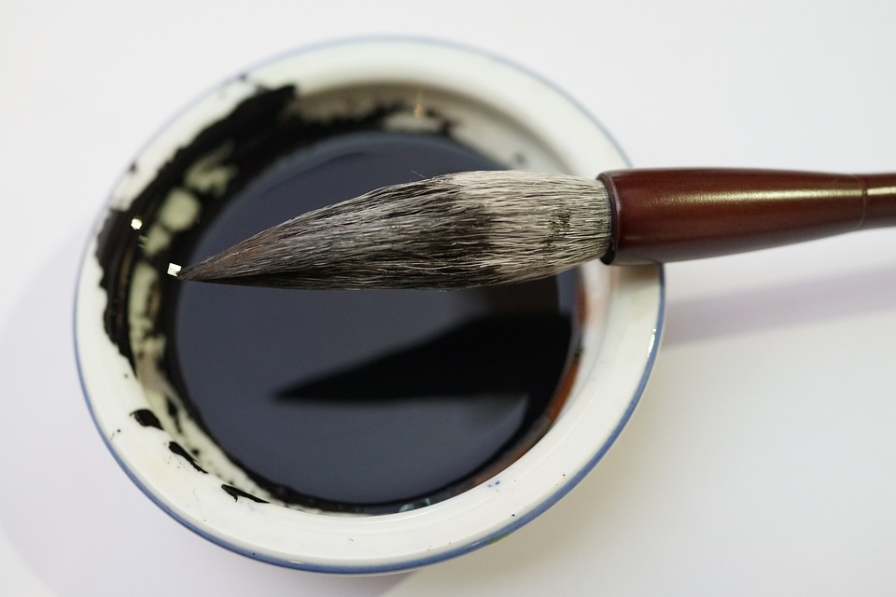
Creating Chinese Calligraphy
Learning how to write using traditional Chinese handwriting

Slide 2
Stay safe
Whether you are a scientist researching a new medicine or an engineer solving climate change, safety always comes first. An adult must always be around and supervising when doing this activity. You are responsible for:
ensuring that any equipment used for this activity is in good working condition
behaving sensibly and following any safety instructions so as not to hurt or injure yourself or others
Please note that in the absence of any negligence or other breach of duty by us, this activity is carried out at your own risk. It is important to take extra care at the stages marked with this symbol: ⚠

Slide 3
You will need
Calligraphy
noun
Decorative handwriting or handwritten lettering with a pen or brush
Worksheet
Paint brush (Xuan)
Paint
Pot of water
Paper

Slide 4
Calligraphy
There are five major script types used today in China
Seal script, Clerical script, Cursive script, Running script, and Standard script
The brush used is called Xuan, named after the area of China that it comes from
Notes:
Discuss with learners.

Slide 5
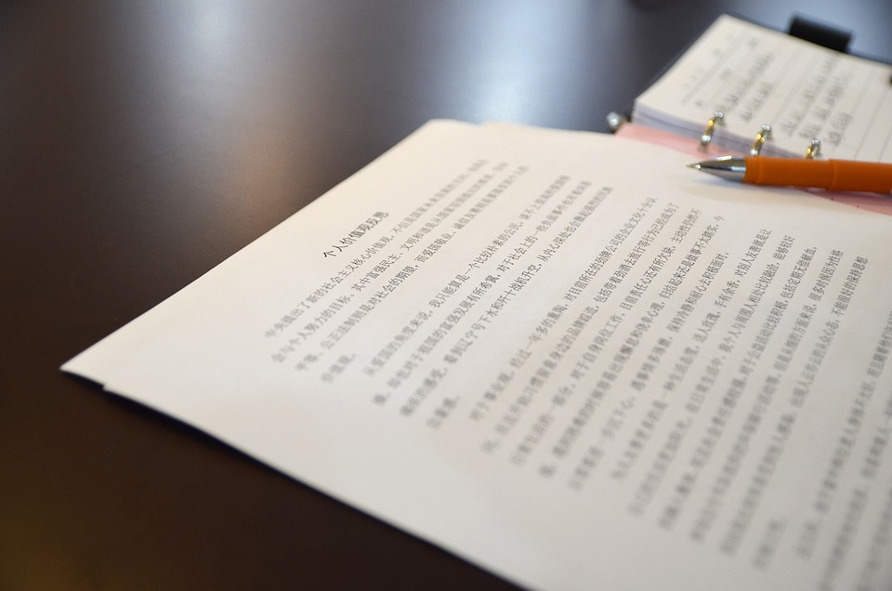
Regular script
‘Regular script’ means ‘the proper script type of Chinese writing’
It is used by all Chinese for government documents and printed books
Notes:
Discuss with learners.

Slide 6
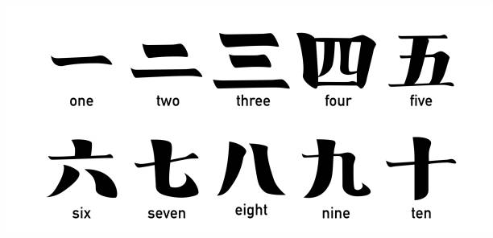
Numbers
This is the standard way of writing numbers 1-10 in Chinese Regular script
Notes:
This slide could be shown, then covered up, with learners being asked to remember each number. This could then be used as part of the wider assessment of the task.

Slide 7
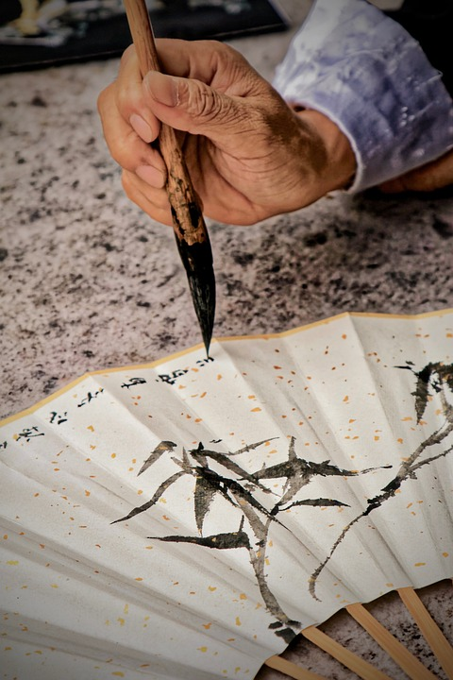
The grip of the Xuan
The Xuan is held in an upright position
Grip between forefinger and thumb
Middle finger then rests on top, with 4th and 5th finger underneath to support
Notes:
Discuss with learners and demonstrate correct grip.

Slide 8
Practice!
Using your worksheet, and the ‘numbers’ in Chinese, practise writing them
Remember how to hold the Xuan correctly
Focus on getting the form of the letters the same

Slide 9
Now do this...
3 + 3 =
4 + 2 =
7 - 5 =
10 – 6 =
Use your new found talent to write and complete the following sums
Don’t forget to write in Chinese calligraphy!

Slide 10
Then do this...
Can you write your own sums to really challenge yourself?
They don’t have to be this complicated though!
Notes:
This could be used as an extension activity.

