Slide 1


Keep the Path Clear
Looking at ways to keep birds away from airport runways

Slide 2
Stay safe
Whether you are a scientist researching a new medicine or an engineer solving climate change, safety always comes first. An adult must always be around and supervising when doing this activity. You are responsible for:
ensuring that any equipment used for this activity is in good working condition
behaving sensibly and following any safety instructions so as not to hurt or injure yourself or others
Please note that in the absence of any negligence or other breach of duty by us, this activity is carried out at your own risk. It is important to take extra care at the stages marked with this symbol: ⚠

Slide 3
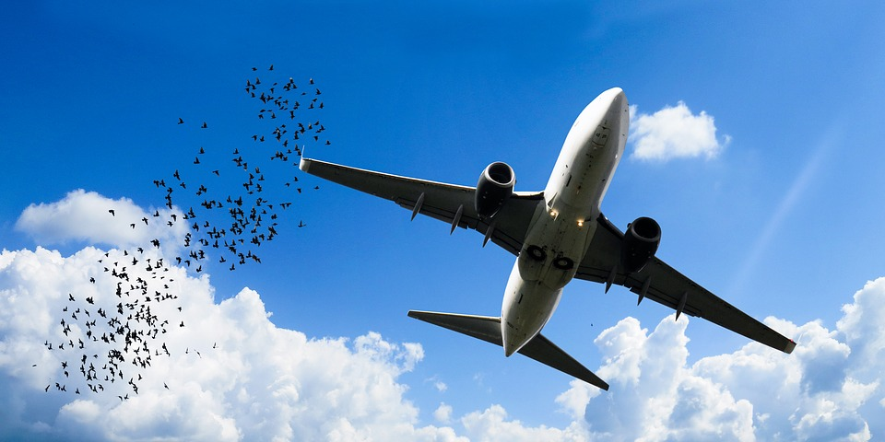
What are the dangers of birds to aircraft?
A bird strike is where a bird gets caught in the engine of an airplane
Bird strikes can happen during take-off or landing
This can be very dangerous for the airplane
Notes:
Discuss the dangers of bird strikes to aircraft and what it can cause to happen. E.g. engine damage/failure, damage to fuselage, wings etc.

Slide 4
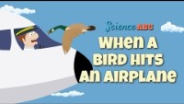
What happens when a bird hits an aircraft
Notes:
Show this video to learners. This video is available on YouTube - https://www.youtube.com/watch?v=tkMJRVuOQXM

Slide 5

How can you stop this happening?
Can you add your thoughts to this?
Noise makers
Scarecrows
Birds
Flashing lights
Electric fences
Birds of prey
Notes:
Learners could produce a spider chart of ideas of ways that could prevent or reduce the chances of bird strikes.

Slide 6

How can you stop this happening?
Method | Positive | Negative
Noise makers |  | Annoy local people
Scarecrows
Flashing lights
Birds of prey
Electric fences
Can you fill out this activity on your worksheet?
Notes:
Learners to write down what they think are the positives and negatives of each method of preventing bird strikes on their worksheet.

Slide 7
Task
Tip
You can use more than 1 method
Draw your ideas onto the picture of the airport on your handout
Where is your safety device going to go?
Be creative – add to the drawing as much detail as you can
Notes:
Learners should add their ideas to prevent bird strikes to the map shown on their activity sheet handout. They could use a range of different methods.

