Slide 1
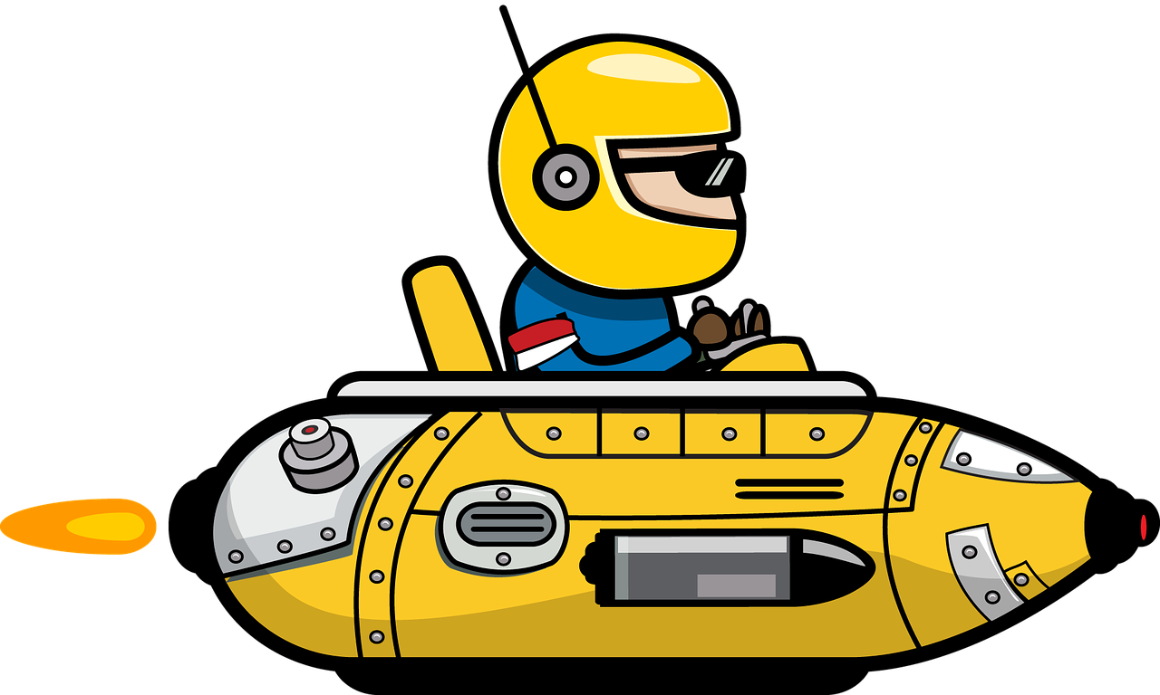
Personal transport system
Designing the personal transport system of the future

Slide 2
Stay safe
Whether you are a scientist researching a new medicine or an engineer solving climate change, safety always comes first. An adult must always be around and supervising when doing this activity. You are responsible for:
ensuring that any equipment used for this activity is in good working condition
behaving sensibly and following any safety instructions so as not to hurt or injure yourself or others
Please note that in the absence of any negligence or other breach of duty by us, this activity is carried out at your own risk. It is important to take extra care at the stages marked with this symbol: ⚠

Slide 3
Design Brief
Situation
As roads are getting busier with more traffic, designers are looking to the sky.
They are asking if people could use personal transporters to travel through the air. What designs will help people take off and land and get to places at speed?
Brief
Design a personal transport system for the future. It should allow people to fly, either individually or in groups.

Slide 4
Design Criteria
The personal transport system must:
Be suitable to carry one person or a group of people
Be aerodynamic
Be lightweight
Be safe to use
Include a method of propulsion
Look good!

Slide 5
Design
Use this space to sketch your idea for your personal transport system.
Don’t forget to add labels to your design to show how it meets the design criteria!
Notes about design:

Slide 6
Peer Review
Ask three people to suggest one improvement each to your design.
Choose one (or more) of these suggested improvements and use it to update your design.

