Slide 1
Pop up Airport
Providing disaster support for a famine hit country

Slide 2
Stay safe
Whether you are a scientist researching a new medicine or an engineer solving climate change, safety always comes first. An adult must always be around and supervising when doing this activity. You are responsible for:
ensuring that any equipment used for this activity is in good working condition
behaving sensibly and following any safety instructions so as not to hurt or injure yourself or others
Please note that in the absence of any negligence or other breach of duty by us, this activity is carried out at your own risk. It is important to take extra care at the stages marked with this symbol: ⚠

Slide 3
What is a famine?
The definition of a famine is a very large shortage, especially of food
An example of famine is when there is no food and people are starving
Notes:
Discuss with learners. Can they think of any recent famines and the effects of these?

Slide 4
Where does it happen?
Several countries in the world are currently in famine
There are five countries in extreme famine
Notes:
Discuss with learners. Do they know which countries these are?
Useful background information can be found here: https://press.un.org/en/2022/sgsm21288.doc.htm

Slide 5
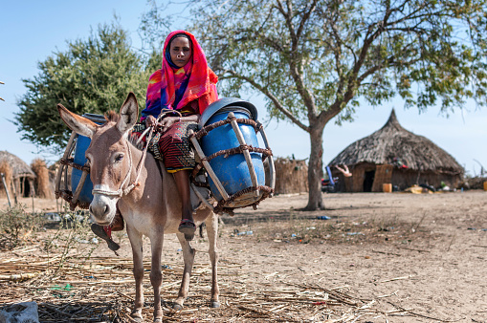
Chad
Chad is a large country in Central Africa
35% of people there do not have enough food

Slide 6
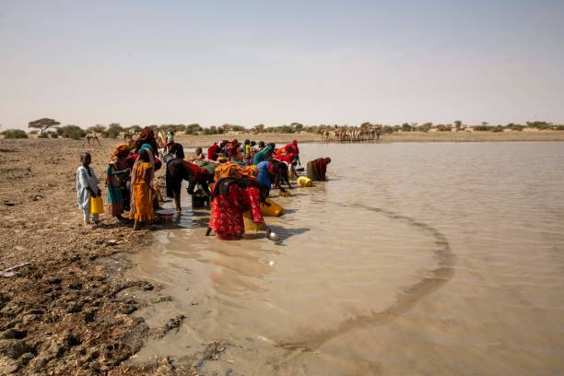
What can we do?
Chad needs airplanes to deliver vital supplies, but there is nowhere for them to land
Your task is to design a pop-up airport to help
This will provide allow medical and food supplies to be flown in for the people
Notes:
Discuss what is meant by a pop up airport – e.g. one which can be built very quickly using whatever is easily available and then taken down again when no longer needed.

Slide 7
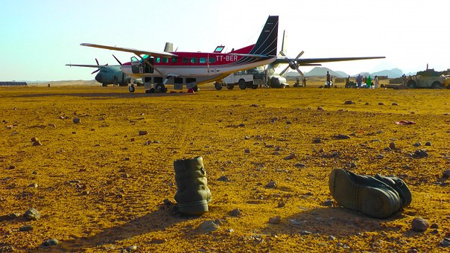
Step 1 - Research
Research what things are needed at the airport
How can you keep it simple?
What are the basic things needed for it to work?
Safe landing and moving of planes is key….
Notes:
Discuss and write down what would be needed – e.g. a runway or landing strip, control tower, space to unload supplies etc.
Emphasise that as a ‘pop up’ airport this should be easy and quick to put both together and take down again once finished, so it should be as simple as possible whilst both working effectively and being safe.

Slide 8
Step 2 – Mind map
Control tower
What is needed?
Runway
Notes:
As learners to complete a mind map or spider chart of what will be needed at the airport. This can be completed using the activity sheet.

Slide 9
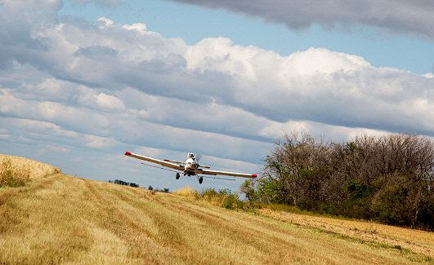
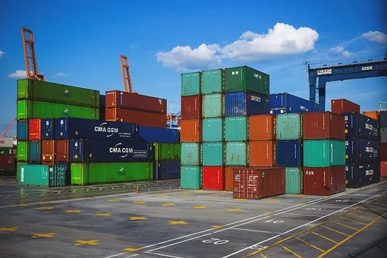
Tips
The runway could be a flat field
The control tower could be a shed or container
It doesn’t have to be complicated
Notes:
These tips could be used to help weaker learners or as a prompt for discussion of ideas.

Slide 10
Step 3 - Design it!
Draw a layout of where things would
go – add labels
Runway
Control tower
Notes:
The design should be completed on the activity sheet, starting with the runway.

