Slide 1

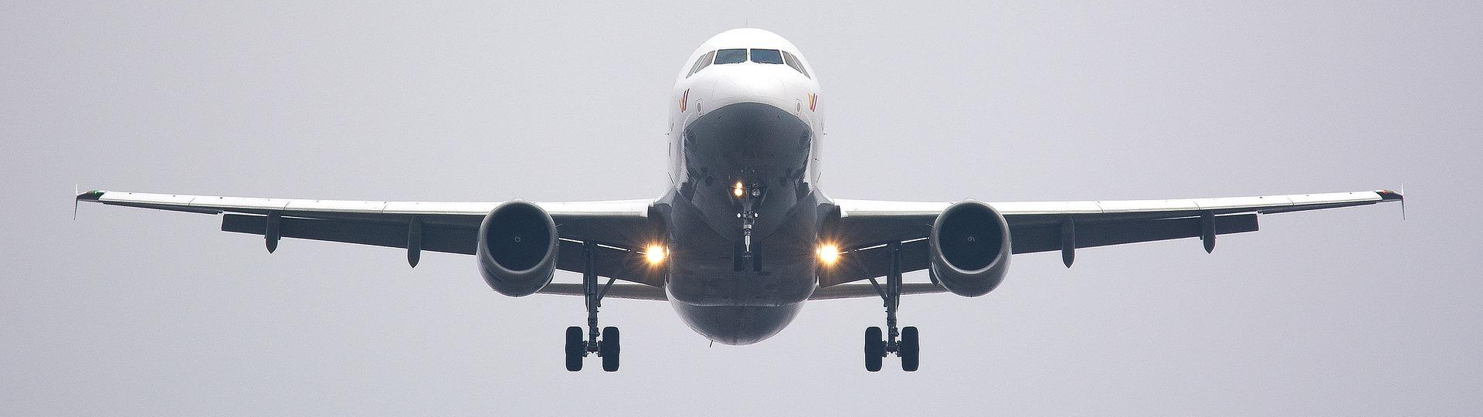
Which Materials for your aircraft?
Measuring the density of materials
to choose which to use in an aircraft

Slide 2
Stay safe
Whether you are a scientist researching a new medicine or an engineer solving climate change, safety always comes first. An adult must always be around and supervising when doing this activity. You are responsible for:
ensuring that any equipment used for this activity is in good working condition
behaving sensibly and following any safety instructions so as not to hurt or injure yourself or others
Please note that in the absence of any negligence or other breach of duty by us, this activity is carried out at your own risk. It is important to take extra care at the stages marked with this symbol: ⚠

Slide 3

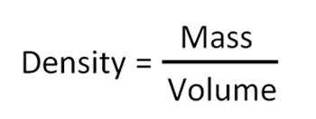
What is Density?
If two things are the same size, the one that is more dense is heavier.
The cubes are the same size
High density
Low density
The density of an object is its mass divided by its volume:
The units of density are g/cm³

Slide 4
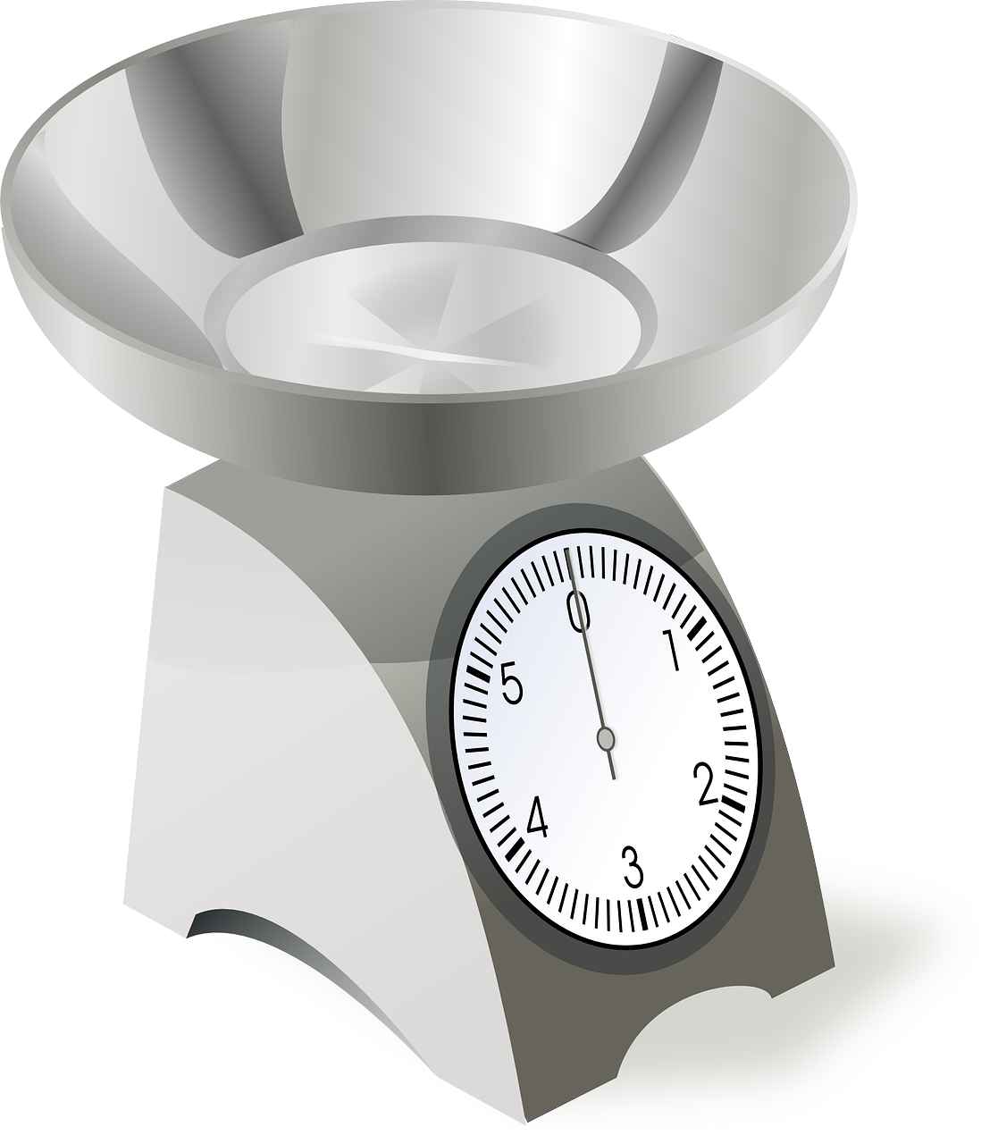
What is Mass?
Mass is how heavy something is.
It is measured in grams, g.

Slide 5
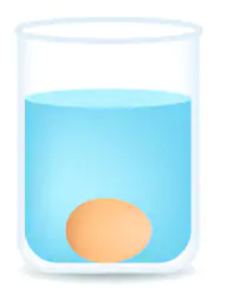
What is Volume?
Volume is the amount of space an object takes up.
It is measured in cm³.
We can measure volume by putting an object in water and seeing how much the water rises.

Slide 6
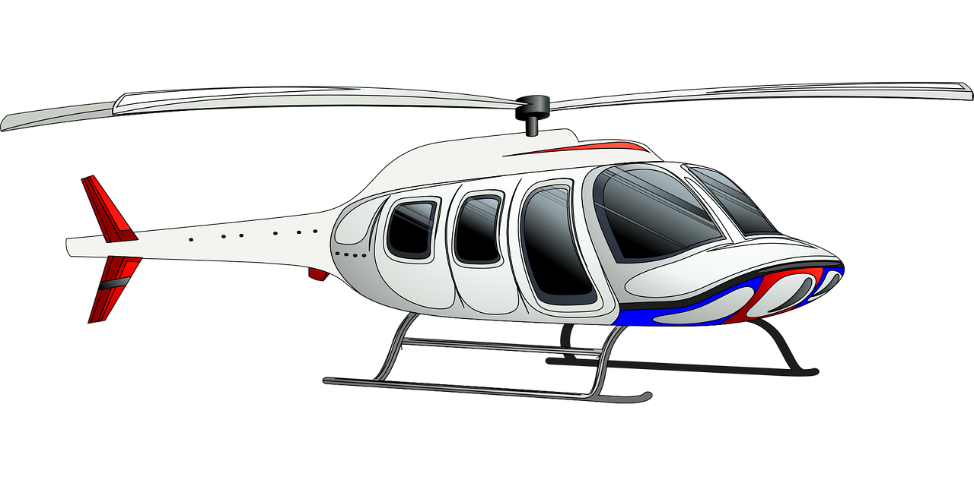
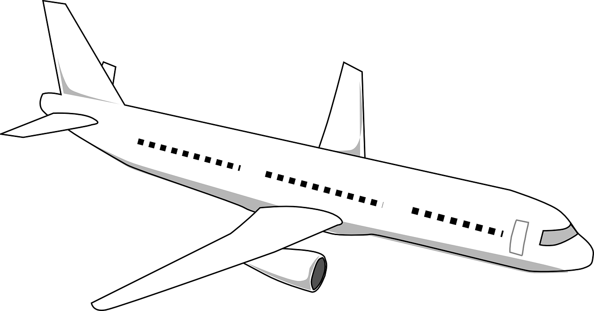
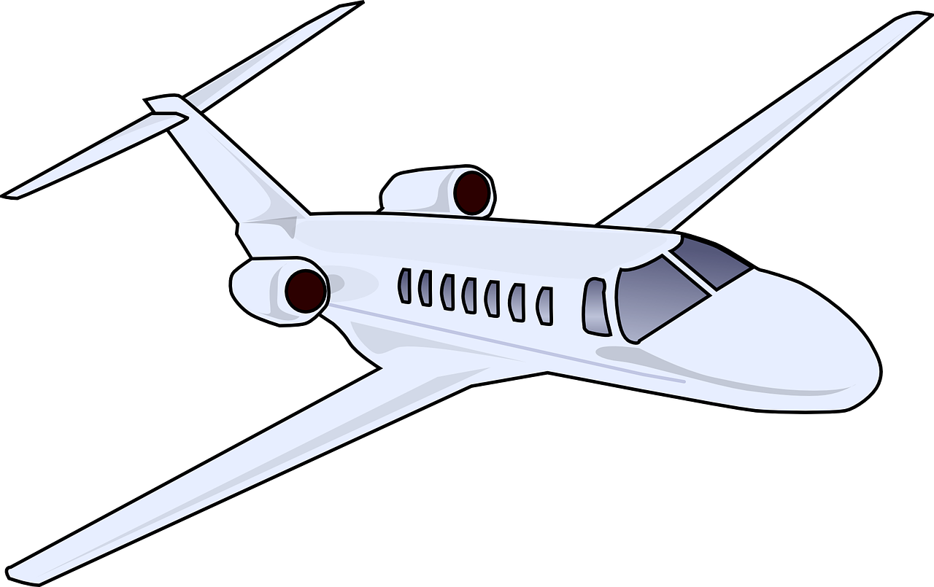
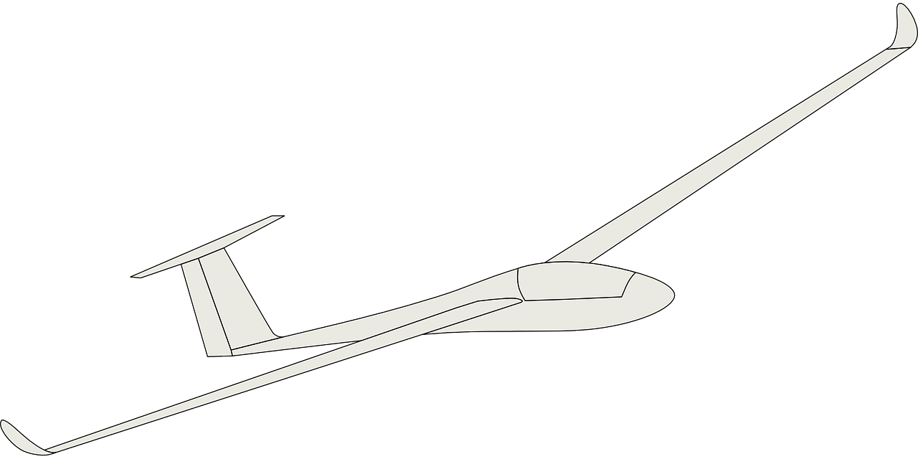
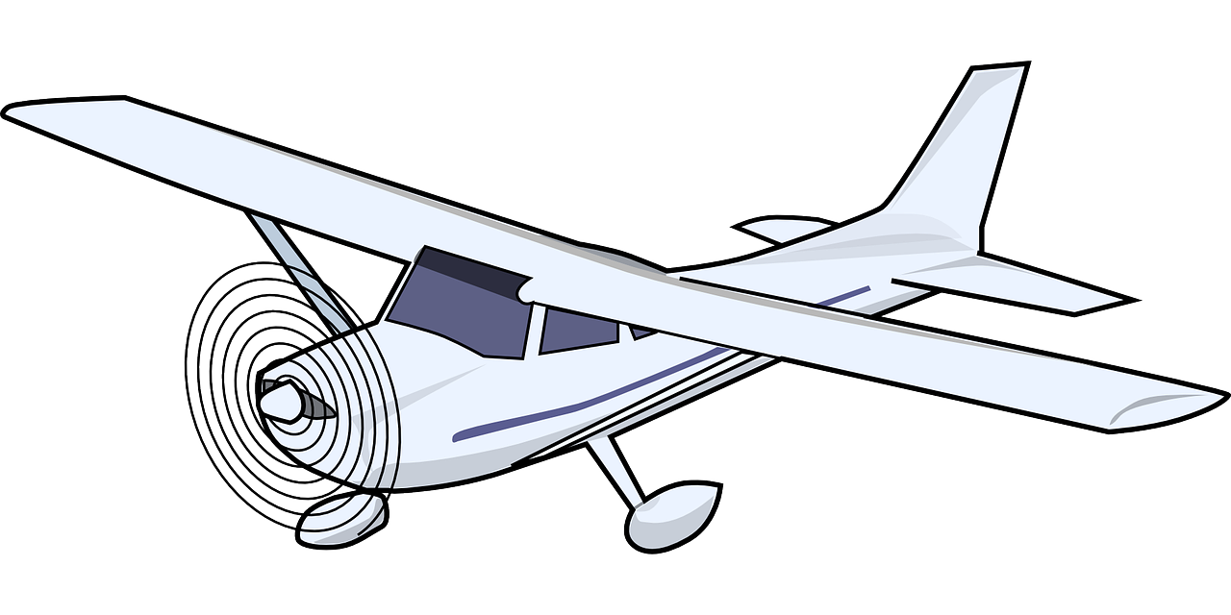
Why is Density Important for Aircraft?
Comparing two aircraft of the same design, the heavier one will:
  need more energy – and fuel – to fly.
  fly slower than a lighter aircraft.
So making the aircraft from suitable materials with a lower density means less weight – so less fuel is needed and it can fly faster.

Slide 7
Testing Activity – Step 1
Weigh each object.
Write down the weight in g.

Slide 8
Step 2 – Find the Volume
Place a bowl on a tray.
Fill the bowl to the brim with water.
Put the object in the water.
The tray will catch all
the water that
overflows.

Slide 9
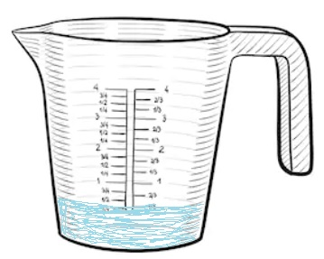
Step 3 – Measure the Water
Carefully take the bowl from the tray.
Pour the water on the tray into a jug.
Write down how much water has been collected in ml.

Slide 10
Step 4 – Work out the density
Weight = 112 grams
Volume of water = 16 ml = 16 cm³
112
____
Density $=$
$$=$$
7 g/cm³
16

