Slide 1
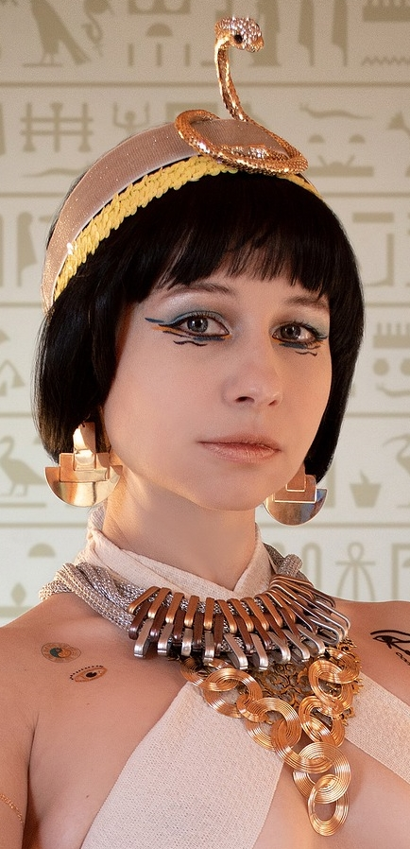
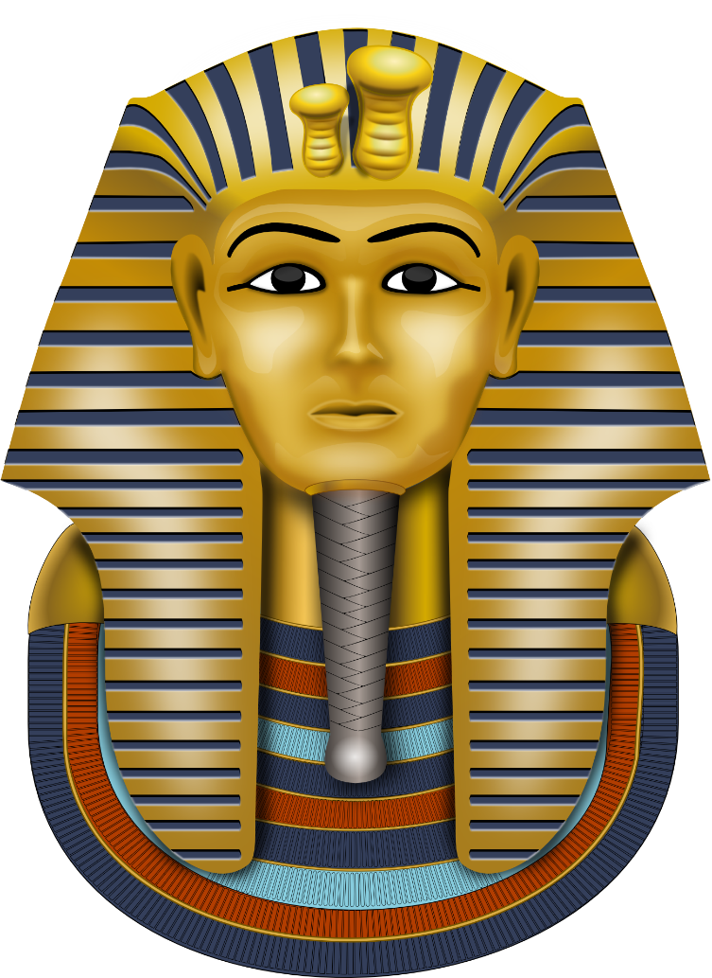
Make an Egyptian necklace
Making an Egyptian Necklace using Card & Rope

Slide 2
Stay safe
Whether you are a scientist researching a new medicine or an engineer solving climate change, safety always comes first. An adult must always be around and supervising when doing this activity. You are responsible for:
ensuring that any equipment used for this activity is in good working condition
behaving sensibly and following any safety instructions so as not to hurt or injure yourself or others
Please note that in the absence of any negligence or other breach of duty by us, this activity is carried out at your own risk. It is important to take extra care at the stages marked with this symbol: ⚠

Slide 3
Design Brief
Your task:
Make a piece of jewellery inspired by the ancient Egyptians

Slide 4
Gold
Silver
Things to consider
Copper
Earrings
Rings
Beads
Necklace
Materials used
Types
Egyptian Jewellery
Precious Stones/Gems
Bracelet
Men
Who would wear it
Adults
Women
Children
Poor
Rich
Notes:
Questions to ask during discussion:
What materials could you use in the classroom?
Paper/card/paper plates/cereal boxes
Pasta
Rope/cord
Paint
Glue
Sellotape
Anything else you can think of?

Slide 5
Things to consider
Egyptian men and women liked to wear jewellery, especially necklaces, bracelets and earrings
Wealthy people wore jewellery made of gold and precious stones such as amethysts and turquoise
Less wealthy people wore jewellery made from bone, stone or artificial gemstones
Notes:
More questions for discussion:
Who wears jewellery now?
Why do we wear jewellery?
If you wear jewellery, what is it made of?

Slide 6
Example of Ancient Egyptian necklace
Notes:
An actual example necklace to inspire students. This exemplar could be made is using rope, cardboard and paint.

Slide 7
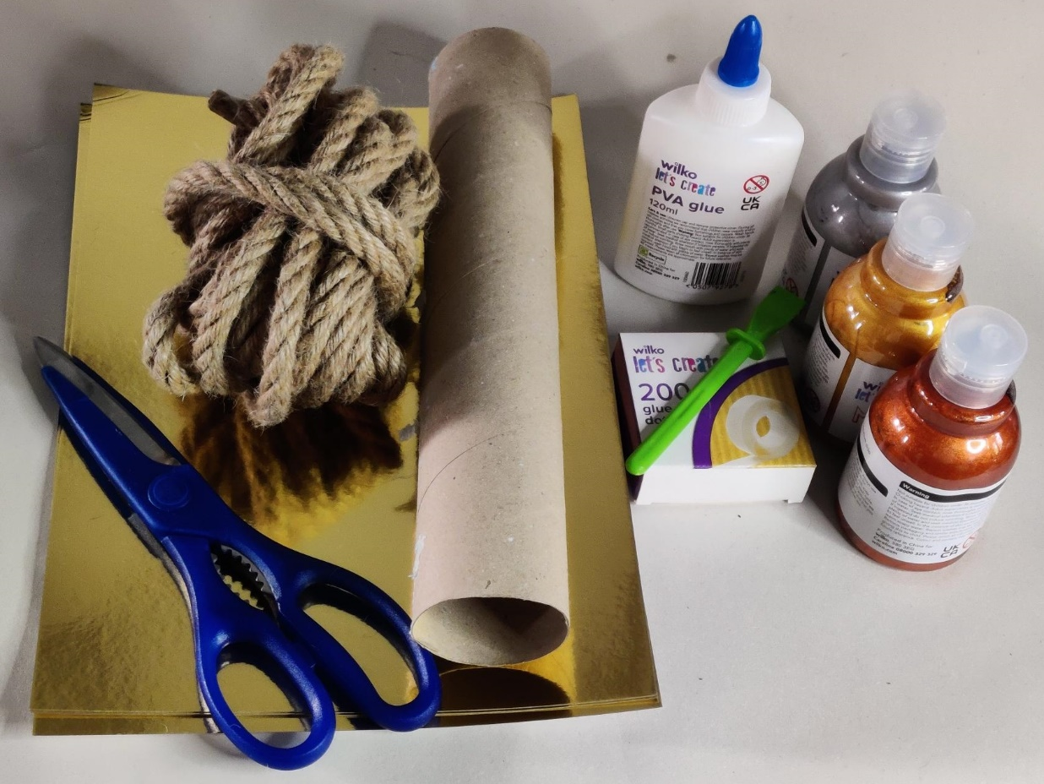
Equipment and Resources
Metallic card
Card tubes (e.g. kitchen roll or similar)
Gold/silver/bronze paint
PVA Glue/glue dots
Scissors
Rope/cord (3 pieces – different lengths)
Notes:
A dummy head or large tube to hang the necklace around while you assemble it would be advantageous.
Sisal rope was used, but rope or thick cord can be used.
Metallic paint is preferred, non-metallic paint can be used if not available.
Also need circle objects that can be drawn around to make the chain.

Slide 8
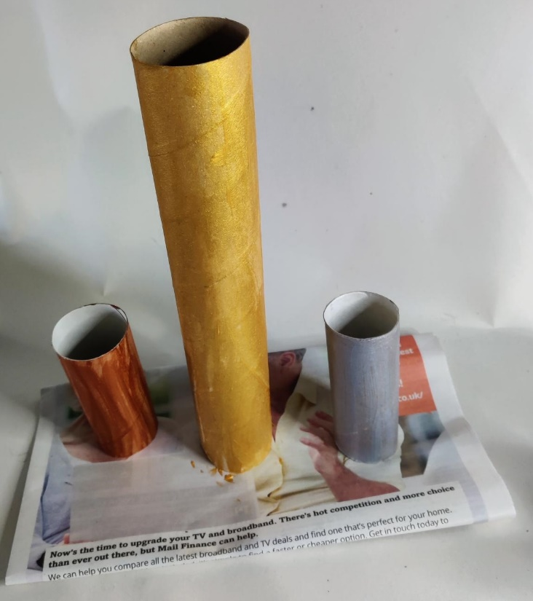
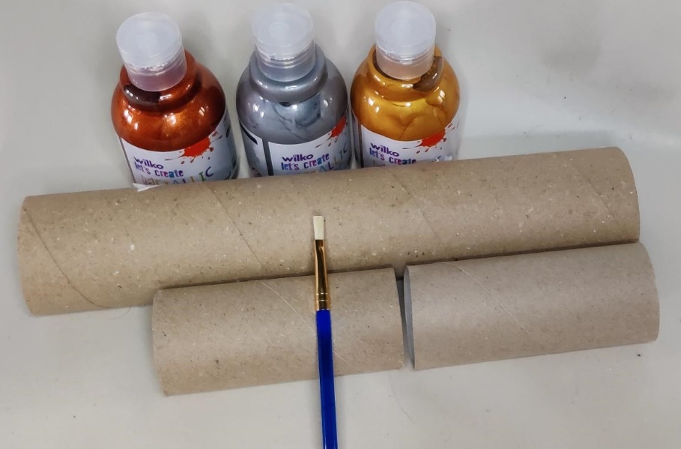
Step 1 Paint the Tubes
⚠
Paint each tube a different metallic shade
(Bronze, Silver and Gold)
Leave to dry
Notes:
Metallic paint is preferred, non-metallic paint can be used if not available.

Slide 9
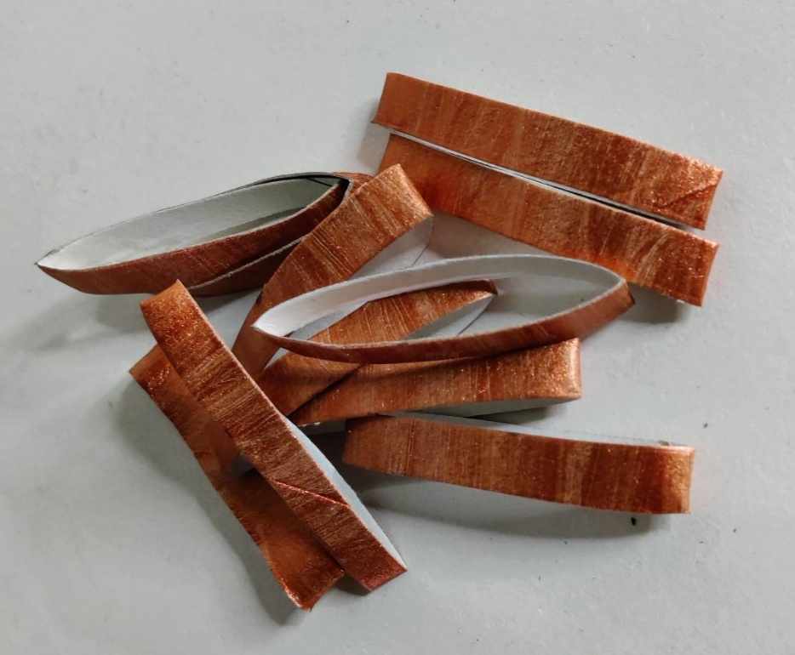
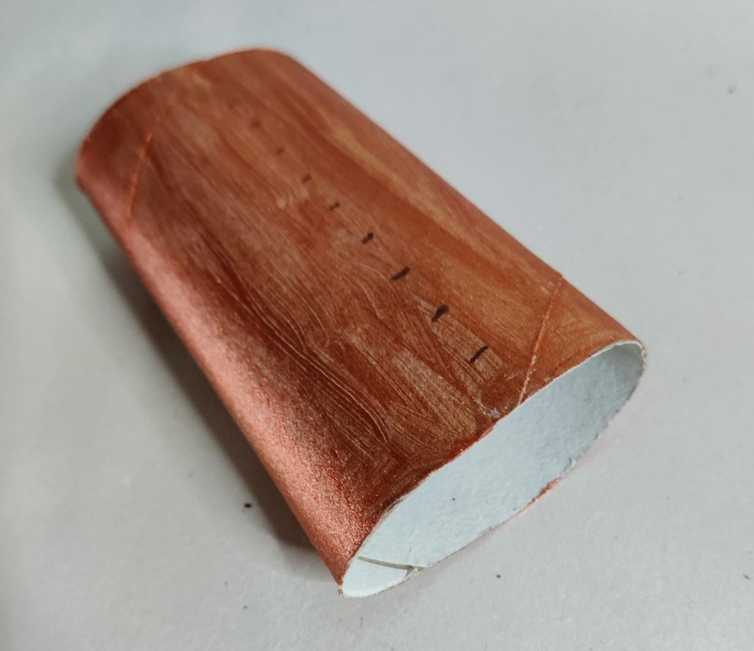
Step 2 Cutting
⚠
Flatten the tube slightly
Measure 1 cm increments on the tube
Cut into approximately 10 pieces
Repeat for each tube

Slide 10
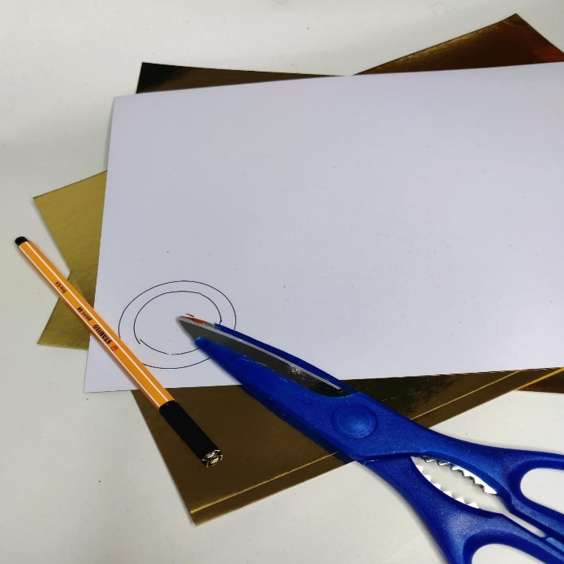
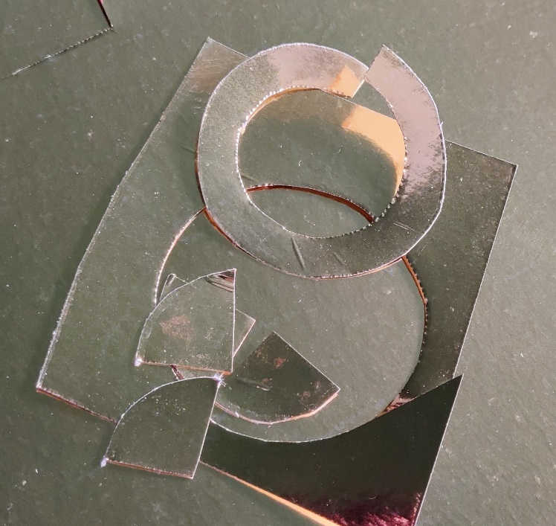
Step 3 Making the Rings
⚠
Draw round a circle approximately 4 cm wide.
Draw round a circle inside approximately 2 cm wide, creating an open gold disc
Notes:
Metallic or matt card can be used for this - what about using turquoise to replicate the stone of the same name?

Slide 11
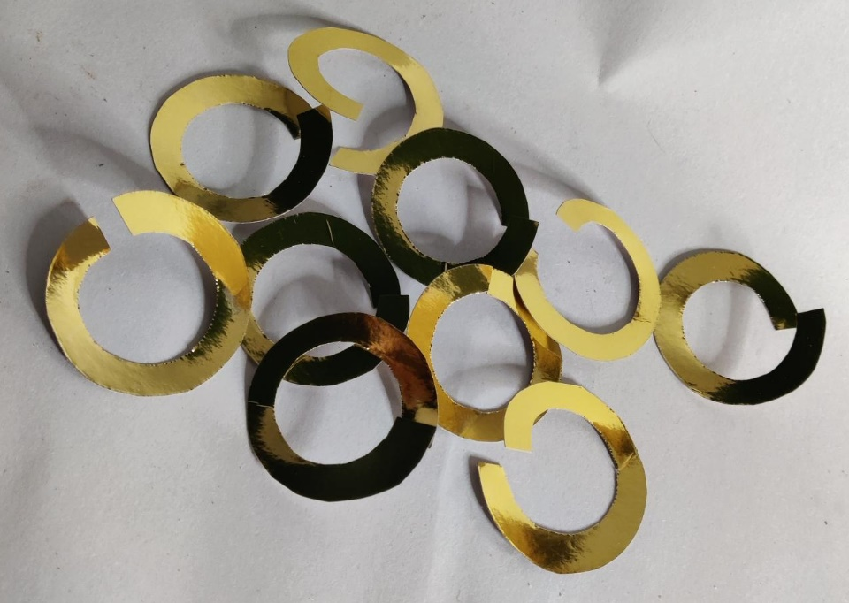
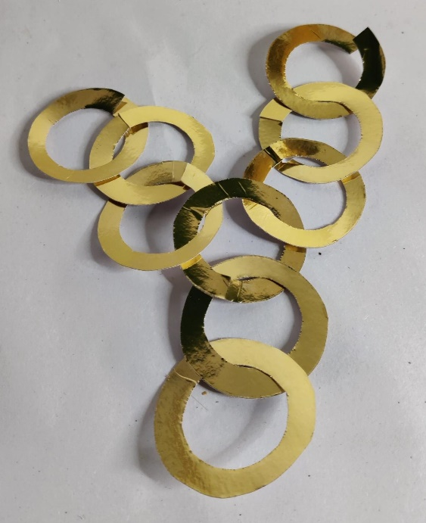
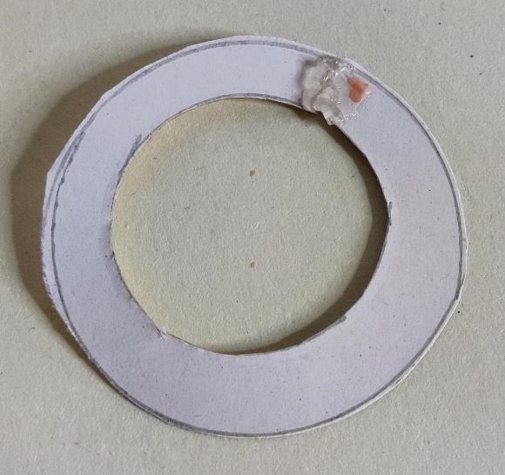
Step 4 Joining the Rings
Arrange the discs into the pattern
Leave the two top discs unsealed
Attach rings with glue/tape to form complete discs
Notes:
Lay the design out and link the discs.
Make sure that they all face the same direction and try to hide the joins as much as possible.

Slide 12
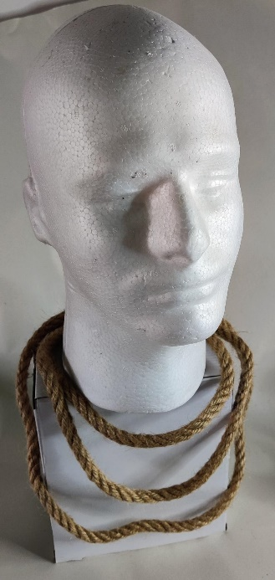
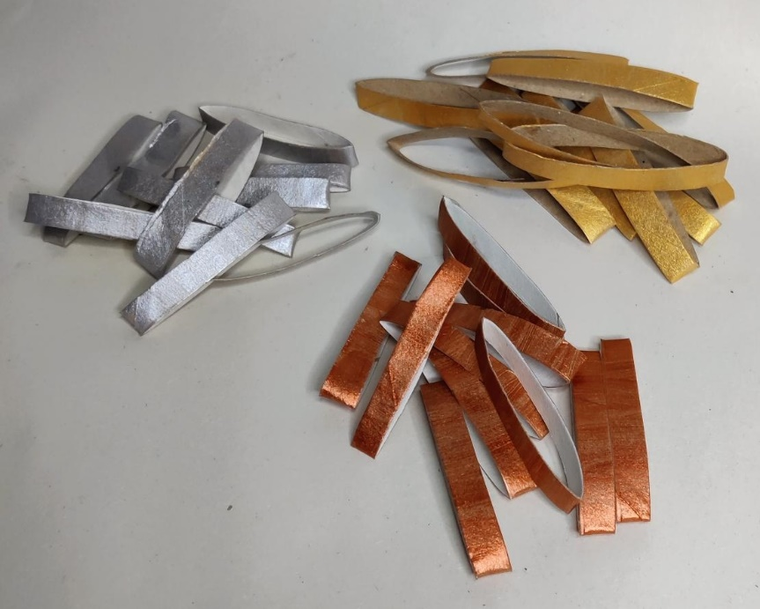
Step 5 Assembly
Time to assemble the necklace!
Notes:
A dummy head or large tube to hang the necklace round while you assemble it would be advantageous.
Rope or thick cord can be used.
Rope one – feed 8 gold flattened discs on to the rope and lay flat.
Rope two – feed the rope through the first disc and then add a bronze disc and repeat.
Rope three – feed the rope through the bronze discs, adding alternate silver discs.
Space the flattened discs so they resemble the pattern.
Add the gold circle chain to the third rope.

Slide 13
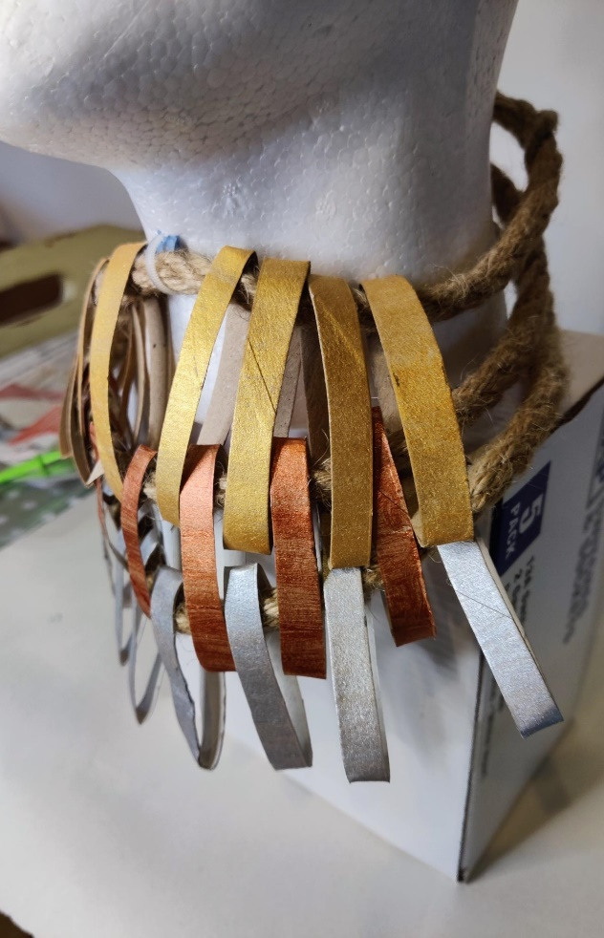
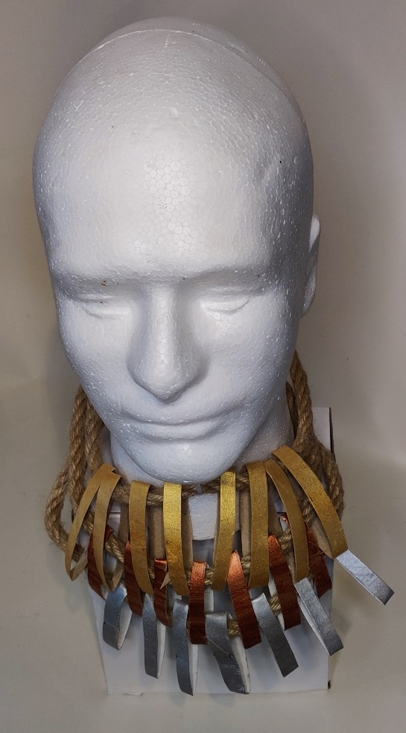
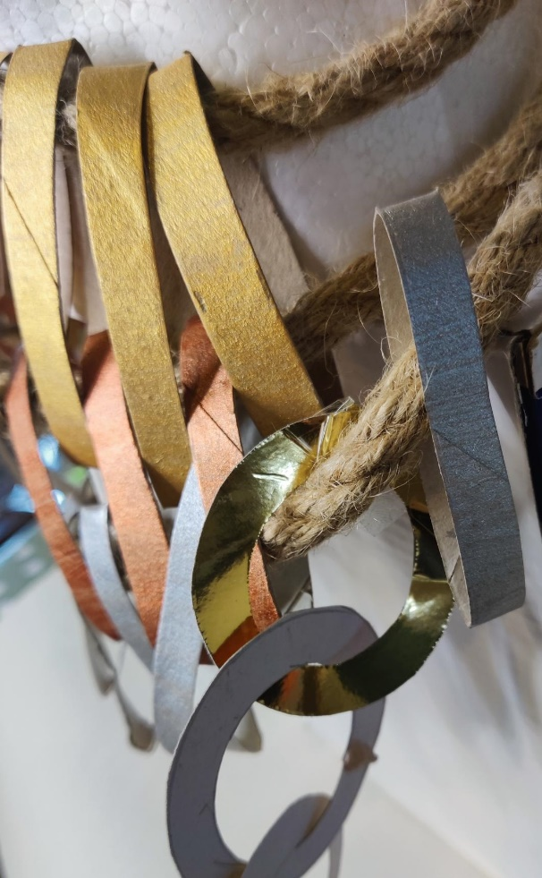
Assembly of necklaces
A
B
C
Notes:
A/B weaving of flattened beads completed.
The back of the necklaces is secured with tape.
C Joining the gold discs to the third necklace.

Slide 14
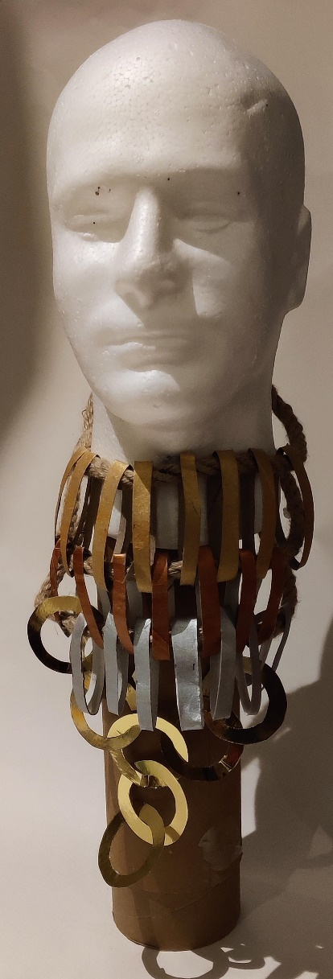
Finished example
Notes:
An example of the finished necklace.

Slide 15
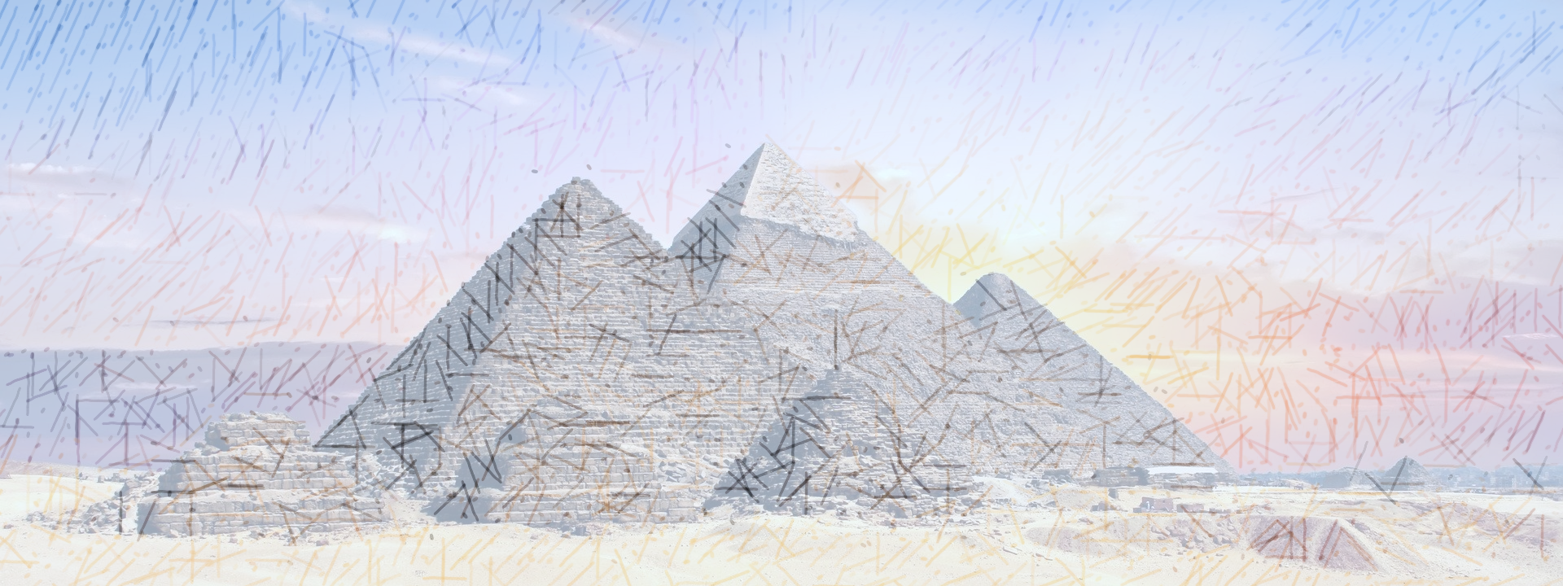
Extension
Design a range of accessories to match the necklace, to include:
Bracelet
Earrings
Headdress
Notes:
What would the earrings/bracelet/headdress look like?
Why might they need a complementary version of the necklace?

