Slide 1
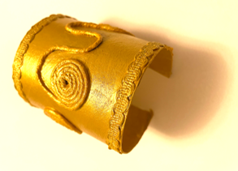
Make an Egyptian bracelet
A project to make and assemble an Egyptian bracelet out of a carboard tube.

Slide 2
Stay safe
Whether you are a scientist researching a new medicine or an engineer solving climate change, safety always comes first. An adult must always be around and supervising when doing this activity. You are responsible for:
ensuring that any equipment used for this activity is in good working condition
behaving sensibly and following any safety instructions so as not to hurt or injure yourself or others
Please note that in the absence of any negligence or other breach of duty by us, this activity is carried out at your own risk. It is important to take extra care at the stages marked with this symbol: ⚠

Slide 3
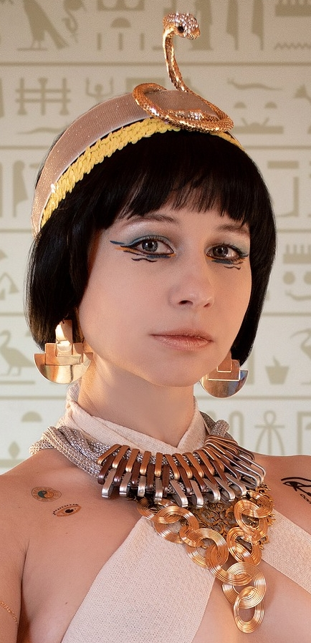
Design Brief
Your task:
Make a piece of jewellery inspired by the ancient Egyptians

Slide 4
Gold
Silver
Things to consider
Copper
Earrings
Rings
Beads
Necklace
Materials used
Types
Egyptian Jewellery
Precious Stones/Gems
Bracelet
Men
Who would wear it
Adults
Women
Children
Poor
Rich

Slide 5
Things to consider
Egyptian men and women liked to wear jewellery, especially necklaces, bracelets and earrings
Wealthy people wore jewellery made of gold and precious stones such as amethysts and turquoise
Less wealthy people wore jewellery made from bone, stone or artificial gemstones

Slide 6
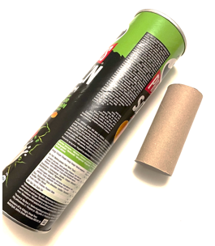
Equipment and Resources
Carboard tube
Paint & brush
Gold paint
Braid
String
Scissors
Items for decoration

Slide 7
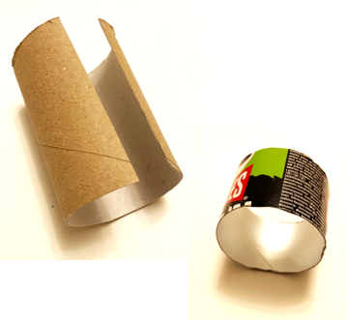
Step 1 Cut your cardboard tube to fit your wrist ⚠
Measure your wrist and find an old cardboard tube to fit.
Cut the tube to the length required.
Make a slit in your tube if your tube is small or create a full bracelet if your tube is bigger.

Slide 8
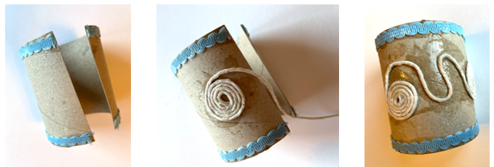
Step 2 Glue on decoration
Glue on braid
Glue on string and allow bracelet to dry

Slide 9
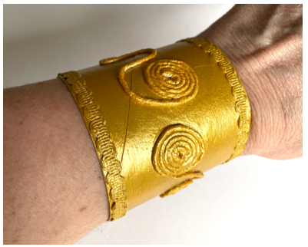
Step 3 Paint your bracelet in gold
Allow to dry

Slide 10
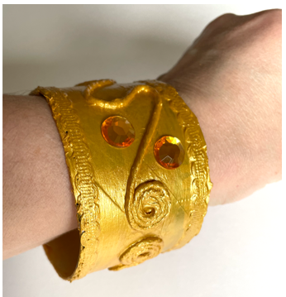
Step 4 Add decoration
Add stick on gems or any decorations that you want!

