Slide 1
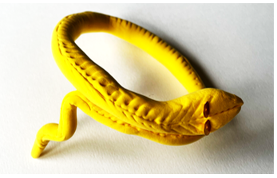
Make an Egyptian Snake bracelet
A project to make and assemble an Egyptian snake bracelet

Slide 2
Stay safe
Whether you are a scientist researching a new medicine or an engineer solving climate change, safety always comes first. An adult must always be around and supervising when doing this activity. You are responsible for:
ensuring that any equipment used for this activity is in good working condition
behaving sensibly and following any safety instructions so as not to hurt or injure yourself or others
Please note that in the absence of any negligence or other breach of duty by us, this activity is carried out at your own risk. It is important to take extra care at the stages marked with this symbol: ⚠

Slide 3
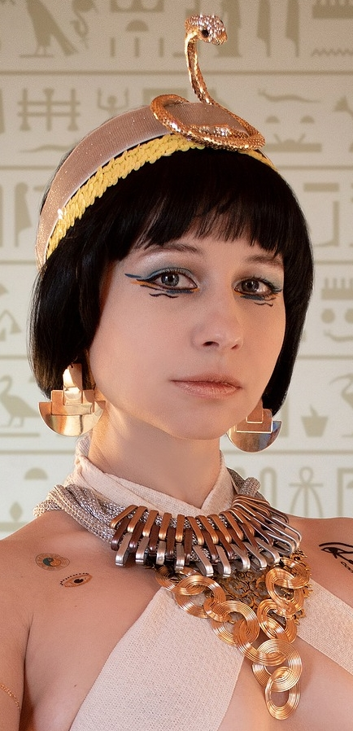
Design Brief
Your task:
Make a piece of jewellery inspired by the ancient Egyptians

Slide 4
Gold
Silver
Things to consider
Copper
Earrings
Rings
Beads
Necklace
Materials used
Types
Egyptian Jewellery
Precious Stones/Gems
Bracelet
Men
Who would wear it
Adults
Women
Children
Poor
Rich

Slide 5
Things to consider
Egyptian men and women liked to wear jewellery, especially necklaces, bracelets and earrings
Wealthy people wore jewellery made of gold and precious stones such as amethysts and turquoise
Less wealthy people wore jewellery made from bone, stone or artificial gemstones

Slide 6
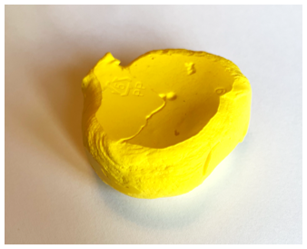
Equipment and Resources
Air drying clay
Sequins

Slide 7
Step 1 Roll out your clay
Measure your wrist
Roll out your clay into a long thin shape - make your snake twice the length of the measurement of your wrist

Slide 8
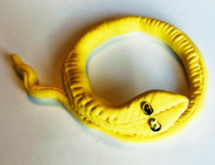
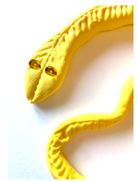
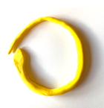
Step 2 Shape your bracelet
Shape your clay into a snake - make a snake head
Use two sequins to make your snakes eyes and add pattern to the clay
Form your snake into the shape illustrated and bend the tail

Slide 9
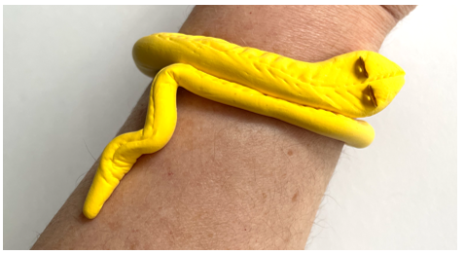
Step 3 Allow Clay to dry

