Slide 1
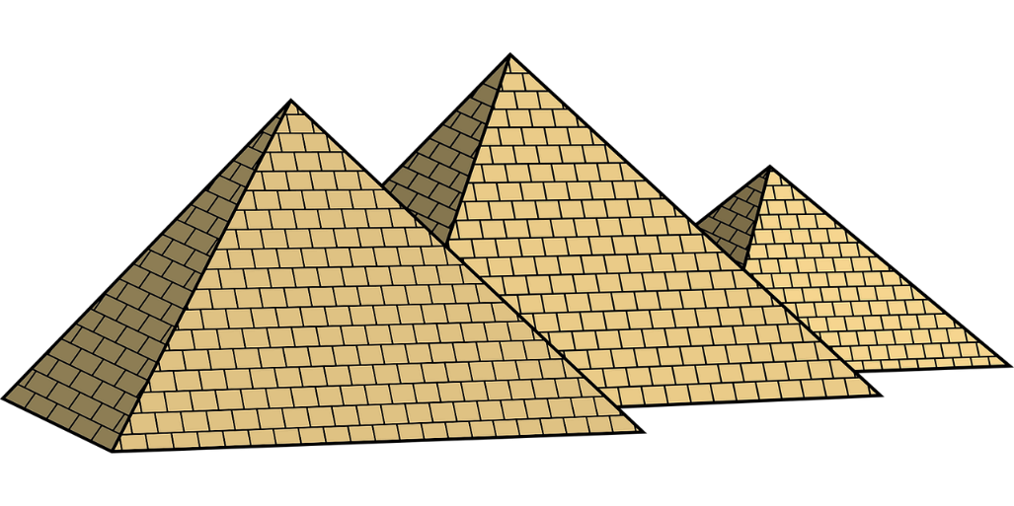
Make a Pyramid
Learning about scale and volume
using pyramids made from paper

Slide 2
Stay safe
Whether you are a scientist researching a new medicine or an engineer solving climate change, safety always comes first. An adult must always be around and supervising when doing this activity. You are responsible for:
ensuring that any equipment used for this activity is in good working condition
behaving sensibly and following any safety instructions so as not to hurt or injure yourself or others
Please note that in the absence of any negligence or other breach of duty by us, this activity is carried out at your own risk. It is important to take extra care at the stages marked with this symbol: ⚠

Slide 3
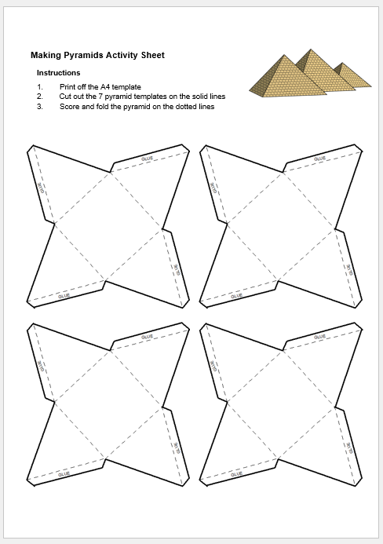
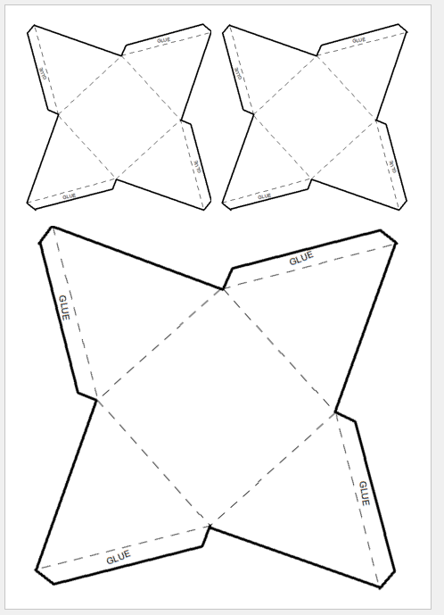
Equipment and Resources
You will need:
the making pyramids activity sheet
Scissors
Rulers
Glue sticks
Calculators
⚠

Slide 4
Pyramid Dimensions in mm
Scale is the proportional difference between two things
For the triangles:
the big one is at a scale of 70:35 = 2:1
the little one is at a scale of 35:70 = 1:2
70
35
80
40
40
80

Slide 5
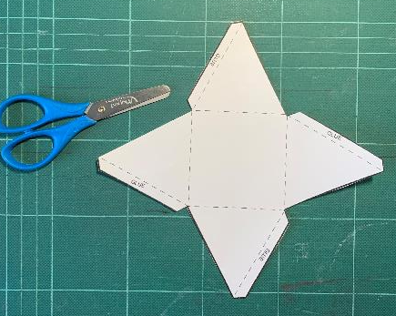
Step 1 - Pyramid Nets ⚠
Carefully cut out the pyramid nets
Score and fold on the dotted lines
⚠

Slide 6
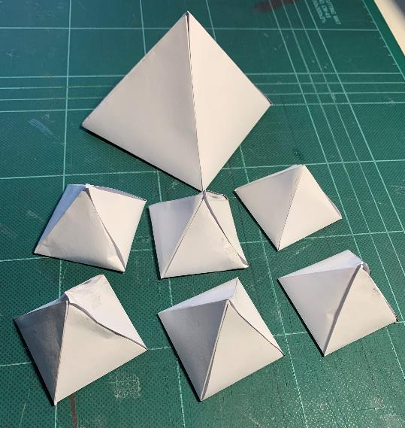
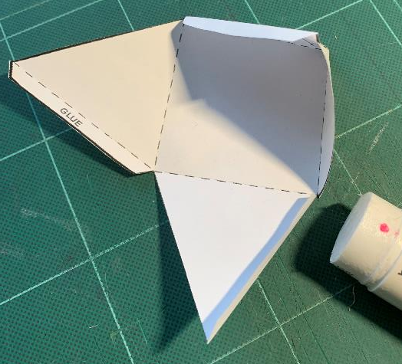
Step 2 – Assembling the Pyramids
Glue the tabs
Join the sides together
Make your pyramids

Slide 7
Volume
Calculate the volume of the large pyramid:
Volume of a pyramid (mm) = 1/3 x length (l) x width (w) x height (h)
Volume of large pyramid = 80 x 80 x 70 = 149333.3 mm³
3
Volume of small pyramid = 40 x 40 x 35 = 18666.6 mm³
3

Slide 8
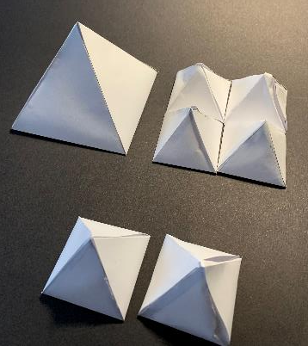
How Scale Affects Volume
The large pyramid is at a scale of 2:1 to the small pyramids
How many small pyramids fit inside the larger pyramid?
What about the gaps?

Slide 9
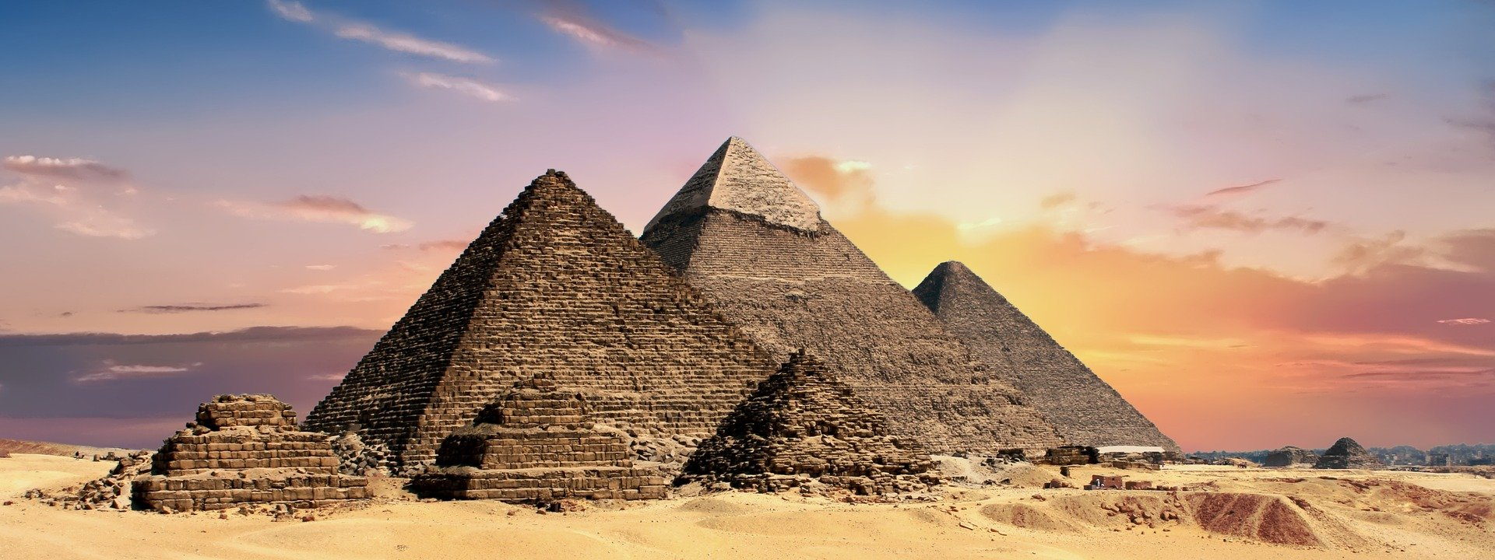
Calculating How Scale Affects Volume
Calculate how many small pyramids will fit into the large pyramid
Large pyramid volume = 149333.3 mm³
149333.3 mm³ = 8
18666.6 mm³
Small pyramid volume = 18666.6 mm³
8 small pyramids will fit into the large pyramid

