Slide 1
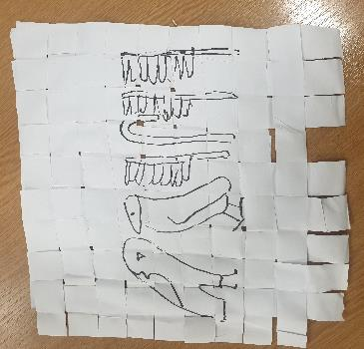
Write in hieroglyphics
Write your name using hieroglyphics

Slide 2
Stay safe
Whether you are a scientist researching a new medicine or an engineer solving climate change, safety always comes first. An adult must always be around and supervising when doing this activity. You are responsible for:
ensuring that any equipment used for this activity is in good working condition
behaving sensibly and following any safety instructions so as not to hurt or injure yourself or others
Please note that in the absence of any negligence or other breach of duty by us, this activity is carried out at your own risk. It is important to take extra care at the stages marked with this symbol: ⚠

Slide 3
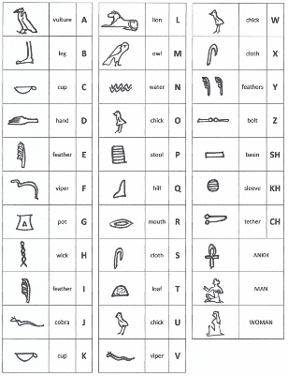
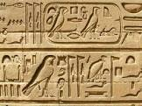
What are Hieroglyphics?
The Egyptians didn’t use letters like we do
They wrote using pictures called hieroglyphics
In Greek:
‘hiero’ means ‘holy’
‘glyphics’ means ‘writings’
so hieroglyphics means holy writings

Slide 4
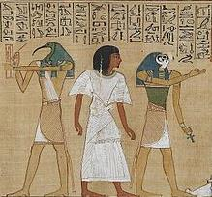
Using Hieroglyphics
The Egyptians believed there was great power in a name
If someone’s name was remembered, then he or she would survive in the afterlife
Pharaohs were the rulers of ancient Egypt, like Kings and Queens.
Here is an example of a Pharaoh’s name in hieroglyphics:
This reads HAKOR – Hakor was a pharaoh about 2400 years ago

Slide 5
Task
Work out how to write your name using hieroglyphics
…then write this onto the papyrus you have made
Here is an example: this means Jasmine

Slide 6
Finished example
(written on papyrus)
This reads ‘Maisie’

