Slide 1
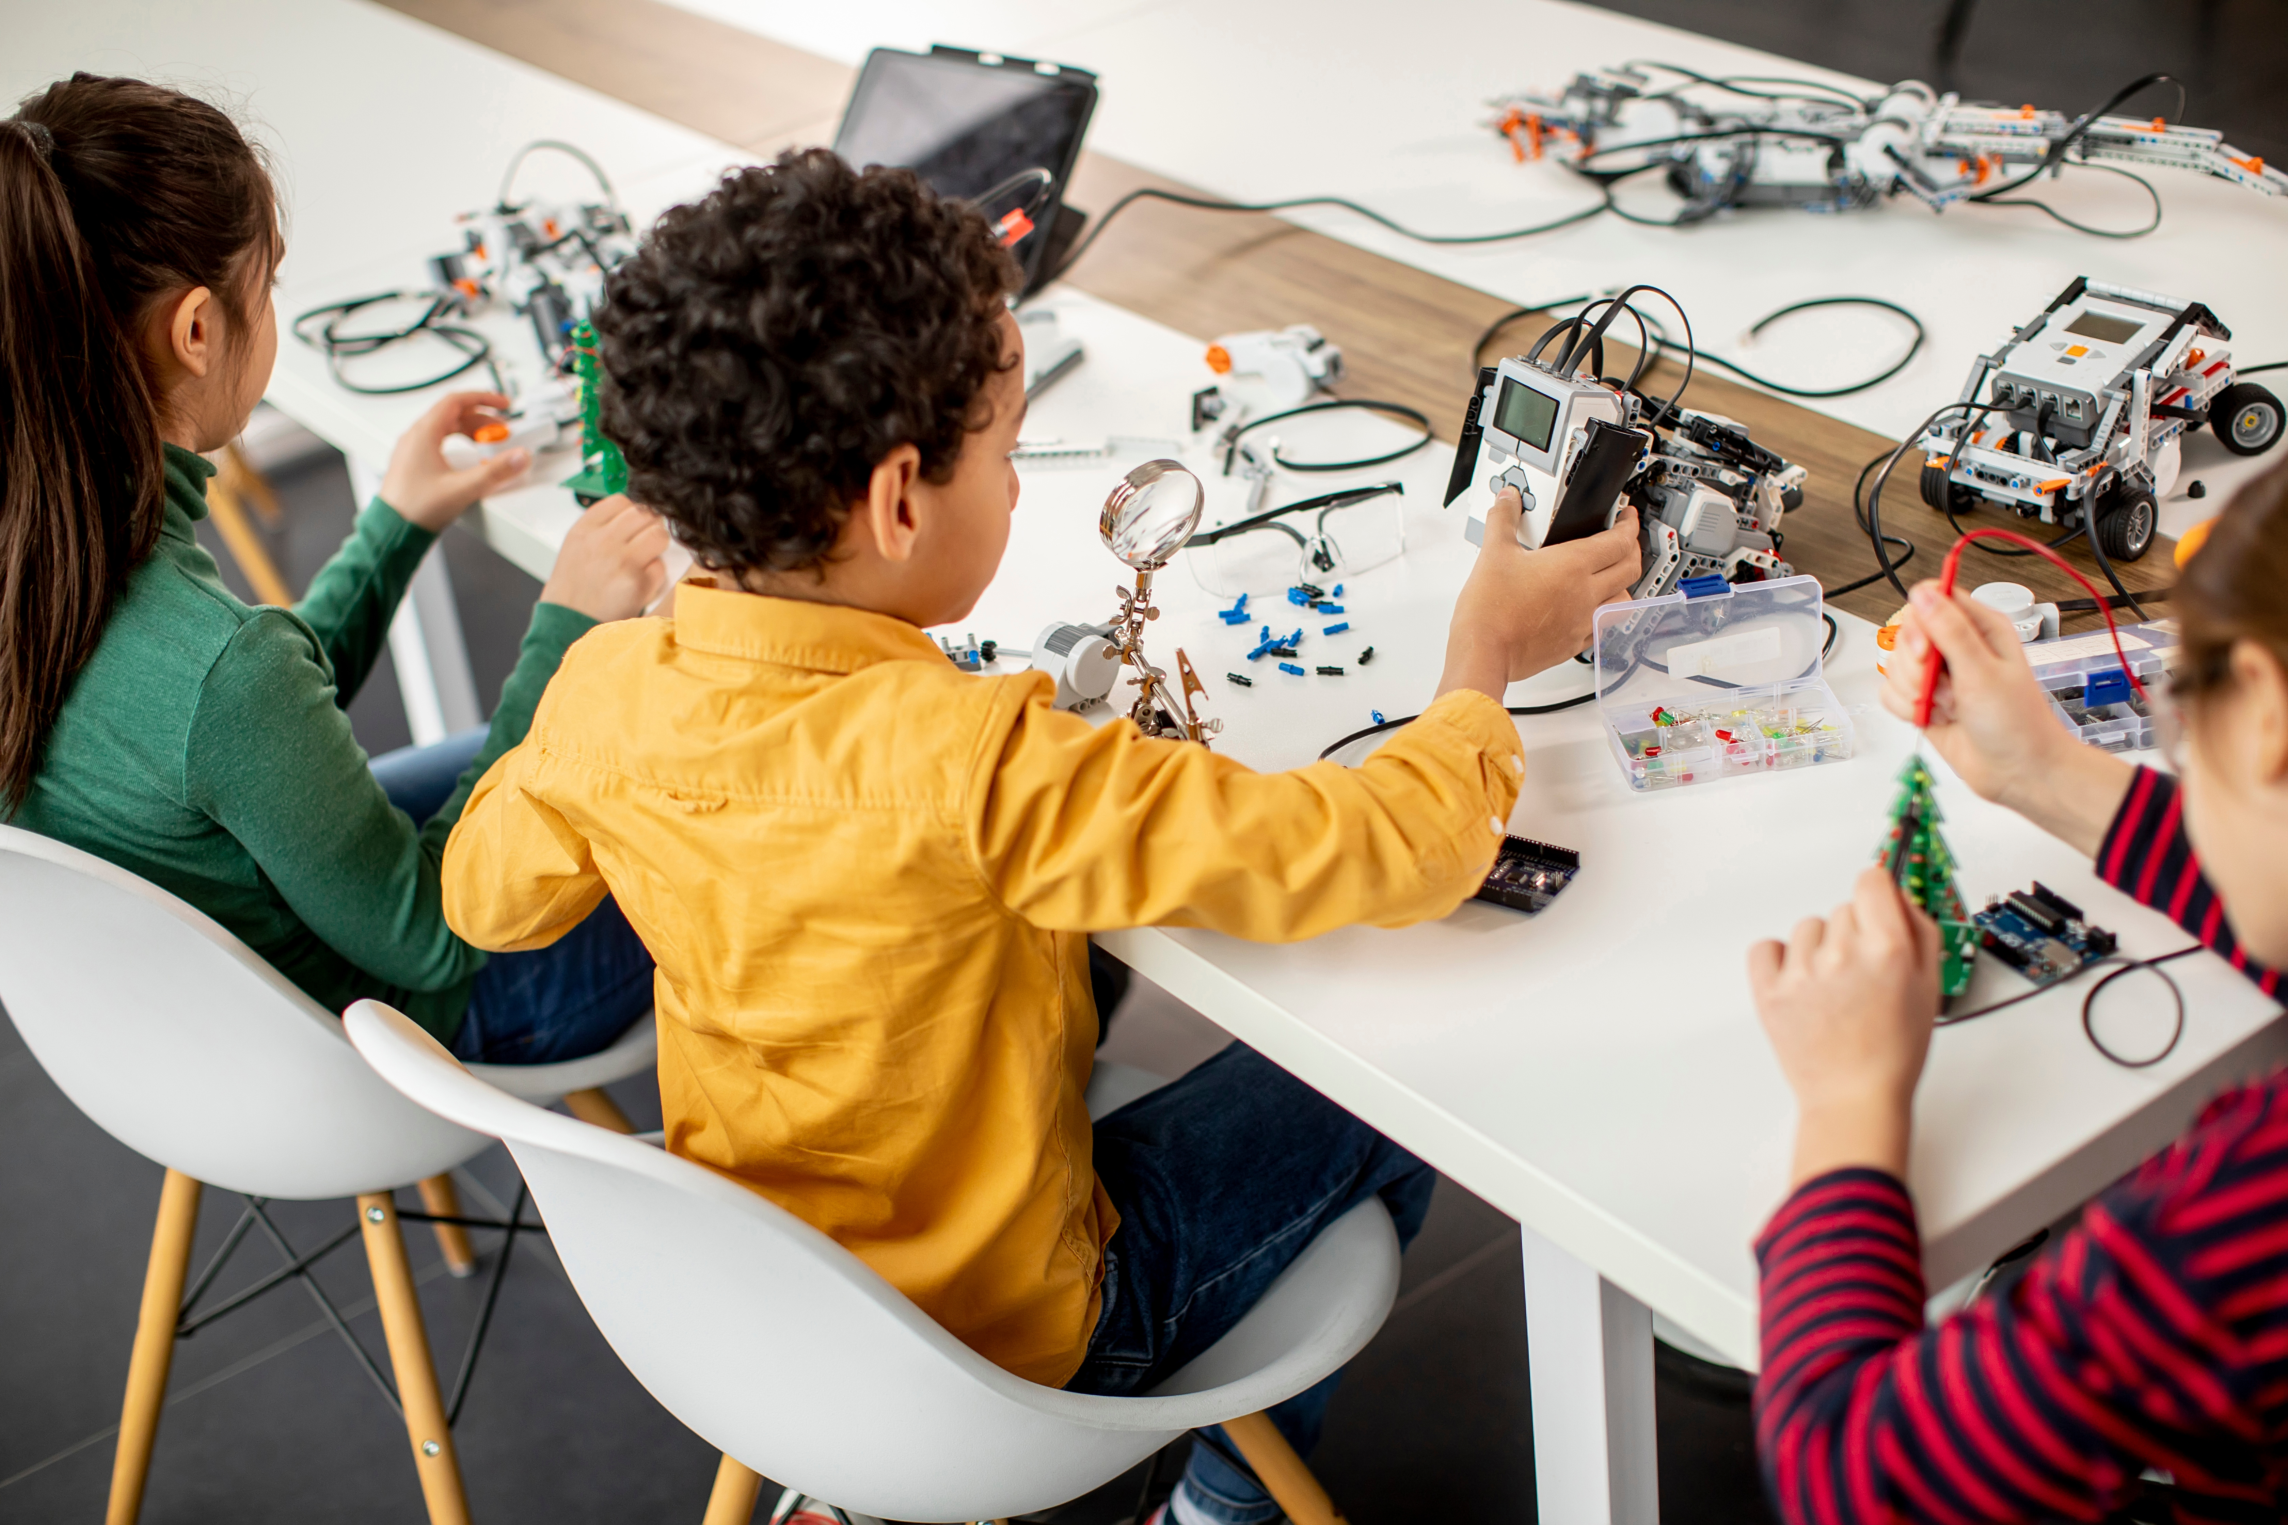
Coding Games
Design and make your own computer game

Slide 2
Coding
Computer coding is the use of computer programming languages to give computers and machines a set of instructions on what actions to perform. It’s how humans communicate with machines. It’s what allows us to create apps (applications).
C
O
D
I
N
G
Notes:
Encourage learners to come up with words that begin with any letter from C-O-D-I-N-G that are associated with IT/Computing/Technology. There is an example on the next slide.

Slide 3
Coding
Computer coding is the use of computer programming languages to give computers and machines a set of instructions on what actions to perform. It’s how humans communicate with machines. It’s what allows us to create apps (applications).
C - computer
O - operating system (windows 10)
D - desktop
I - iPad
N - Nanotech
G - gaming
Notes:
Encourage learners to come up with words that begin with any letter from C-O-D-I-N-G that are associated with IT/Computing/Technology. There is an example on the next slide.

Slide 4
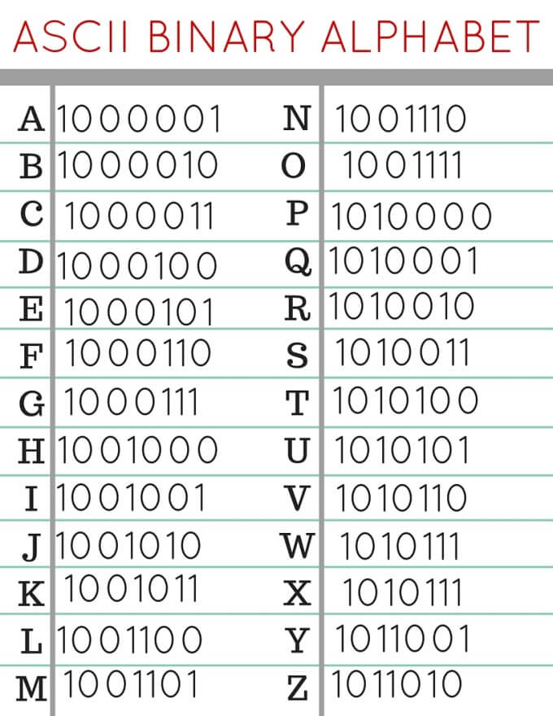
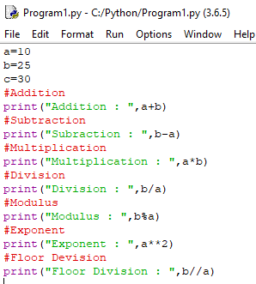
How has coding changed?
Can you write your name using the binary alphabet?
Notes:
Discuss what the differences are with the screenshots above. Photo 1- First generation coding (machine code), to photo 2- assembly language, high level programming. Photo 3- Block coding is a visual way for learners to learn coding. Remind pupils that Scratch can be downloaded at home and used for free. Explain how it has gotten much easier to use, before the code was very long, as they will see when trying to write their names but now we just drag and drop blocks.

Slide 5
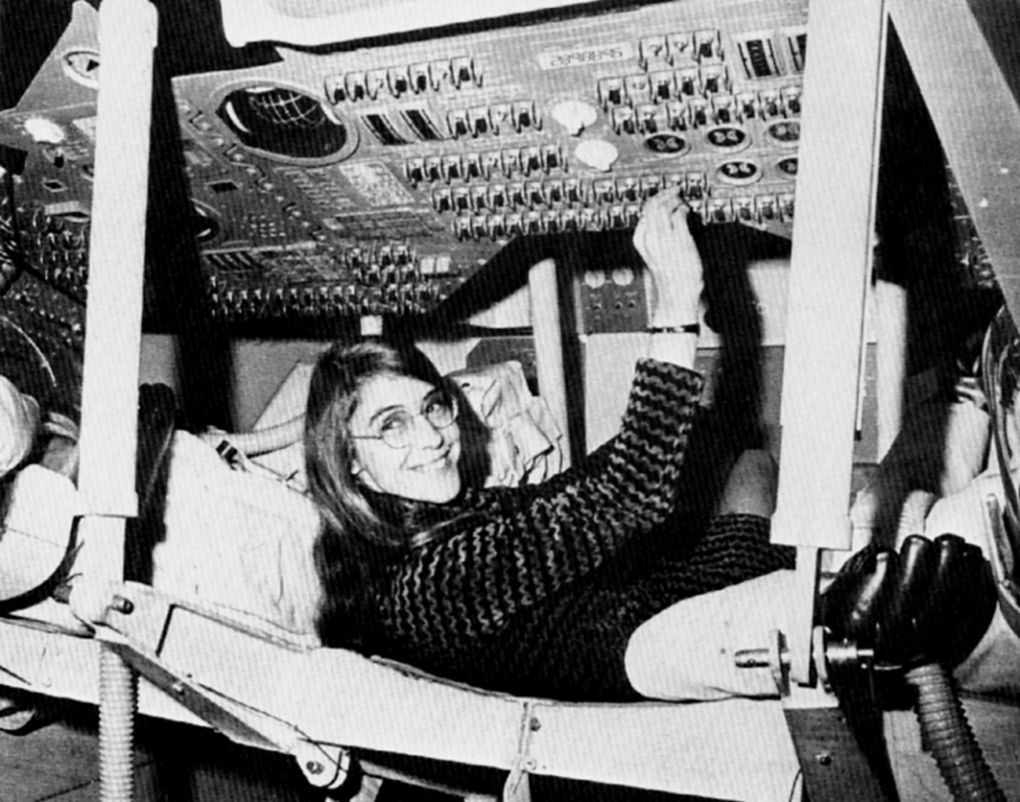
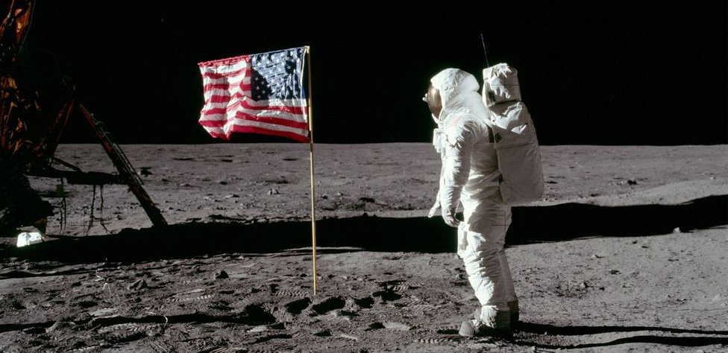
Inspirational coders: Margaret Hamilton
Margaret was responsible for developing the software that helped with the first mission to the moon!
Born: August 17th, 1936
Location: Indiana, USA
16th July, 1969
Notes:
Image sources: http://www.nasa.gov/50th/50th_magazine/scientists.html
The story of Nasa’s first software engineer – Margaret Hamilton: https://www.youtube.com/watch?v=kYCZPXSVvOQ – watch 6 minute video if time available.

Slide 6
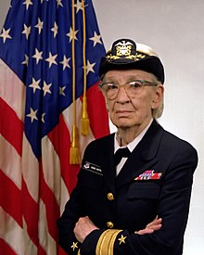
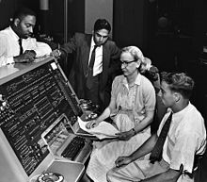
Inspirational coders: Grace Hopper
Grace joined the US military where she programmed systems to help her country! Her team developed the first computer compiler (a program that translates code).
Born: December 9th, 1906
Location: New York, USA
Notes:
Image source & attribution: Unknown (Smithsonian Institution) - Flickr: Grace Hopper and UNIVAC
SI Neg. 83-14878. Date: na...Grace Murray Hopper at the UNIVAC keyboard, c. 1960. Grace Brewster Murray: American mathematician and rear admiral in the U.S. Navy who was a pioneer in developing computer technology, helping to devise UNIVAC I. the first commercial electronic computer, and naval applications for COBOL (common-business-oriented language).

Slide 7
Inspirational coders: Mark Zuckerberg
Mark – a keen coder who founded one of the largest social media platforms in the world: Facebook.
Born: May 14th, 1986
Location: New York, USA
Photo credits: https://en.wikipedia.org/wiki/Mark_Zuckerberg
Notes:
Image source: https://www.flickr.com/photos/1971867@N05
What similarities do you see with the previous three coders? They are all from USA! It’s time we had some inspirational coders from the UK!

Slide 8
Your task
Plan and code a functioning game with selections and variables.
But what are selections and variables?
Do any of you know?
Go to the next slide to learn or see if you were correct!

Slide 9
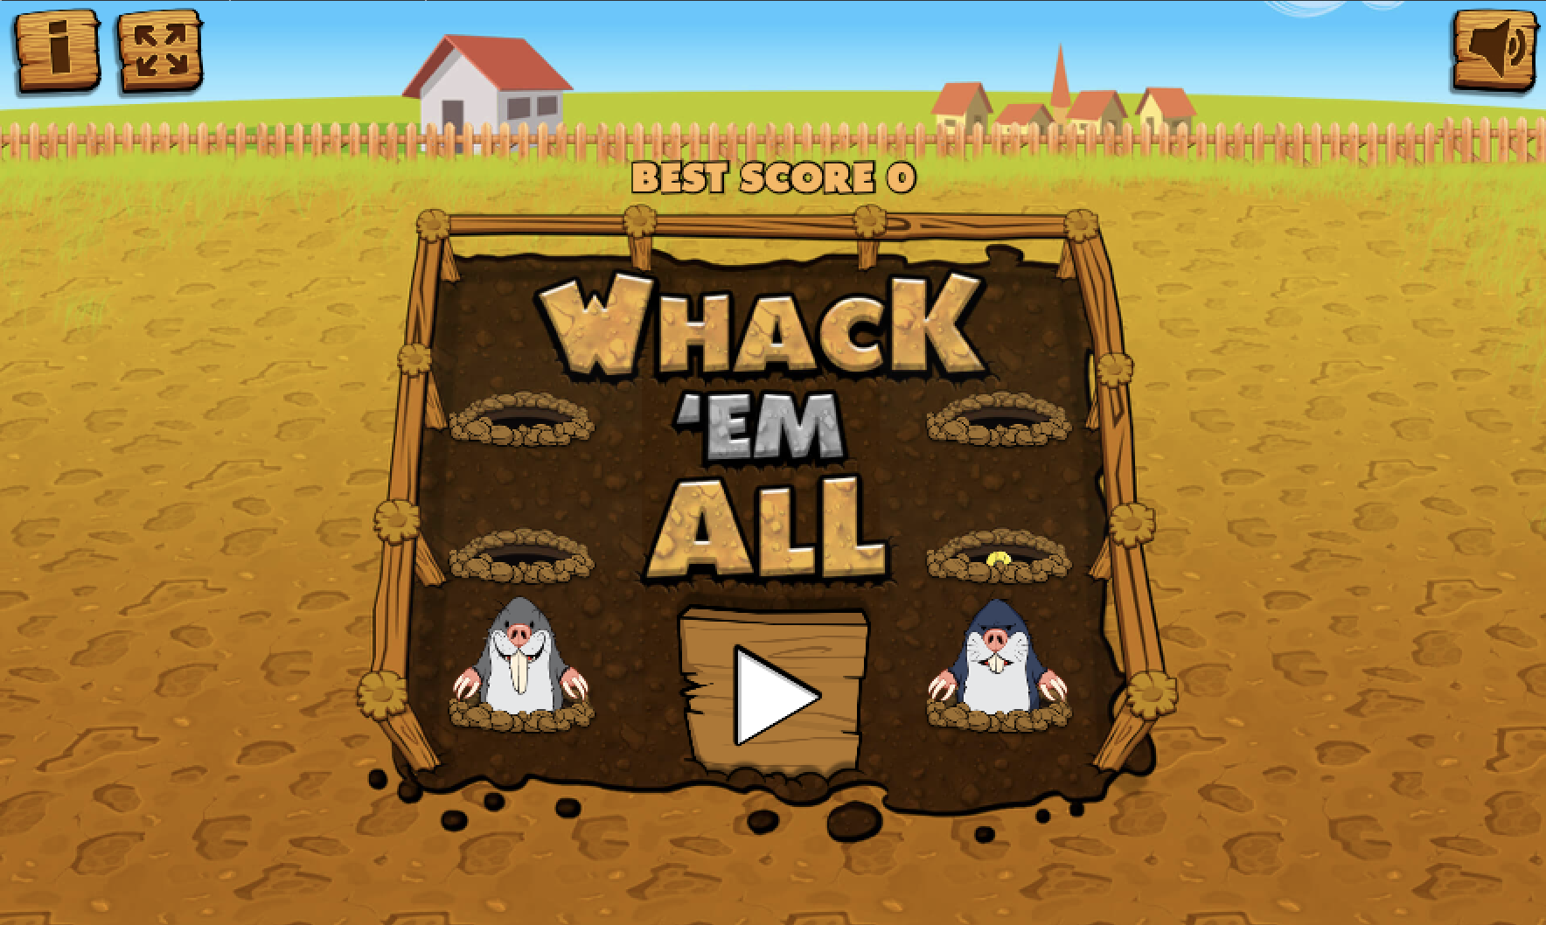
Variables
Let’s have a go!
Click on the picture to have a go at this game.
Think about what happens to the score and the time. Why does this happen?
Notes:
The game has an ad to start so worth loading before the lesson starts. Choose one or two learners to have a go at the game, get the learners to consider when the score goes up and how the timer is counting down. https://www.classicgame.co.uk/game/Whack+a+Mole

Slide 10
Variables
A variable is a placeholder for the computer’s memory.
Variables can be set and changed.
Each value needs to be named, as it can only store one value at a time. For example, time, team names, the score.
What are the names of the values on these sticky notes?
elephants
6
Notes:
a variable in simple terms…..it is a placeholder that changes value. For example a game such as FIFA will have the following variables; Time, Score, Teams, name, points (if applicable), level, position etc. A simple game such as Pac Man will also have similar variables.

Slide 11
Changing a value
Write a number value or an animal on your post it note.
elephants
6
Notes:
The game has an ad to start so worth loading before the lesson starts. Choose one or two learners to have a go at the game, get the learners to consider when the score goes up and how the timer is counting down. https://www.classicgame.co.uk/game/Whack+a+Mole

Slide 12
Changing a value
If the value of a variable is changed, then the new value will replace it and the old one must be destroyed.
Have a go at coming up to the board to put your values into this sentence!
Remember to destroy any old values before you replace them.
I love
so much that I have
at home!
Notes:
Get the learners to take turns putting their values into the sentence, showing them how we get a new outcome each time the value is changed.

Slide 13
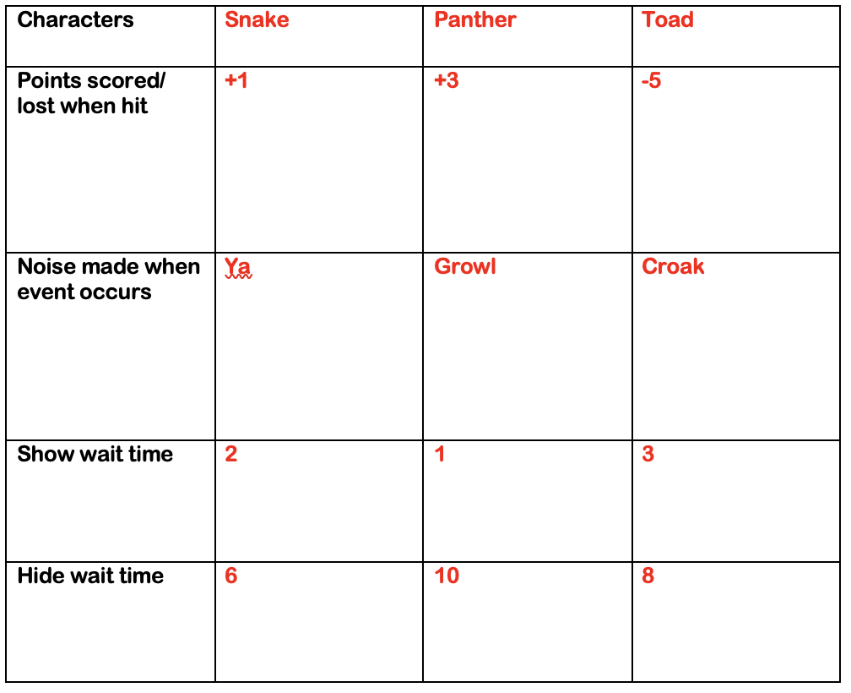
Designing your game
We are going to have a go at creating our own whack ‘em all style games!
First, you must plan your game. Fill out the planning sheet.
Top Tip:
You may wish to open scratch to see all your character and sound options.
Notes:
Let the learners open scratch to see their options of characters and sounds.

Slide 14
Show wait time: The time your sprite will appear on the screen. Less time will make the game trickier as it gives the player less time to click on your sprite.
You can add more characters in later but start with three until you are happy your code is correct.
Hide wait time: The time your sprite will not appear on the screen.
Notes:
Let the learners open scratch to see their options of characters and sounds.

Slide 15
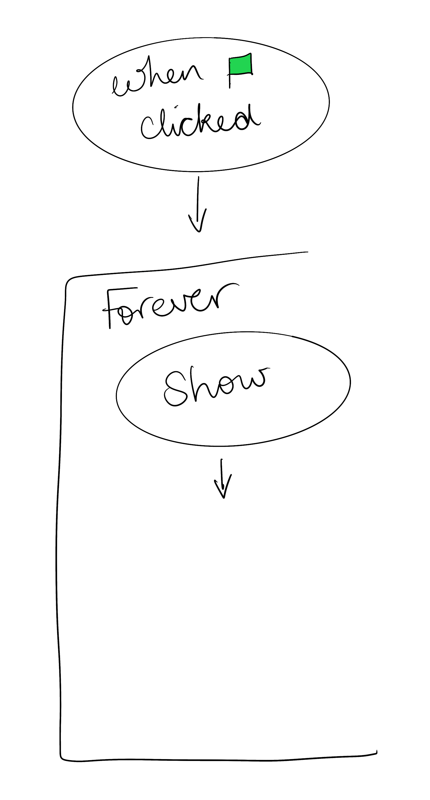
Making your game
Discovery time! It is up to you to figure out the code needed for your game, so have a play.
Remember to make a note of your flowchart, noting what worked and what needs to be changed.
Hint: Try and use as little code as possible by using the repeat blocks.
Hint: You will need two separate flow charts for each character.
Notes:
Allow the learners to explore the tools on scratch to see if they can code it for themselves without aid first. Any learners still struggling after some time, show the hint on next slide.

Slide 17
See separate video files in the download area for this resource.
Notes:
Remember only show this video to the learners who are really stuck. You may wish to show this video to the learners who want to check their code or towards the middle of the lesson to make sure they are on track.
If you are unsure how to code games it may be helpful for you and any other adults in your class to watch this too.

Slide 18
Saving your game
Don’t forget to save your game.
Remember you can only do this if you have an account.
Name your game
Save your game
Notes:
Extension task

Slide 19
Adding a time variable
Now it is time to add your time variable.
Answer
HINT: You will need to add a new ‘time’ variable. Remember to name your variables so they don’t get mixed up!
Notes:
Allow the learners to explore the tools on scratch to see if they can code it for themselves without aid first. Any learners still struggling after some time, show the answers under the circle. This is quite challenging so it may not be worth letting them struggle for too long. Again there is a video for this and resetting the score for each new game two slides away from this one.
We advise watching all the help videos provided before giving the lesson if you are unsure of coding or need a refresh.

Slide 20
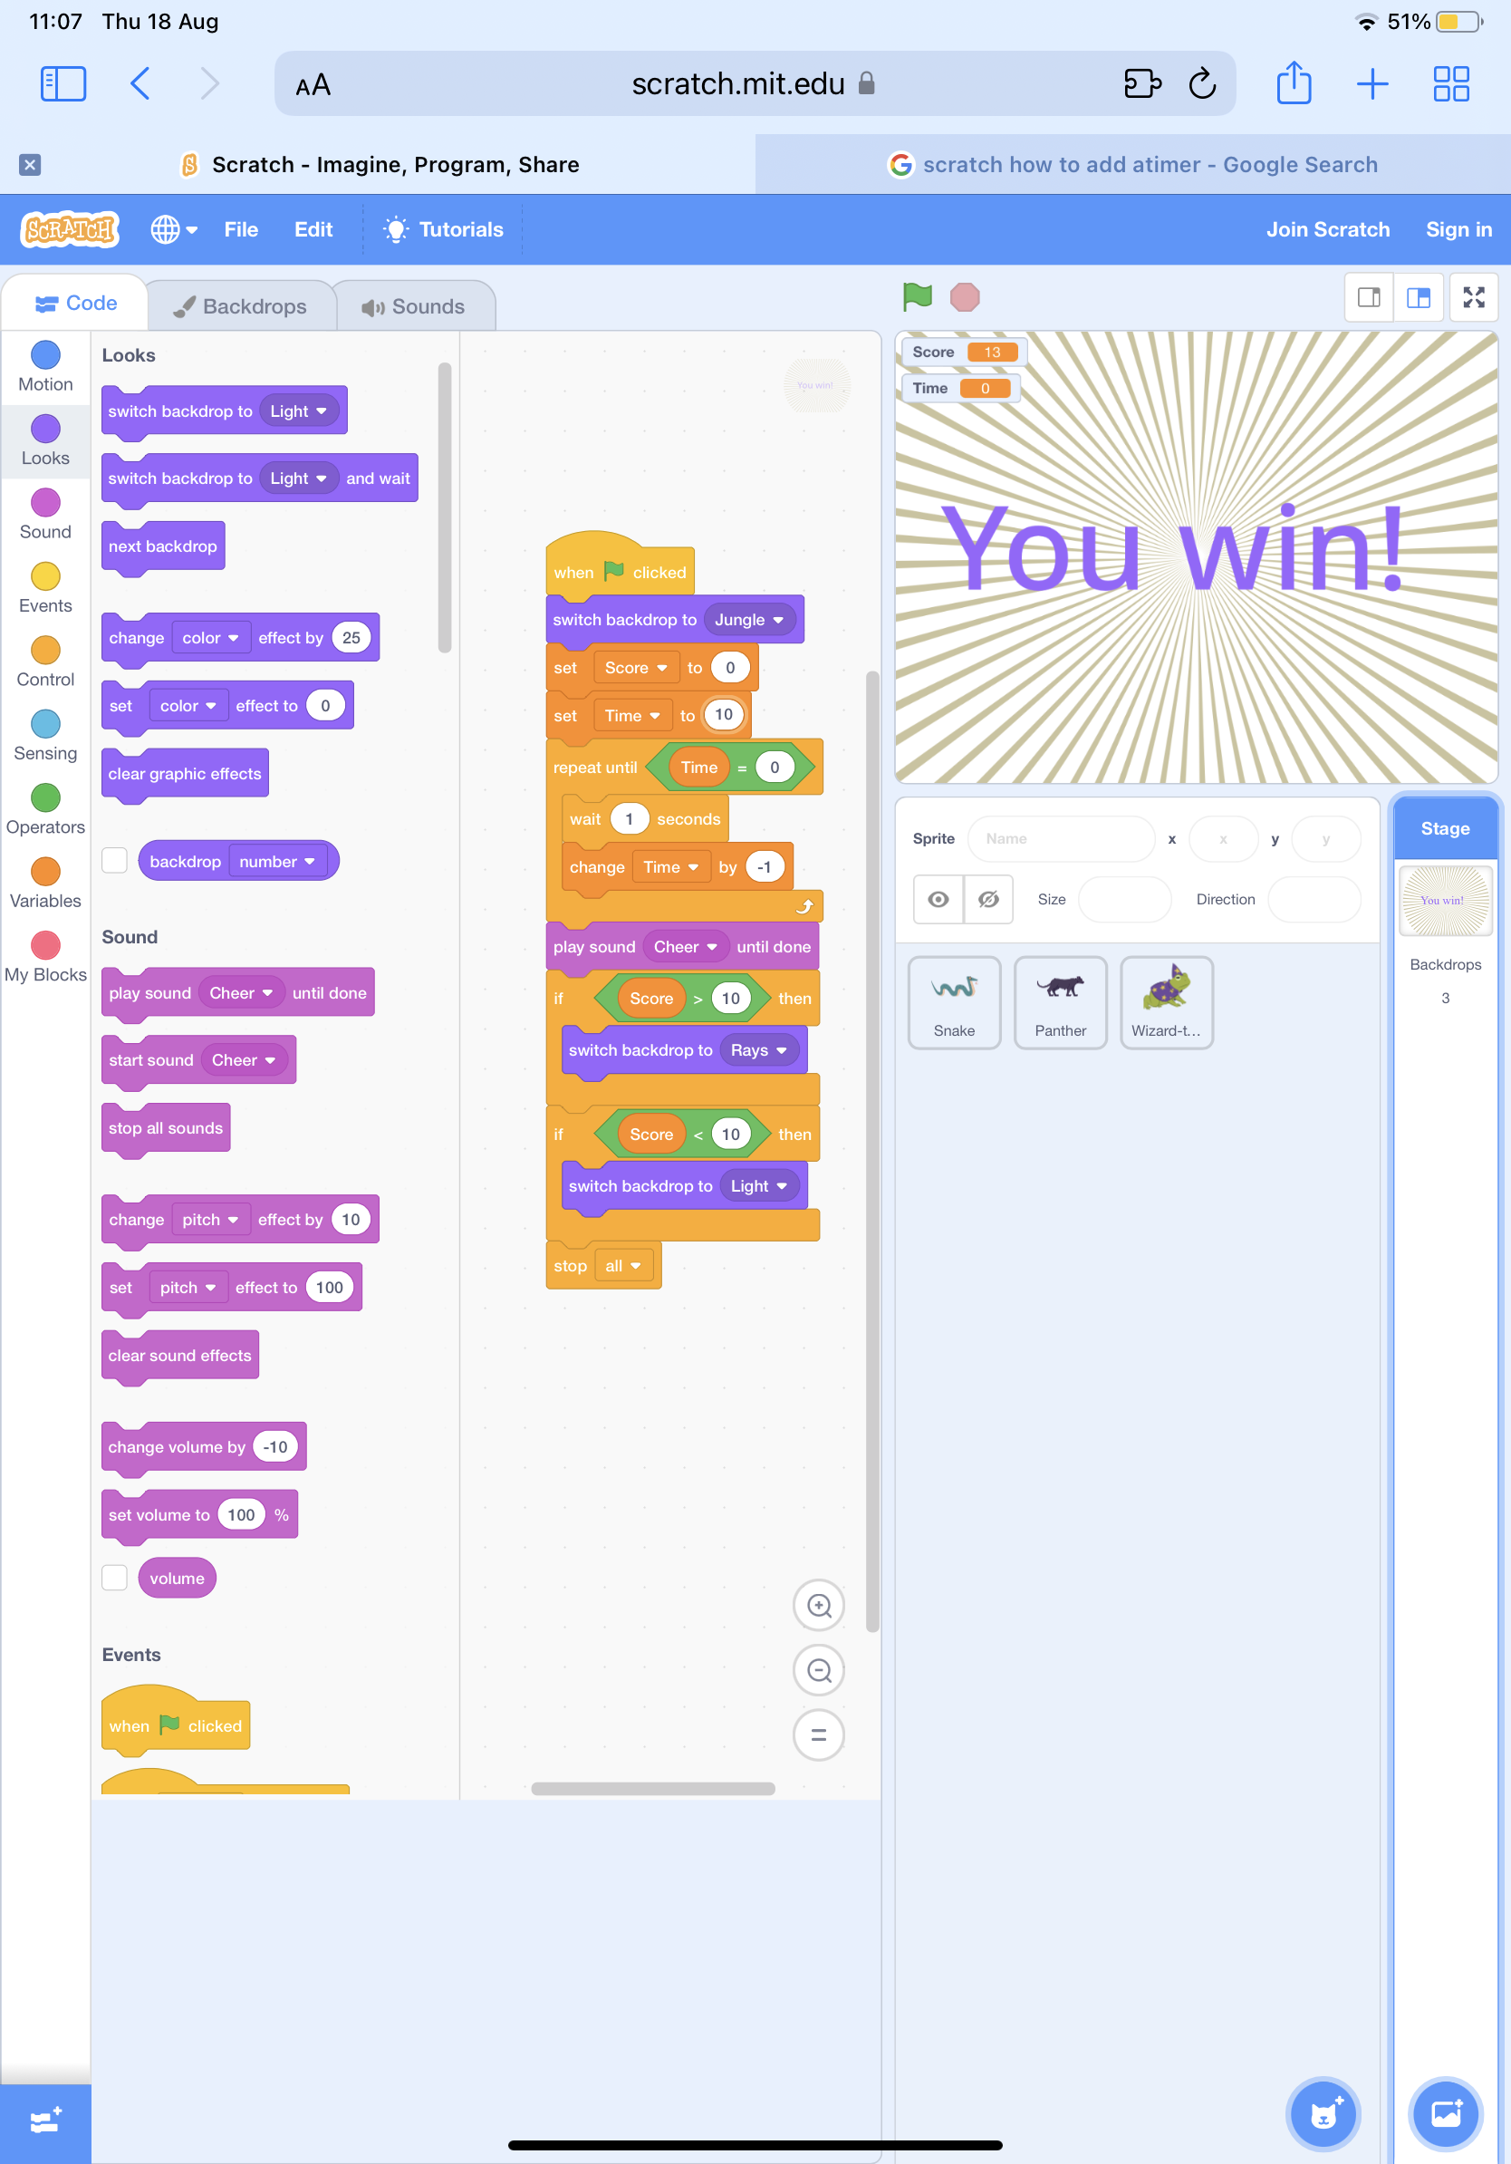
Finished?
What happens when the time runs out? Did you win? Did you lose?
Find and use these value blocks to create a winning or losing page.
Notes:
Extension task- again see what the learners can do on their own, however there is a video explaining how to do this on the next slide.

Slide 21
See separate video files in the download area for this resource.
Notes:
This video also talk about how to add the time variable so if your students need extra help in understanding this, skip along to: 1:22

Slide 22
Saving your game
Let’s test out each other’s games!
Remember to leave two stars and a wish to help the maker improve their game.
Notes:
Extension task

Slide 23
Saving your game
Don’t forget to save your game.
Remember you can only do this if you have an account.
Name your game
Save your game
Notes:
Extension task

