Slide 1
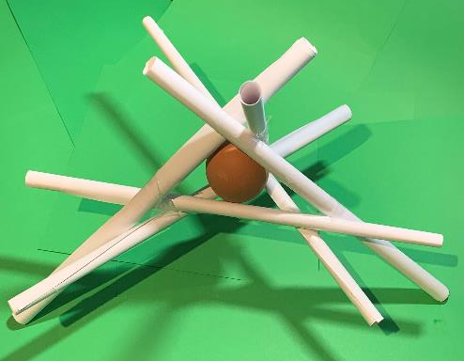
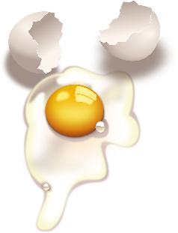
Egg Drop Challenge
?
A challenge to protect an egg from breaking when it is dropped from height

Slide 2
Stay safe
Whether you are a scientist researching a new medicine or an engineer solving climate change, safety always comes first. An adult must always be around and supervising when doing this activity. You are responsible for:
ensuring that any equipment used for this activity is in good working condition
behaving sensibly and following any safety instructions so as not to hurt or injure yourself or others
Please note that in the absence of any negligence or other breach of duty by us, this activity is carried out at your own risk. It is important to take extra care at the stages marked with this symbol: ⚠

Slide 3
The Challenge
Your egg is going to be dropped from a height.
Can you save your egg from certain doom by creating a way to protect it from the hard ground?
Using the available materials, can you design some way of preventing the egg from breaking when dropped from a height of 1 meter?

Slide 4
Gravity
When an egg is dropped the force of gravity pulls it towards the ground.
Hitting the ground can cause the egg to break.
To prevent this, one possible design is to use a paper tube structure. The paper tubes will be damaged but they may stop the egg hitting the ground hard.

Slide 5
Step 1 Making Tubes
Roll paper into a tube using pencils
Stick the outside edge of the paper down with sticky tape and take the pencils out
Make 6 paper rolls
Notes:
The purpose of the pencil (or pencils) is to achieve a uniform size, as differences in diameter will create zones where failure is more likely to occur. wood dowel can be used as an alternative to pencils. If this has a slot to tuck the paper into, that can help to ensure that the roll is tight. The sticky tape works most effectively when running along the length of the tube (rather than around it).

Slide 6
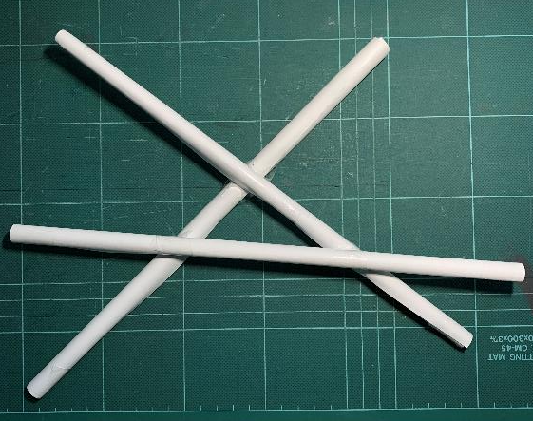
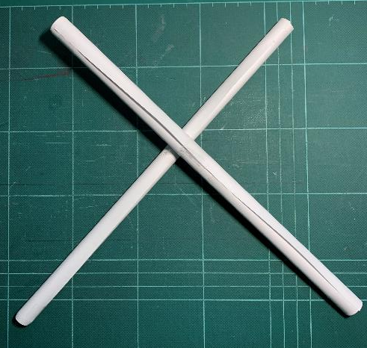
Step 2 Base Frame
Use sticky tape to join 3 paper rolls as shown
Make the triangle in the middle a size so that an egg sits on it without falling out

Slide 7
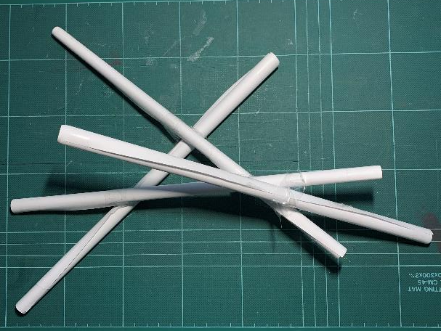
Step 3 Uprights
Use sticky tape to attach the last 3 paper rolls to the points shown
Don’t join the other ends yet, or your egg will not fit in!
= Paper roll position
First one attached

Slide 8
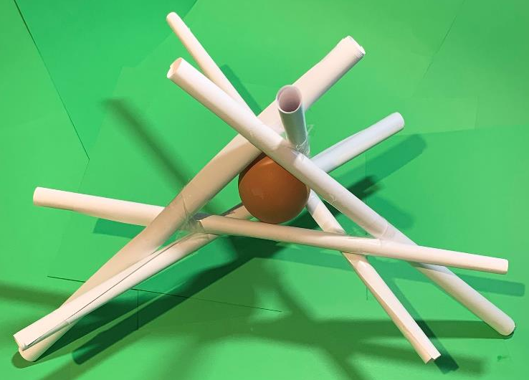
Step 4 Final Assembly
Add your egg to the centre of the completed frame
Use sticky tape to join the three loose upright straws, so the egg is held in place

Slide 9
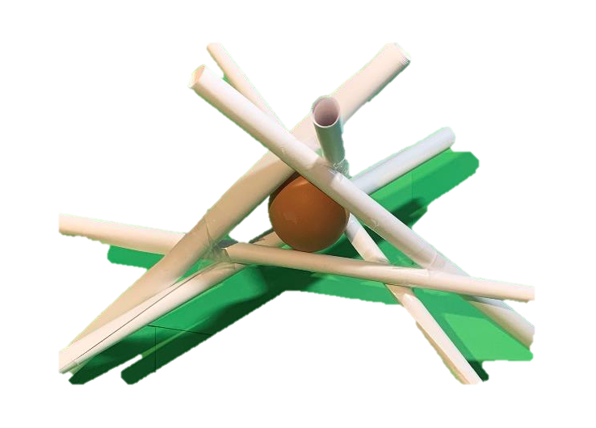
Egg Drop Challenge
Hold your egg protector and drop from a height of 0.5 m
Then try 1 m height
From how high can you drop the egg before it breaks?
?
1 m
0.5 m

Slide 10
Other ideas
How could you change the design to help stop the egg breaking?
What other materials could you use to help the egg survive?
Could you add a parachute made from a shopping bag?

