Slide 1
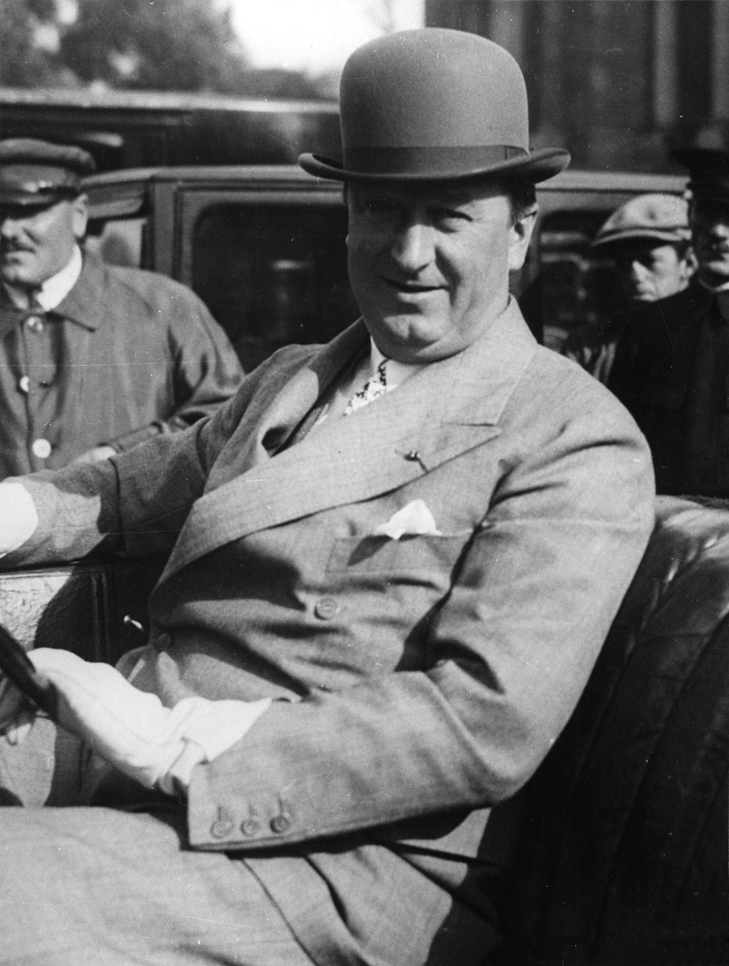
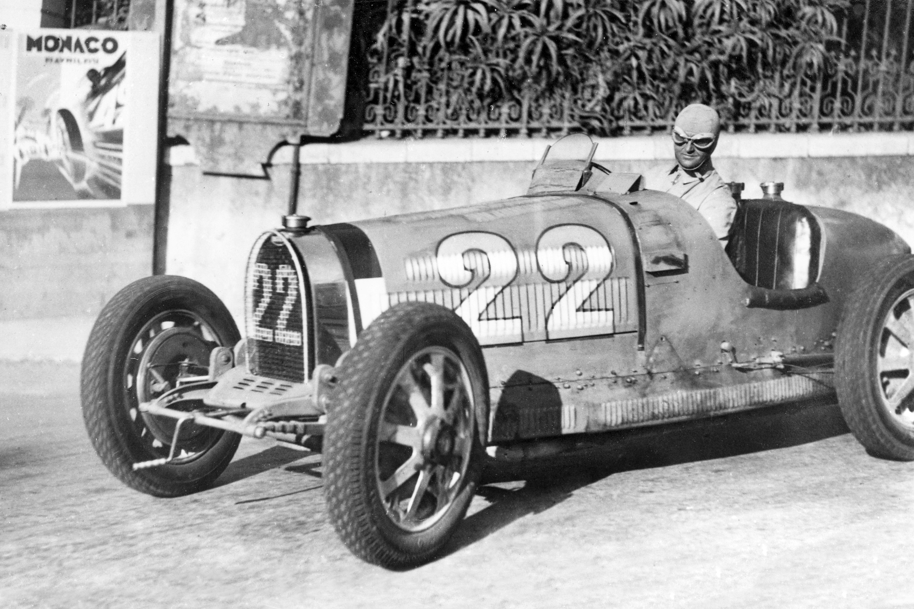
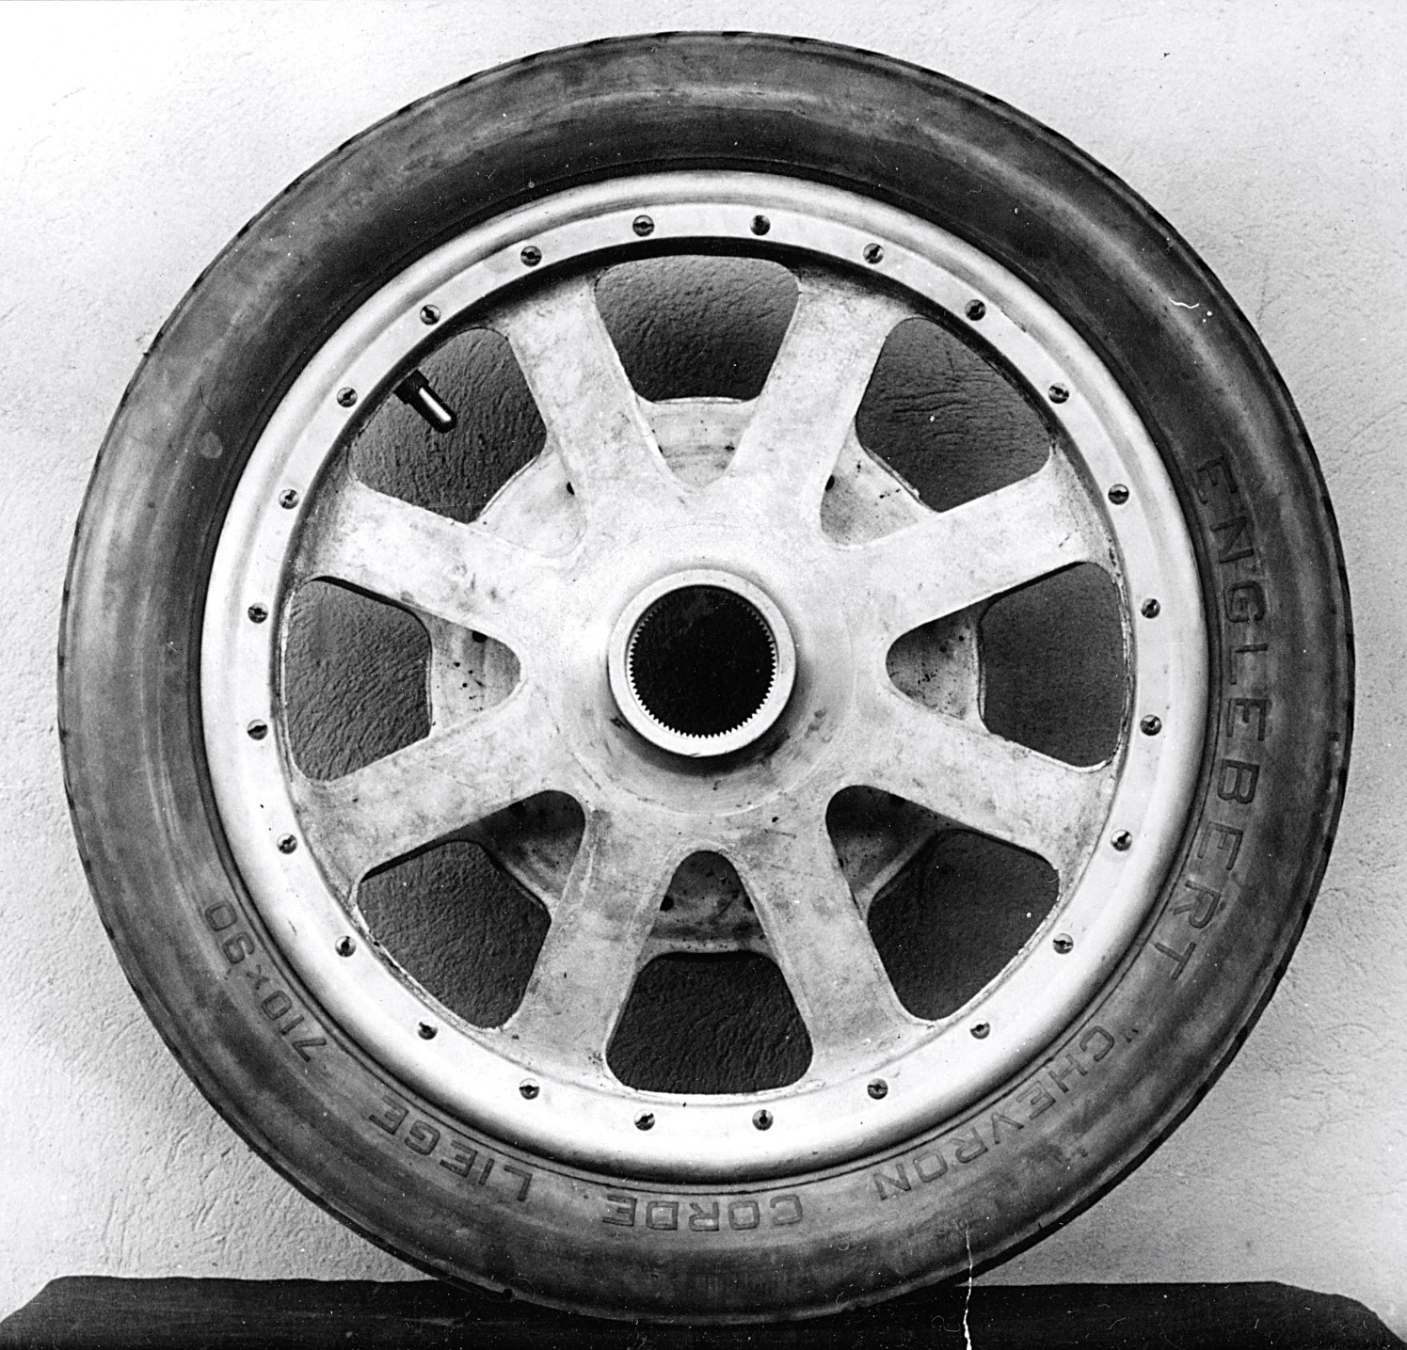
Bugatti Trust – Wheel Materials
An activity to test material suitability for a wheel

Slide 2
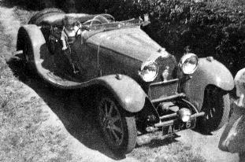
Stay safe
Whether you are a scientist researching a new medicine or an engineer solving climate change, safety always comes first. An adult must always be around and supervising when doing this activity. You are responsible for:
ensuring that any equipment used for this activity is in good working condition
behaving sensibly and following any safety instructions so as not to hurt or injure yourself or others
Please note that in the absence of any negligence or other breach of duty by us, this activity is carried out at your own risk. It is important to take extra care at the stages marked with this symbol: ⚠

Slide 3
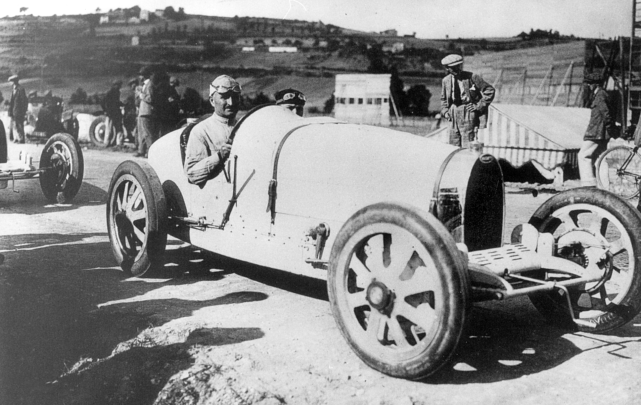
Who was Bugatti?
Ettore Bugatti was the founder and designer of Bugatti sports cars.
First designer to use aluminium wheels to decrease the weight of Grand Prix racing cars.
According to Bugatti, “weight was the enemy”.
The 1924 Bugatti Type 35 is one of the most successful racing cars in the world.

Slide 4
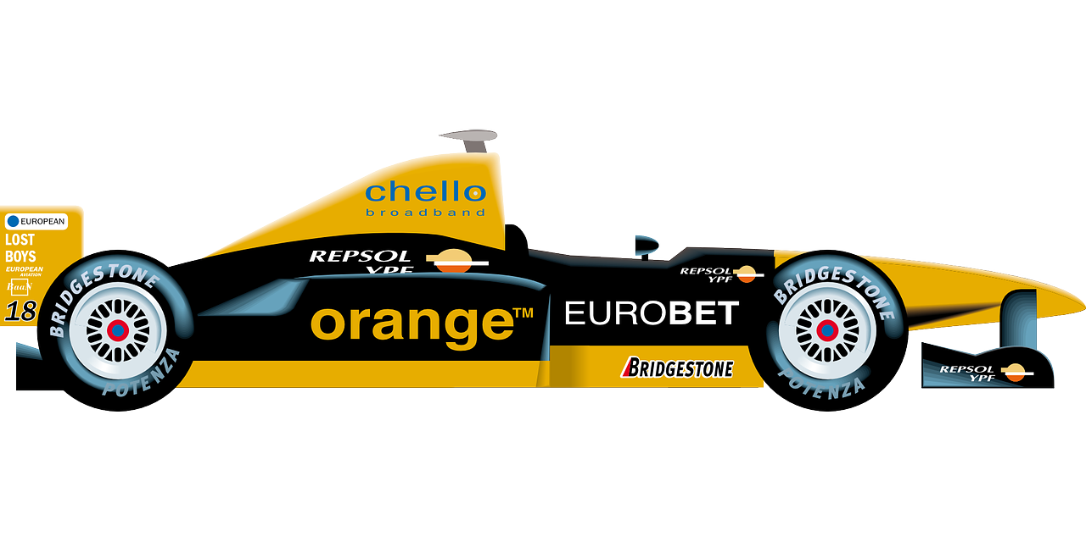
Wheel design – Material testing
Formula 1 engineers test different materials to see how they perform on Grand Prix cars.
Testing involves using a test rig and recording the results.
We will make our own test rig and test different materials to see how many times they rotate when a set force is applied

Slide 5
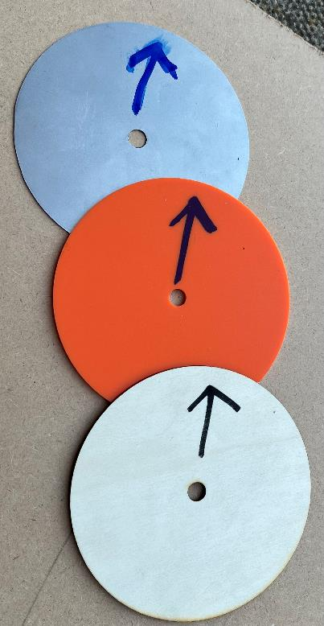
Test pieces ⚠
Wheels on sports cars need to be lightweight, strong and durable.
Lightweight wheels use less energy and therefore use less fuel.
To carry out material testing make three discs of the same size, from metal, plastic and wood.
Discs are 140 mm diameters with a 10 mm centre hole.
Mild steel
Plastic acrylic
Plywood

Slide 6
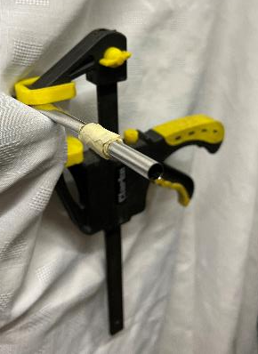
Make a test rig ⚠
Masking tape
Use a metal bar or tube, of suitable size, to allow the material discs to spin freely on them.
Clamp the bar to a fixed object.
Mark each disc with an up arrow.
Add some masking tape to the bar to support the disc.

Slide 7
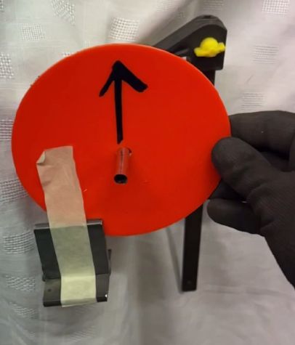
Testing ⚠
Using the test rig:
Hold the disc steady.
Holding the disc, attach a metal weight to the disc using masking tape.
Let go of the disc and let the weight drop safely avoiding toes!
Use a stopwatch to record how long the disc spins.
Count the number of rotations each material disc makes.

Slide 8
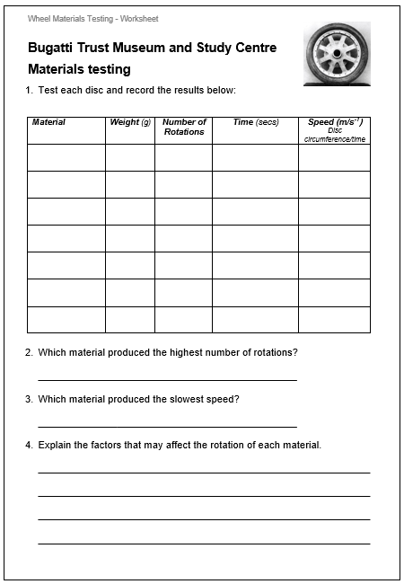
Recording results
Record your results on the worksheet.
Carry out several tests to get an average result.
Calculate the speed using:
speed ($v$) = $\frac{d}{t}$
distance $\left(d\right)$ = disc circumference
= $2πr=2 x π x 70= 440 mm$
Speed ($v$) = $\frac{440}{3.6}=0.122 m/s^{−1}$

Slide 9
Extension
Carry out tests with different weights and materials. What affect does this have on the rotations?
Calculate the force exerted on the discs.

Slide 10
6. Extension - Force
Force = mass (kg) x acceleration (m/s²)
Example: mass = 250 g = 0.25 kg
Material disc tested: Rotated 4 times in 3.6 secs with disc radius of 70 mm
speed ($v$) = $\frac{d}{t}$
distance $\left(d\right)$= Disc circumference = $2πr=2 x π x 70= 440 mm$
Speed ($v$) = $\frac{440}{3.6}=0.122 m/s^{−1}$
Acceleration = $\frac{∆v}{∆t}$ = $\frac{0.122}{3.6}=0.034 m/s^{2}$
Force = $0.25 kg x 0.034 m/s^{2}$ = 0.0085N

