Slide 1
Bugatti Trust Museum and Study Centre Gear Ratios
Making a gear train

Slide 2
Stay safe
Whether you are a scientist researching a new medicine or an engineer solving climate change, safety always comes first. An adult must always be around and supervising when doing this activity. You are responsible for:
ensuring that any equipment used for this activity is in good working condition
behaving sensibly and following any safety instructions so as not to hurt or injure yourself or others
Please note that in the absence of any negligence or other breach of duty by us, this activity is carried out at your own risk. It is important to take extra care at the stages marked with this symbol: ⚠

Slide 3
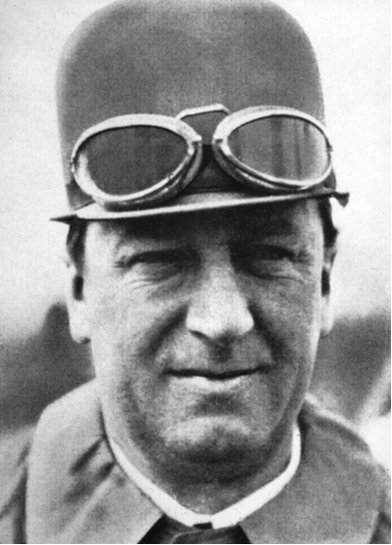
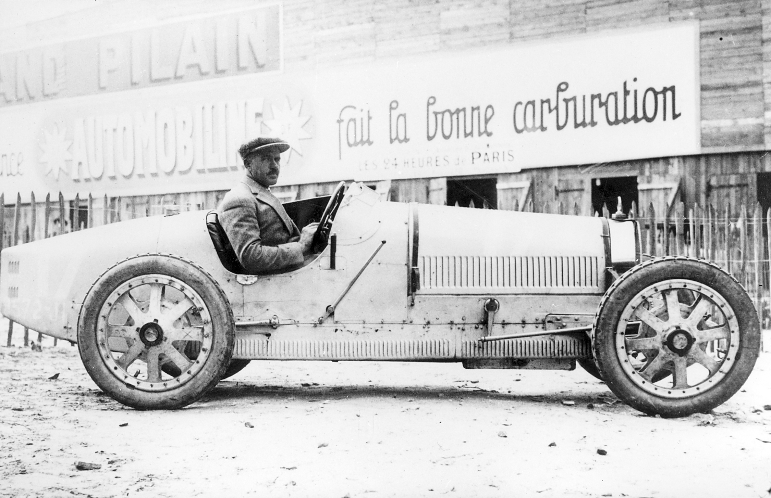
What or who is ‘Bugatti’?
Ettore Bugatti was born in Milan, Italy.
His company was founded in 1909 and manufactured high-performance cars.
The 1924 Bugatti Type 35 was one of the most successful racing cars in the world.
Ettore Bugatti

Slide 4
What are Gears?
A gear is a wheel with teeth.
The teeth mesh together with other gears.
Gears are used to change the speed at which something turns.
A series of gears that turn each other are called a ‘gear train’.

Slide 5
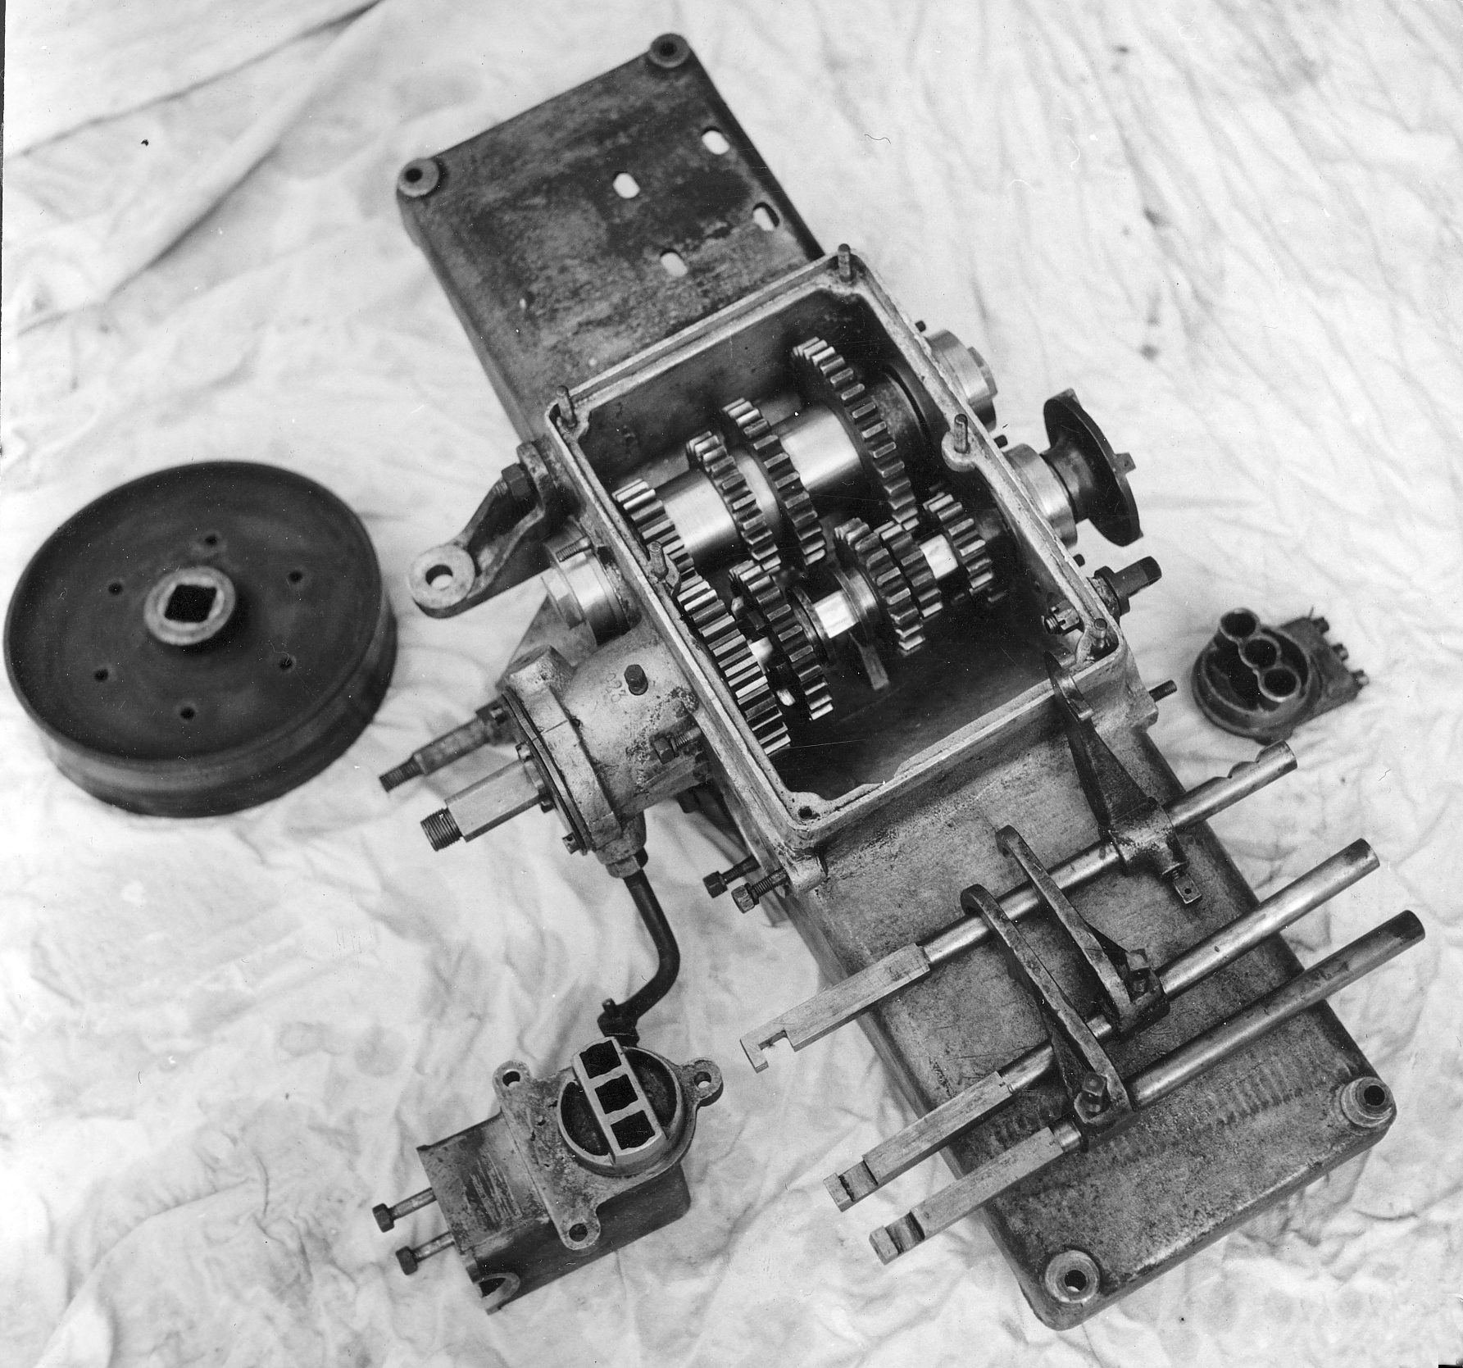
Uses of Gears
Gears are used in cars, bicycles, powered wheel chairs, drills, wind-up toys …
They are commonly made from metal or plastic, depending on the needs of the product.
Early Bugatti gear box

Slide 6
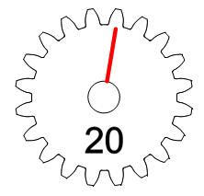
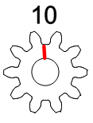
How Gears Work
This type of gear is called a spur gear.
Gear ‘A’ is called the ‘driver’ because this is turned by a motor.
As gear ‘A’ turns it meshes with (and turns) gear ‘B’.
Gear ‘B’ is called the ‘driven’ gear.
Note that gear B will be turning in the opposite direction to gear A.
A
B

Slide 7
Gear Ratio
Gear ‘A’ has 20 teeth and gear ‘B’ has 10 teeth. If gear ‘A’ turns one revolution, how many times will gear ‘B’ turn ?
Which gear revolves the fastest ?
A
B

Slide 8
Calculation
Gear Ratio = Number of teeth on the driven gear
Number of teeth on the driver gear
Gear Ratio = 10
20
= 0.5 or 1:2
Gear Ratio =
Number of teeth on the driven gear
Number of teeth on the driver gear

Slide 9
The Answer - Explained
When gear 'A' completes one revolution gear 'B' turns 2 revolutions.
If a large gear (gear ‘A’) turns a small gear (gear ‘B’) the speed increases.
If a small gear turns a large gear the opposite happens and the speed decreases.
A
B

Slide 10
Now practice…
Work out the following Gear Ratios:
Gear Ratio =
Number of teeth on the driven gear
Number of teeth on the driver gear
Driver | Driven | Ratio
80 | 20 | 1:
100 | 50
60 | 20
30 | 90
Notes:
Answers: 1:4, 1:2, 1:3, 3:1

Slide 11
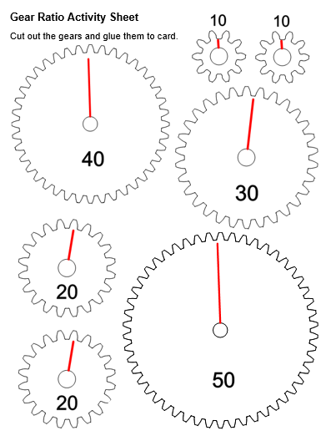
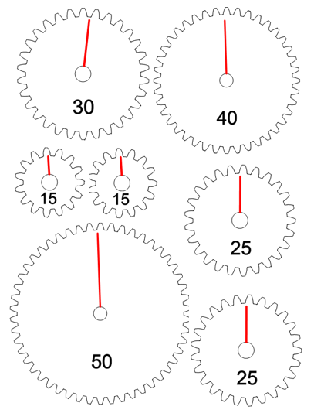
Step 1 Mounting
Glue the Gear Ratio Activity Sheets onto card.

Slide 12
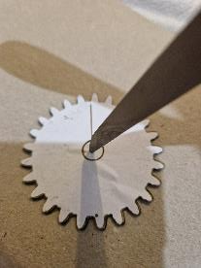
Step 2 Cutting ⚠
Cut around the gear shapes.
Make a hole in the centre of each gear using a sharp pencil and sticky tack.

Slide 13
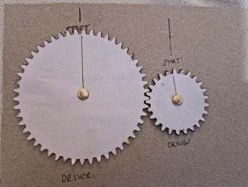
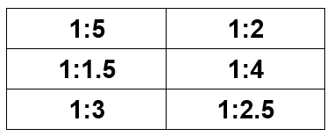
Step 3 Gear Train
Look at the ratios on the worksheet
Create a gear train that can achieve the given ratios
How many different ways can you create each ratio?

Slide 14
Step 4 Modelling ⚠
Using a split pins, fix your selected gears to a piece of cardboard.
The gears must mesh (the teeth must fit together).
Split pin
Close up view of gears meshing
Notes:
Alternatively, thumb tacks and foam board.

Slide 15
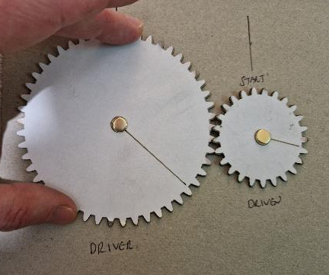
Checking your results
Check your answer by counting the revolutions of the two gears.
Use the lines on the gears to help you count.
This ratio is 1:2

