Slide 1
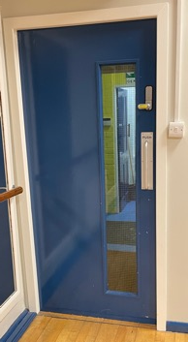
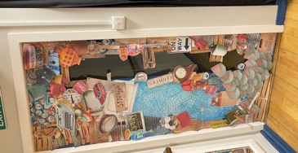
Book themed door display
Decorating a classroom door with a book theme

Slide 2
Stay safe
Whether you are a scientist researching a new medicine or an engineer solving climate change, safety always comes first. An adult must always be around and supervising when doing this activity. You are responsible for:
ensuring that any equipment used for this activity is in good working condition
behaving sensibly and following any safety instructions so as not to hurt or injure yourself or others
Please note that in the absence of any negligence or other breach of duty by us, this activity is carried out at your own risk. It is important to take extra care at the stages marked with this symbol: ⚠

Slide 3
Objective
We are going to turn our classroom door into a book cover for World Book Day!
Which book do you think we should use?
Why do you like that book?
What do you need to think about when designing the decoration for the door?
Notes:
Discuss the context/situation with learners. Have learners heard of World Book Day?

Slide 4
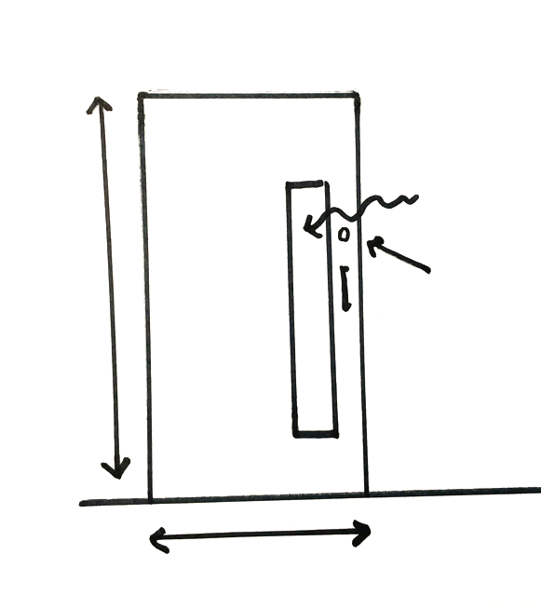
Research
How big is the door?
What features does the door have: a window? A handle?
Does the features have to be left uncovered?
How can you attach the design to the door?
Window
Handle
Notes:
When considering how the design will be attached to the door, if it is a fire door ensure that the material of the door is not pierced or penetrated (for example by using tacks or staples) as these would invalidate the protection offered by the door.

Slide 5
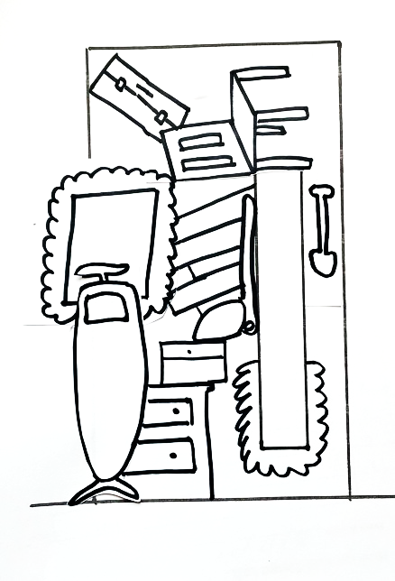
Generate Ideas
What book do you want to use?
What key features do you remember about the story? What does this book make you think of?
What would you put on the cover of this book to make someone want to read the book?
Are you going to draw the artwork? Or use printed images? Or something else?
Sketch your design idea.
Add labels to explain the features.
Notes:
When considering the design, ensure that no essential features of the door are obstructed.

Slide 6
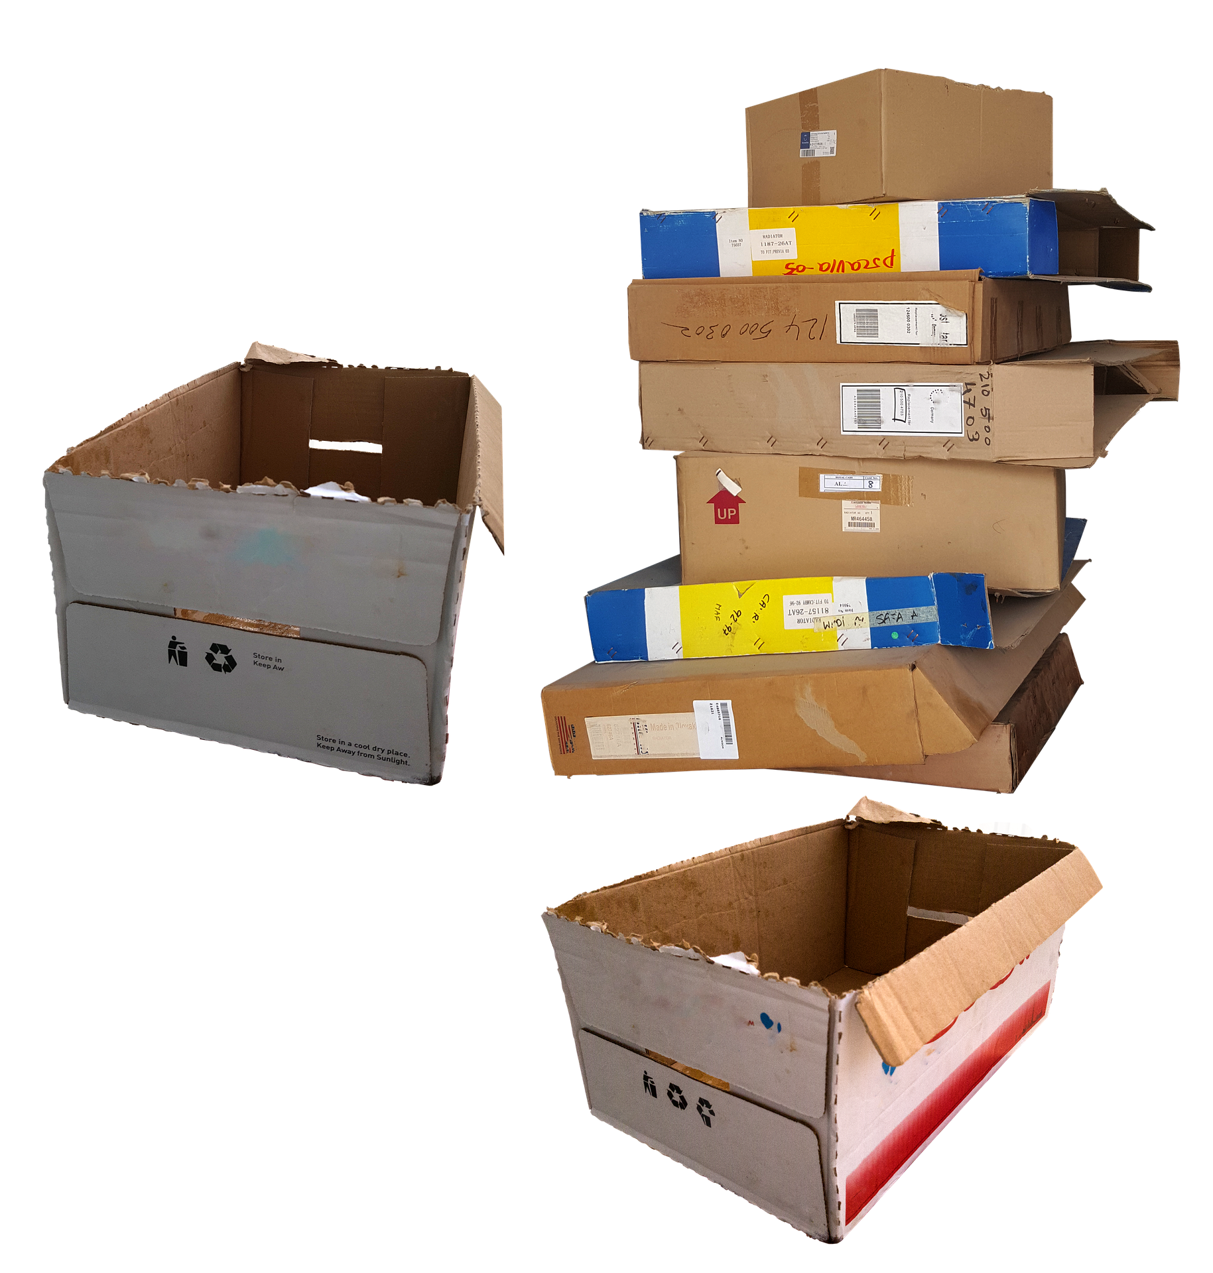
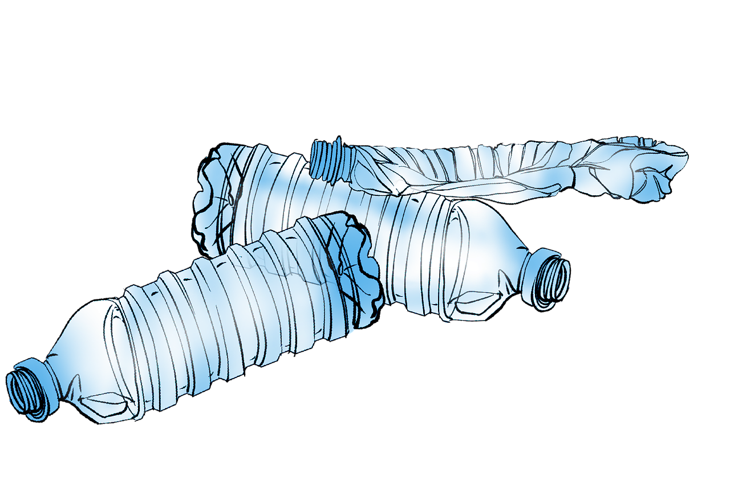
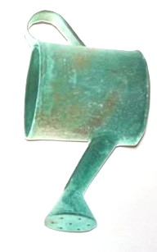
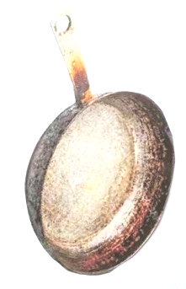
Example of a Design Idea
Consider the book ‘Stig of the Dump’ (by Clive King)
Stig built his den using rubbish from the dump
Our design idea could be to make the door look like it is built from rubbish!

Slide 7
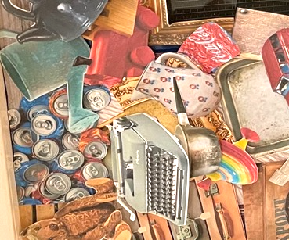
Example of Implementation
This design used images found on the internet and some artwork
It was attached to the door using sticky tack
Close up of some features

Slide 8
Extensions
How could your design be improved?
Can you design covers or door designs for other books?
Are there books that have a door as a major part of their story?

