Slide 1
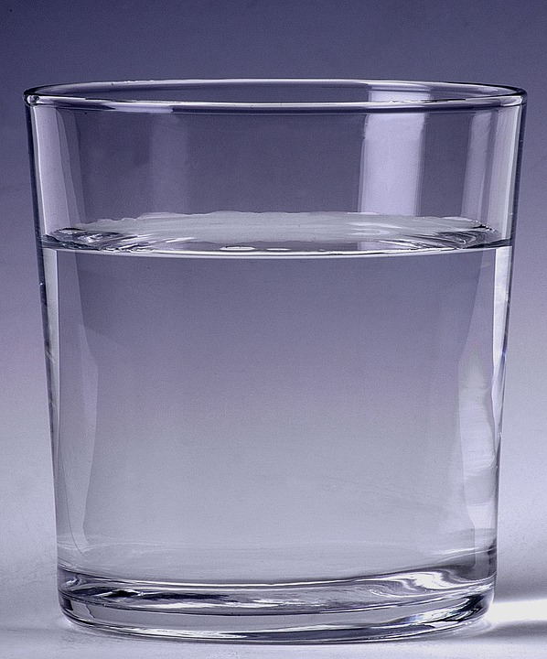
Gravity free water
Using the effects of air pressure to defy gravity

Slide 2
Step 1
Fill your glass all the way to the top with water.
Empty glass
Half full glass
Full glass
Notes:
If there is not easy access to a sink then this step could be done in advance with glasses pre-filled with water. The drinking glasses used must have a top that can be completely covered by a piece of card without letting any air in. Alternatively, an open water bottle could also be used.

Slide 3
Step 2
Put your piece of card over the top of the glass, making sure it is fully covered.
Piece of card
Full glass of water
Make sure that there are no air bubbles in the glass or the experiment may not work!
Notes:
Get learners to check there are no air bubbles in the glass as this could lead to the experiment failing and water going everywhere! Teacher may wish to check this to make sure before learners complete step 3. The card used should be cut into small pieces that are large enough to completely cover the whole of the top of the glass.

Slide 4
Step 3
Turn the glass upside down whilst holding the piece of card in place. Then take your hand away from the card.
Turn glass upside down
Take hand away from piece of card
Notes:
This part can be tricky so may need a bit of practice to get completely right. Learners should do this over a sink in case the experiment fails and there are spillages. This may need to be done in pairs where one learner turns the glass upside down whilst the other holds and then removes their hand from the piece of card.

Slide 5
Results of the experiment
The piece of card should stick to the glass and the water should stay inside it.
Why do you think this happens?
Notes:
Learners could write down their findings or teacher could lead a class discussion. Explain that there is no air inside the glass and so the air pressure is higher outside it than inside it. Therefore the card and water stays where it is, making it look like there is no gravity!

