Slide 1
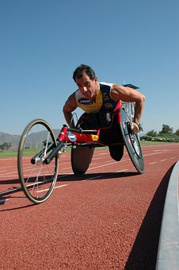
Designing a Sports Wheelchair
Designing a sports wheelchair for a marathon race

Slide 2
Stay safe
Whether you are a scientist researching a new medicine or an engineer solving climate change, safety always comes first. An adult must always be around and supervising when doing this activity. You are responsible for:
ensuring that any equipment used for this activity is in good working condition
behaving sensibly and following any safety instructions so as not to hurt or injure yourself or others
Please note that in the absence of any negligence or other breach of duty by us, this activity is carried out at your own risk. It is important to take extra care at the stages marked with this symbol: ⚠

Slide 3
The Marathon
Following a battle in Ancient Greece, a soldier called Pheidippides ran with a message of victory from Athens to Marathon - the race commemorates his fabled run.
A marathon has an official distance of 42.195 kilometres (26 miles and 385 yards).
The race usually takes place on the road.
Throughout the world, more than 500 marathons take place each year.
Large marathons can attract thousands of runners.
There are special categories for wheelchair racers.

Slide 4
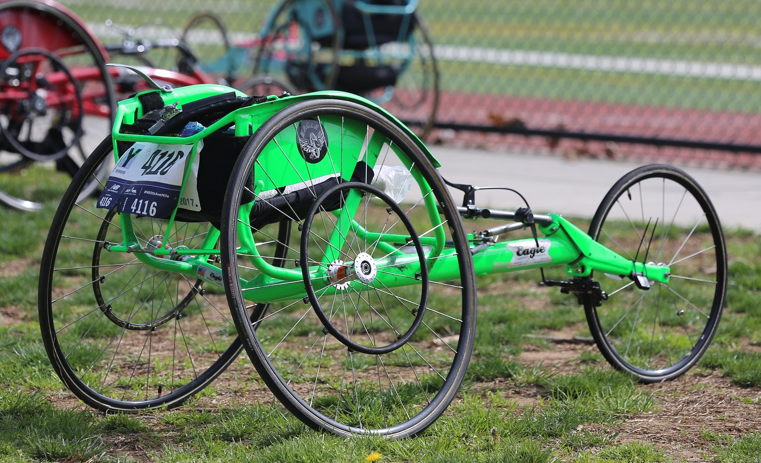
Racing Wheelchairs
Racing chairs are not like regular wheelchairs.
They have two large wheels in the back, and one smaller wheel in the front.
You may be able to go fast in an everyday wheelchair, but you will never get up to the same speeds as a sports wheelchair.

Slide 5
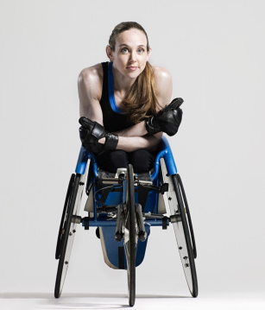
Case study - Tatyana McFadden
Born in the Soviet Union, in 1989, McFadden was born with spina bifida and paralyzed from the waist down.
Abandoned in an orphanage that was too poor to afford a wheelchair.
She walked on her hands for the first six years of her life.
Eventually, she was adopted and moved to the United States

Slide 6
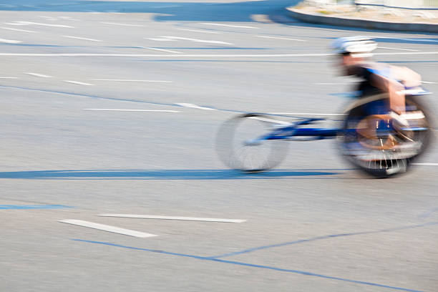
Case study continued
A few interesting features set McFadden’s racer apart.
A carbon fiber frame provides greater stiffness and efficiency than traditional aluminum frames.
Tweaks to the chassis improve aerodynamics.
Everything, from the cockpit to the steering arm to the gloves she wore, was designed specifically for her body and how she sits in the wheelchair.

Slide 7
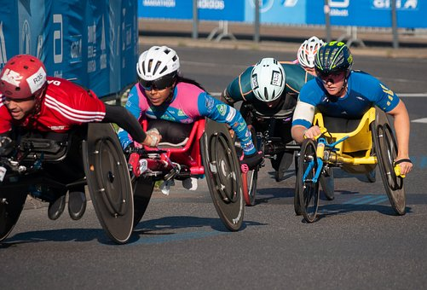
Now do this…
You are going to search the internet for information about the success of British athletes in wheelchair racing at the Olympics.
At each step, make sure that you write down the answer to the question(s) asked before moving on.

Slide 8

Then try this…
Open Google
Search for information using the terms:
wheelchair + racing
  This will find all websites that include both the words ‘wheelchair' and ‘racing'.
  a. How many websites does the search engine find?
  b. View the list of websites. Do the first three websites listed appear useful?

Slide 9
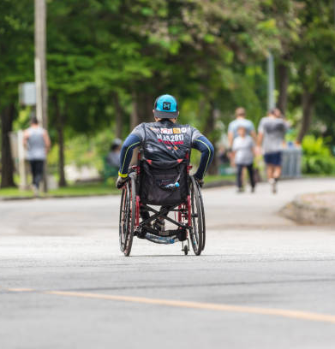
Internet searching 2
Now search for information using the term:
wheelchair + racing + Britain + Olympics
  This will find websites that include all of these terms.
  a. How many sites does your search engine find?
  b. Once again, view the list of websites. Do the first three sites from this search appear useful?

Slide 10

Internet searching 3
Now search for information using the term:
“wheelchair racing” + Britain + Olympics’
  … including the double quotation marks. This will find websites that include 'Britain', 'Olympics' and the specific phrase ‘wheelchair racing'.
  a. How many websites does your search engine find?
  b. Do the first three sites listed appear useful?

Slide 11
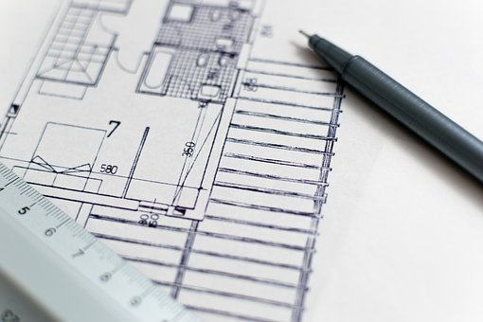
Use your research….
Now using the inspiration you have found start to design your ultimate racing wheelchair
There are a few things you need to consider on the following slides

Slide 12

Rules
All racing wheelchairs must have:
two rear wheels and one front wheel
a braking system
hand-operated steering
no mechanical devices that make the wheelchair more aerodynamic

Slide 13

You will need to consider…
The reach of the rider
Aerodynamics is the study of the motion of air when affected by a solid object - such as an airplane wing, a car body or the frame of a wheelchair
Aerodynamics
Steering the chair
Weight - limiting
Aesthetics
Camber

Slide 14
Camber
Camber redirects forces going through the wheelchair from the environment – this makes the ride less bumpy.
Cambered wheels also provide a sportier look to the wheelchair
Without wheel Camber
With wheel Camber

Slide 15
Designing – 4 initial ideas

Slide 16

Final Design – the best you can draw…
Add annotation to show your thoughts
What safety features does it have?
How big are the parts?
What material is it made from?
What have you done to make it look good?

