Slide 1
London Marathon Landmarks
Making a map of the route with information about the famous landmarks

Slide 2
Stay safe
Whether you are a scientist researching a new medicine or an engineer solving climate change, safety always comes first. An adult must always be around and supervising when doing this activity. You are responsible for:
ensuring that any equipment used for this activity is in good working condition
behaving sensibly and following any safety instructions so as not to hurt or injure yourself or others
Please note that in the absence of any negligence or other breach of duty by us, this activity is carried out at your own risk. It is important to take extra care at the stages marked with this symbol: ⚠

Slide 3
The Marathon
Following a battle in Ancient Greece, a soldier called Pheidippides ran with a message of victory from Athens to Marathon - the race commemorates his fabled run.
A marathon has an official distance of 42.195 kilometres (26 miles and 385 yards).
The race usually takes place on the road.
Throughout the world, more than 500 marathons take place each year.
Large marathons can attract thousands of runners.

Slide 4
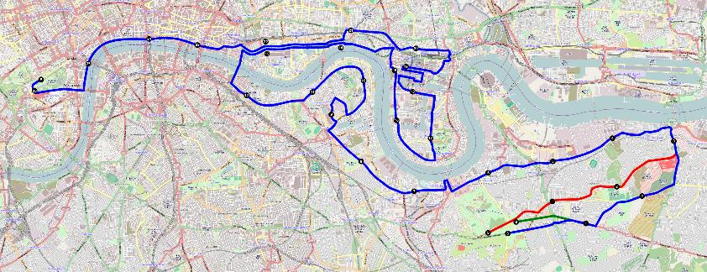
London Marathon – The Route

Slide 5
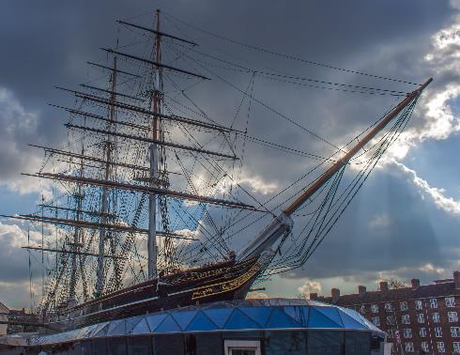
London Marathon - Landmarks
The Cutty Sark
Mile 6

Slide 6
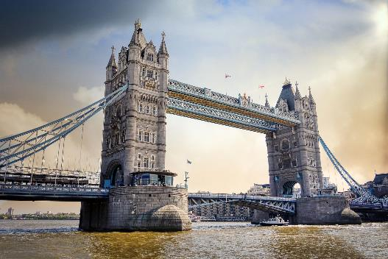
London Marathon - Landmarks
Tower Bridge
Mile 12

Slide 7
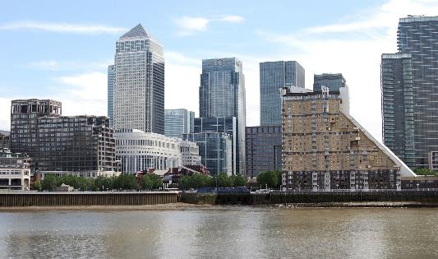
London Marathon - Landmarks
Canary Wharf
Mile 18

Slide 8
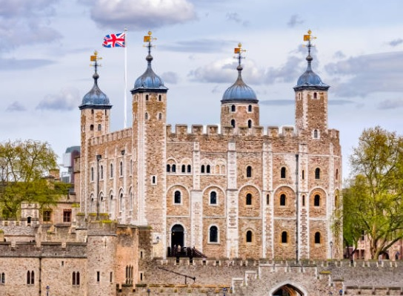
London Marathon - Landmarks
The Tower of London
Mile 22

Slide 9
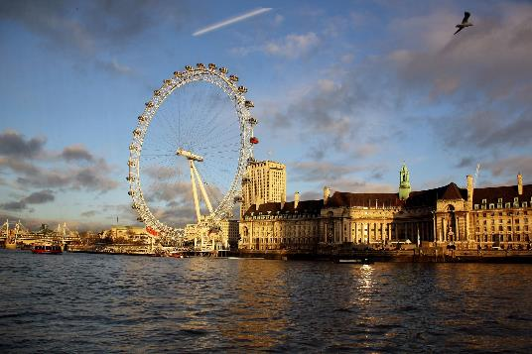
London Marathon - Landmarks
The London Eye
Mile 25

Slide 10
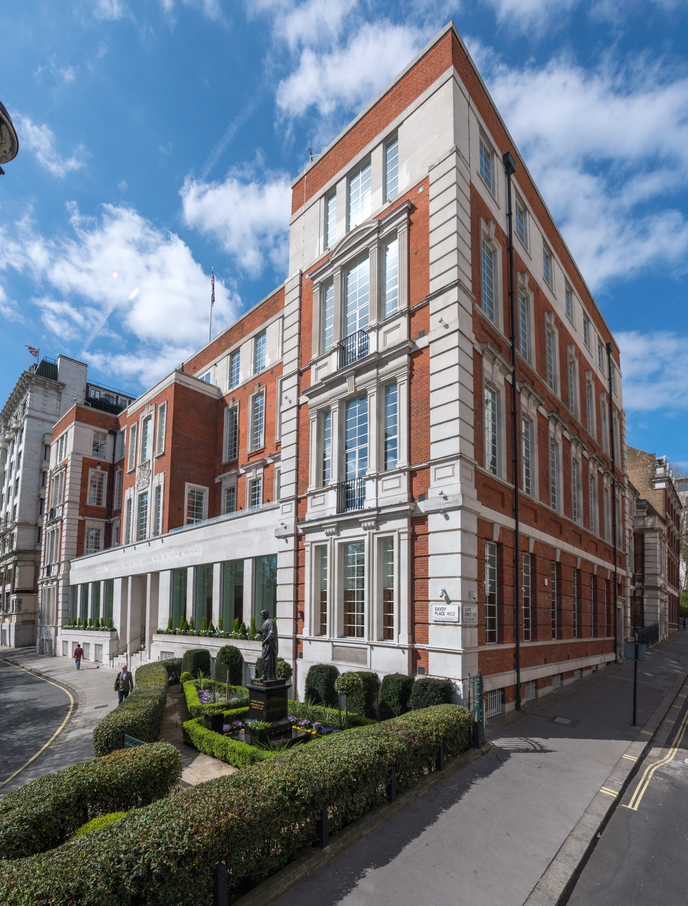
London Marathon - Landmarks
IET, Savoy Place
Mile 25

Slide 11
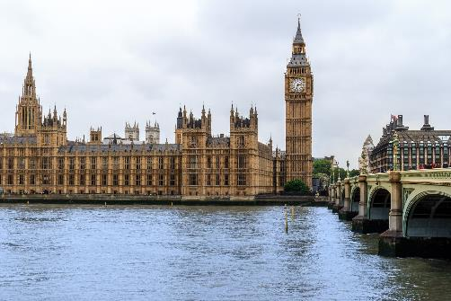
London Marathon - Landmarks
Big Ben
Mile 25

Slide 12
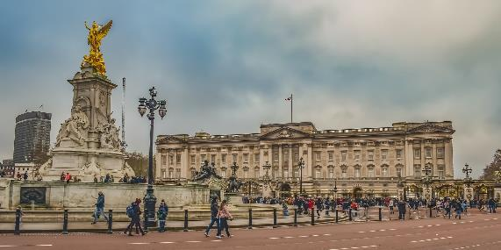
London Marathon - Landmarks
Buckingham Palace
Mile 26

Slide 13
1. Make a London Marathon Landmark Map
Safely cut out the map sheets, images and arrows with scissors.
⚠

Slide 14
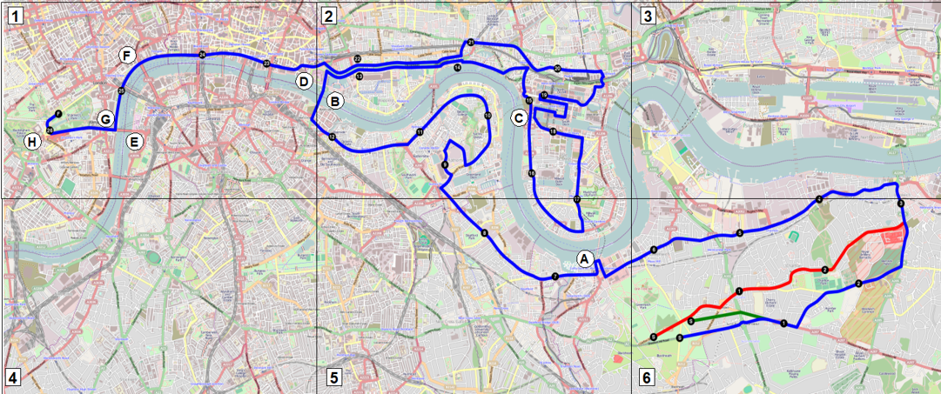
2. Make a London Marathon Landmark Map
Match up the numbered sections to create the route map
Use sticky tape to join them together
⚠

Slide 15
3. Make a London Marathon Landmark Map
Find the following landmarks on the map:
A - Mile 6: Cutty Sark.
B - Mile 12: Tower Bridge.
C - Mile 18: Canary Wharf.
D - Mile 22: The Tower of London.
E - Mile 25: The London Eye.
F - Mile 25: IET, Savoy Place.
G - Mile 25: Big Ben.
H - Mile 26: Buckingham Palace.

Slide 16
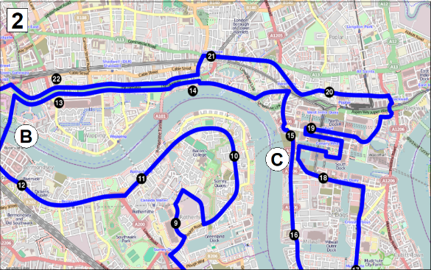
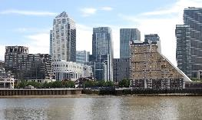
4. Make a London Marathon Landmark Map
Attach a green arrow to each location and attach the correct image, for example:
Mile 18: Canary Wharf

Slide 17
Extension
Find more information about each landmark and add it to the map below the image.

