Slide 1
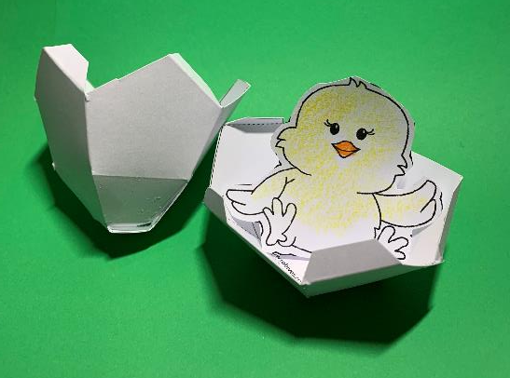
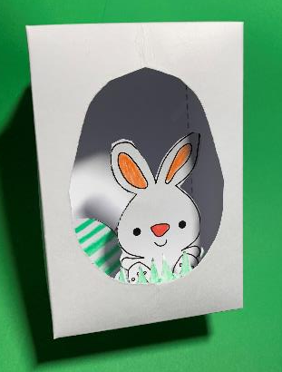
Easter diorama box project
A graphics project that makes an Easter box diorama

Slide 2
Stay safe
Whether you are a scientist researching a new medicine or an engineer solving climate change, safety always comes first. An adult must always be around and supervising when doing this activity. You are responsible for:
• ensuring that any equipment used for this activity is in good working condition
• behaving sensibly and following any safety instructions so as not to hurt or injure yourself or others
Please note that in the absence of any negligence or other breach of duty by us, this activity is carried out at your own risk. It is important to take extra care at the stages marked with this symbol: ⚠

Slide 3
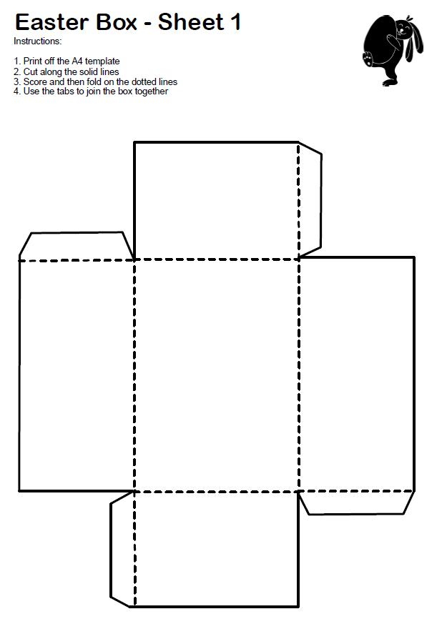
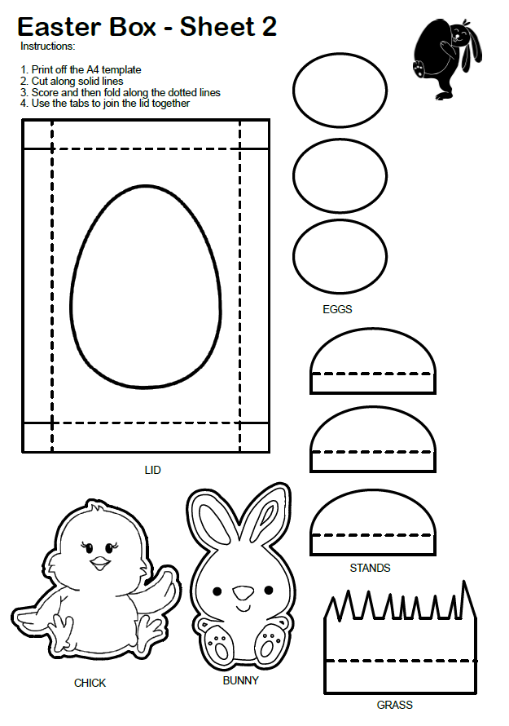
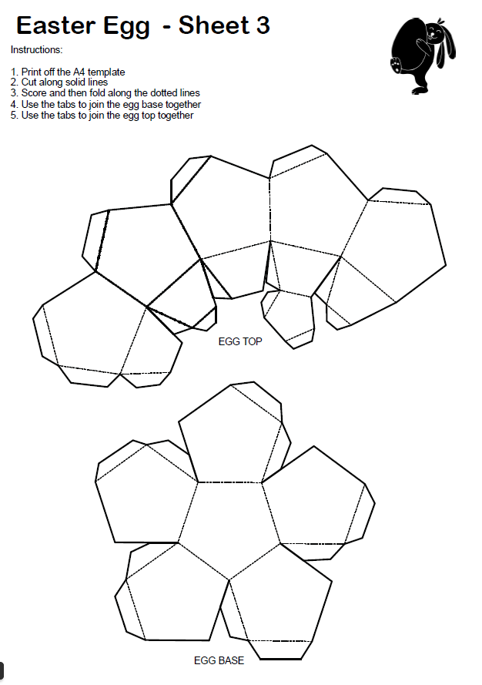
Templates

Slide 4
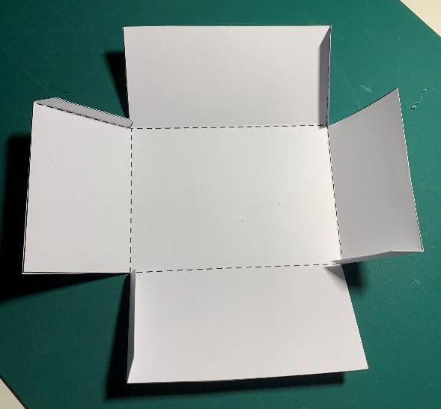
Step 1 – Template sheet 1 -
Easter Box
⚠ Cut out the solid lines
Score and fold the dotted lines
⚠ Glue the tabs and make the box

Slide 5
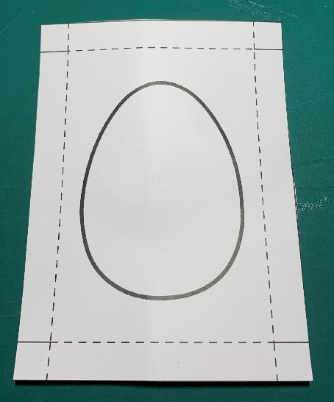
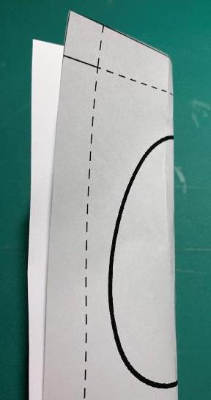
Step 2 – Template sheet 2 -
Easter Box Lid
⚠ Cut out the lid
Fold in half
⚠ Cut out the egg shape to create a viewing hole

Slide 6
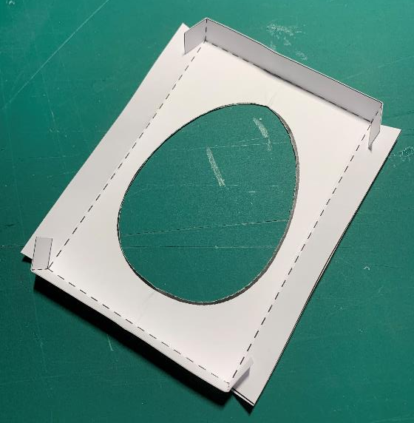
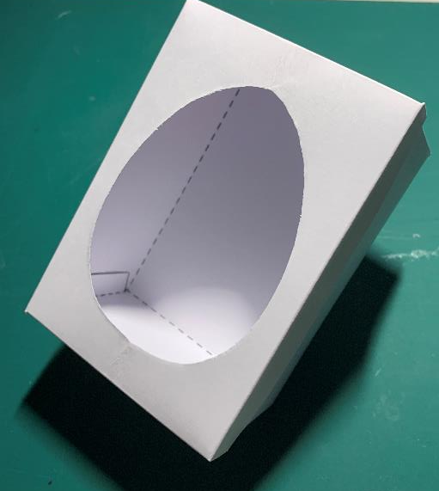
Step 3 – Template sheet 2 -
Easter Box Lid
⚠ Cut the tabs on the solid lines
⚠ Score and fold the dotted lines
⚠ Glue the tabs to make the lid
Check the lid fits on the box

Slide 7
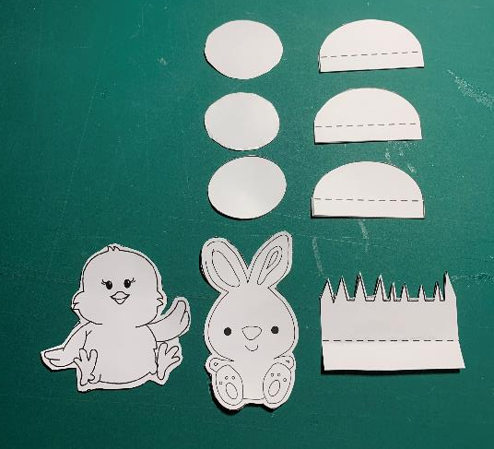
Step 4 – Template sheet 2 -
Easter Box Parts
⚠ Cut out the solid lines
⚠ Score and fold the dotted lines
⚠ Glue the eggs, bunny and chick to the stands
Add colour to the parts.

Slide 8
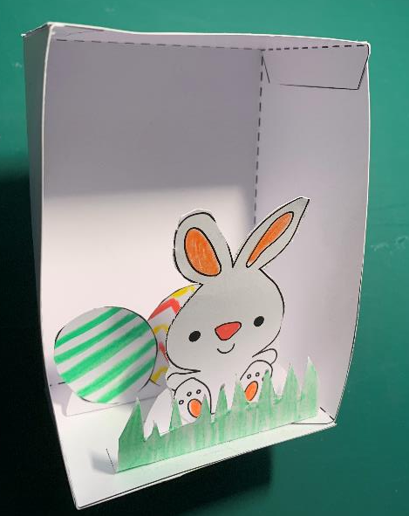
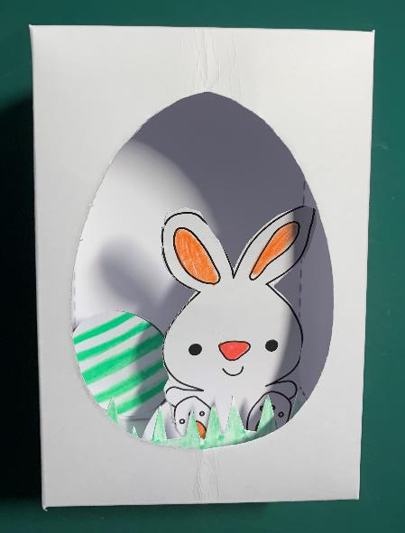
Step 5 – Create the Scene
⚠ Glue the parts into place to create a diorama
Add the lid to complete the Easter box

Slide 9
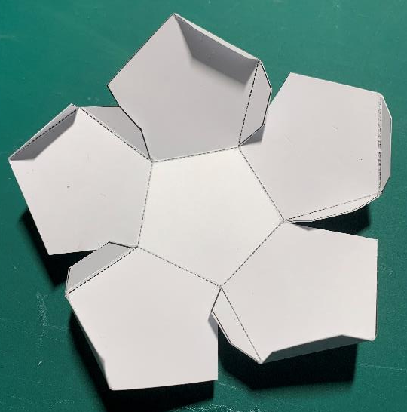
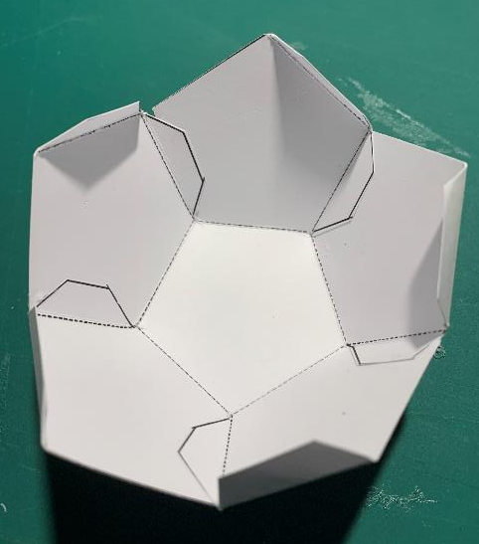
Step 6 – Template sheet 3 -
Egg Base
⚠ Cut out the solid lines
⚠ Score and fold the dotted lines
⚠ Glue the inner tabs and make the egg base

Slide 10
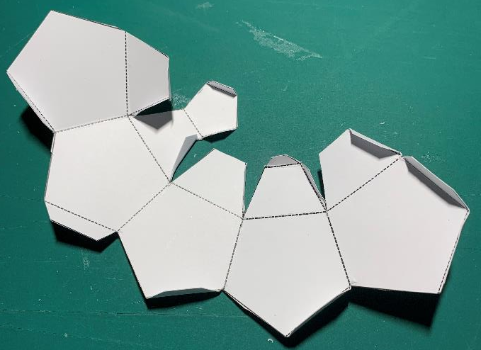
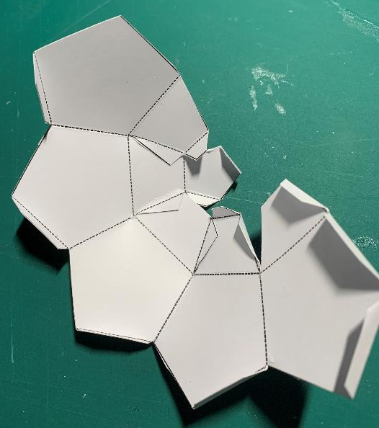
Step 7 – Template sheet 3 -
Egg Top
⚠ Cut out the solid lines
⚠ Score and fold the dotted lines
⚠ Glue the smaller tabs at the top and join together

Slide 11
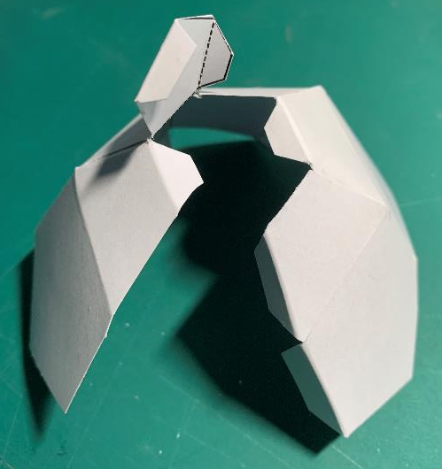
Step 8 – Template sheet 3 -
Egg Top
2
1
⚠ Glue the side tabs and join the egg top together.
⚠ Glue the tabs on the top cover and close
Assembled egg top

Slide 12
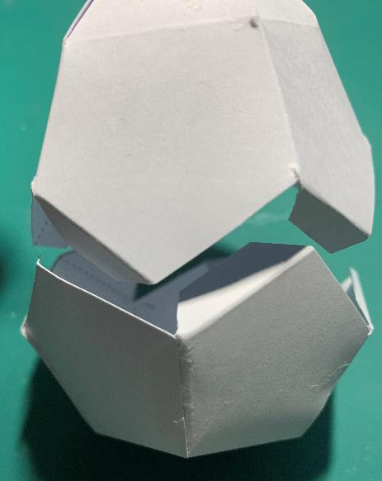
Step 9 – Template sheet 3 -
Egg Assembly
The egg parts may be kept separate or the top placed on the base
How the tabs join together

Slide 13
Step 10 – Create the Scene
Egg may be placed in the box open or closed

