Slide 1
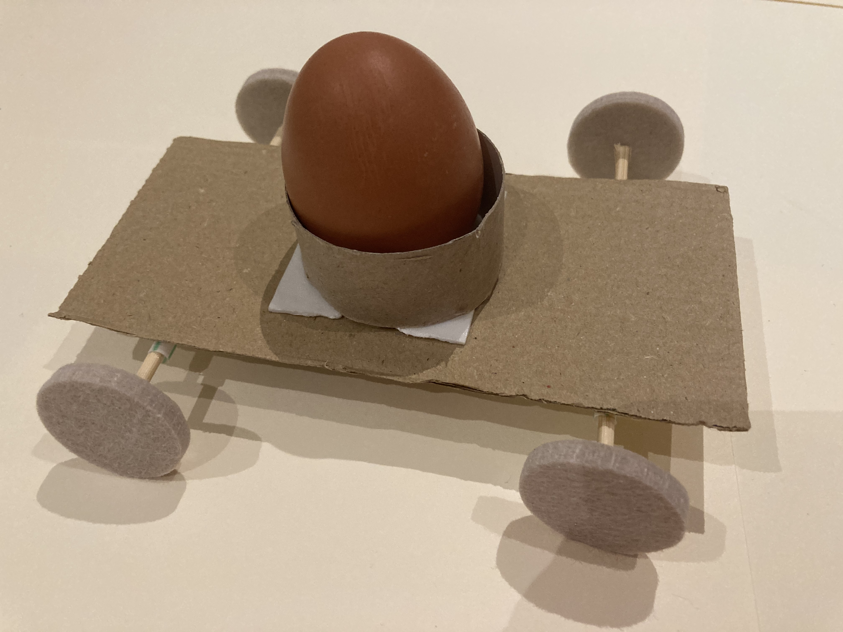
Making a vehicle for an egg race
Designing and making a vehicle to transport an egg in a race

Slide 2
Stay safe
Whether you are a scientist researching a new medicine or an engineer solving climate change, safety always comes first. An adult must always be around and supervising when doing this activity. You are responsible for:
• ensuring that any equipment used for this activity is in good working condition
• behaving sensibly and following any safety instructions so as not to hurt or injure yourself or others
Please note that in the absence of any negligence or other breach of duty by us, this activity is carried out at your own risk. It is important to take extra care at the stages marked with this symbol: ⚠

Slide 3
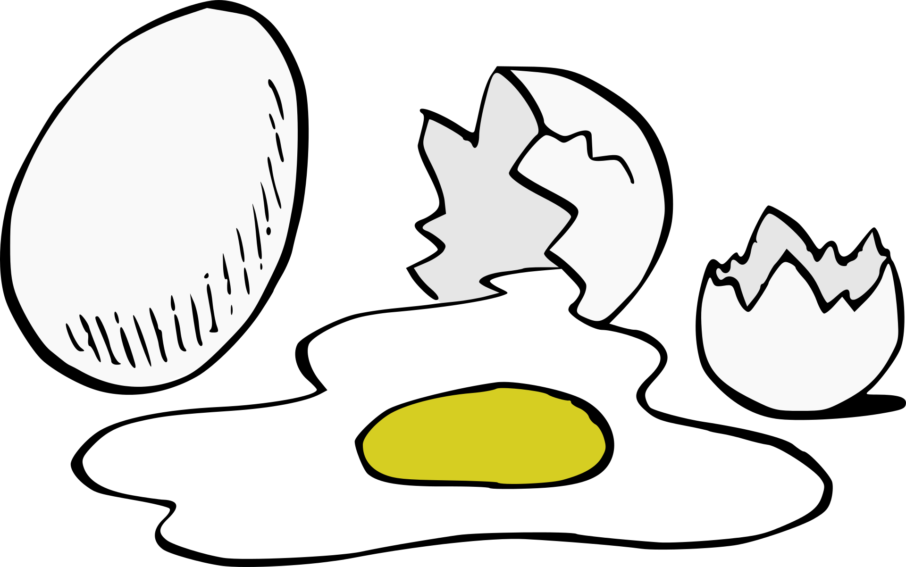
Design Brief
Design and make a race car that can safely carry an egg down a slope
Your racer will compete against others to see which is the fastest
The egg must not break!
Notes:
These materials/resources can be adjusted depending on what is practical and available. For example, the wheels could be made from card or pieces of wood instead of plastic bottle tops.

Slide 4
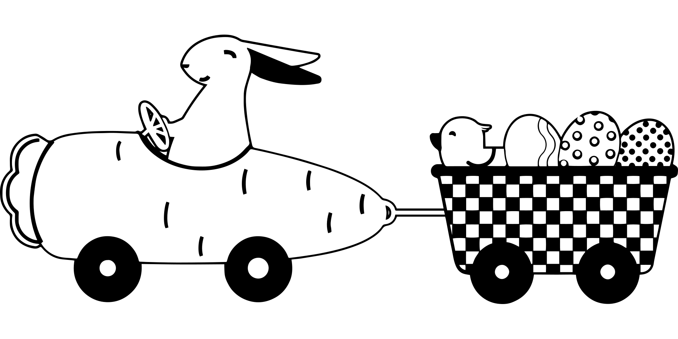
Resources
The racer must be made from the following materials and resources:
Card
Straws
Wooden dowels
Wheels (or plastic bottle tops)
Card tubes
Masking tape
Glue and glue gun
Notes:
These materials/resources can be adjusted depending on what is practical and available. For example, the wheels could be made from card or pieces of wood instead of plastic bottle tops.

Slide 5
Example Racer
The following steps show an example of how an egg racer could be made

Slide 6
Step 1 – Making the base
Piece of card
⚠ Cut a piece of card 150 mm (length) x 70 mm (width)
Length
150 mm
Width
70 mm
Notes:
This step could be completed in advance for learners or a template could be given so that they cut to the right measurements.

Slide 7
Step 2a – Making the wheel axles
⚠ Cut two straws to a length of 70 mm each
Use masking tape to stick the straws to each end of the card base
Straws
Width
70 mm
Notes:
The straws could be cut to the appropriate 70 mm length in advance.

Slide 8
Step 2b – Making the wheel axles
Insert your dowel into the straws
Leave an equal amount of space on each side for the wheels to fit
Dowel
Notes:
Dowels should be pre-cut to 100 mm in advance. Dowels must be small enough that they can fit easily through the straws and rotate freely. Wooden skewers with the sharp edge cut off could also be used.

Slide 9
Step 3 – Adding the wheels
Put glue in the middle of the inside of each bottle top
Use this to join each bottle top to each dowel
These are your wheels!
Wheels
Notes:
A hot glue gun could be used for this stage. Glue should be placed on the inside of the bottle tops. Alternatively, card wheels could be made and glued or taped in place. It is important that the join between the wheels and the dowel is in the middle of the wheel so that they rotate correctly.

Slide 10
Step 4 – Making the egg holder
Turn your car upside down.
⚠ Cut a toilet roll holder to a third of its usual size
⚠ Glue or tape this to the main body of the car
Toilet roll holder

Slide 11
Extension
Think about how you could add a source of thrust to your racer
For example, you could use an elastic band, a balloon or even an electric motor!

Slide 12
Egg Racer Design
Use this space to sketch your idea for your racer!
Notes about design:
Notes:
Learners can use this sheet to present their ideas, annotations and supporting notes.

