Slide 1
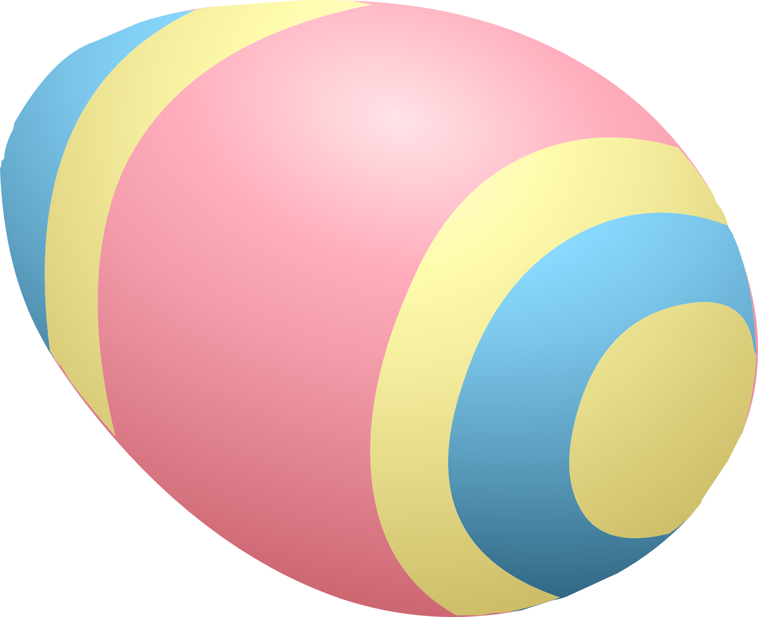
Test out Galileo's gravity experiment
Investigating velocity and acceleration down a slope

Slide 2
Stay safe
Whether you are a scientist researching a new medicine or an engineer solving climate change, safety always comes first. An adult must always be around and supervising when doing this activity. You are responsible for:
• ensuring that any equipment used for this activity is in good working condition
• behaving sensibly and following any safety instructions so as not to hurt or injure yourself or others
Please note that in the absence of any negligence or other breach of duty by us, this activity is carried out at your own risk. It is important to take extra care at the stages marked with this symbol: ⚠

Slide 3
Resources
You will need:
A length of channel or guttering
A tape measure
A protractor
A stop watch
The results table
A pen or pencil
An egg (plastic or boiled or solid)

Slide 4
The Set Up
Measure the distance between the ends of the slope, shown by the two arrows

Slide 5
Task Instructions
Measure the angle of the slope using a protractor
Place the egg at the top of the slope
Release the egg and measure the time it takes to roll down the slope
Repeat two more times, to get an average speed
Change the angle and repeat the activity!

Slide 6
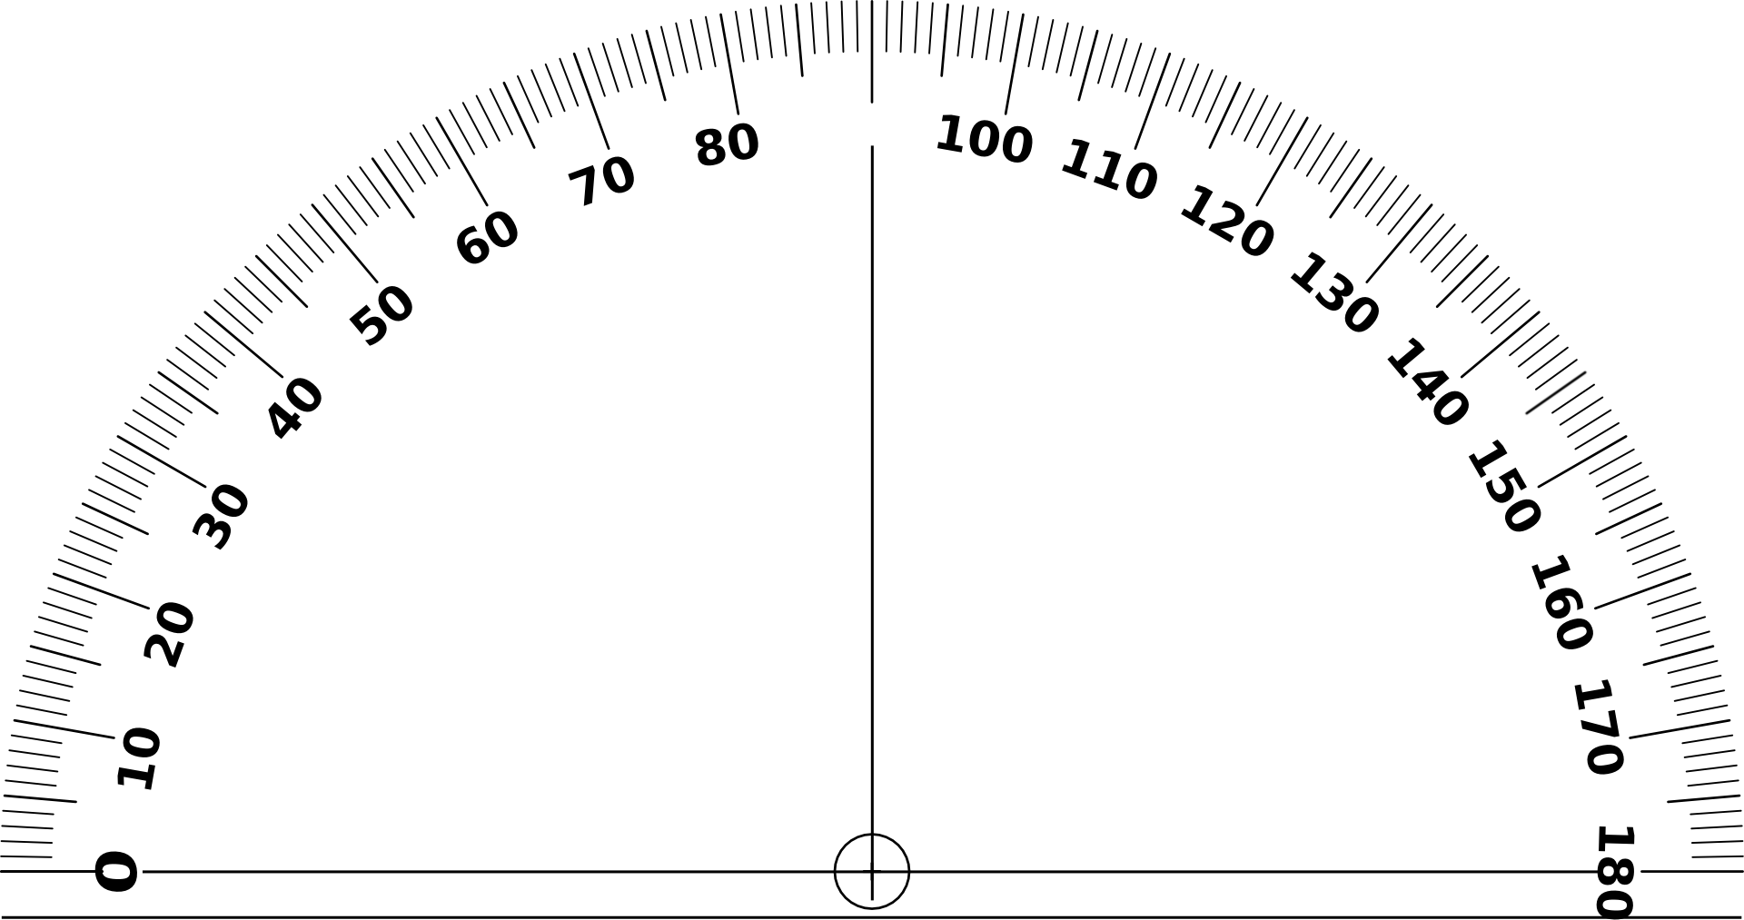
Measuring the Angle
Use a protractor to measure the angle

Slide 7
The Experiment
Measure the time for the egg to move between the two ends of the slope, shown by the arrows

Slide 8
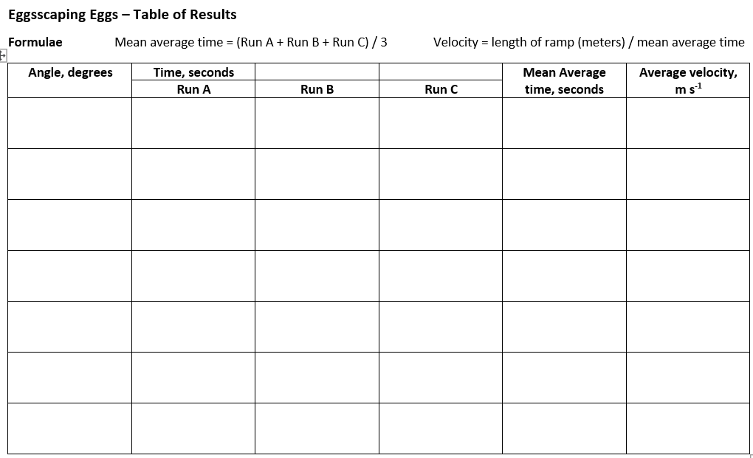
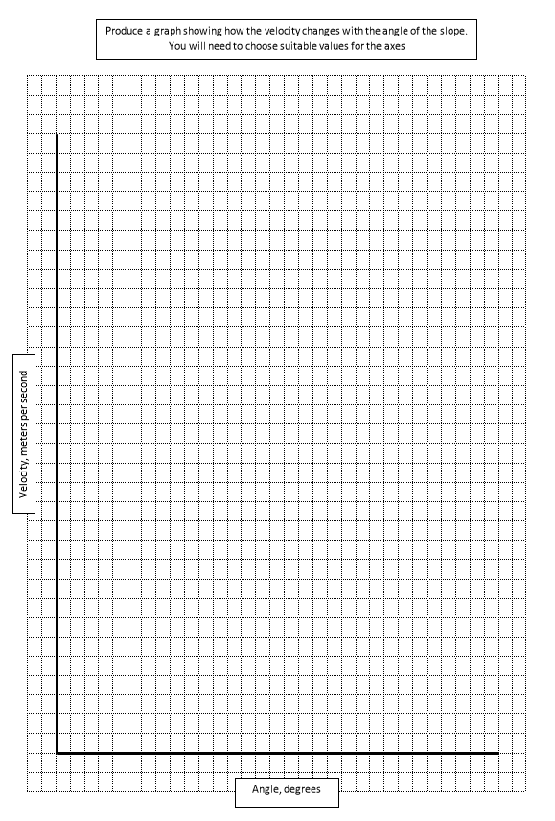
Complete the Table with your results
… then plot a graph to show the relationship between the angle and the average velocity

Slide 9
Extension 1
Calculate the acceleration of the egg:
Acceleration = velocity / mean average time
Plot the acceleration against the angle of the slope.
The acceleration due to gravity is 9.81 m s⁻².
Explain how this is different from the observed value.

Slide 10
Extension 2
Weigh the egg
Measure the height from the ground to the release point for the egg
Calculate the potential energy of the egg: PE = mgh
(where m = the weight of the egg, g = the acceleration due to gravity, 9.8 m s-2, h = height in meters)
From the principle of the conservation of energy, when it reaches the ground, the kinetic energy of the egg should be equal to the potential energy at the release point
Kinetic energy = ½ m v²
(where m = the weight of the egg, v = the velocity, m s⁻¹)
Calculate the theoretical velocity at the bottom of the slope
Is this the value you found? If it is different, why is this?

