Slide 1
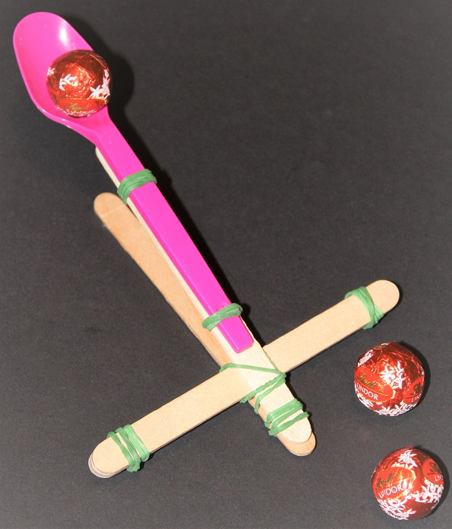
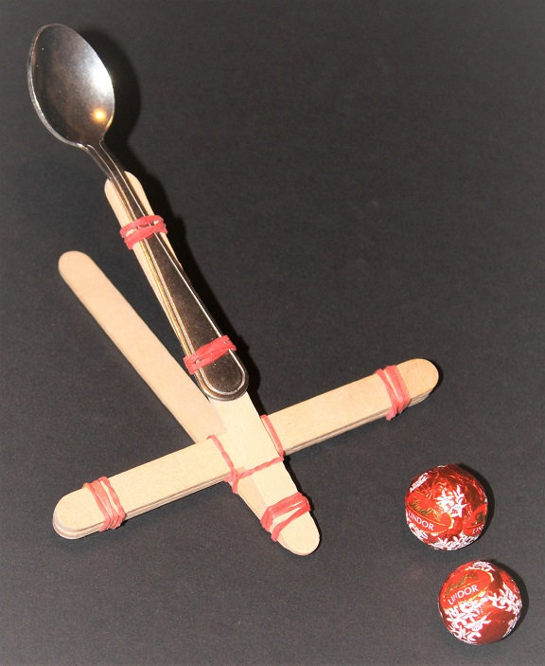
Build a popsicle stick catapult
Learning about levers by making a catapult

Slide 2
Stay safe
Whether you are a scientist researching a new medicine or an engineer solving climate change, safety always comes first. An adult must always be around and supervising when doing this activity. You are responsible for:
• ensuring that any equipment used for this activity is in good working condition
• behaving sensibly and following any safety instructions so as not to hurt or injure yourself or others
Please note that in the absence of any negligence or other breach of duty by us, this activity is carried out at your own risk. It is important to take extra care at the stages marked with this symbol: ⚠

Slide 3
What are Levers?
A lever is the simplest form of machine
It is used to change the size or direction of a force
Some types of lever can give a mechanical advantage – this means you can move heavy loads with less effort
Effort
Load
The lever is a beam or bar
When used, there is a fulcrum, load and effort
Beam
Fulcrum

Slide 4
How Levers Work 1
If the load and effort are the same force (weight) and are each the same distance from the fulcrum, the lever will balance
Changing the distances between the fulcrum, the load or the effort changes the amount of effort needed to move the load
Effort
Load
Fulcrum

Slide 5
How Levers Work 2
Here, the load and effort are the same force but the distance from the load to the fulcrum is less than the distance from the load to the effort.
What will happen?
Load
Effort
Load
Effort
Fulcrum
Fulcrum
Notes:
The effort will be lower than the load – the image will change to show this on the first mouse click.

Slide 6
How Levers Work 3
Here, the load is bigger than the effort
They are each the same distance from the fulcrum
What will happen?
Effort
Effort
Load
Load
Fulcrum
Fulcrum
Notes:
The load will be lower than the effort – the image will change to show this on the first mouse click.

Slide 7
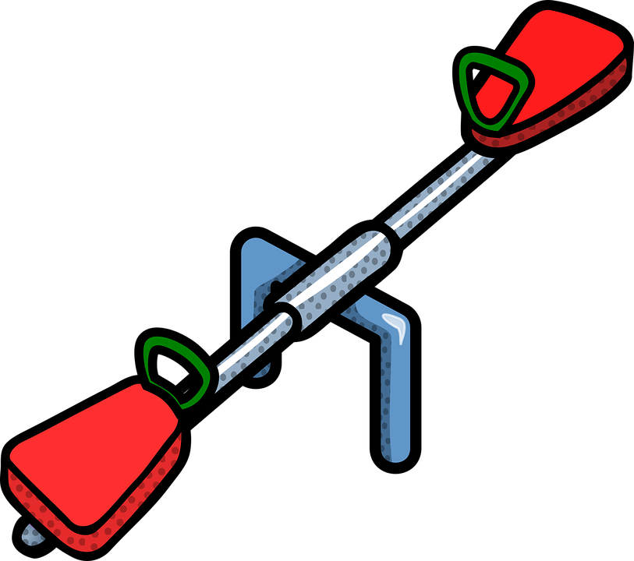
First Class levers
There are three classes (or types) of lever
In a first class lever, the fulcrum is between the load and effort
A seesaw is a first class lever
Effort
Load
Beam
Fulcrum

Slide 8
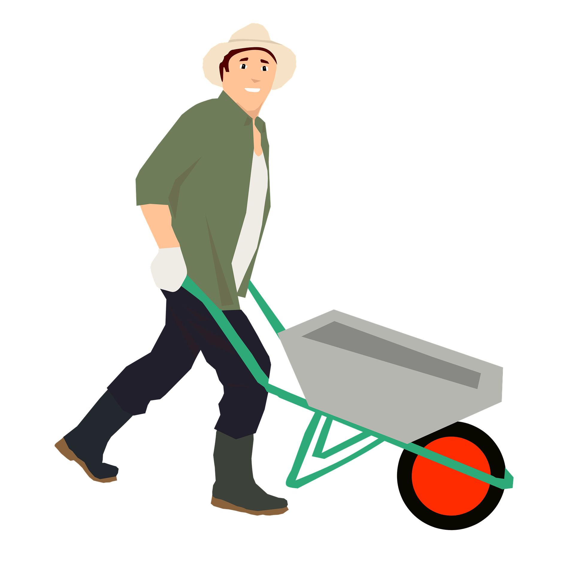
Second Class Levers
In a second class lever, the load is between the effort and the fulcrum
Wheelbarrows and nutcrackers are second class levers
Effort
Load
Beam
Fulcrum

Slide 9
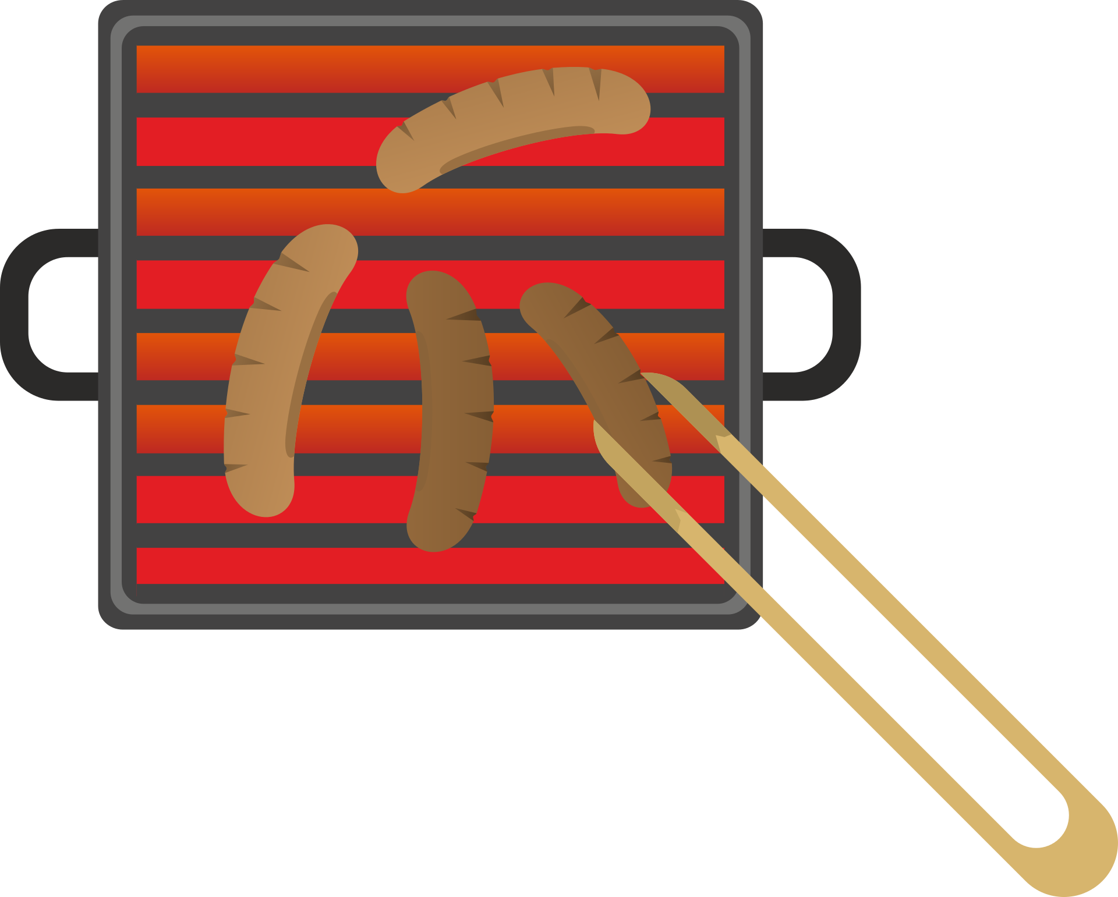
Third Class Levers
In a third class lever, the effort is between the load and the fulcrum
Barbecue tongs are an example of a third class lever
Load
Effort
Beam
Fulcrum

Slide 10
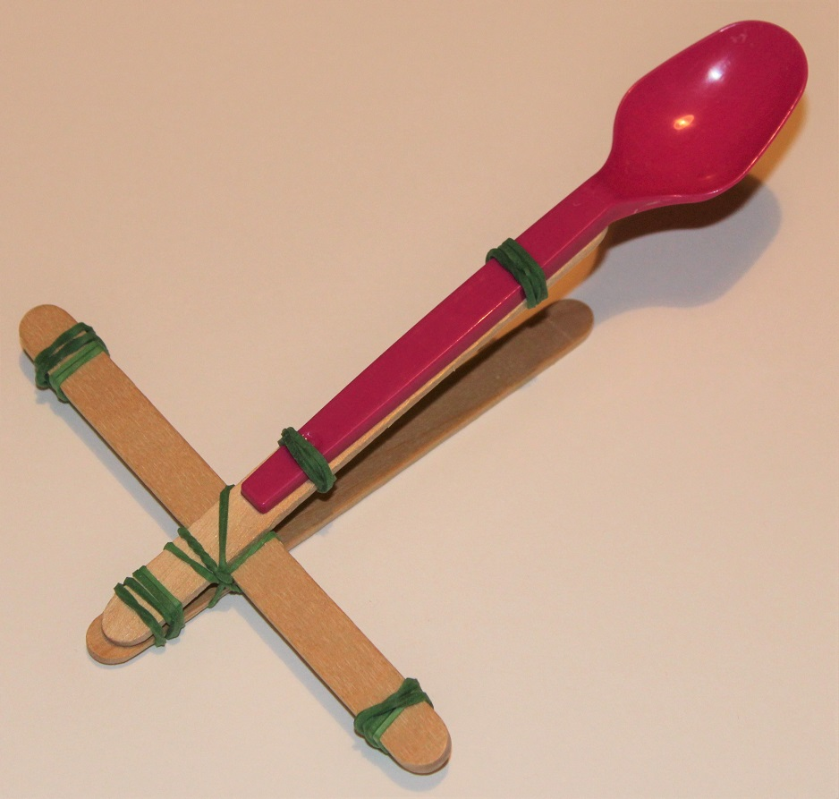
Resources
We are going to make a catapult – this uses the principles of levers to throw things! You will need:
Craft sticks – at least 7
Small elastic bands – at least 6
A teaspoon (metal or plastic)
Chocolate mini-eggs (or similar) – ammunition!

Slide 11
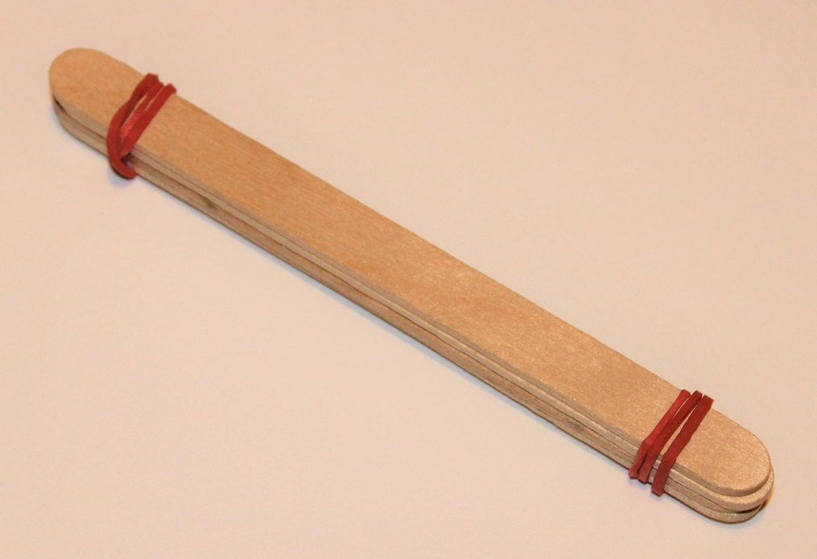
Step 1 – Make your ‘fulcrum’
Using elastic bands at each end, attach 4 (or 5) craft sticks together
You will need to wrap the elastic bands around a few times to hold it securely

Slide 12
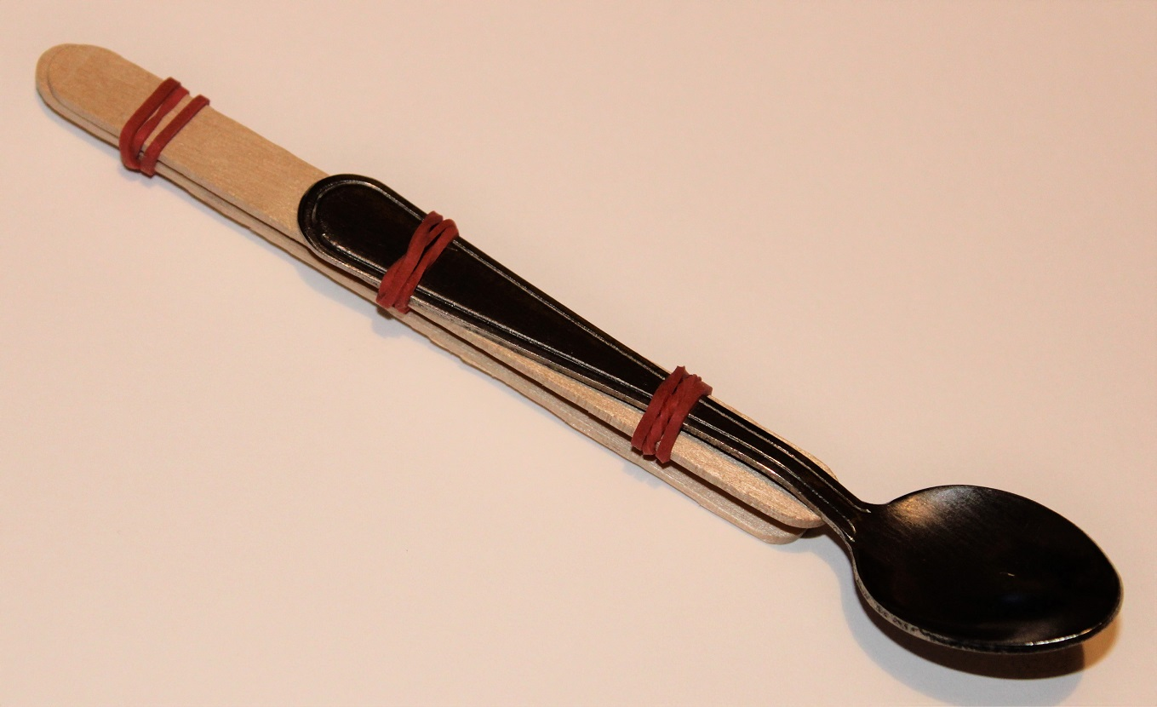
Step 2 – Make your ‘thrower’
Using two elastic bands, attach the tea spoon to one end of a craft stick
Using one elastic band, attach a second craft stick to the other end of the first stick

Slide 13
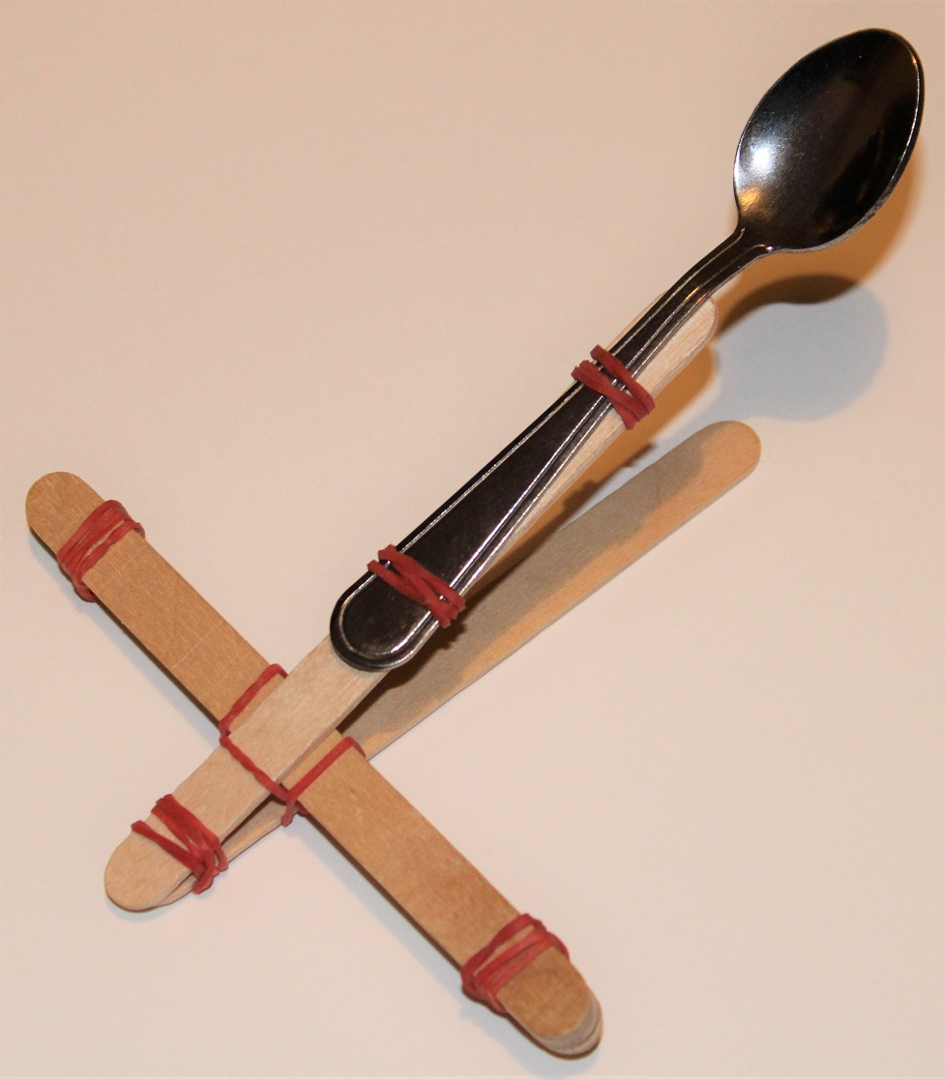
Step 3 – Assembly
Wedge the block between the two craft sticks of the thrower
Wrap an elastic band about the point where it touches the craft sticks to hold it in place

Slide 14
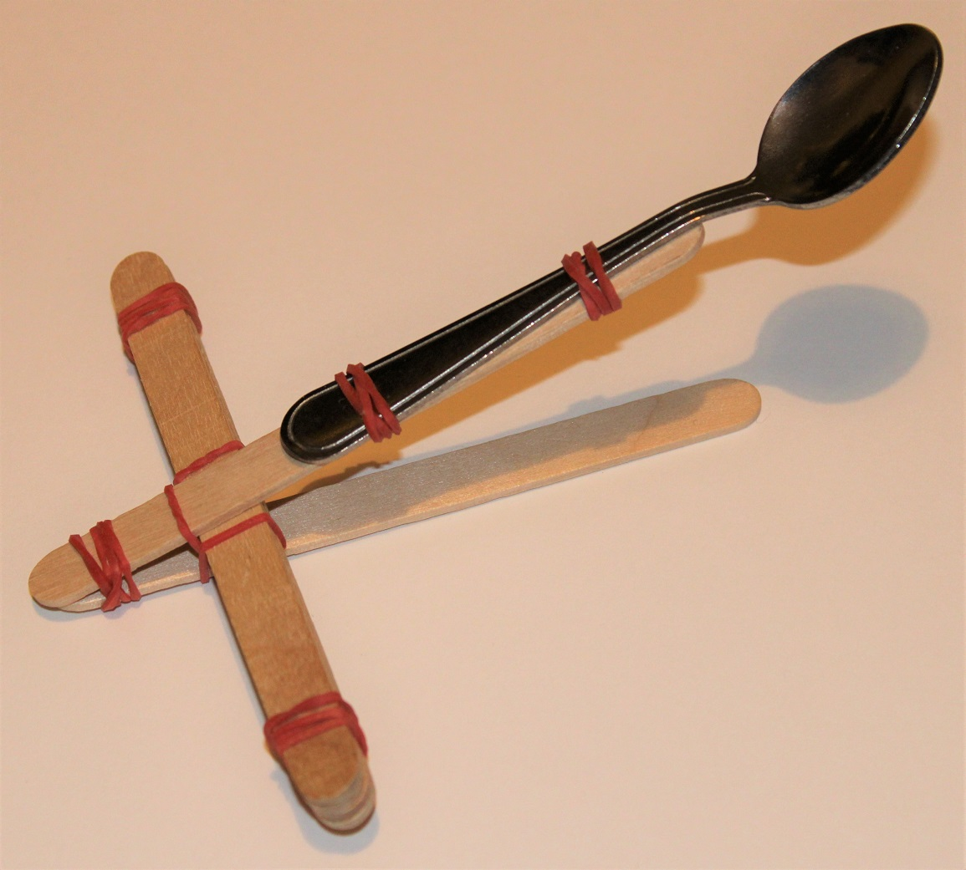
Step 4 – Fire!
Pull back
& release
Using one hand, hold down the catapult at the end
Place the chocolate mini egg in the spoon
Pull the spoon back – then release and launch the egg!
Egg
Hold it down

Slide 15
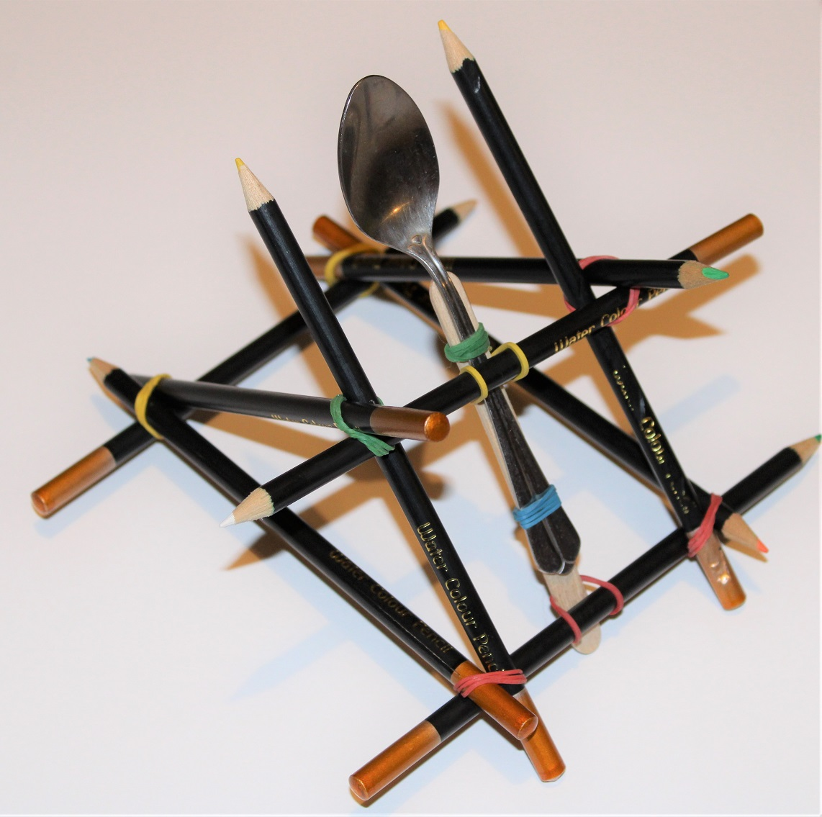
Alternative design
For more throwing power, try making a structure using pencils and elastic bands

Slide 16
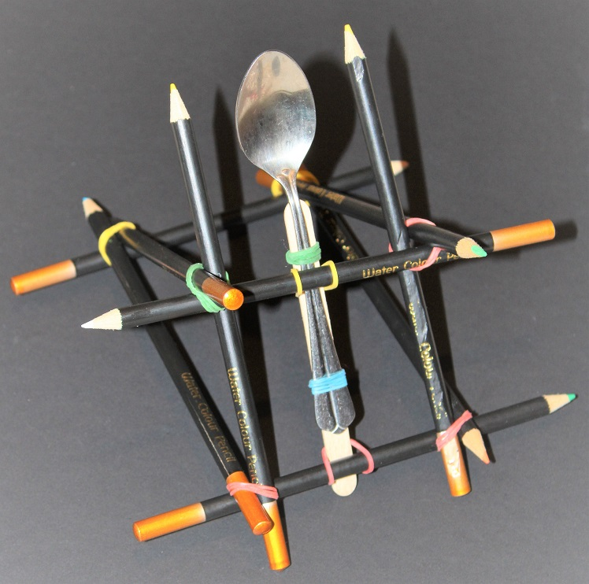
Additional Examples

