Slide 1
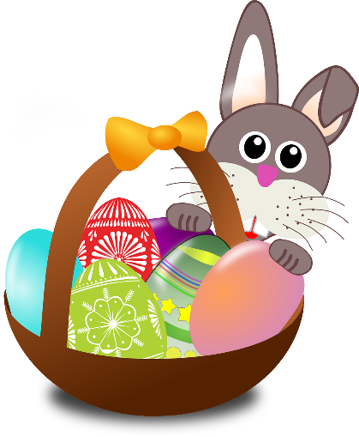
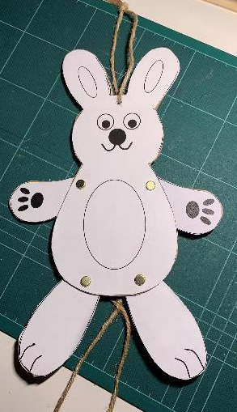
Make a DIY Easter Bunny
A project to make a bouncing bunny that’s moves its arms and legs

Slide 2
Stay safe
Whether you are a scientist researching a new medicine or an engineer solving climate change, safety always comes first. An adult must always be around and supervising when doing this activity. You are responsible for:
• ensuring that any equipment used for this activity is in good working condition
• behaving sensibly and following any safety instructions so as not to hurt or injure yourself or others
Please note that in the absence of any negligence or other breach of duty by us, this activity is carried out at your own risk. It is important to take extra care at the stages marked with this symbol: ⚠

Slide 3
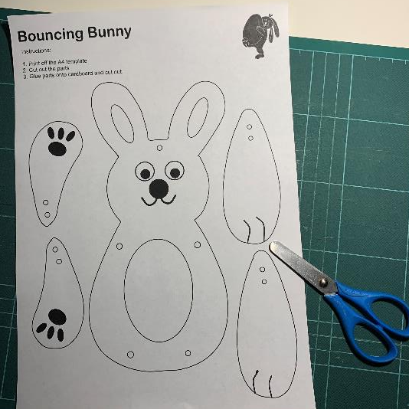
Resources
You will need:
The bouncing bunny template
Scissors
Card or cardboard
Glue

Slide 4
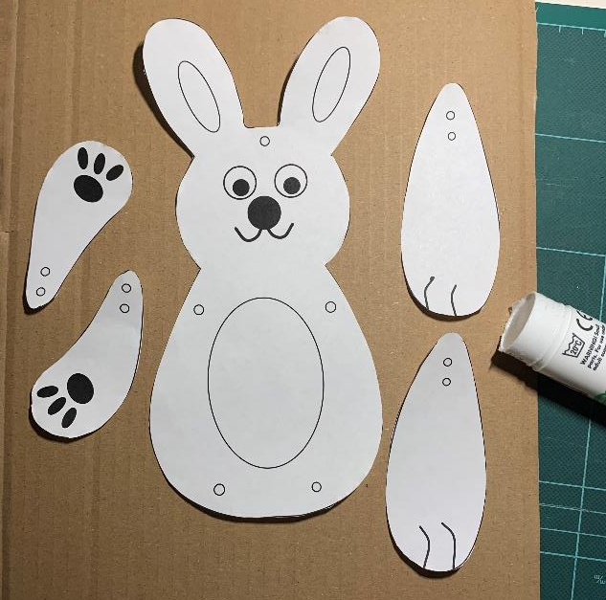
Step 1 – Cut out the bunny parts ⚠
Carefully cut along all the solid outlines
Glue onto card or cardboard
When glue is dry, cut out the
cardboard

Slide 5
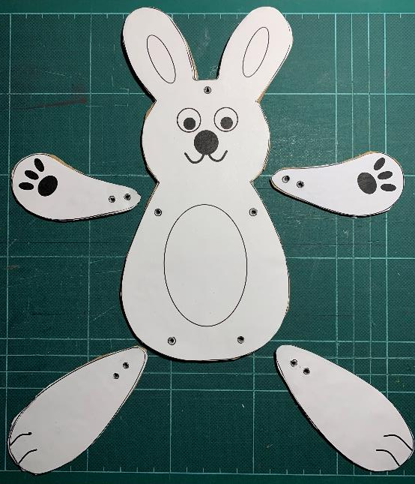
Step 2 – Make the holes ⚠
Make the holes. Put an eraser or sticky tack behind the hole, then push a sharp pencil in to make a small hole.
13 Holes

Slide 6
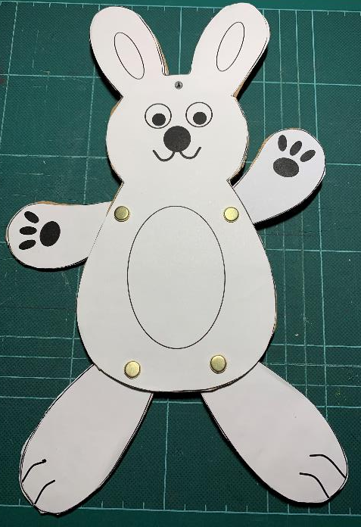
Step 3 – Connect the arms and legs
Brass fastener goes here
String goes here

Slide 7
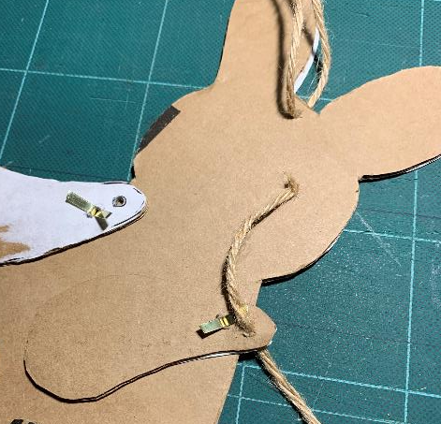
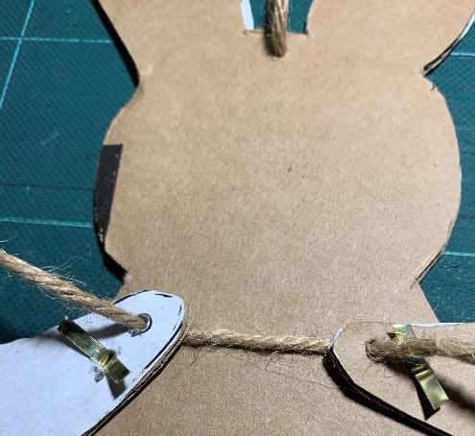
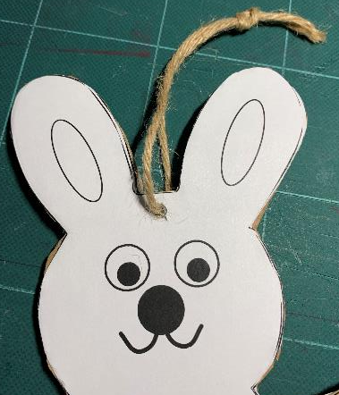
Step 4 – String the arms
Tie string to the head
Thread the arms

Slide 8
Step 5 – String the legs
Thread the legs
Crossover X
Tie a knot

Slide 9
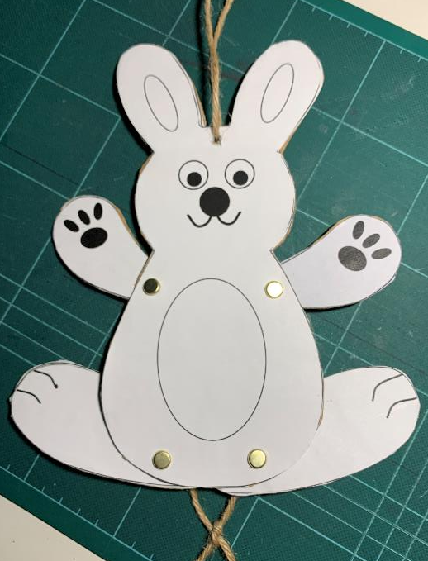
Step 6 – Test your bunny
Hold the top string…
… and pull

Slide 10
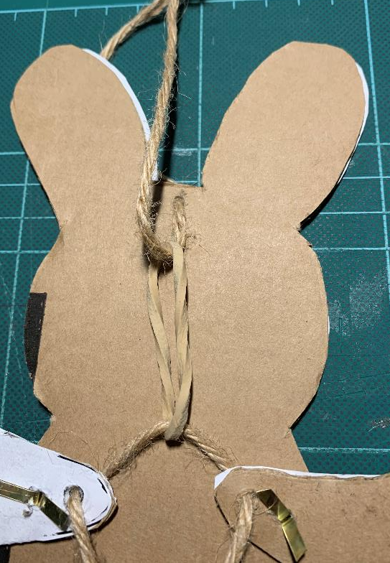
Extension
Make bunny more bouncy
Add an elastic band
Try different elastic bands

