Slide 1
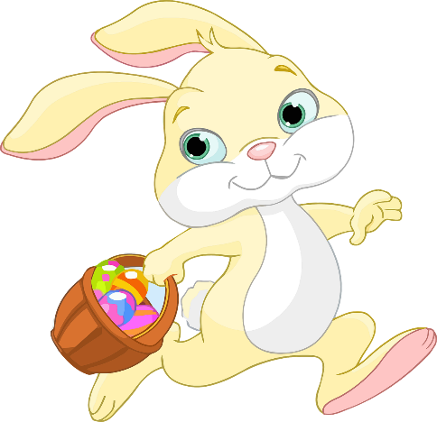
Build a Bunny craft activity
A project to make and assemble a bunny from card strips

Slide 2
Stay safe
Whether you are a scientist researching a new medicine or an engineer solving climate change, safety always comes first. An adult must always be around and supervising when doing this activity. You are responsible for:
• ensuring that any equipment used for this activity is in good working condition
• behaving sensibly and following any safety instructions so as not to hurt or injure yourself or others
Please note that in the absence of any negligence or other breach of duty by us, this activity is carried out at your own risk. It is important to take extra care at the stages marked with this symbol: ⚠

Slide 3
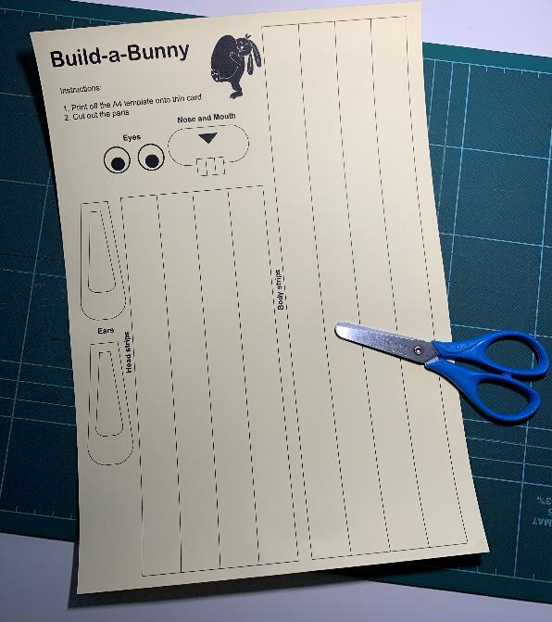
Resources
You will need:
the build a bunny handout
Scissors
glue

Slide 4
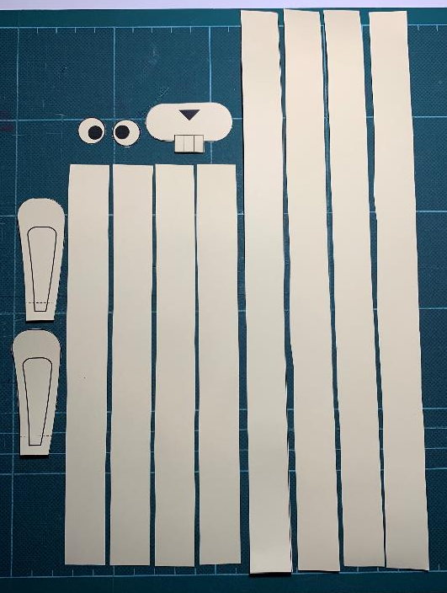
Step 1 – Cut out the bunny parts ⚠
Carefully cut along all the solid outlines
Fold the ears on the dotted line
FOLD

Slide 5
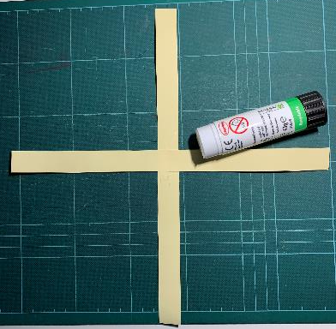
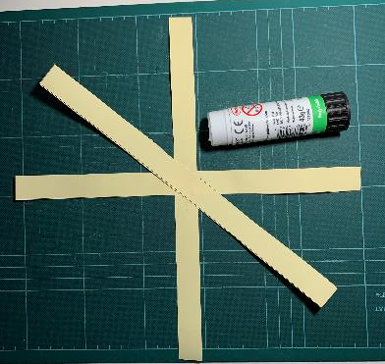
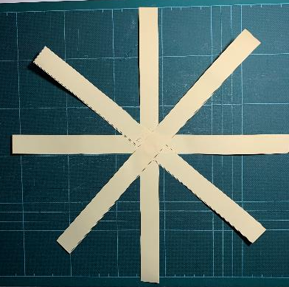
Step 2 – Sticking the Body ⚠
Fold the strips in half
Glue the body strips together
GLUE
1
2
3

Slide 6
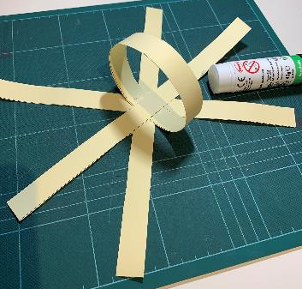
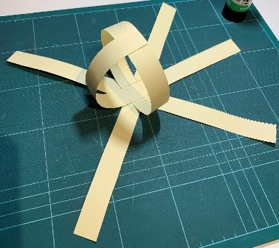
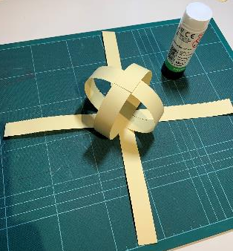
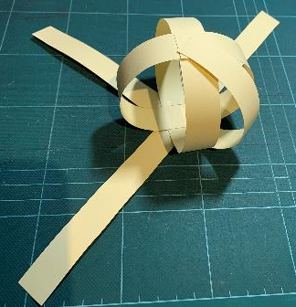
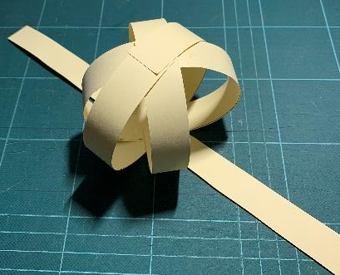
Step 3 – Making the Body ⚠
GLUE
1
2
3
4
5
6
7

Slide 7
Step 4 – Assembly ⚠
Repeat Steps 3-4 for the head
Stick the head to the body

Slide 8
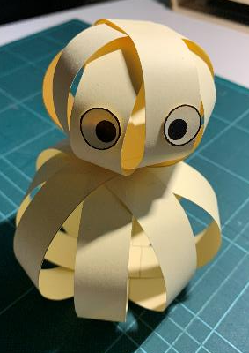
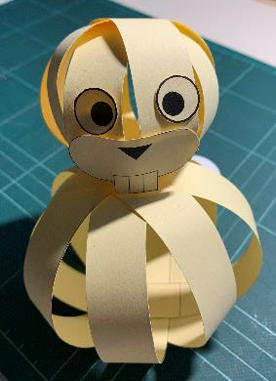
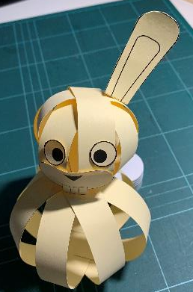
Step 5 – Adding the Face ⚠
Stick on the eyes, nose and ears
Eyes
Nose
Ears

