Slide 1
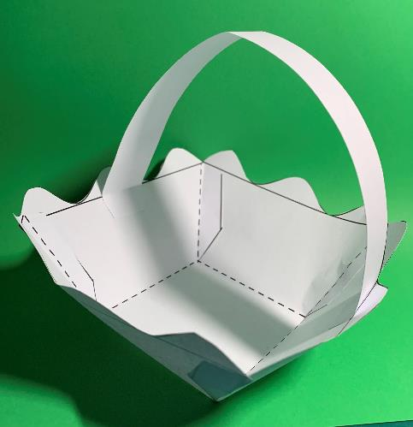
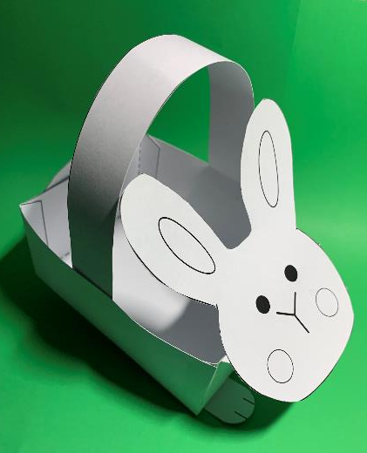
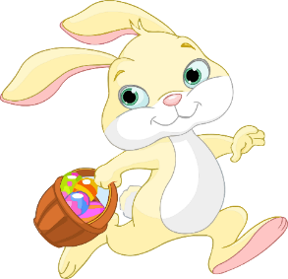
Build an Easter Bunny Basket
A project to make and assemble bunny baskets from card

Slide 2
Stay safe
Whether you are a scientist researching a new medicine or an engineer solving climate change, safety always comes first. An adult must always be around and supervising when doing this activity. You are responsible for:
• ensuring that any equipment used for this activity is in good working condition
• behaving sensibly and following any safety instructions so as not to hurt or injure yourself or others
Please note that in the absence of any negligence or other breach of duty by us, this activity is carried out at your own risk. It is important to take extra care at the stages marked with this symbol: ⚠

Slide 3
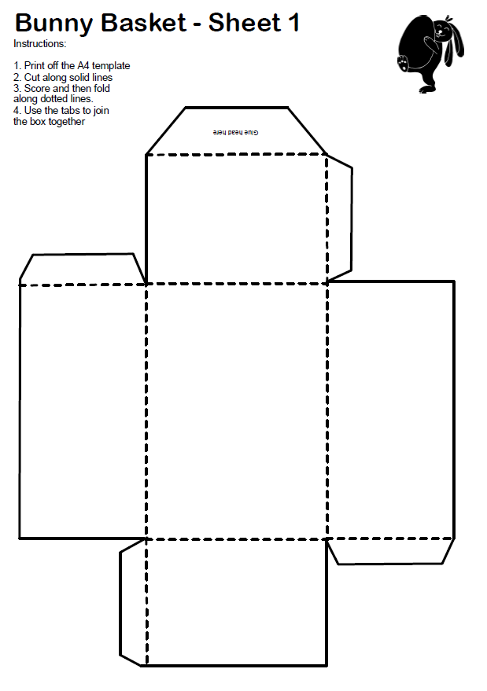
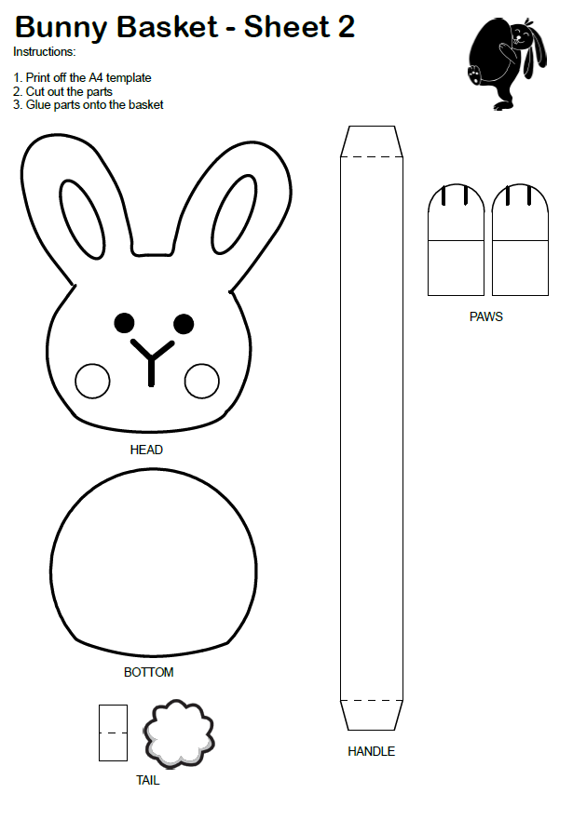
Resources
You will need:
The bunny basket sheets 1 and 2
Scissors
Glue

Slide 4
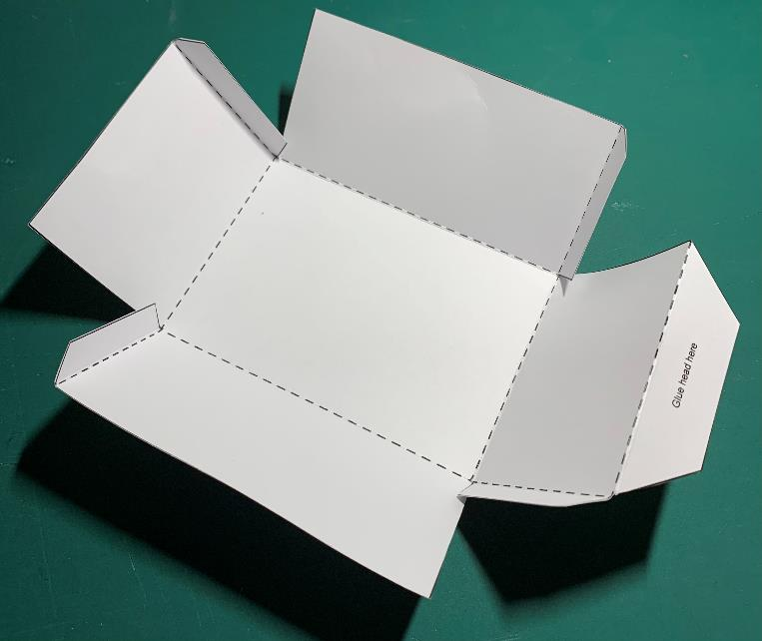
Step 1 – Cut out the basket ⚠
Carefully cut along all the solid outlines
Score and fold the dotted lines

Slide 5
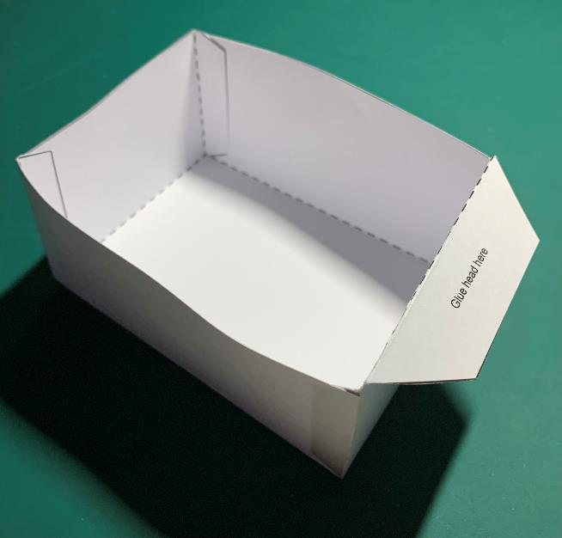
Step 2 – Glue Basket Together ⚠
Glue the tabs and stick the
basket together
Fold the tab for the head

Slide 6
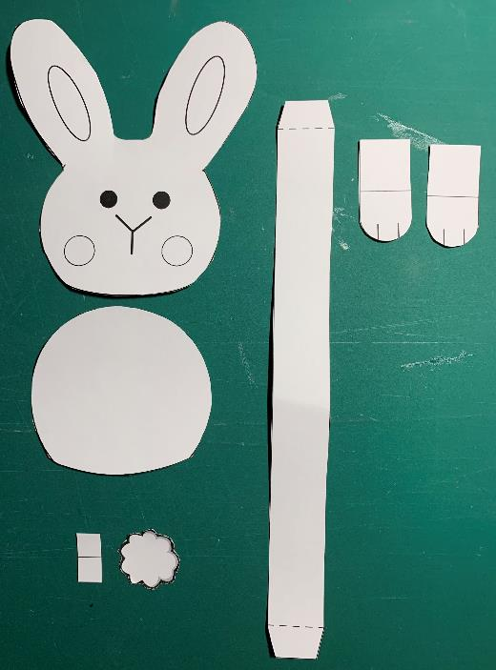
Step 3 – Cut out the bunny parts ⚠
Carefully cut along all the solid outlines
Fold the dotted lines

Slide 7
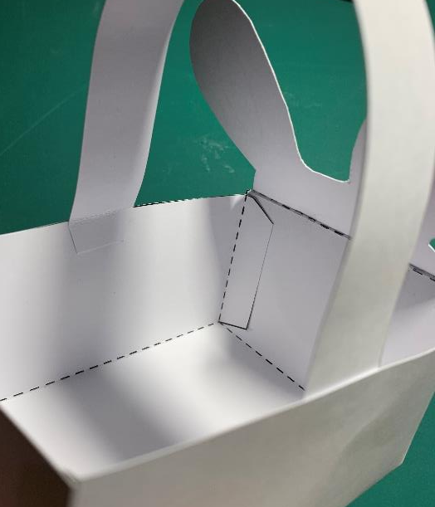
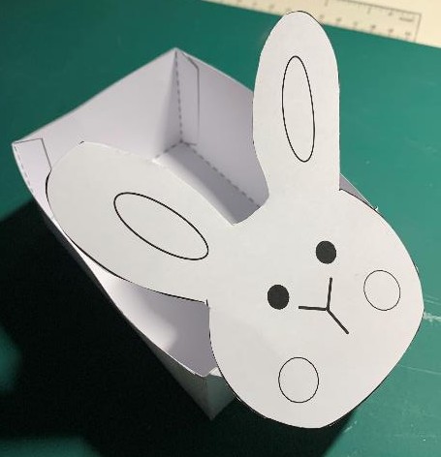
Step 4 – Assembly ⚠
Stick the head to the tab
Stick on the handle (to the inside of the basket)
Glue

Slide 8
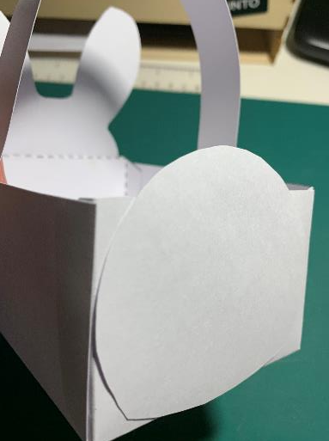
Step 5 – Assembly ⚠
Stick on the bottom
Fold and stick tail holder
Stick on the tail
Glue

Slide 9
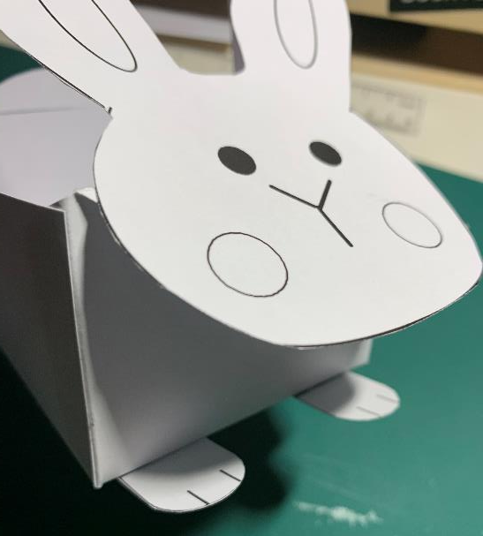
Step 6 – Assembly ⚠
Stick the paws to the basket

Slide 10
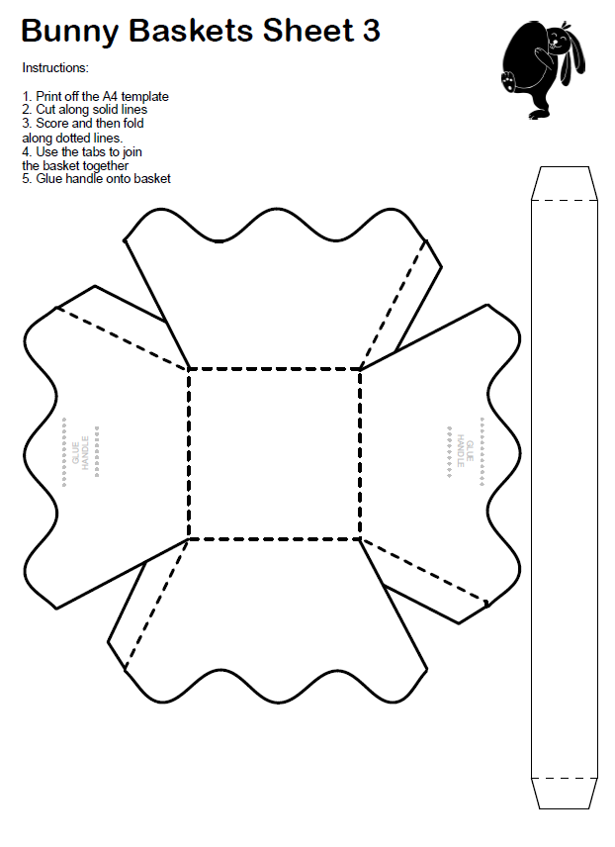
Extension – Wavy Basket ⚠
Carefully cut along all the solid outlines

Slide 11
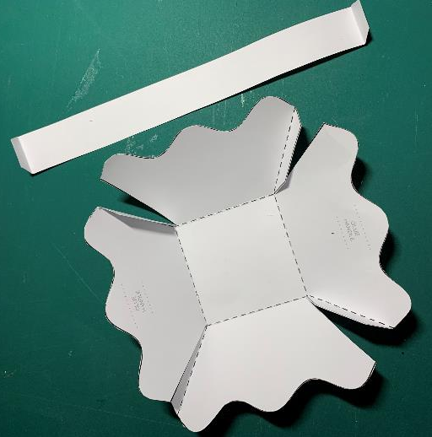
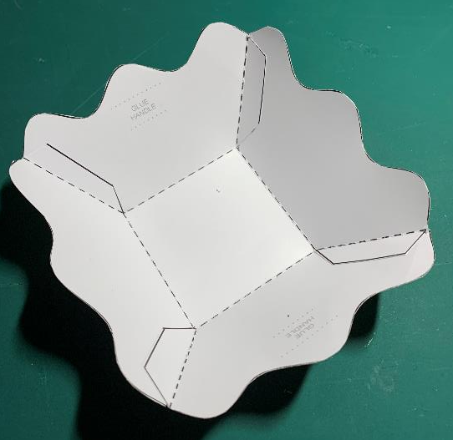
Extension – Wavy Basket ⚠
Score and fold the dotted lines
Glue the tabs and stick together

Slide 12
Extension - Wavy Basket ⚠
Glue the handle
Glue

