Slide 1
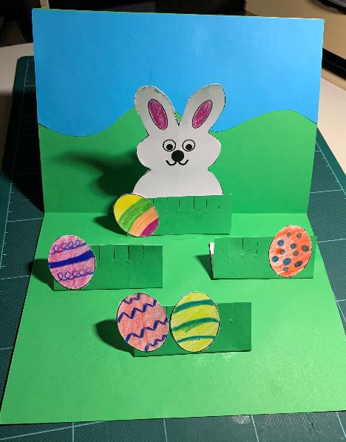
Make an amazing bunny pop up card
A project to make an amazing Easter pop-up card

Slide 2
Stay safe
Whether you are a scientist researching a new medicine or an engineer solving climate change, safety always comes first. An adult must always be around and supervising when doing this activity. You are responsible for:
• ensuring that any equipment used for this activity is in good working condition
• behaving sensibly and following any safety instructions so as not to hurt or injure yourself or others
Please note that in the absence of any negligence or other breach of duty by us, this activity is carried out at your own risk. It is important to take extra care at the stages marked with this symbol: ⚠

Slide 3
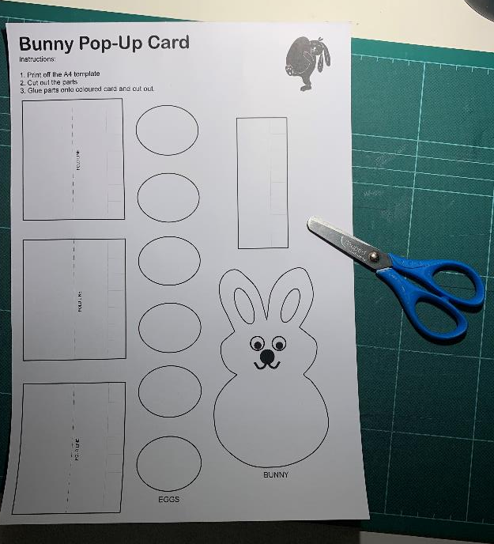
Step 1 – Cutting out the parts ⚠
You will need the bunny pop-up template and scissors
Carefully cut out the parts

Slide 4
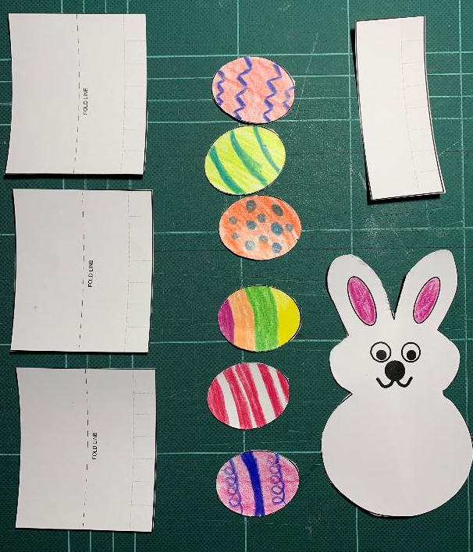
Step 2 – Decorating the parts
Add your own egg designs
Colour in the bunny

Slide 5
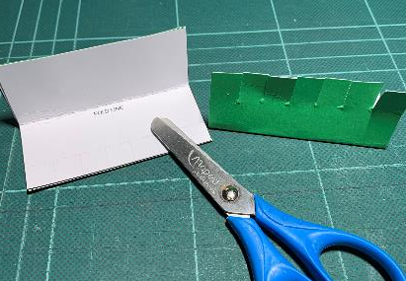
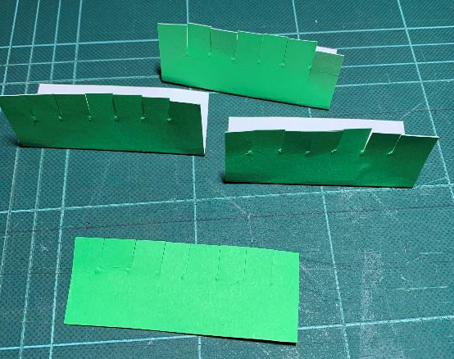
Step 3 – Grass stands ⚠
Glue grass stands to green paper and cut them out
Fold on the line
Follow the lines to cut out the slits

Slide 6
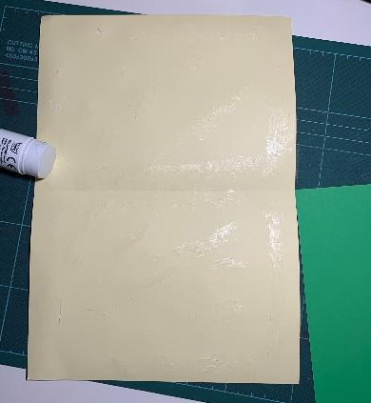
Step 4 – Make the Card ⚠
Glue green paper to one side of the card
Fold the card, so the green paper is on the inside

Slide 7
Step 5 – Mark and Cut the Slot ⚠
Use the bunny grass part
Find the slot line and place in the middle of the card
Draw round the part with a pencil
Cut 2 slits
Folded side
Cut 2 slits
Draw round the part
SLOT LINE

Slide 8
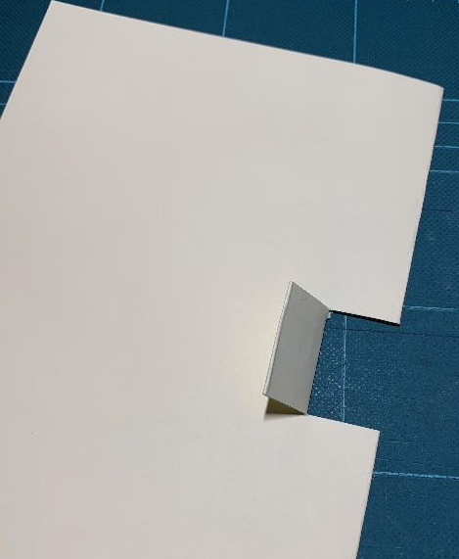
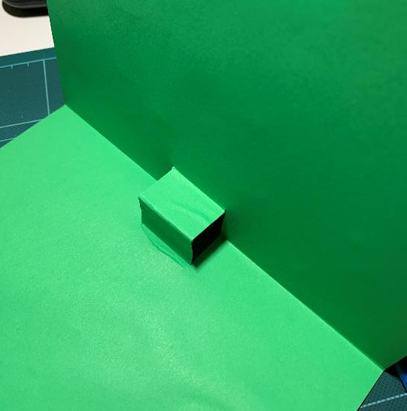
Step 6 – Fold the Flap ⚠
Fold the flap over on the outside
Fold the flap
Open up the card
Push flap to the inside to make a step
Push the flap inside

Slide 9
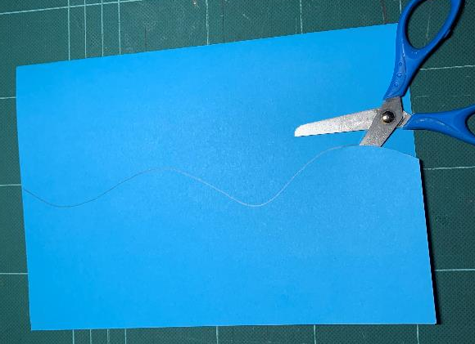
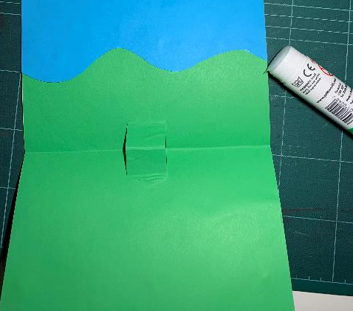
Step 7 – Make the sky ⚠
Draw a wavy line on the blue paper
Cut out the shape
Glue this to the inside of the card to make the sky

Slide 10
Step 8 – Glue the bunny ⚠
Glue the bunny grass part to the bunny
Put glue on the flap and stick on the bunny

Slide 11
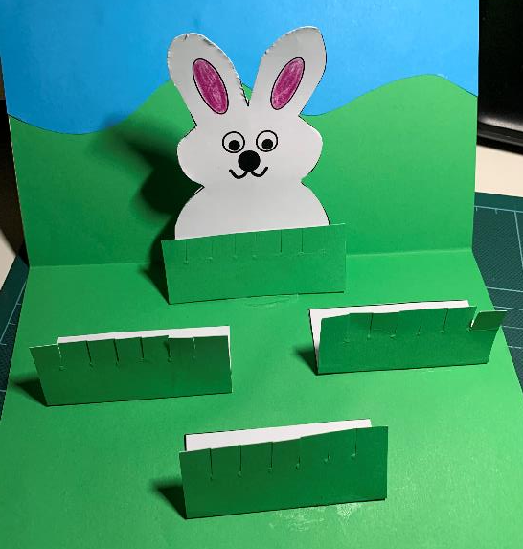
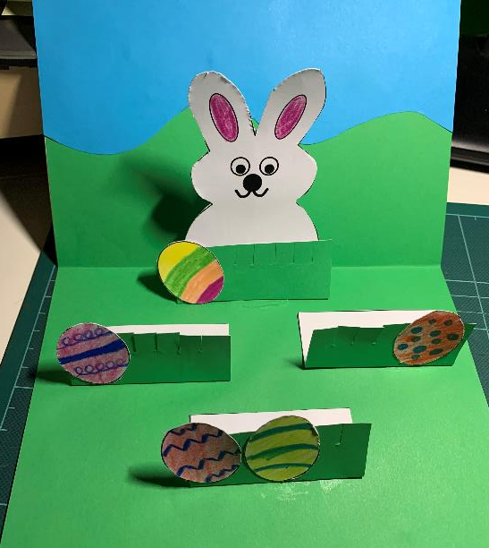
Step 9 – Glue grass and eggs ⚠
Glue grass stands and eggs on to the card

Slide 12
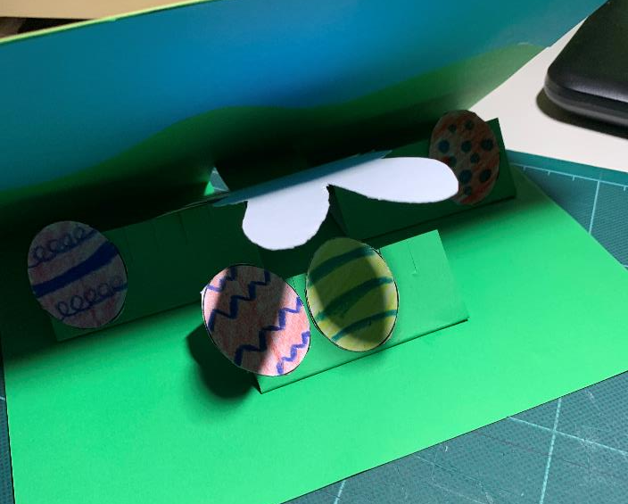
Step 10 – Close the card
Fold over the parts and close the card
Add your own design to the front
Fold parts

