Slide 1
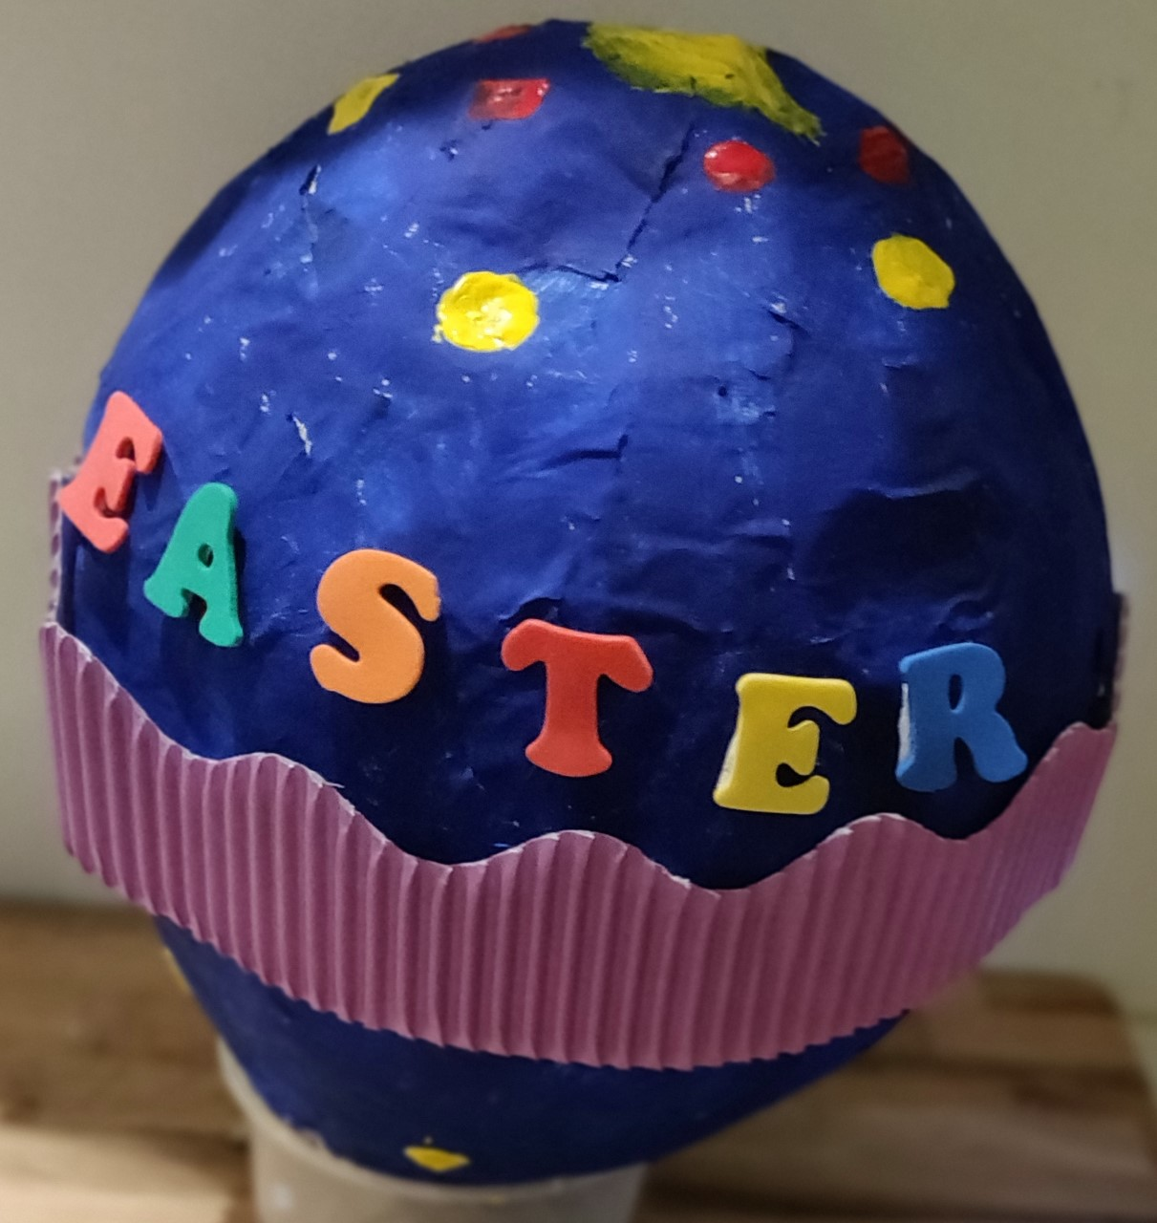
Make a Papier Mâché Easter Egg
Using papier mâché to make and then decorate an egg

Slide 2
Stay safe
Whether you are a scientist researching a new medicine or an engineer solving climate change, safety always comes first. An adult must always be around and supervising when doing this activity. You are responsible for:
• ensuring that any equipment used for this activity is in good working condition
• behaving sensibly and following any safety instructions so as not to hurt or injure yourself or others
Please note that in the absence of any negligence or other breach of duty by us, this activity is carried out at your own risk. It is important to take extra care at the stages marked with this symbol: ⚠

Slide 3
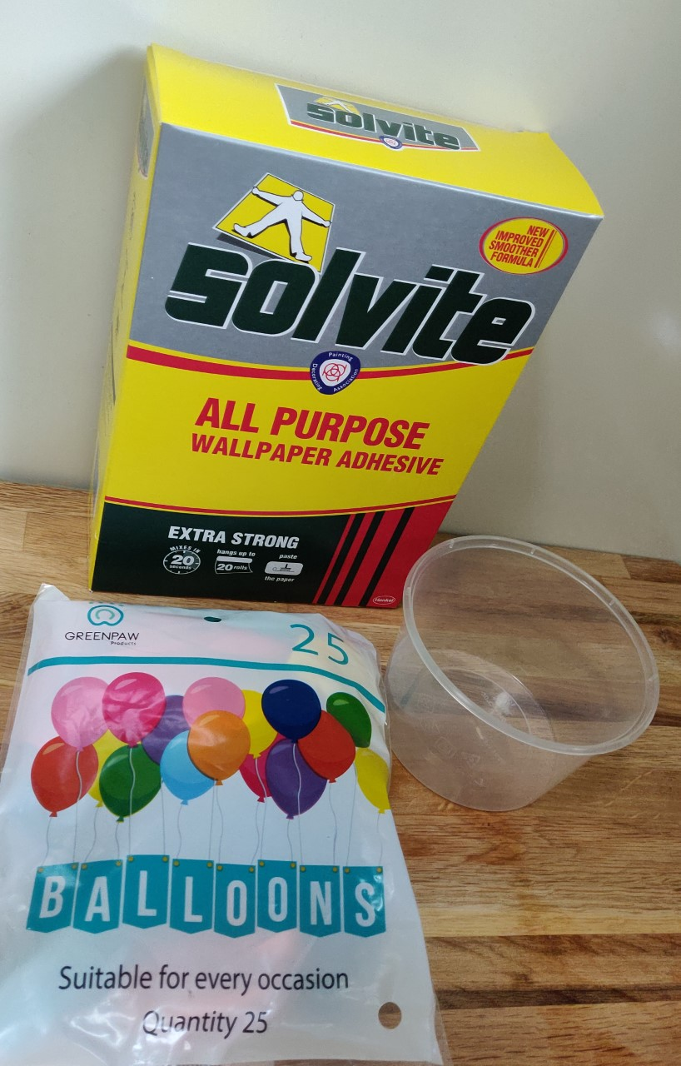
Resources
You will need:
A balloon
Newspaper and white paper
Wallpaper paste
A small plastic pot
Different coloured paints and other materials for decorating, such as foam letters and card borders
Notes:
Instead of wallpaper paste, flour and water or PVA glue can be used.

Slide 4
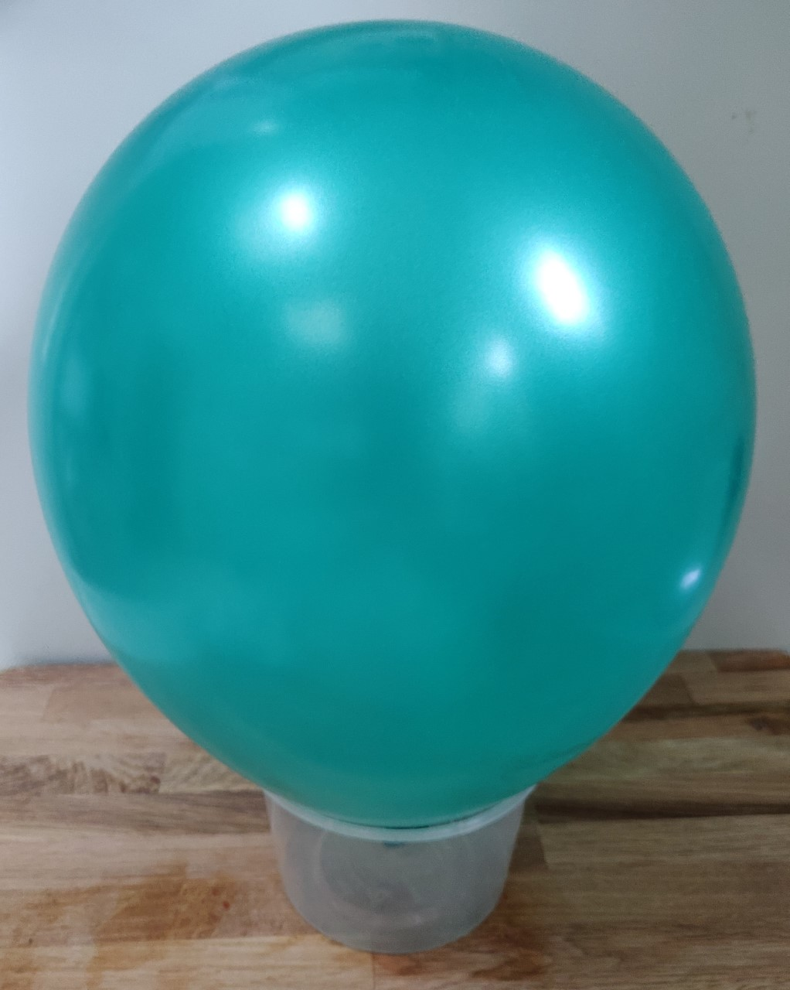
Step 1
Blow up the balloon
Tie it and put it into your plastic pot
Notes:
This step could be completed in advance for learners by the teacher or technician. The plastic pot will allow the learners to work on the egg without it moving.

Slide 5
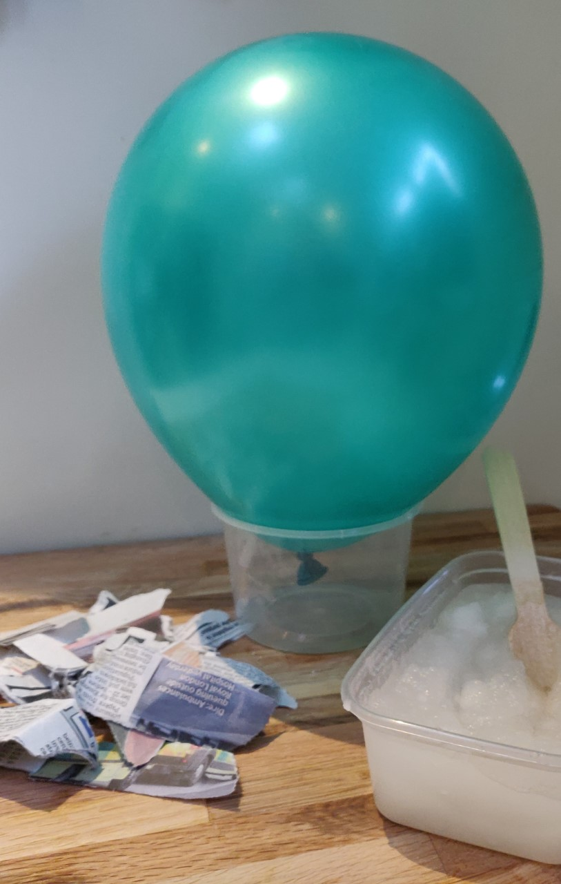
Step 2
Tear the newspaper into small pieces
Prepare the wallpaper paste
Notes:
Do not use glossy paper as this will not stick correctly. Wallpaper paste and small pieces of newspaper could be prepared in advance for learners.

Slide 6
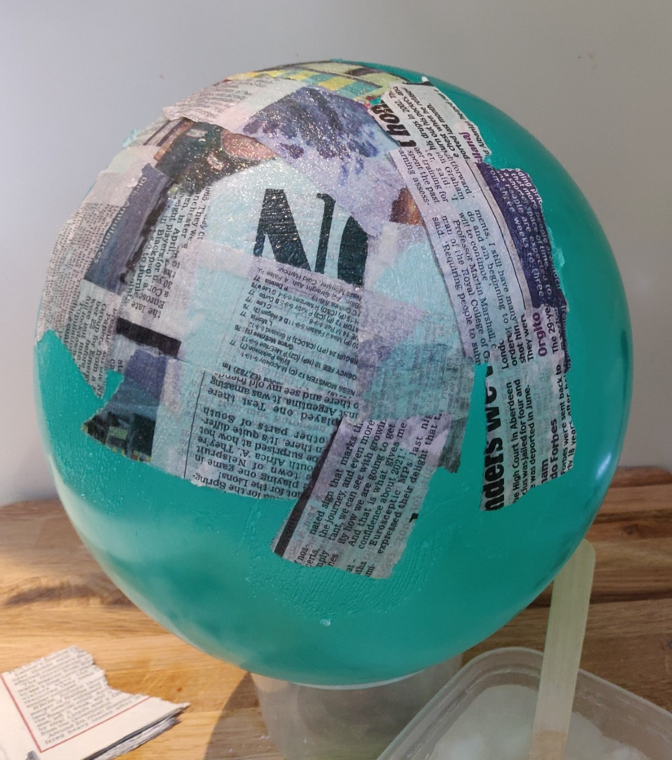
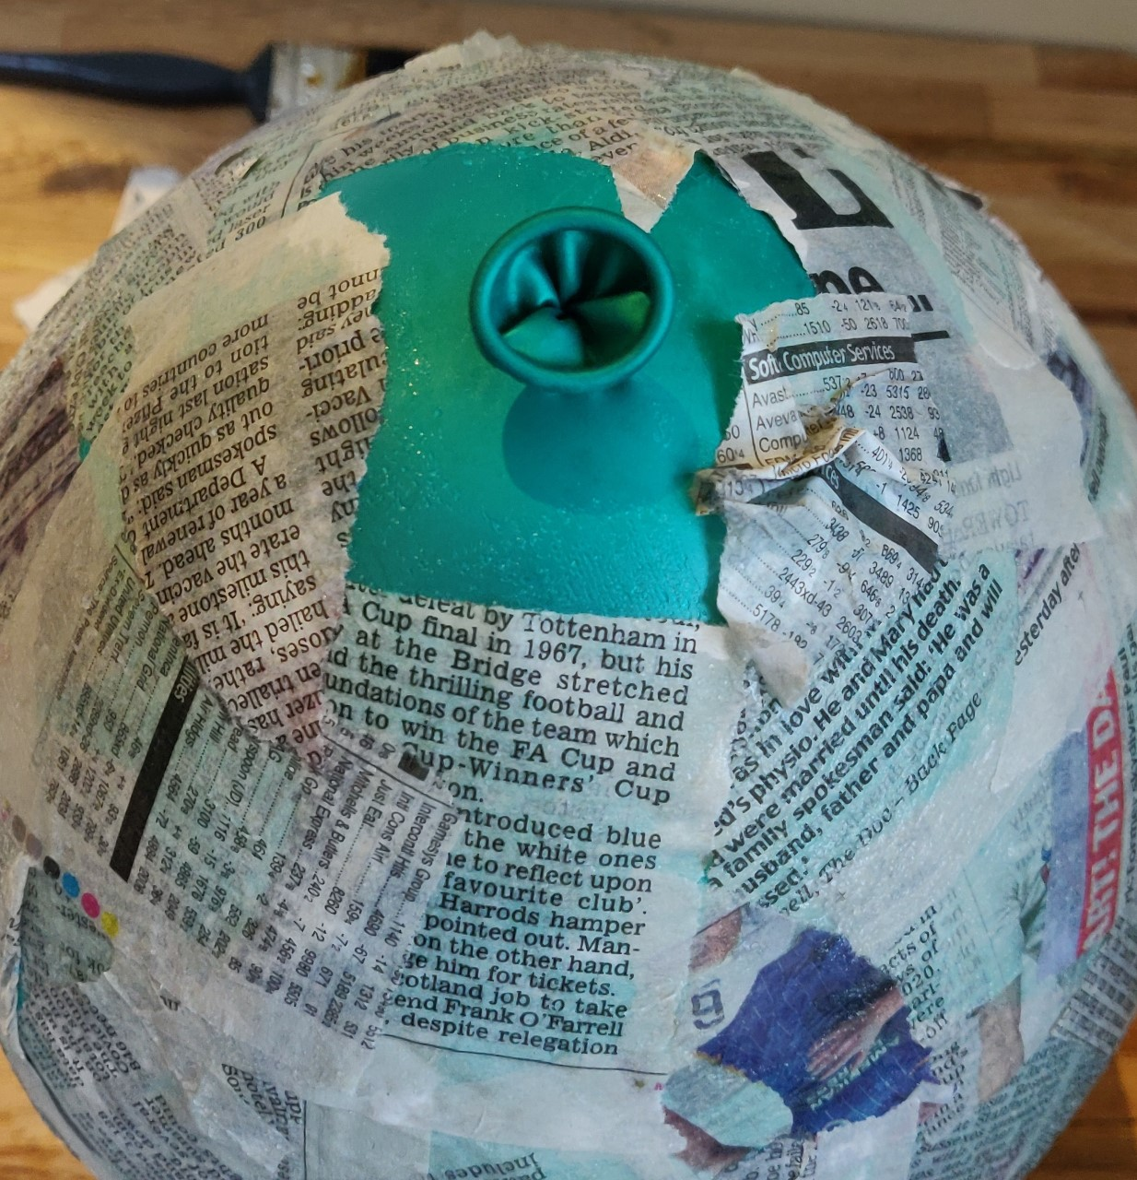
Step 3 ⚠
Lightly coat the pieces of paper with wallpaper paste
Stick them over the balloon to cover it
Leave a gap at the bottom so the balloon can be removed
Notes:
Make sure a large enough gap is left to remove the balloon at the bottom.

Slide 7
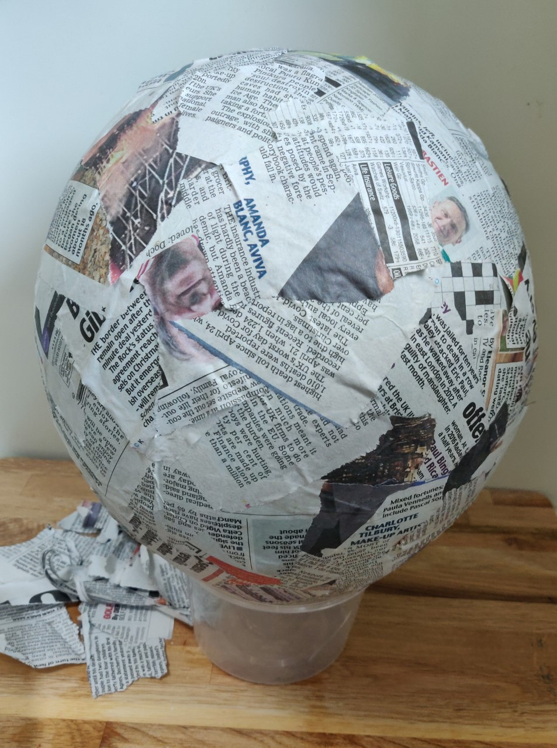
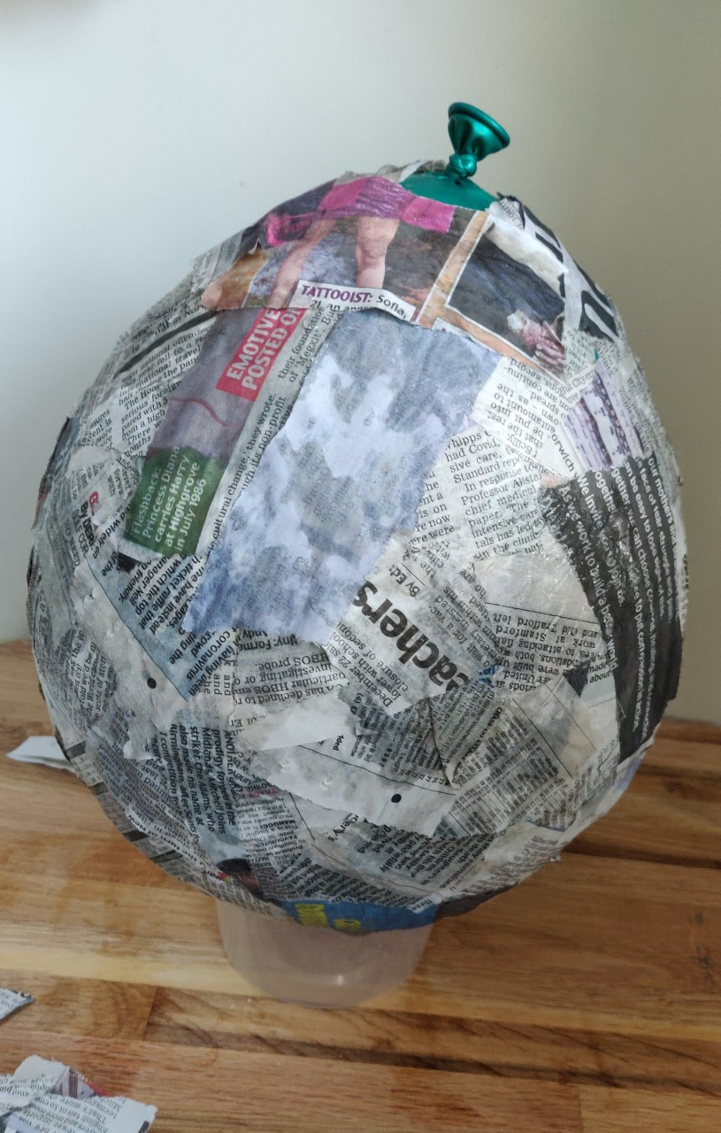
Step 4
Wait until the papier mâché is completely dry
Apply a second layer of papier mâché and leave to dry
Notes:
To make painting easier, use white paper as the second layer.

Slide 8
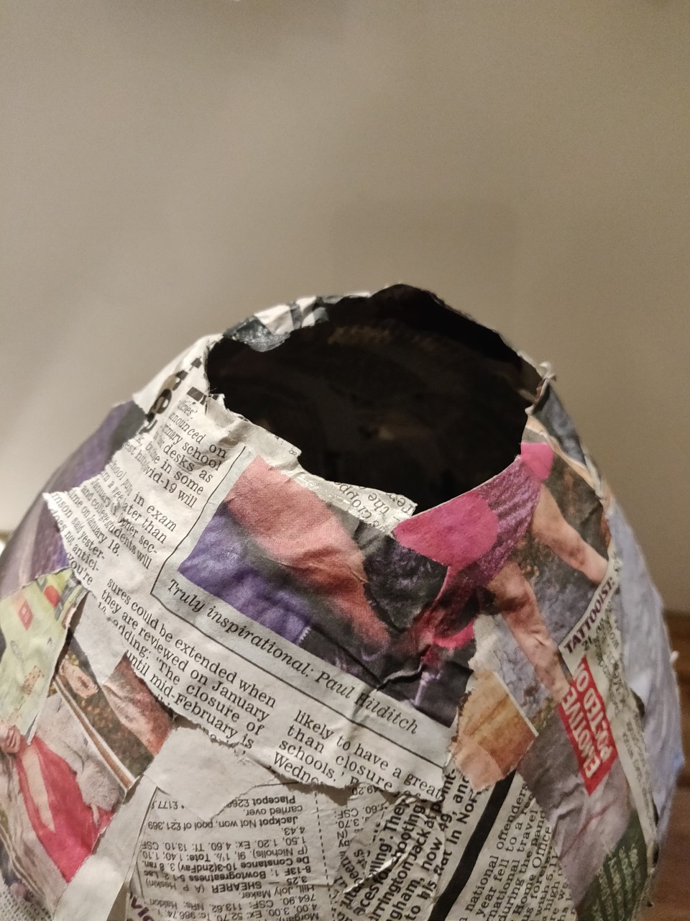
Step 5 ⚠
Carefully burst the balloon
Take the balloon out from inside the egg
Notes:
Balloon may stick to inside of the egg, so gently prize it out using hands. Be careful to avoid tearing.

Slide 9
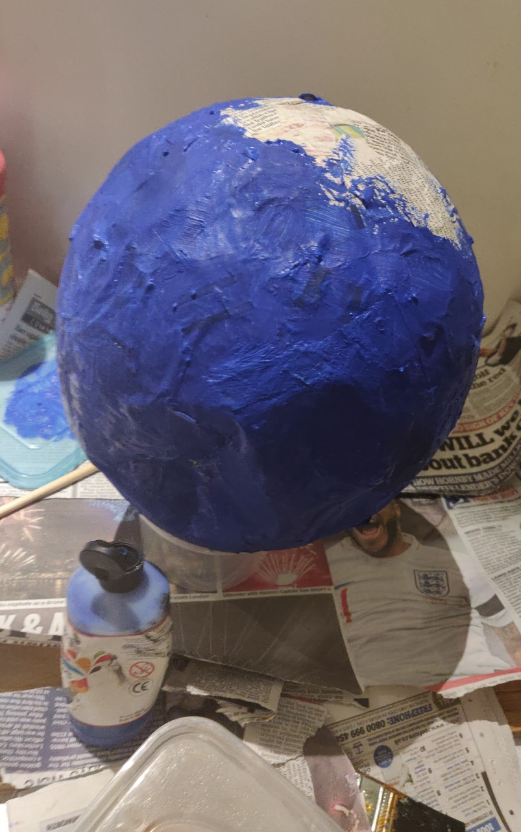
Step 6
Paint the egg with your background colour
Leave to dry
Notes:
Acyclic paints work well for this.

Slide 10
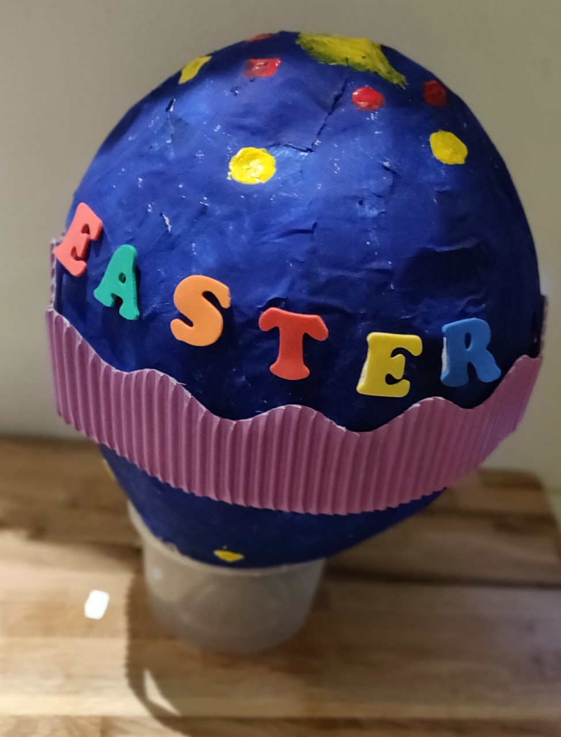
Step 7
Decorate your egg with different colours and materials.
Be as creative as you can!
Notes:
Learners could use different coloured paints, foam letters, borders etc. depending on what is available in the classroom or at home.

Slide 11
Notes:
A finished example

