Slide 1
Eggs-actly Right
Linking words and numbers

Slide 2
Stay safe
Whether you are a scientist researching a new medicine or an engineer solving climate change, safety always comes first. An adult must always be around and supervising when doing this activity. You are responsible for:
• ensuring that any equipment used for this activity is in good working condition
• behaving sensibly and following any safety instructions so as not to hurt or injure yourself or others
Please note that in the absence of any negligence or other breach of duty by us, this activity is carried out at your own risk. It is important to take extra care at the stages marked with this symbol: ⚠

Slide 3
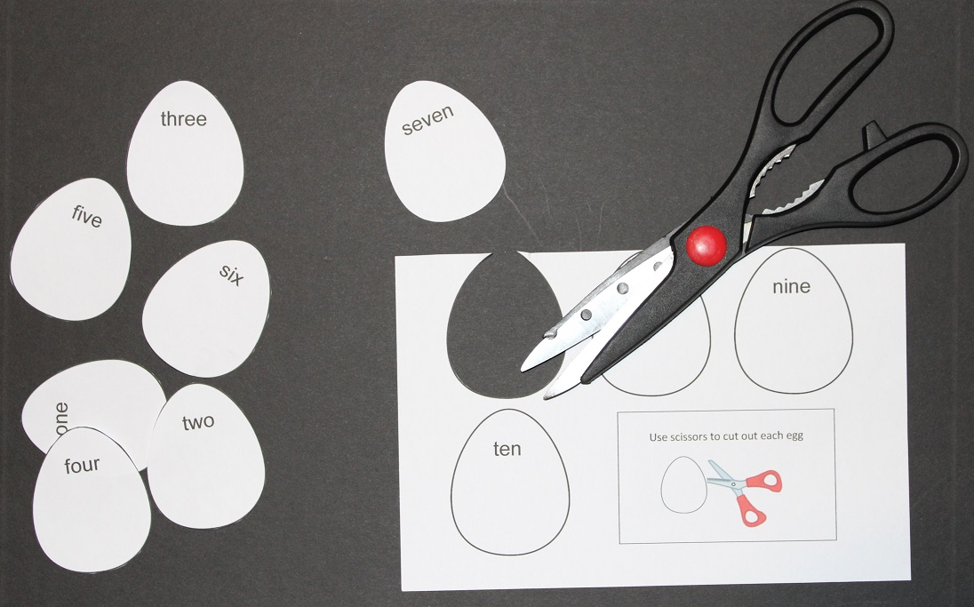
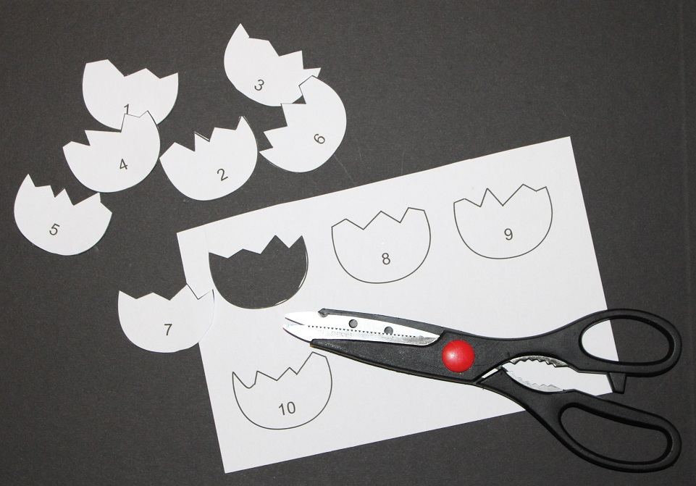
Step 1 – Cutting out ⚠
Carefully cut out the eggs and the shells

Slide 4
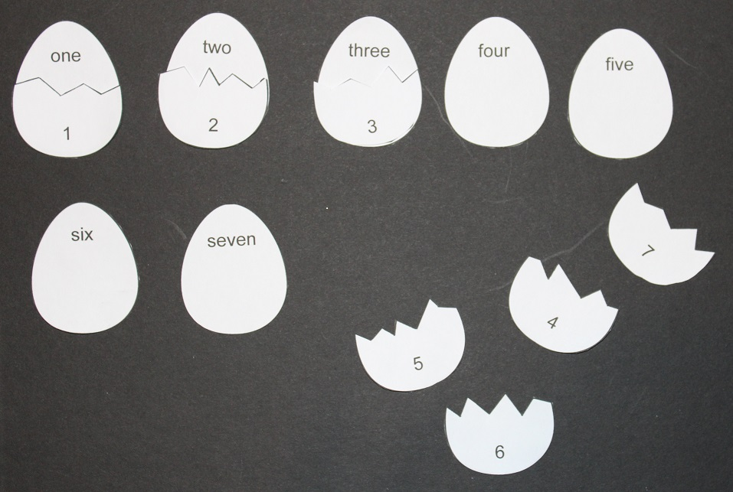
Step 2 – Sorting
Put the shells with the correct eggs

Slide 5
Extension
Use the eggs to make and solve maths problems

Slide 6
Extension 2
Use the eggs to make and solve maths problems

