Slide 1
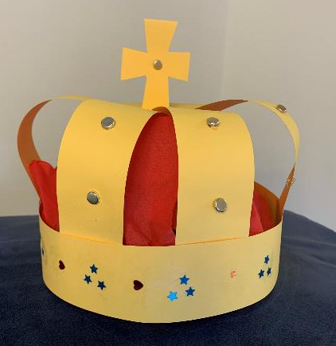
How to make a crown
Making and assembling a crown from card strips

Slide 2
Stay safe
Whether you are a scientist researching a new medicine or an engineer solving climate change, safety always comes first. An adult must always be around and supervising when doing this activity. You are responsible for:
ensuring that any equipment used for this activity is in good working condition
behaving sensibly and following any safety instructions so as not to hurt or injure yourself or others
Please note that in the absence of any negligence or other breach of duty by us, this activity is carried out at your own risk. It is important to take extra care at the stages marked with this symbol: ⚠

Slide 3
Design brief
The coronation of King Charles III will take place on Saturday 6 May 2023
There will be a bank holiday on Monday 8 May
Lots of public events will take place to celebrate this historic event
Your task:
Design and make a crown that is fit for a king!
Notes:
Questions for discussion:
Have they heard of the coronation?
Do they know who the King is?

Slide 4
Equipment and resources
Coloured card
Coloured crepe paper
Scissors
Glue stick
Sticky tape
Sticky tack
Sharp pencil
Paper fastener
Decorative items!

Slide 5
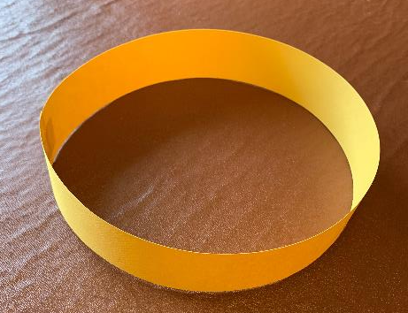
⚠
Step 1 Headband
Using coloured card
Carefully cut out a 40 mm wide strip
Check that the strip is long enough to go around your head, with a small overlap
Glue the ends to form a circle
Add sticky tape to reinforce the join

Slide 6
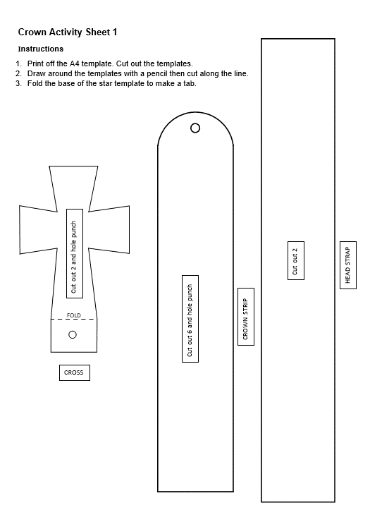
⚠
Step 2 Cutting the head straps
Cut out the shapes on the crown activity sheet
On black card, draw around the head strap template
Cut out two head straps

Slide 7
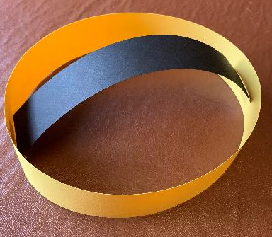
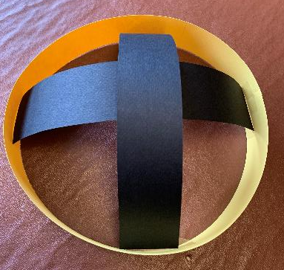
Step 3 Head straps
Glue the first strap across the headband
Try on the crown and adjust to fit
Glue the second strap into place
Add sticky tape to secure the straps to the headband

Slide 8
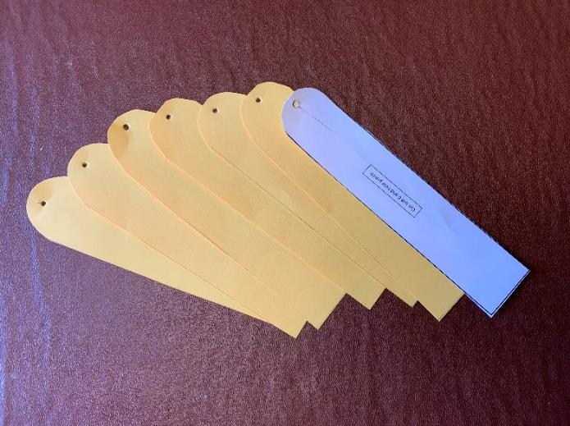
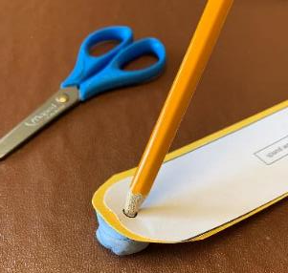
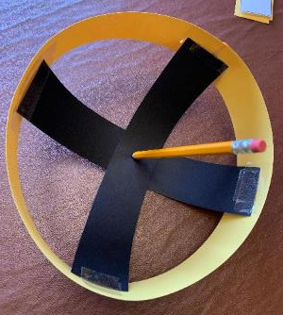
Step 4 Cutting the crown straps
⚠
On card draw around the crown strap template
Cut out six straps
Make a hole in each strap using sticky tack and a sharp pencil
Make a hole at the centre of the head straps

Slide 9
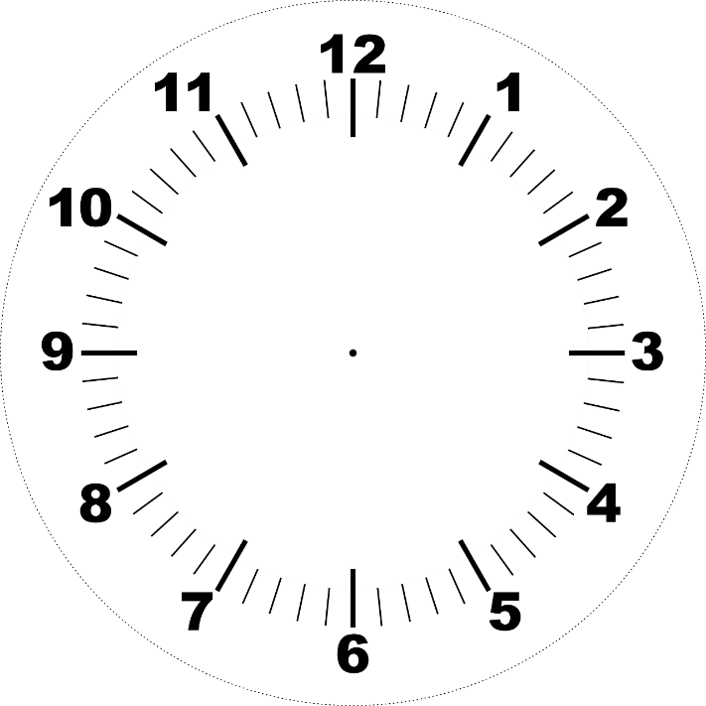
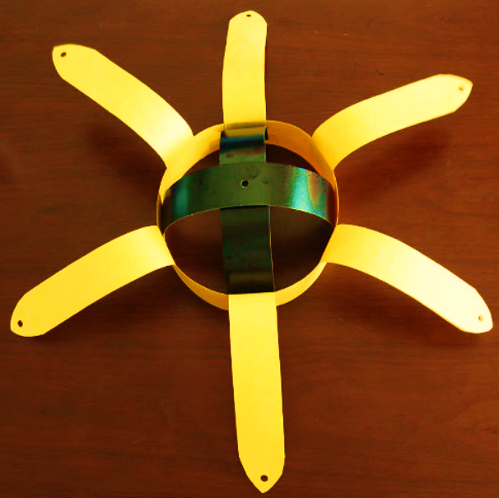
Step 5 Crown straps
Glue the six crown straps in place at the following positions:
12, 2, 4, 6, 8 and 10 o’clock

Slide 10
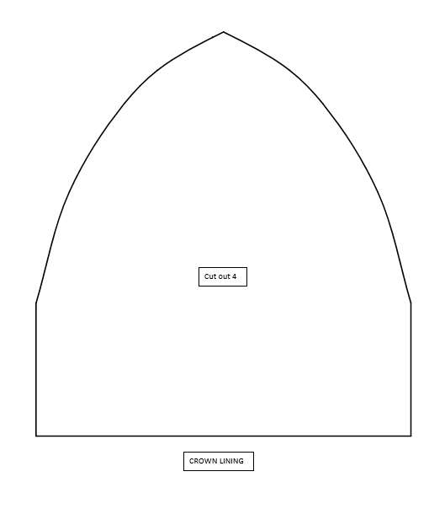
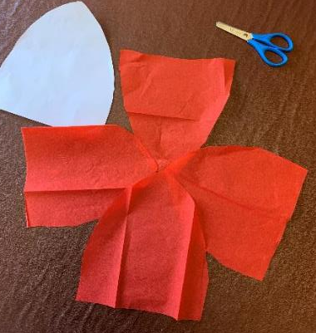
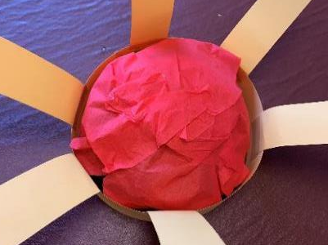
Step 6 Cutting the lining
⚠
Cut out the crown lining shape from the crown activity sheet 2
On red crepe paper, draw around the crown lining template
Cut out 4 shapes
Glue them onto the black head straps to form a dome shape

Slide 11
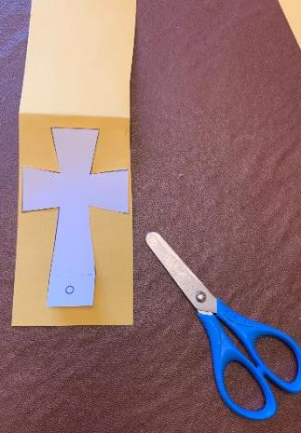
Step 7 Cross
⚠
Draw around the cross template on folded card
Cut out the cross
Fold the tabs and punch a hole in one tab using a sharp pencil and sticky tack
Glue the cross together
Place a paper fastener into the hole

Slide 12
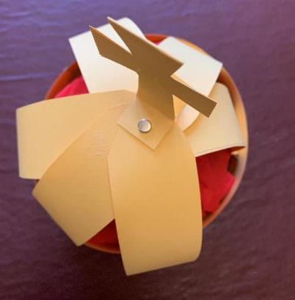
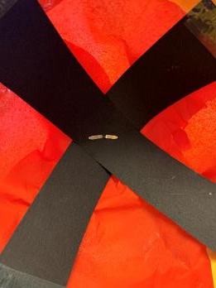
Step 8 Crown straps
Insert the cross paper fastener through the holes on the crown straps
Push the fastener through the paper lining and head straps
Split and fix the paper fastener in place
Put stick tape over the ends of the fastener for safety

Slide 13
Step 9 Decorate the crown!
Decorate the crown using:
Paper fasteners
Beads
Glitter glue
Sequins
Tinsel paper
Gem-style stickers
Paint

