Slide 1
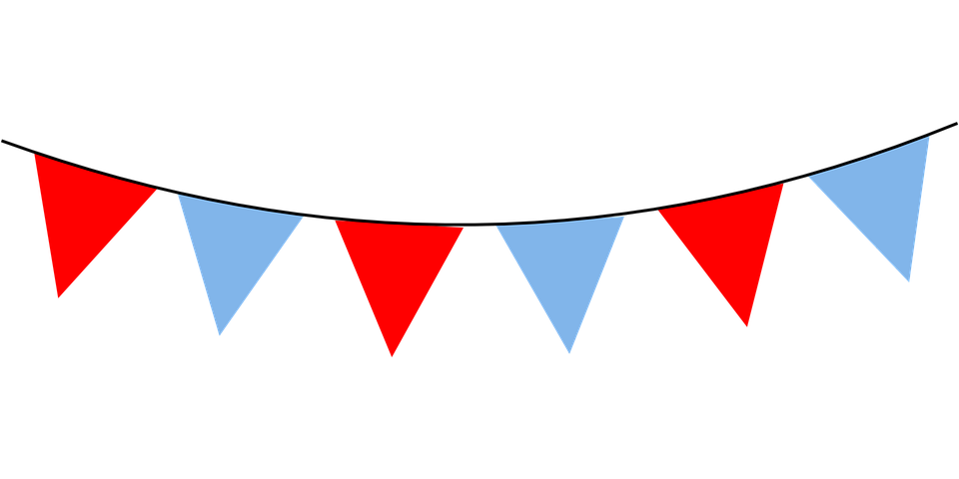
Make bunting for a party
Make bunting as a class for a celebration
e.g. the coronation of King Charles III

Slide 2
Stay safe
Whether you are a scientist researching a new medicine or an engineer solving climate change, safety always comes first. An adult must always be around and supervising when doing this activity. You are responsible for:
ensuring that any equipment used for this activity is in good working condition
behaving sensibly and following any safety instructions so as not to hurt or injure yourself or others
Please note that in the absence of any negligence or other breach of duty by us, this activity is carried out at your own risk. It is important to take extra care at the stages marked with this symbol: ⚠

Slide 3
Design brief
The coronation of King Charles III will take place on Saturday 6 May 2023
There will be a bank holiday on Monday 8 May
Lots of public events will take place to celebrate this historic event
Your task:
As a class, design and make bunting that can be put up at a street party to celebrate the occasion
Notes:
Individual learners will each produce their own flag designs, then these will be joined together to create the finished bunting for the street party. Discuss the brief with learners and ensure they understand what they need to do.

Slide 4
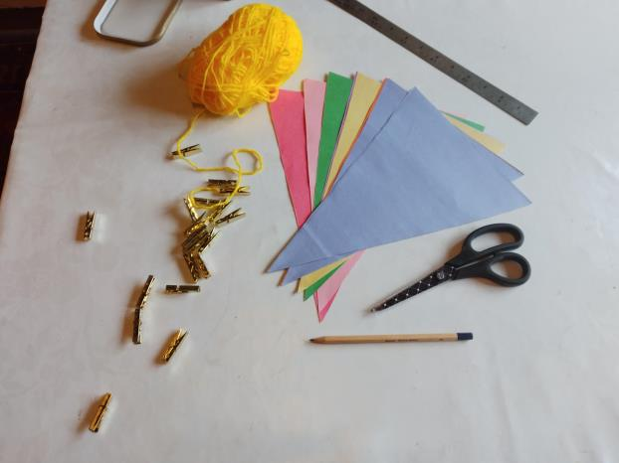
Equipment and Resources
Potatoes
Knives
Paint
Paper
Colouring pencils or pens
Scissors
Pencils and rulers
String
Stapler

Slide 5
Step 1 Design your own flag
Using the worksheet, design your own flag that will be added to the class bunting
Think about the different colours you could use - for example, red, white and blue
What lettering could you use to celebrate this event?
Notes:
This activity should be completed by individual learners using the flag design worksheet to create a triangular shaped outcome.
As an extension learners could try using different shapes other than a triangle.

Slide 6
Flag design worksheet
Notes:
Learners could individually draw their designs on a printed version of this slide, then cut them out and add them all together as a class to make the finished bunting.

Slide 7
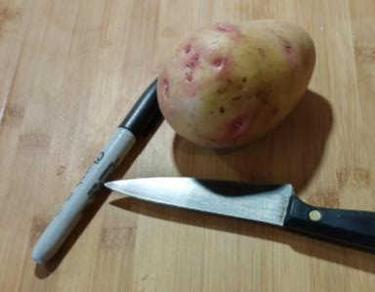
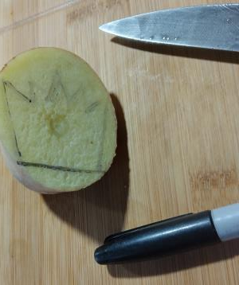
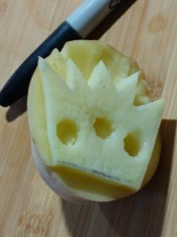
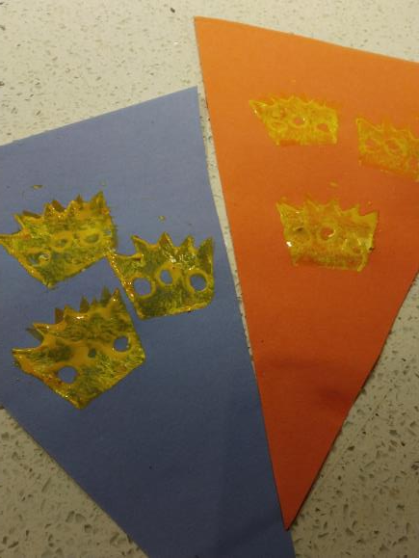
Step 2 Potato printing
⚠
Use potato printing to make your flag look really interesting
Carefully cut a potato in half with a knife
Draw the shape you want to make
Cut away the parts of the potato not needed
Paint the shape and use it to print your design!
Notes:
Potato printing could be used to add more visual interest. Care must be taken when using knives or other sharp cutting tools – assistance may be needed for weaker learners.
Pre-made templates could be produced for this stage.

Slide 8
Step 3 Cut out your flag
⚠
Cut out your flag using scissors
Be careful not to cut yourself!
Everyone in the class needs to complete this step so we have enough flags for our bunting!

Slide 9
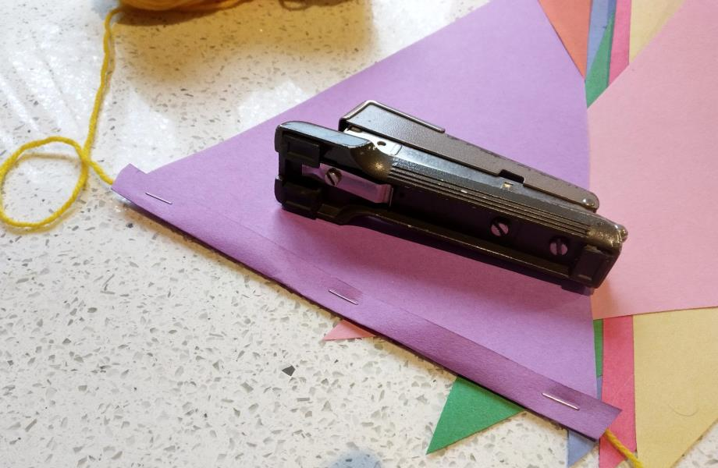
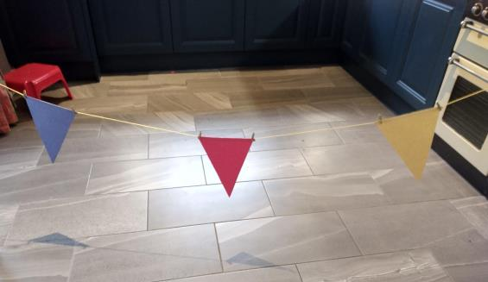
Step 4 Making the bunting
⚠
As a class, everyone now needs to add their flag to the string to make the bunting
Fold the top of each flag over the string as shown
Use a stapler to make sure each flag is fitted properly and won't fall off
Notes:
Teacher should have string cut and ready for attaching the flags – the size will depend on the number in the class and the number of flags that are to be added.
Learners need to think about the spacing between each flag and what will look the best.
Learners should take care when using a stapler not to hurt their hands.

Slide 10
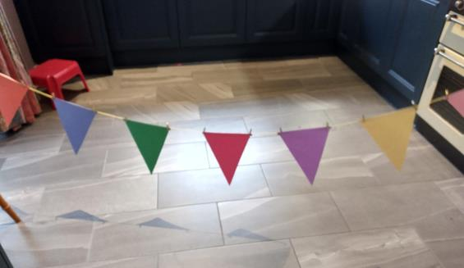
Hang up your bunting
As a class, hang up your finished bunting, ready for the party!
You will need to tie each end to make sure it doesn't fall down

