Slide 1
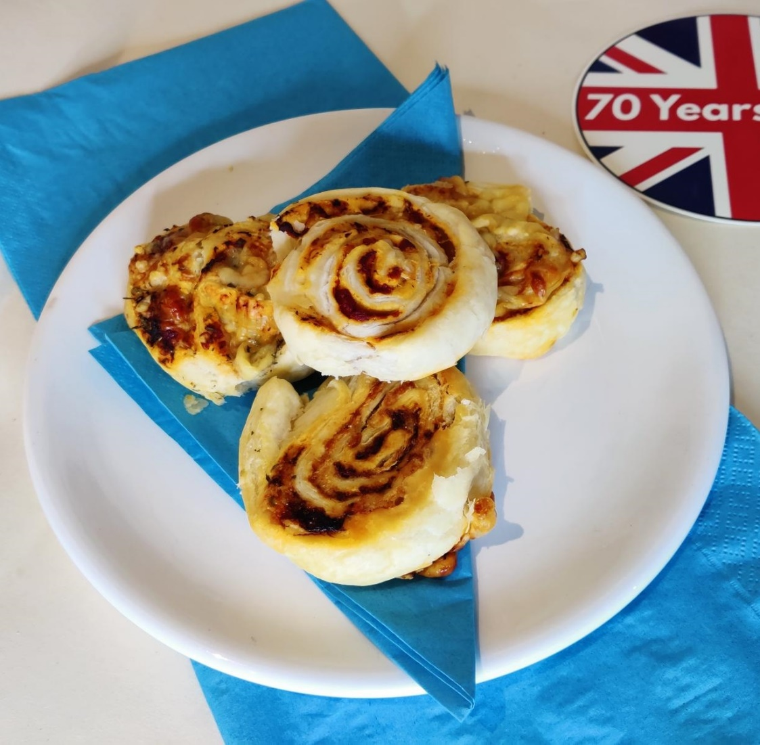
Puff pastry pizza swirls recipe
Designing and making a food dish for a street party celebration e.g. for the coronation of King Charles III

Slide 2
Stay safe
Whether you are a scientist researching a new medicine or an engineer solving climate change, safety always comes first. An adult must always be around and supervising when doing this activity. You are responsible for:
ensuring that any equipment used for this activity is in good working condition
behaving sensibly and following any safety instructions so as not to hurt or injure yourself or others
Please note that in the absence of any negligence or other breach of duty by us, this activity is carried out at your own risk. It is important to take extra care at the stages marked with this symbol: ⚠

Slide 3
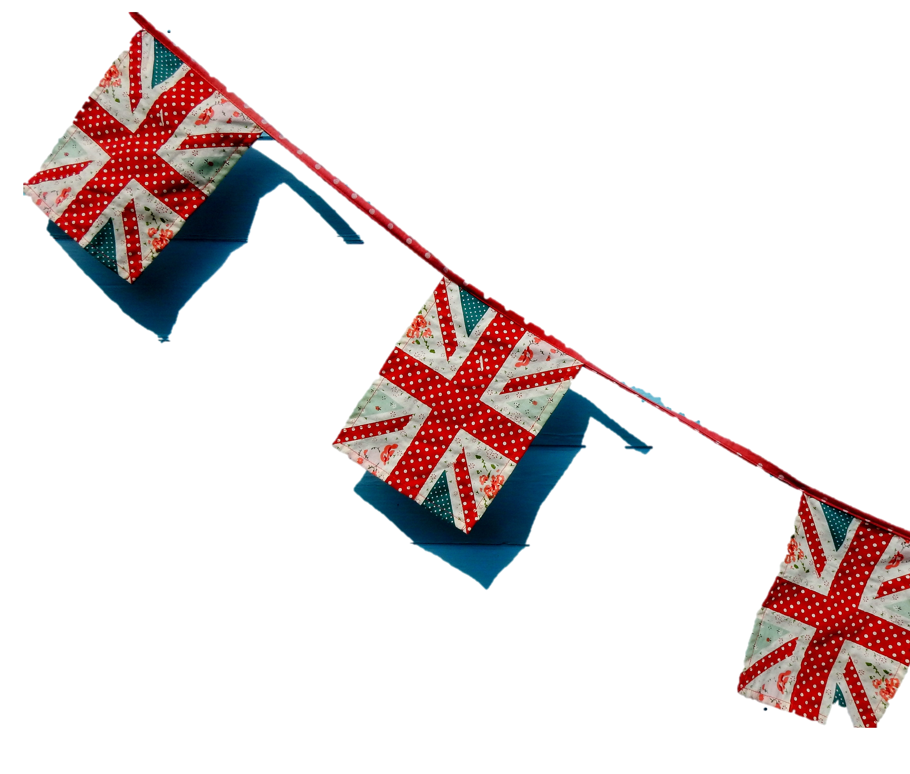
Design brief
What is the celebration?
The coronation of King Charles III will take place on Saturday 6 May 2023
There will be a bank holiday on Monday 8 May
Lots of public events will take place to celebrate this historic event
Your task:
Design and make a food item that can be served at a street party to celebrate this occasion!
Notes:
Questions for discussion:
Have they heard of the coronation?
Do they know who the King is?

Slide 4
Things to think about
What is a street party?
How many people do you need to feed?
How will the food items be made?
What dietary needs do we need to consider?
How do I make the portion sizes bigger or smaller?
How will the food be presented?
Notes:
Learners could produce a spider chart to capture their initial thoughts on the brief.
Things to consider:
Where can they hold the party?
How many people are they going to feed? They may need to scale up or down a recipe to accommodate this.
Where are they going to prepare their food?
Have they seen any royal celebrations before? For example Harry and Meghan wedding.
Do they need to take into consideration special dietary/religious food options?
How are they going to serve the food, is it going to be a buffet or already plated up?

Slide 5
Spider chart example
Brownies
Cup cakes
Victoria Sponge
Cakes
Fillings
Cheese straws/ swirls
Fruit kebabs
Quiche
Samosa
Sweet
Jam tarts
Pastry
Sausage rolls
Foods
Scones
Rolls/loaf
Jam/Cream
Naan/wrap/pittas
Bread
Pizza
Savoury/Sweet
Rice/Pasta
Sandwiches
Salads
Burgers
Hot/Cold
Fillings
Notes:
This could be used as an example spider chart to think about different types of food that could be made.
Vegetarian/Vegan/Gluten free alternatives are available for most of the above suggestions.
Food decoration – cake decorating/use of colour in the food/accompaniments/use of coloured crockery.
Additional questions:
How would you decorate the food?
Which is your favourite food idea?

Slide 6
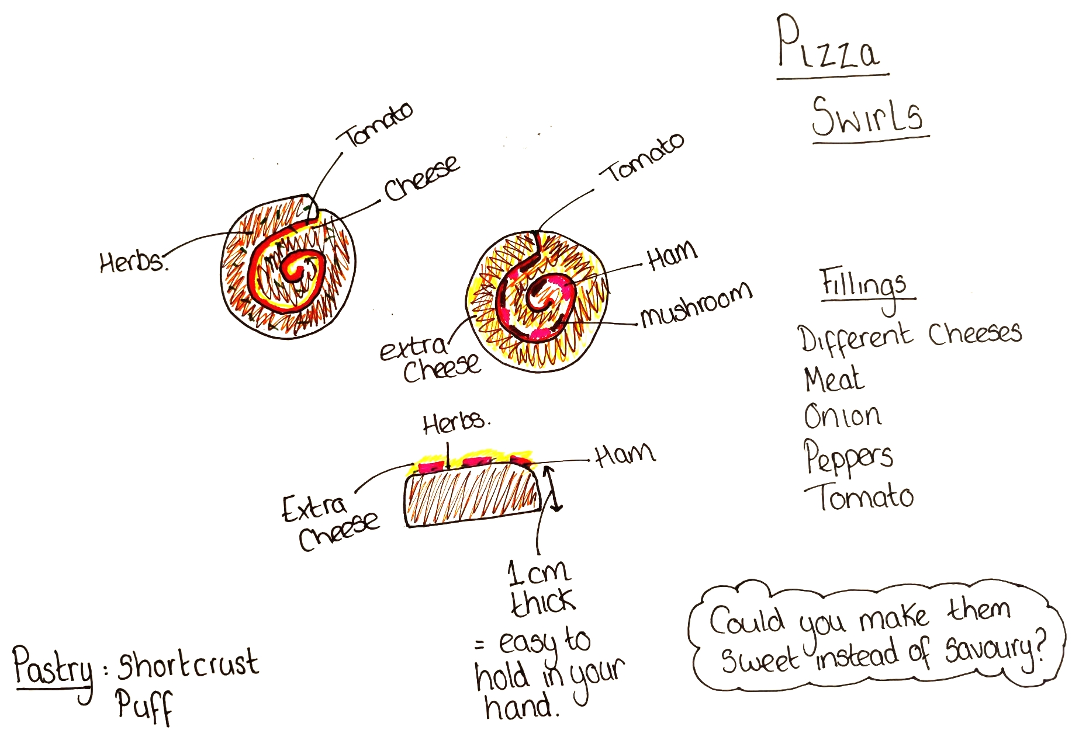
Example design idea 1
Notes:
This is an example design idea for a pizza swirl.
Templates of shapes can be used to assist the design process.
The design process can be skipped if the making process is guided and everything is being provided in advance.

Slide 7
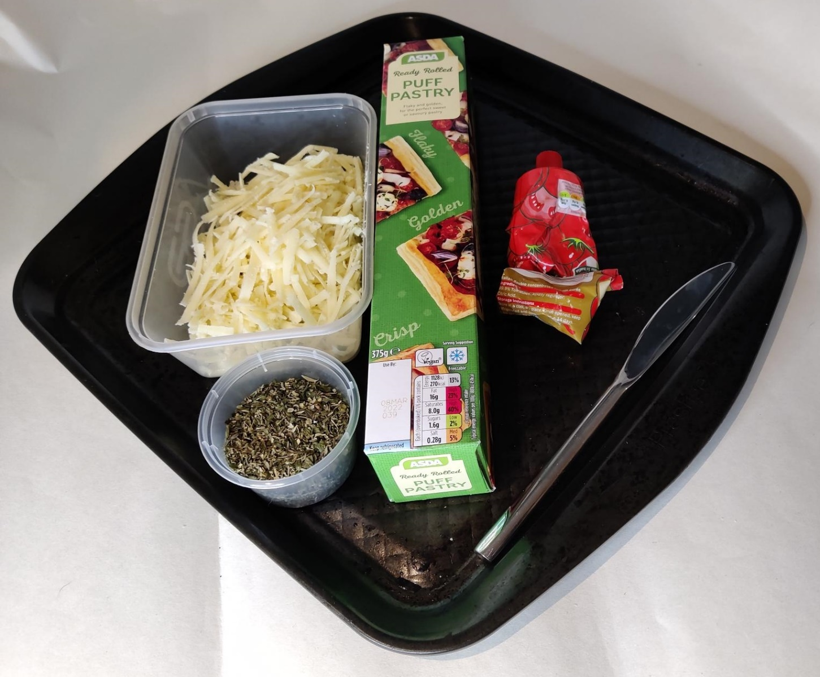
Example – How to make pizza swirls
Ingredients
100g Grated cheese
Dried mixed herbs
1 packet Ready rolled puff pastry (approx. 320g)
1 Tbsp Tomato puree
Notes:
Vegetarian/Vegan alternatives are available for most of the above suggestions.
Food decoration – use of colour in the food/accompaniments/use of coloured crockery.
Maths link:
How can you upscale/downscale the recipe to make different portion sizes? E.g. 1, 5, 20, 100 as it’s a street party.
Calculate the scaling factor by dividing the number of servings (or grams) you want to make by the recipe yield. Example: This recipe yields 10 servings, the scaling factor is 10, e.g. 100 ÷ 10 = 10, so 10g per Pizza Swirl. This needs to be done for each ingredient.
1 Portion of Swirl:
10g Grated Cheese
1g Dried Herbs
32g Puff Pastry
1.5ml Tomato Puree

Slide 8
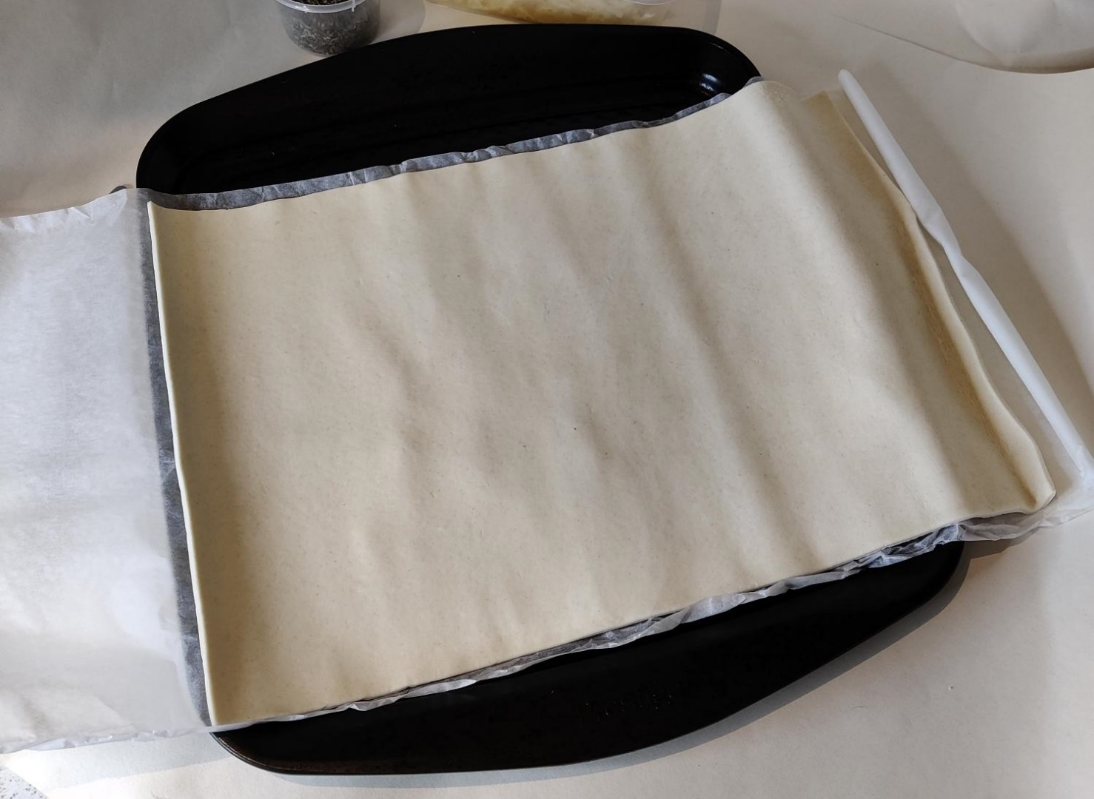
Step 1
Unroll the pastry onto the baking tray (leave the paper on)
Notes:
The pastry needs to be out of the fridge for a minimum of 15 minutes before it is used, otherwise it will crack.
Keep the pastry on the paper so that it is easier to work with.

Slide 9
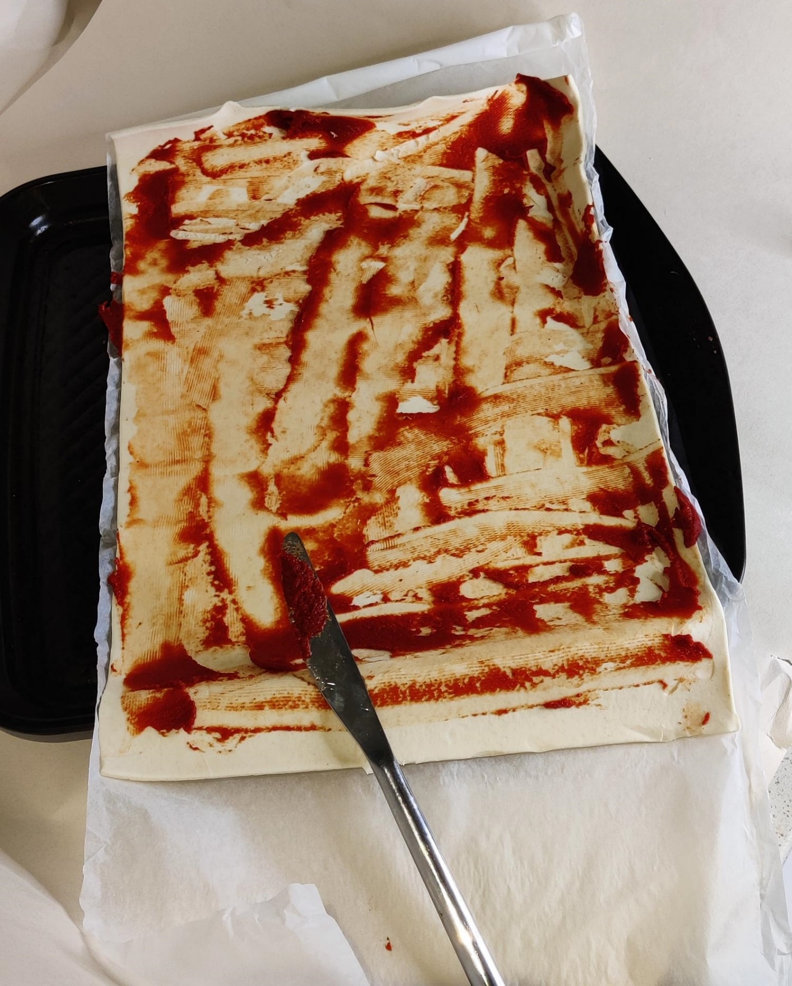
Step 2
⚠
Spread the tomato puree with the knife
Notes:
If double concentrate puree is being used, a smaller quantity will be needed.
Other sauces that could be used:
Tomato ketchup
BBQ sauce
Peri-peri sauce
Jamaican sauce
A sweet alternative could be made with chocolate spread or jam used as the sauce and not adding the additional toppings, e.g. chocolate spread and chopped up banana.

Slide 10
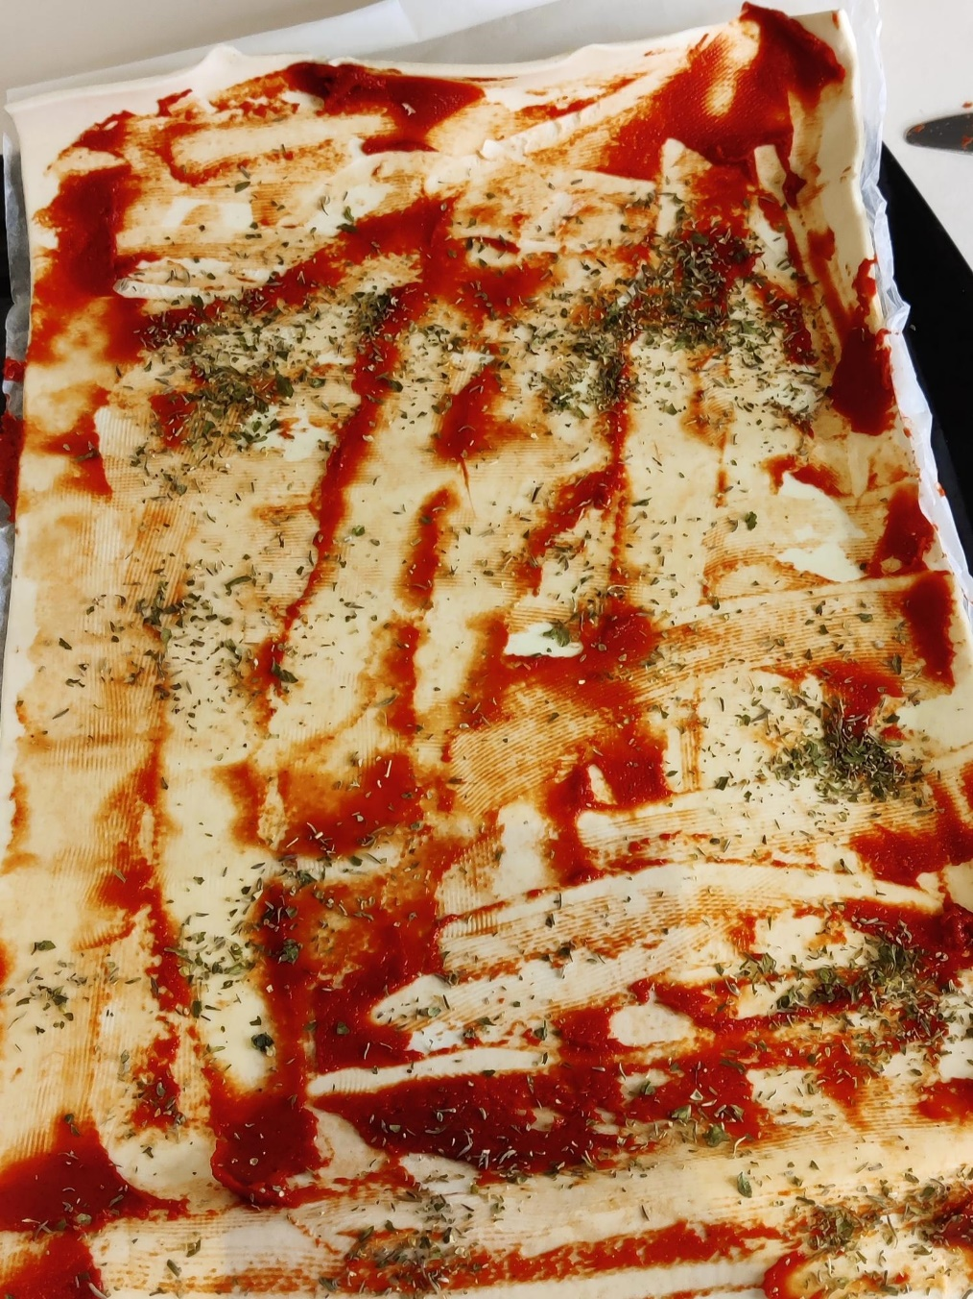
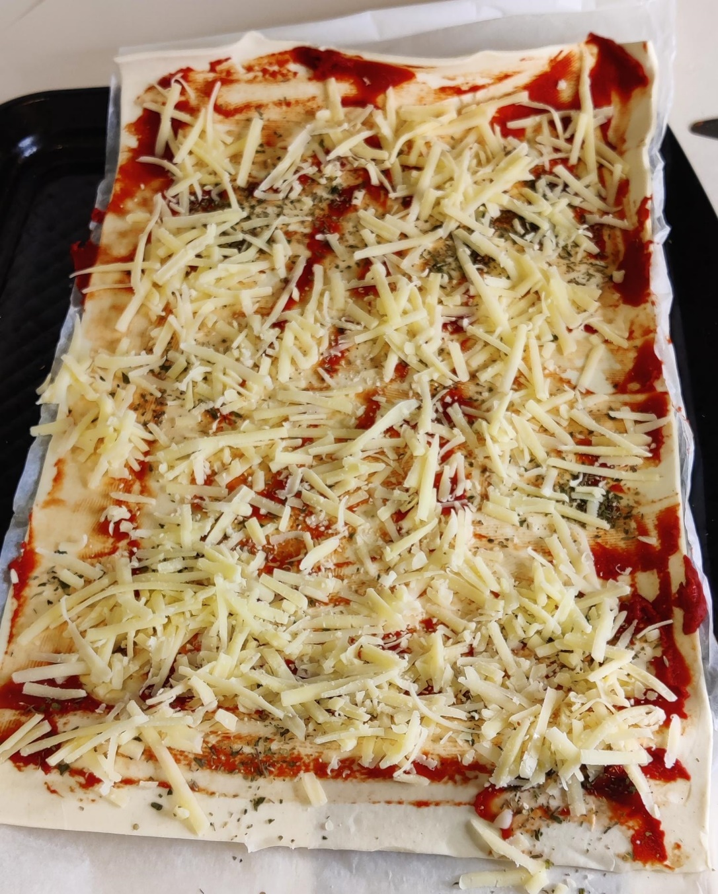
Step 3
Sprinkle dried herbs evenly over the pastry
Sprinkle the grated cheese evenly over the tomato and herbs
Notes:
Add additional fillings at this stage.
Mixed herbs were used in this example, but Oregano, Basil and Italian style herbs can be used too.
Cheese – buy in a block and grate or buy it ready grated. Cheddar, mozzarella, red Leicester or a mixture can be used.

Slide 11
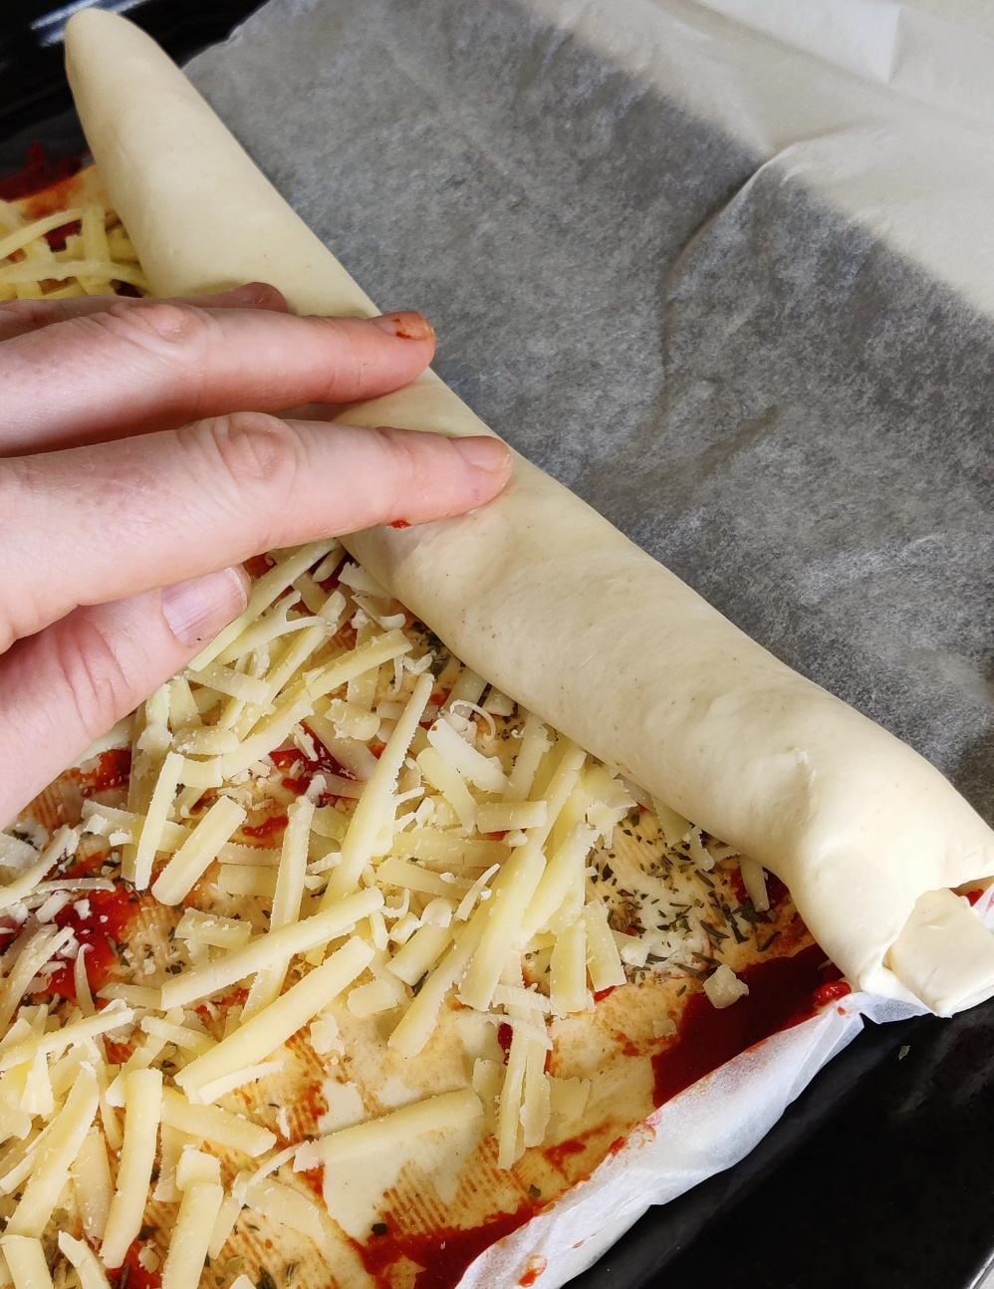
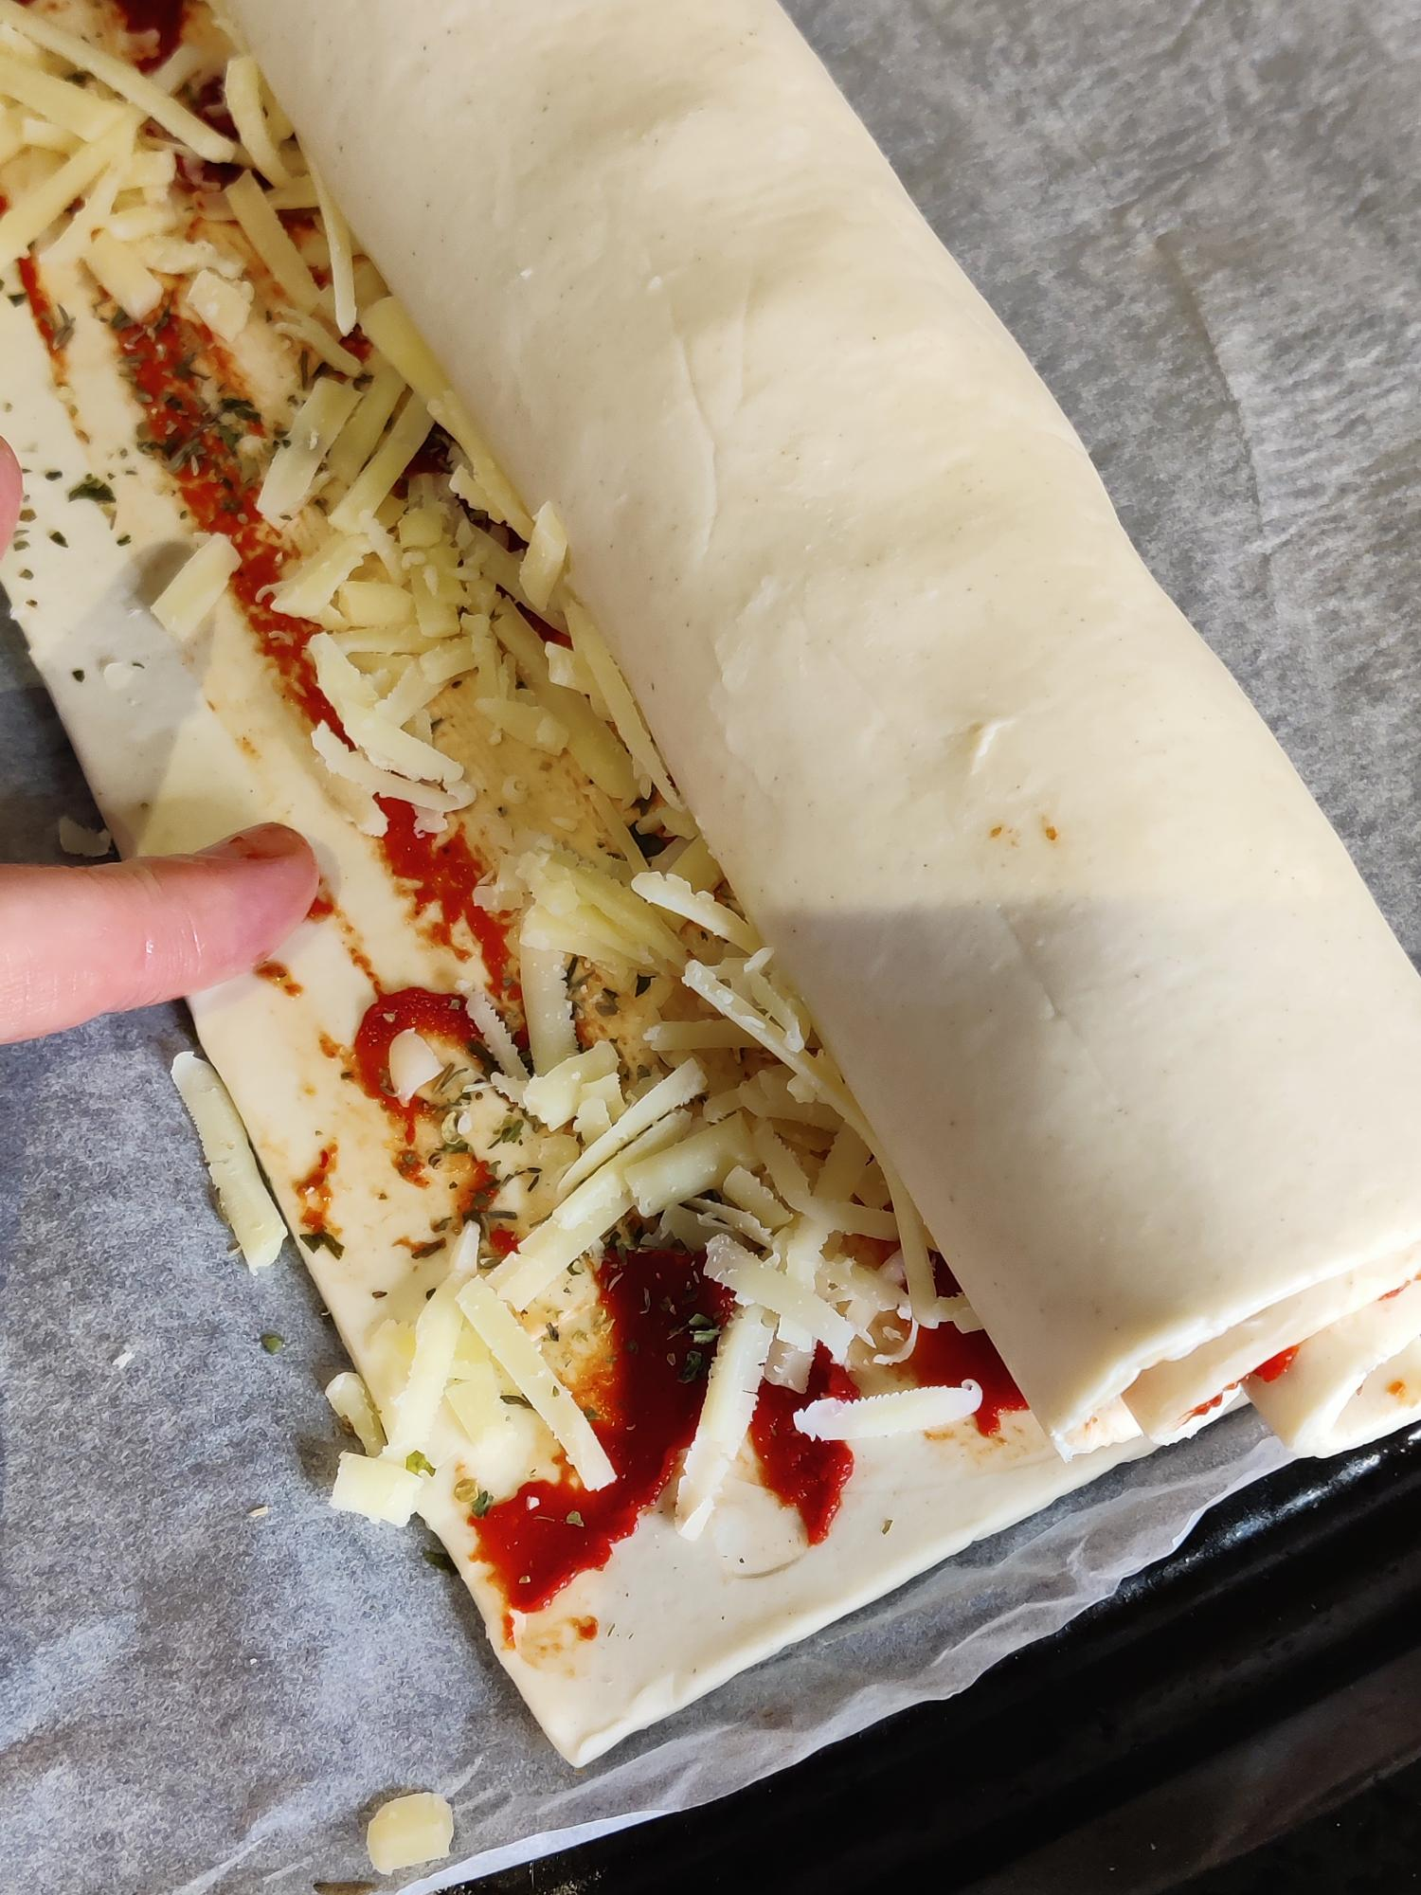
Step 4
Roll the pastry tightly until you have about 2 cm left
Use your finger to wipe water across the end to seal the pastry
Notes:
Rolling the pastry on the paper makes sure it does not stick and can aid the rolling process if needed.
It is important to get the roll as tight as possible otherwise the fillings may escape during the cooking process.
Water is a ‘magic glue’ with pastry and bread, that allows you to stick the edges down. Whisked egg or milk can be used to.

Slide 12
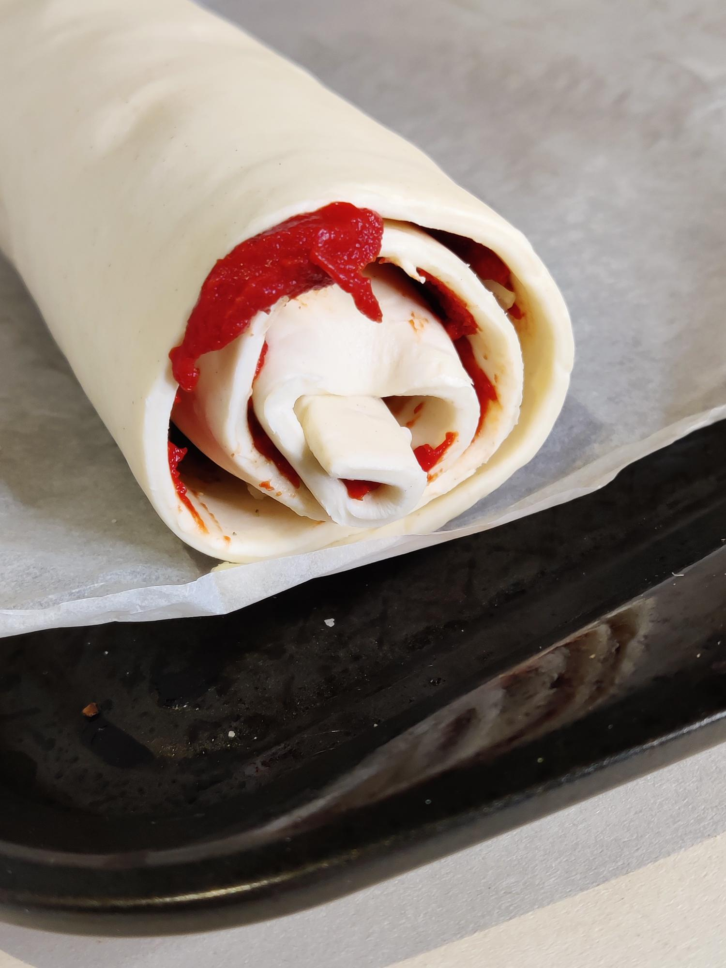
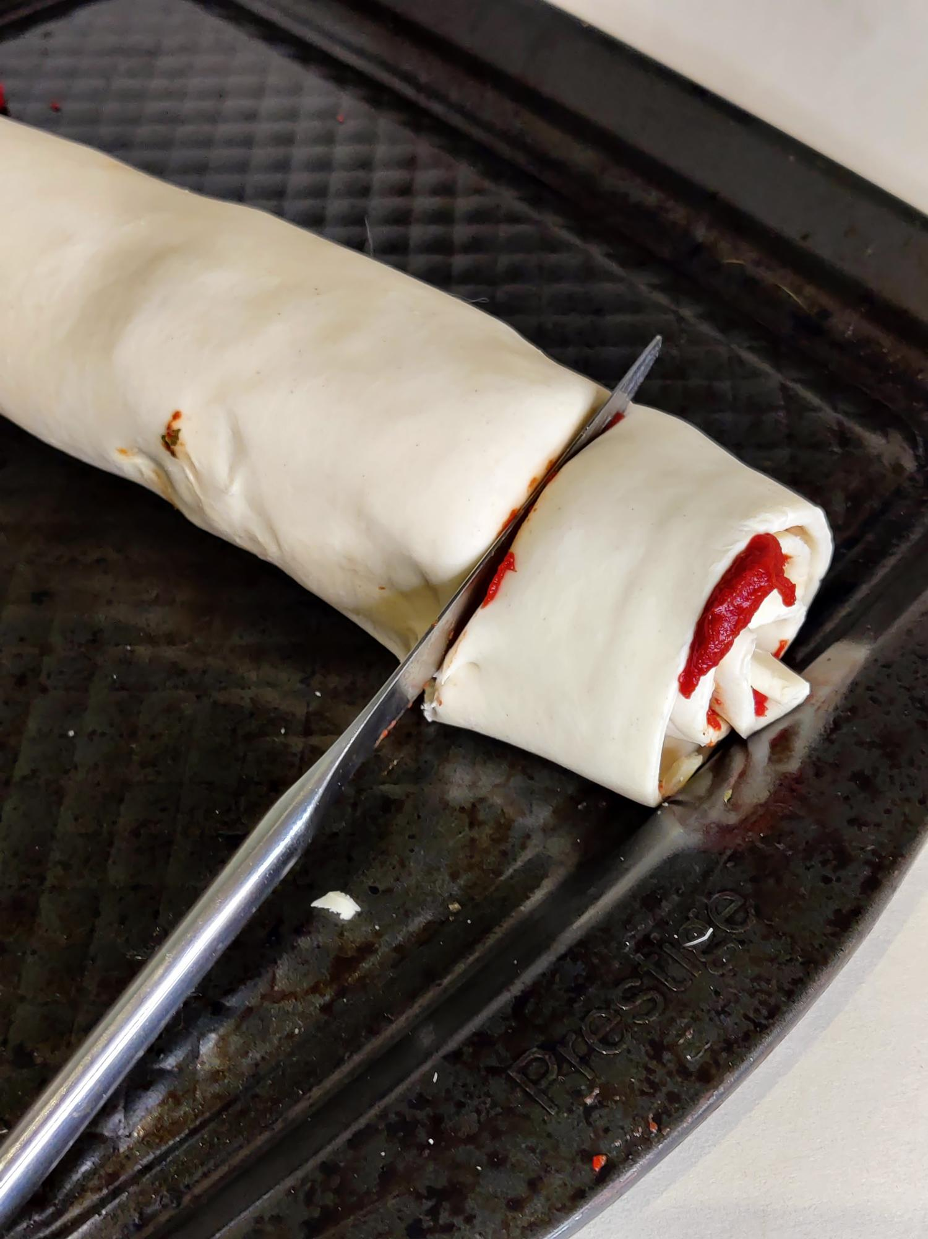
Step 5
⚠
Roll the pastry and make sure the open end is on the bottom
Cut the roll into 10 pieces
Notes:
Measure the length of the pastry and divide by 10/12/own agreed portions. Mark lightly with knife before cutting to ensure equal swirls.
Maths/Fair portion control:
Measure the length of the pastry and equally divide by 10
***cm /10 = ***cm per swirl
Or: make into 12
Cut in half, then half again and again = 12 pieces.
Could they increase/decrease the swirl sizes for portion control, e.g. for children you can make the swirls smaller, for example 15 portions instead of 10.
Measurement of the cut swirls – are they all equal – are you using a tolerance +/- 2mm?
When cooked, measure the swirls again. How much have they risen/shrunk? Work out the percentage difference between raw and cooked food.
Increase/decrease calculation:
% Increase = Increase / Original Number × 100
Decrease = Original Number - New Number
% Decrease = Decrease / Original Number × 100
Compare the increase/decrease between batches – what could affect them?
Oven temperatures?
Human error?

Slide 13
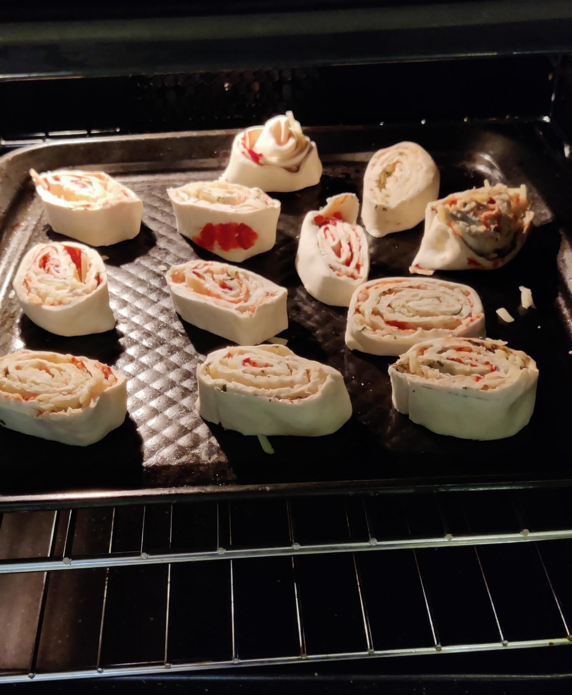
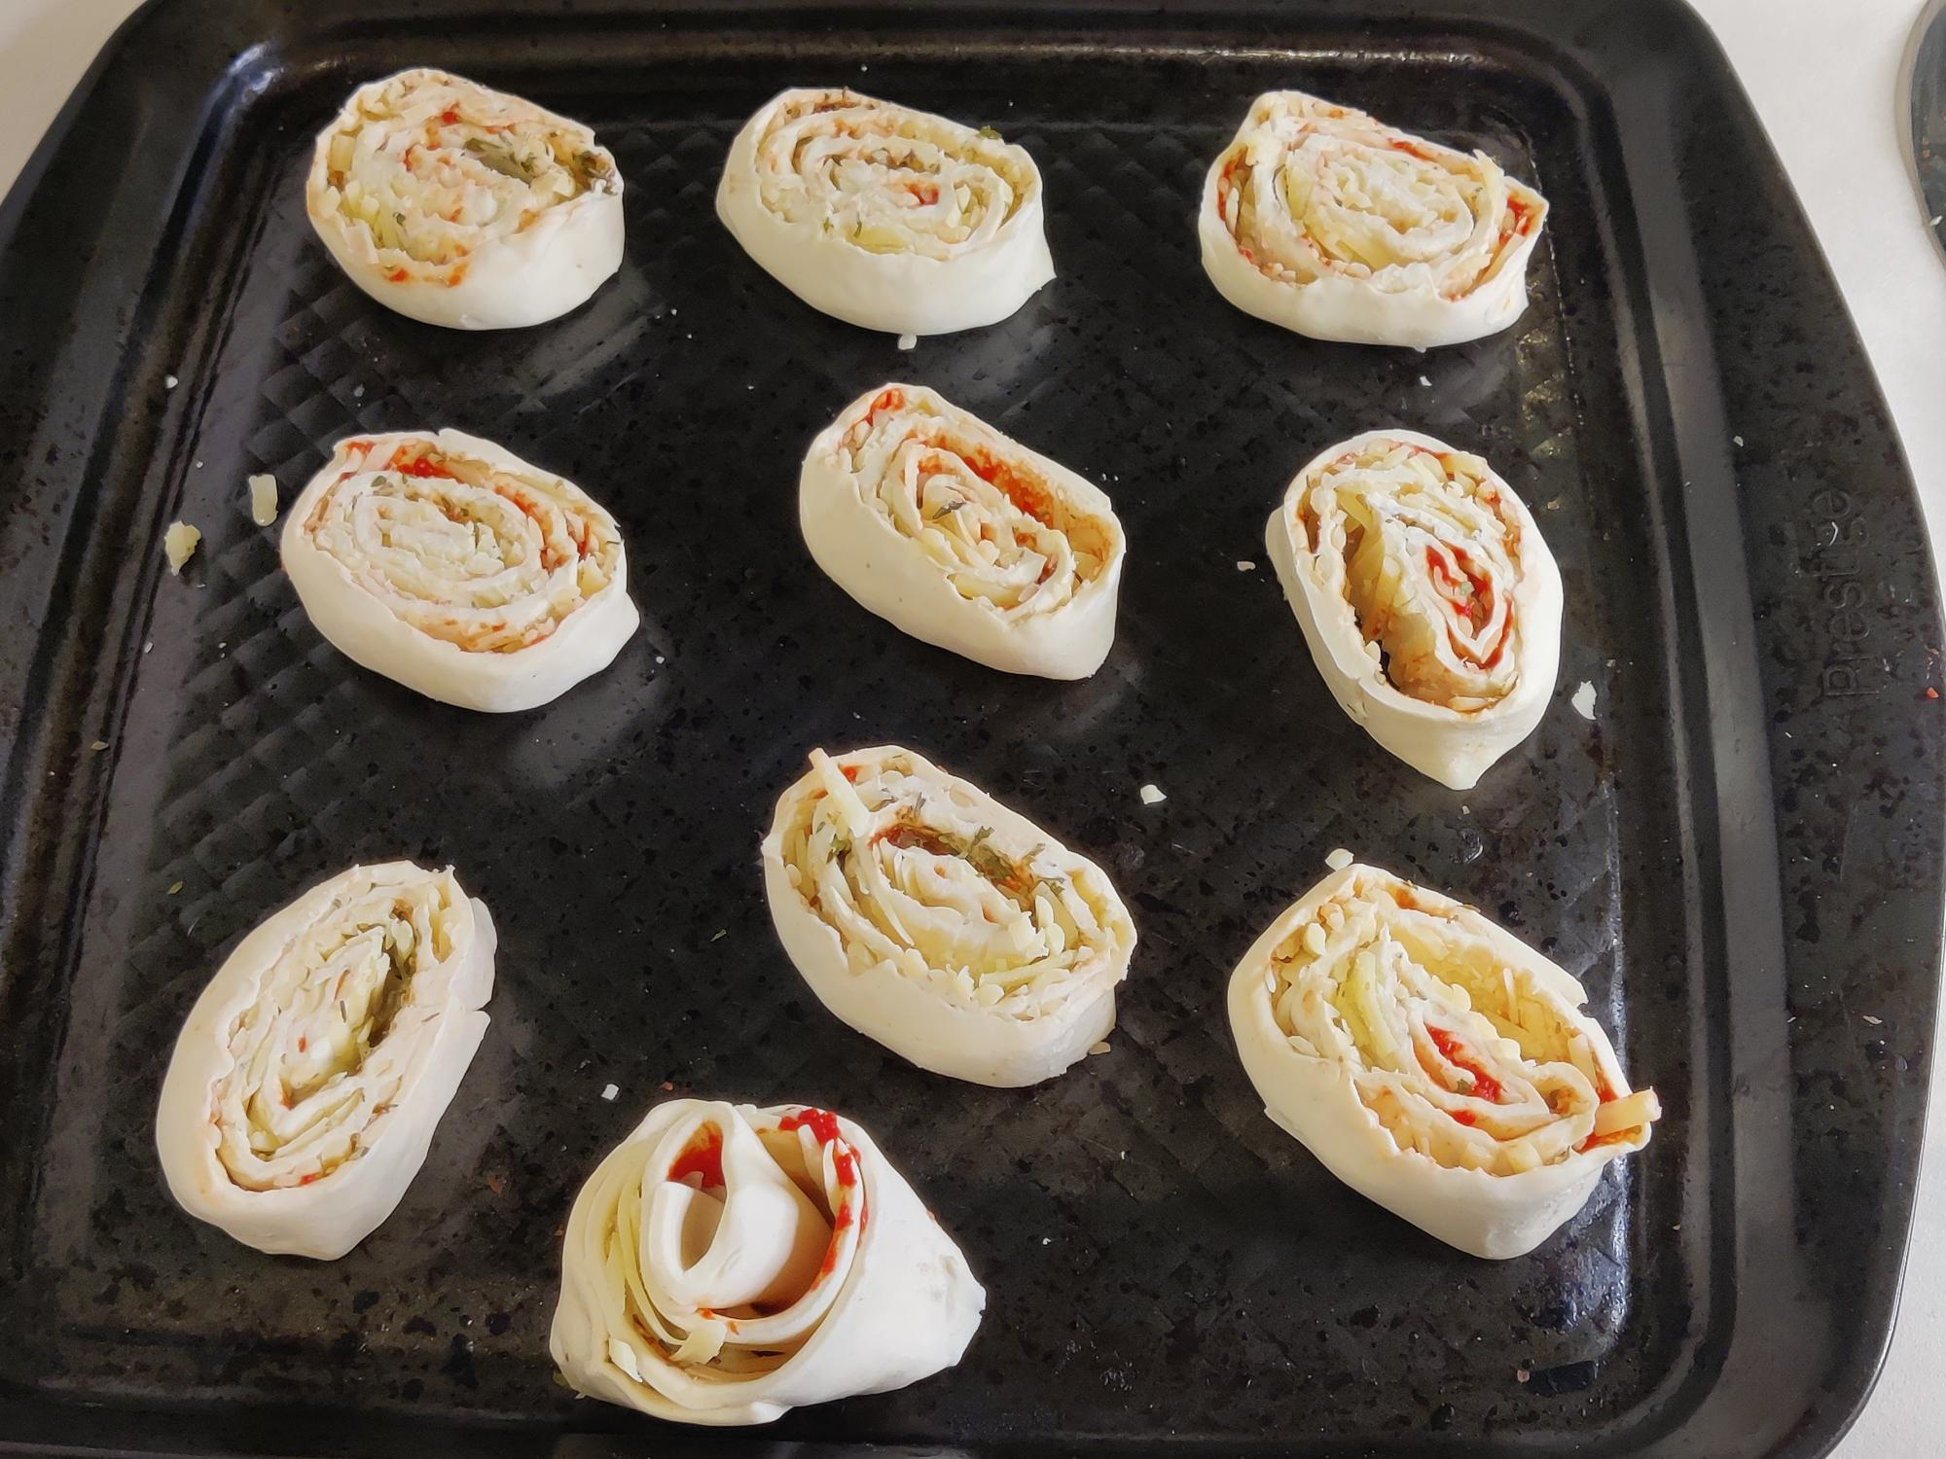
Step 6
⚠
Place evenly on the baking tray
Cook in the oven for 15 minutes
Notes:
Additional cheese and herbs can be added before putting in the oven.
To make the pastry go golden, brush with beaten egg or milk.
Food should be allowed to cool when removed from the oven. Always wear oven gloves when handling hot food.

Slide 14
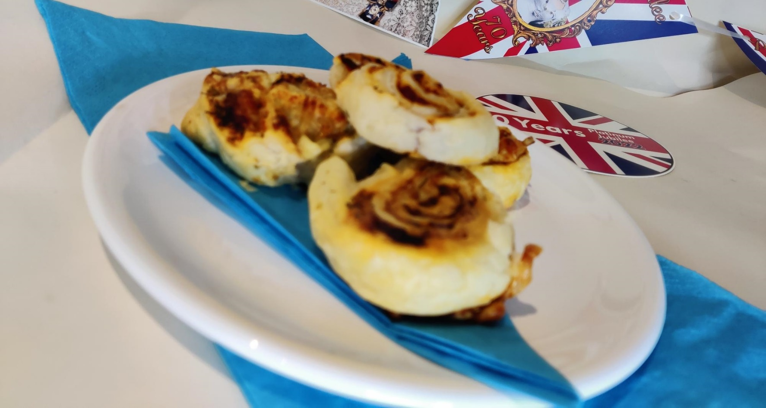
Step 7
Present, serve and enjoy your food!
Notes:
Flags, bunting and stickers could be used to help present the food to reflect the theme of the jubilee celebrations.

Slide 15
The finished product!
Notes:
Examples of pizza swirls and cupcakes:
This slide shows examples of recipes that could be made based on the theme of the design brief.
Learners could follow these to create lots of different food items, or design their own.

Slide 16
Pizza Swirls (10 pieces)
Ingredients Equipment
Ready Rolled Puff Pastry 1 Greased Baking Tray
1 Tbsp Tomato Puree Tablespoon
100g Grated Cheese Knife
Dried Mixed Herbs Wooden Spoon
Ruler
Method
Collect your equipment and preheat the oven to 200°C/gas mark 6.
Unroll the pastry onto the baking tray (leave the paper on).
Spread the tomato puree onto the pastry with the knife.
Sprinkle dried herbs evenly over the pastry.
Sprinkle the grated cheese evenly over the tomato and herbs.
Roll the pastry tightly until you have approximately 2 cm left. With your finger wipe water across the end of the pastry to seal it.
Roll the pastry and make sure the open end is on the bottom on the roll.
Cut the roll into 10 pieces.
Place evenly on the baking tray.
Cook in the oven for 15 minutes (until golden brown).
Notes:
The above recipe is Vegetarian friendly, Vegan pastry/cheese can be purchased if required.

Slide 17
Bread (4 rolls)
Ingredients Equipment
200g Bread flour Mixing bowl
15g Margarine Sieve
1 tsp Yeast Wooden spoon
1 tsp Salt Teaspoon
1 tsp Sugar Measuring jug
Warm water Greased baking tray
Method
Collect your equipment. Preheat the oven to 200°C/gas mark 6.
Sieve together the flour and salt into the mixing bowl. Stir in yeast and sugar.
Add warm water and mix into a dough and knead for 10 minutes.
Divide dough into 4 and place on greased baking tray.
Leave the dough for 5-10 minutes in a warm place. (cover with a tea towel and leave on top of the hob).
Bake for 10-15 minutes until golden brown. When tapped on the bottom they will sound hollow.
Make a hedgehog!
Using thumb and finger pinch the dough to create the hedgehog’s nose, use the same method to create spikes over the dough. Add raisin eyes.
Notes:
Bread flour can be white, brown, wholemeal or a mixture.
This mixture can be made into rolls or a whole loaf (adjust cooking time accordingly).
Consider the shapes that can be made with the bread: plaits, cottage loaf, round bap.

Slide 18
Cous Cous Salad (2 portions)
Ingredients Equipment
1 Vegetable/chicken stock cube Tablespoon
100g Plain dried couscous Chopping board
1 Tomato Vegetable knife
1 Spring onion Measuring jug
Small piece of cucumber Small saucepan
½ Yellow pepper or small tin sweet corn Container
2 tbsp Salad dressing
Method
Measure 200ml water in to the jug.
Then place into saucepan and add stock cube – stir until dissolved. Bring water to the boil. TURN OFF HEAT.
Empty the couscous into the pan and stir once. Leave until all water is absorbed.
Meanwhile, chop and slice vegetables.
When couscous is ready, add the chopped vegetables and dressing.
Put into your container.
Tip
Consider your salad
dressing - honey & mustard,
French, Italian, balsamic,
thousand island...
Notes:
Cooked meat can be added to this recipe, e.g. cooked chicken, chopped ham or sausage.
Three or four vegetables need to be selected.
Colour variety needs to be considered, make sure the salad is not all the same colour.

Slide 19
Buns (Creaming Method) (12 buns)
Ingredients Equipment
100g SR Flour 1 bun tin
100g Sugar 12 bun cases
100g Margarine Mixing bowl
2 Large Eggs Wooden spoon
1 tsp Vanilla extract Tablespoon
Method
Collect your equipment and preheat the oven to 200°C/gas mark 6.
Place margarine and sugar into the mixing bowl, beat until white, light and fluffy to incorporate air into the mixture.
Add eggs gradually and beat well.
Sieve flour into the mixture and slowly fold in using a spoon. If you beat the mixture at this stage air will fall out of the mixture and the cake will not rise very well.
Spoon mixture into paper cases filling each one ½ to 2 /3 full. No more or the cakes will spill over the paper cases and burn the tins.
Place buns into pre heated oven and bake for 15-20 minutes until the sponge is golden brown and springy to touch.
Tip
Change 20g of flour for
coco powder.
Add 20g of dried fruit,
e.g. raisins, cherries or sultanas.
Notes:
This recipe can be scaled up and down depending on quantity required.

