Slide 1
Make your own recipe book
Designing and making a recipe book for party food
e.g. The coronation of King Charles III
Notes:
This resource builds on the existing IET Faraday activity ‘Jubilee Food’.

Slide 2
Stay safe
Whether you are a scientist researching a new medicine or an engineer solving climate change, safety always comes first. An adult must always be around and supervising when doing this activity. You are responsible for:
ensuring that any equipment used for this activity is in good working condition
behaving sensibly and following any safety instructions so as not to hurt or injure yourself or others
Please note that in the absence of any negligence or other breach of duty by us, this activity is carried out at your own risk. It is important to take extra care at the stages marked with this symbol: ⚠

Slide 3
Design brief
What is the celebration?
The coronation of King Charles III will take place on Saturday 6 May 2023
There will be a bank holiday on Monday 8 May
Lots of public events will take place to celebrate this historic event
Your task:
Design and make a recipe book of foods for your celebration!
Notes:
Questions for discussion:
Have they heard of the Coronation?
Do they know who the King is?

Slide 4
Things to think about
Recipes
Front cover
Photos/
drawings
What do we need to include in a recipe book?
Contents page
Top tips
The recipes need to be suitable for a ‘Street Party’
Notes:
Learners could produce a spider chart to capture their initial thoughts on the brief. Can they think of any additional points to add?

Slide 5
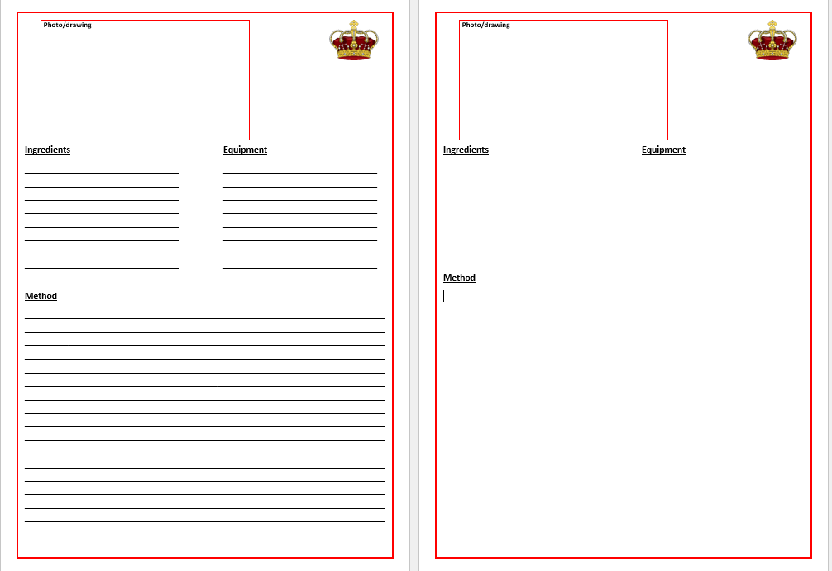
Step 1 – Writing your recipes
Write your recipes onto the template
Don’t forget to add a photo or drawing of the food
Use your best handwriting!
Notes:
There are three templates available:
With guide lines (differentiation)
Without guidelines, suitable for use on a computer.
Learners could hand write their recipes or use ICT software to produce them if available.
Learners should think about food items that represent the King, the United Kingdom and the commonwealth. They could research these in advance, or use ideas developed when completing the IET resource ‘Jubilee Food’.

Slide 6
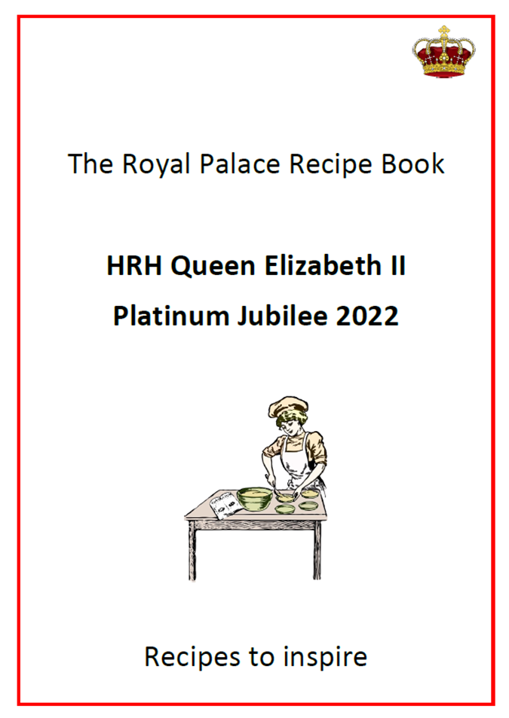
Step 2 – Front cover and contents
Design a front cover for your recipe book
Write a list of contents and page numbers
HRH King Charles III
Coronation 2023

Slide 7
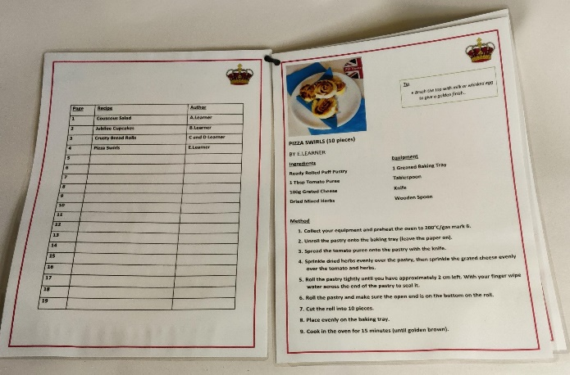
Step 3 – Print and bind
Print any pages you designed on the computer
Use treasury tags or a plastic binder spine to bind them all together

Slide 8
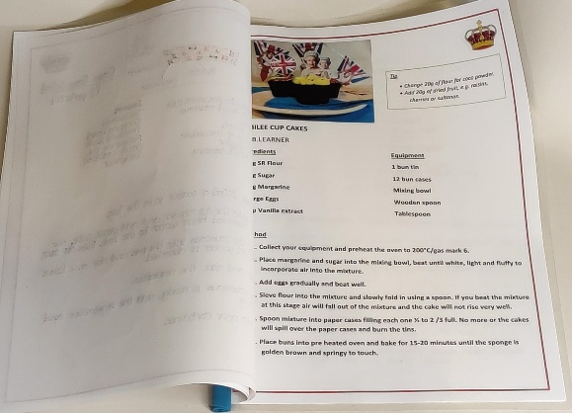
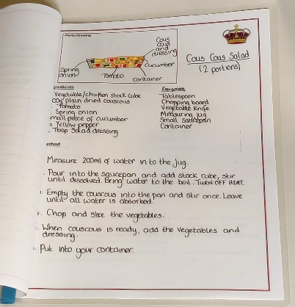
Finished examples 1
Notes:
This is an example using a plastic binder to join single sided pages together as a display book.

Slide 9
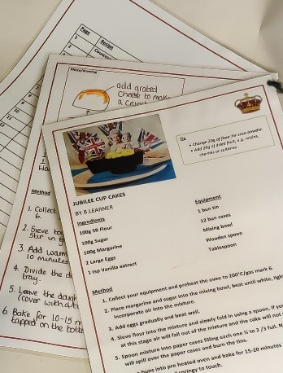
Finished examples 2
Notes:
This is an example using treasury tags to join double sided laminated pages together.

