Slide 1
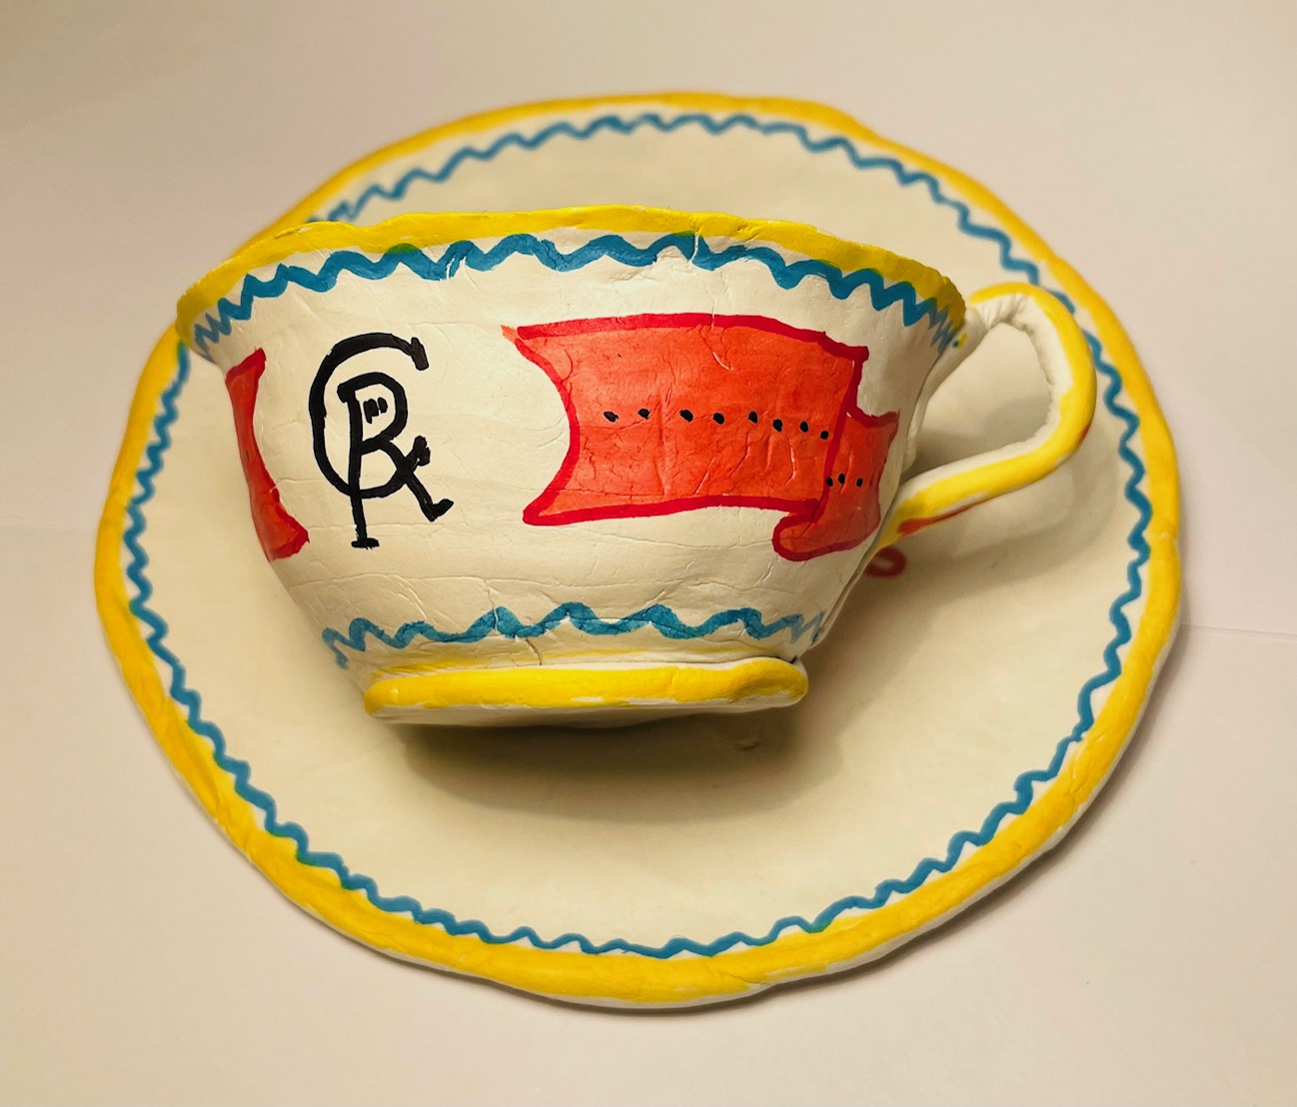
Make a DIY clay teacup
Making a commemorative cup for a celebration
e.g. the coronation of King Charles III

Slide 2
Stay safe
Whether you are a scientist researching a new medicine or an engineer solving climate change, safety always comes first. An adult must always be around and supervising when doing this activity. You are responsible for:
ensuring that any equipment used for this activity is in good working condition
behaving sensibly and following any safety instructions so as not to hurt or injure yourself or others
Please note that in the absence of any negligence or other breach of duty by us, this activity is carried out at your own risk. It is important to take extra care at the stages marked with this symbol: ⚠

Slide 3
Design brief
What is the celebration?
The coronation of King Charles III will take place on Saturday 6 May 2023
There will be a bank holiday on Monday 8 May
Lots of public events will take place to celebrate this historic event
Your task:
Design and make a cup to commemorate the occasion!
Notes:
Questions for discussion:
Have they heard of the Coronation?
Do they know who the King is?

Slide 4
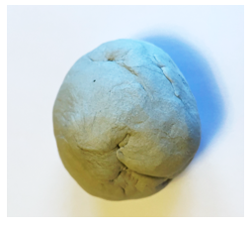
Equipment and resources
Air drying clay
Empty yogurt pot or half a potato
Clingfilm
Paint and brushes
Felt tip pens

Slide 5
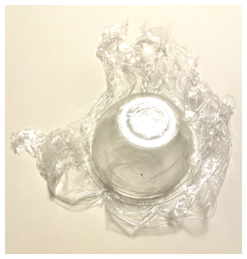
Step 1 Prepare your cup mould
Turn your yogurt pot (or potato) upside down and cover with clingfilm

Slide 6
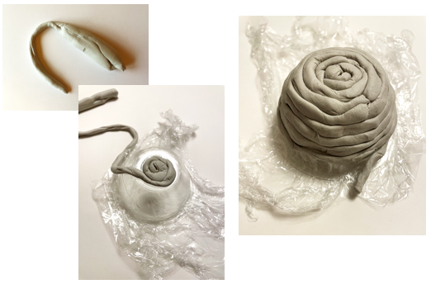
Step 2 Make your cup
Shape your clay into a snake
Coil the clay around itself covering the outside of the yogurt pot

Slide 7
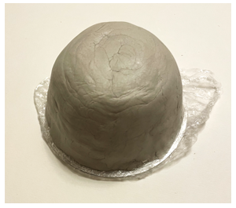
Step 3 Smooth the cup surface
Smooth the clay so you can not see the coils
Top tip: you can mix a bit of the clay with water and smooth it over the surface to make a super smooth finish!

Slide 8
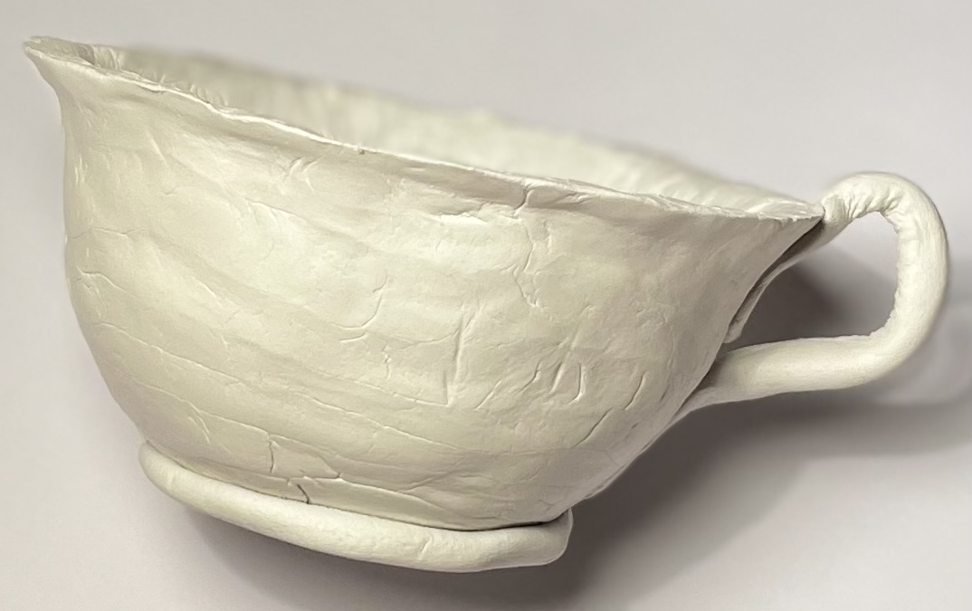
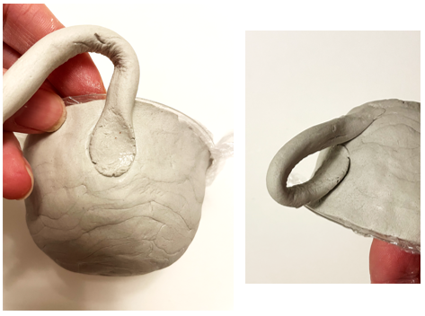
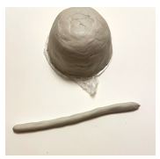
Step 4 Make the cup handle
Roll a snake of clay
Use water to stick the cup handle to the cup as shown
Allow the cup to dry overnight

Slide 9
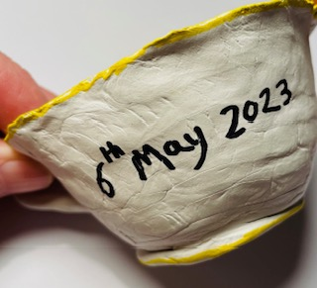
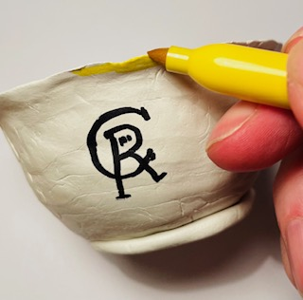
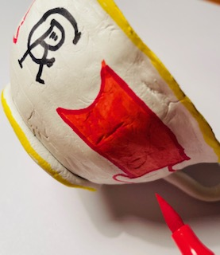
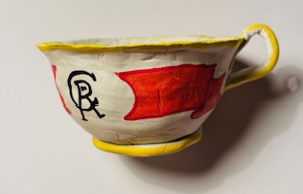
Step 5 Decorate your cup
Your cup must be dry before decorating!
Remove your cup from the mould - carefully hold the clingfilm and ease the cup from the yogurt pot
Paint your cup
Add in your own design using felt tips
Don’t forget to decorate inside your cup

Slide 10
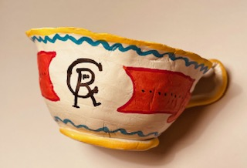
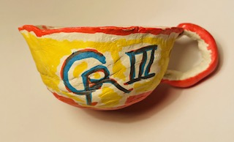
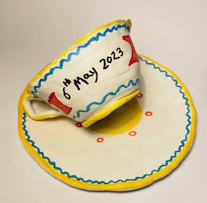
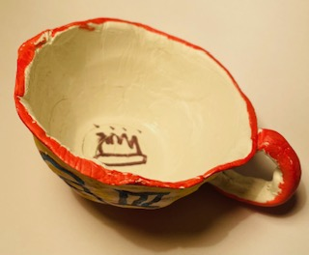
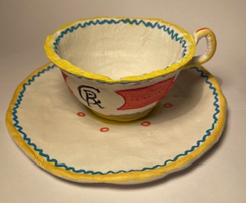
Examples of finished cups

