Slide 1
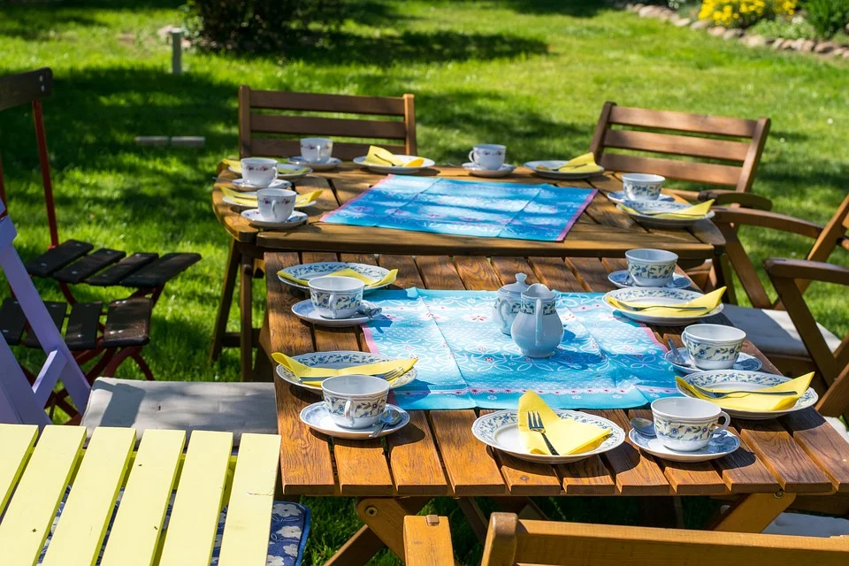
Design a place setting for a party
Creating a place setting for a party e.g. the coronation of King Charles III

Slide 2
Stay safe
Whether you are a scientist researching a new medicine or an engineer solving climate change, safety always comes first. An adult must always be around and supervising when doing this activity. You are responsible for:
ensuring that any equipment used for this activity is in good working condition
behaving sensibly and following any safety instructions so as not to hurt or injure yourself or others
Please note that in the absence of any negligence or other breach of duty by us, this activity is carried out at your own risk. It is important to take extra care at the stages marked with this symbol: ⚠
Notes:
Safety Warning

Slide 3
Design brief
The coronation of King Charles III will take place on Saturday 6 May 2023
There will be a bank holiday on Monday 8 May
Lots of public events will take place to celebrate this historic event
Your task:
Design a place setting that could be used at a party to celebrate the occasion

Slide 4

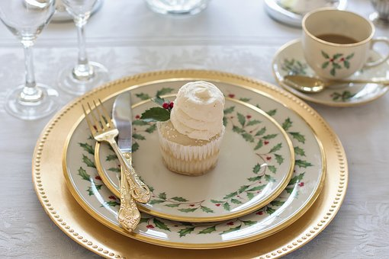
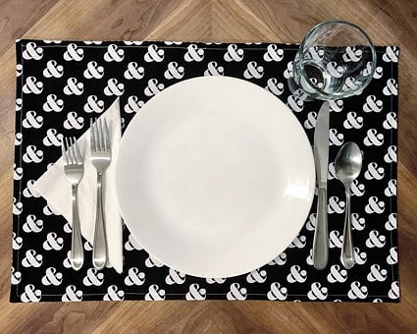
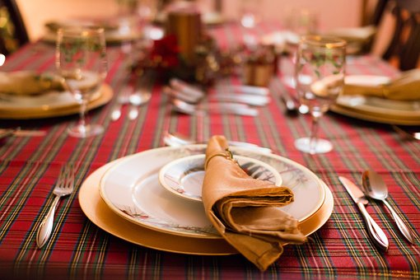
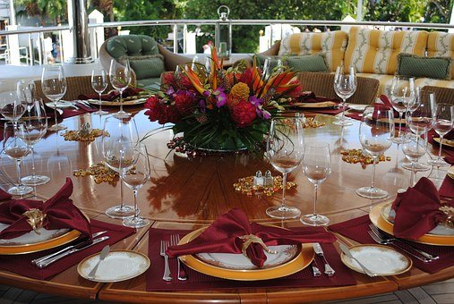

Slide 5
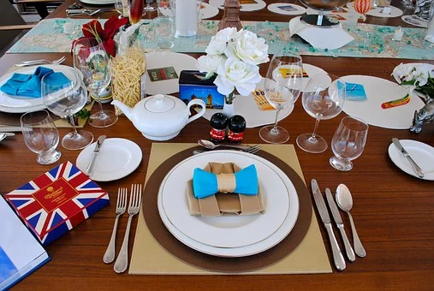
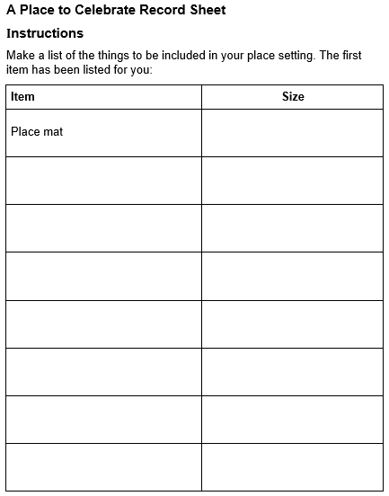
What do we need?
Other than food and drink, what things might be on the table in front of you at a party?
Why would these things be there?
Make a list of the things you need in the place setting

Slide 6
How much space will each person need?
Sit round a table with some friends.
How close together can you get before you are bumping into each other?
Use a ruler to measure the space you need to eat comfortably.
⚠ Be careful not to be too close to anyone with those elbows as you pretend to eat!
Notes:
If you are working in a group then everyone sit round a table next to each other as if you were going to have a sit down party.
When you eat you need to use your elbows for the knives and forks and to reach for your drink. Do you have enough room? Wave your elbows (carefully) to experiment.
How close together can you get before you are bumping into each other?
Use a ruler to measure the space you need to eat comfortably.

Slide 7

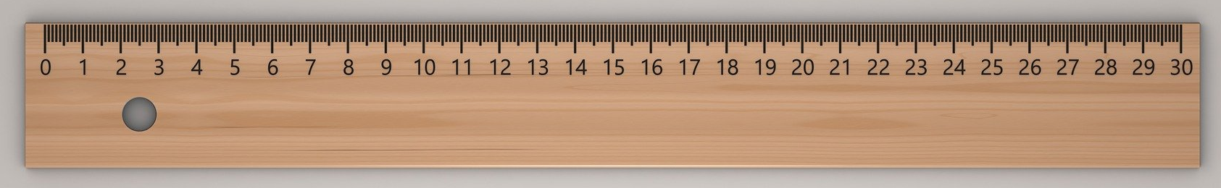
How much space will your place setting need?
Measure the items that need to be included in your place setting. For example:
The diameter of a plate
The diameter of a cup
The length and width of each piece of cutlery.
Keep a note of the measurements!

Slide 8
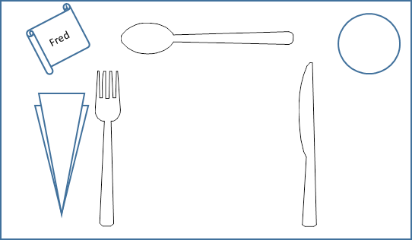
Designing
You are now ready to design your place setting.
On a large piece of paper, draw all the things for a place setting.
Make sure you draw it to the right sizes (dimensions).
You can:
  Rearrange the different pieces
  Add extra pieces that work for you (chopsticks for example)
  Put your name on it
  Swap it all round if you are left handed.

Slide 9
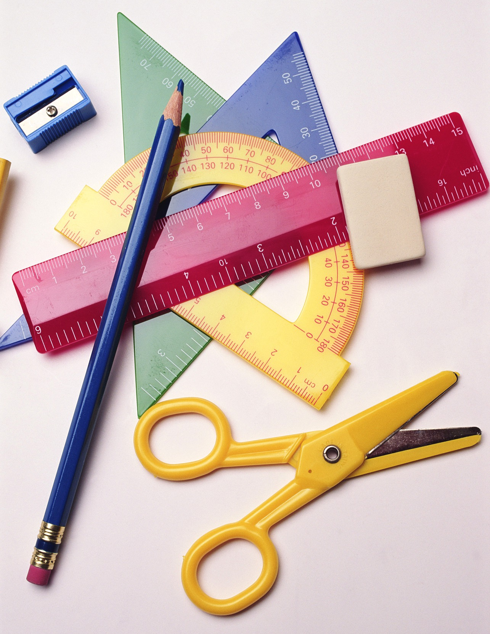
Equipment and Resources
Paper and card
Colouring pencils or pens
Scissors
Pencils and rulers
Glue sticks (if needed)

Slide 10
Let’s make!⚠
Make the items for your place setting. Some hints:
Use card to make plates, coasters and cutlery.
Use paper to make napkins.
Stick items in the correct place on your setting.
Add designs to each item to make them interesting!
Show your place setting to your group and arrange them all on a table to see how they look.
⚠ Be careful when using the scissors

Slide 11
Template

