Slide 1
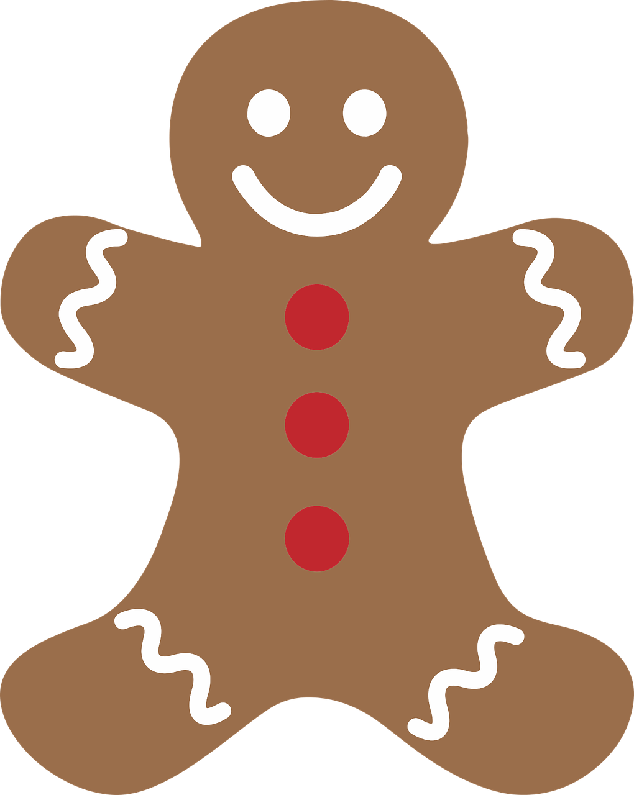
Gingerbread Man STEM Challenge
Finding all the possible solutions

Slide 2
Stay safe
Whether you are a scientist researching a new medicine or an engineer solving climate change, safety always comes first. An adult must always be around and supervising when doing this activity. You are responsible for:
ensuring that any equipment used for this activity is in good working condition
behaving sensibly and following any safety instructions so as not to hurt or injure yourself or others
Please note that in the absence of any negligence or other breach of duty by us, this activity is carried out at your own risk. It is important to take extra care at the stages marked with this symbol: ⚠

Slide 3
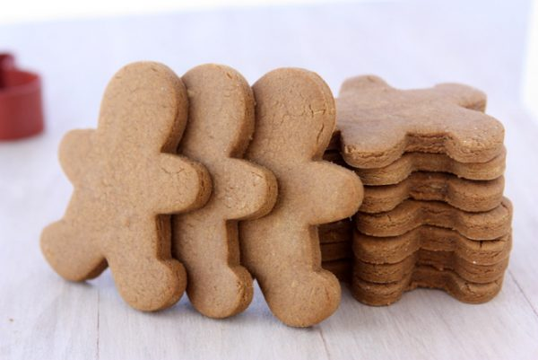
Decorating biscuits
We have red buttons and blue buttons, and we have lots of gingerbread biscuits and we want them all to look different.

Slide 4
How many different ways can we decorate the biscuits using 2 buttons

Slide 5
How many different ways can we decorate the biscuits using 2 buttons
Can you find a different solution?
What is the same and what is different about your gingerbread biscuit?

Slide 6
The solution to activity 1

Slide 7
How many different ways can we decorate the biscuits using 3 different coloured buttons
Can you find a different solution?
What is the same and what is different about your gingerbread biscuit?

Slide 8
The solution to activity 2
Can you spot a pattern in the solution?

Slide 9
I think that…..
My prediction is….
I noticed that…..
It must be because….
If…. then…..
I already know….. so……..

Slide 10
Now try this….
You have 15 minutes to solve activity 3:
You have three coloured buttons and can now give each gingerbread character 3 buttons.
Can you work systematically to find out how many gingerbread characters can be decorated so they are all different?

Slide 11
Now try this….
Keep two of the button the same colour and just change one button

Slide 12
Solution to Activity 3
There are 27 solutions.
Did you find them all?
What strategy did you use to make sure you didn’t have any repeats?

