Slide 1
KS2 Times Table Cake Challenge
A challenge for 7-9 year olds
A pattern spotting problem using multiplication knowledge

Slide 2
Stay safe
Whether you are a scientist researching a new medicine or an engineer solving climate change, safety always comes first. An adult must always be around and supervising when doing this activity. You are responsible for:
ensuring that any equipment used for this activity is in good working condition
behaving sensibly and following any safety instructions so as not to hurt or injure yourself or others
Please note that in the absence of any negligence or other breach of duty by us, this activity is carried out at your own risk. It is important to take extra care at the stages marked with this symbol: ⚠

Slide 3
Decorating cakes
We can use different toppings to decorate our cakes and make them more appealing.

Slide 4
Different toppings
Blue sprinkles
White icing
Red Sweets

Slide 5
Practice example: Rules for decorating our cakes
We need to decorate 6 cakes
Every second cake must have white icing
Every third cake must have three red sweets
1
2
3

Slide 6
Prediction questions
Will there be any cakes that have no toppings?
Why do you think this is?
Will there be any cakes that have both toppings?
Why do you think this is?

Slide 7
I think that…..
My prediction is….
I noticed that…..
It must be because….
If…. then…..
I already know….. so……..

Slide 8
Practice example: Rules for decorating our cakes
Every other cake must have white icing
Every third cake must have three red smarties

Slide 9
Reflection questions
Which cakes have no toppings?
Why do you think this is?
Which are the cakes that have icing on?
Which are the cakes that have smartie toppings?
Which cake has both toppings?
What do you notice?

Slide 10
Now try this….
You have 15 minutes to decorate 24 cakes
Place your cakes in a line
Put a spoonful of white icing onto every third cake
Put some blue sprinkles onto every fourth cake
Put a three red smarties on every eight cake

Slide 11
Exploring the patterns
Which cakes have icing on top?
Which cakes have blue sprinkles?
Which cakes have smartie toppings?
What do you notice about the cakes with no toppings?
What do you notice about the cake that has all three toppings?
How many cakes might we need to make to have another cake with 3 toppings?
Why do all the cakes that have red smarties also have blue sprinkles?

Slide 12
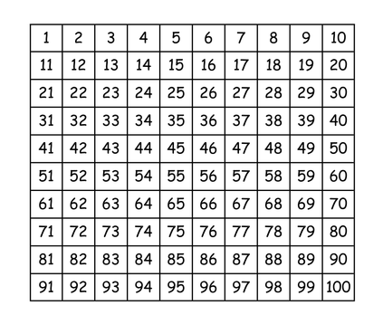
Additional Image for Reference

