Slide 1
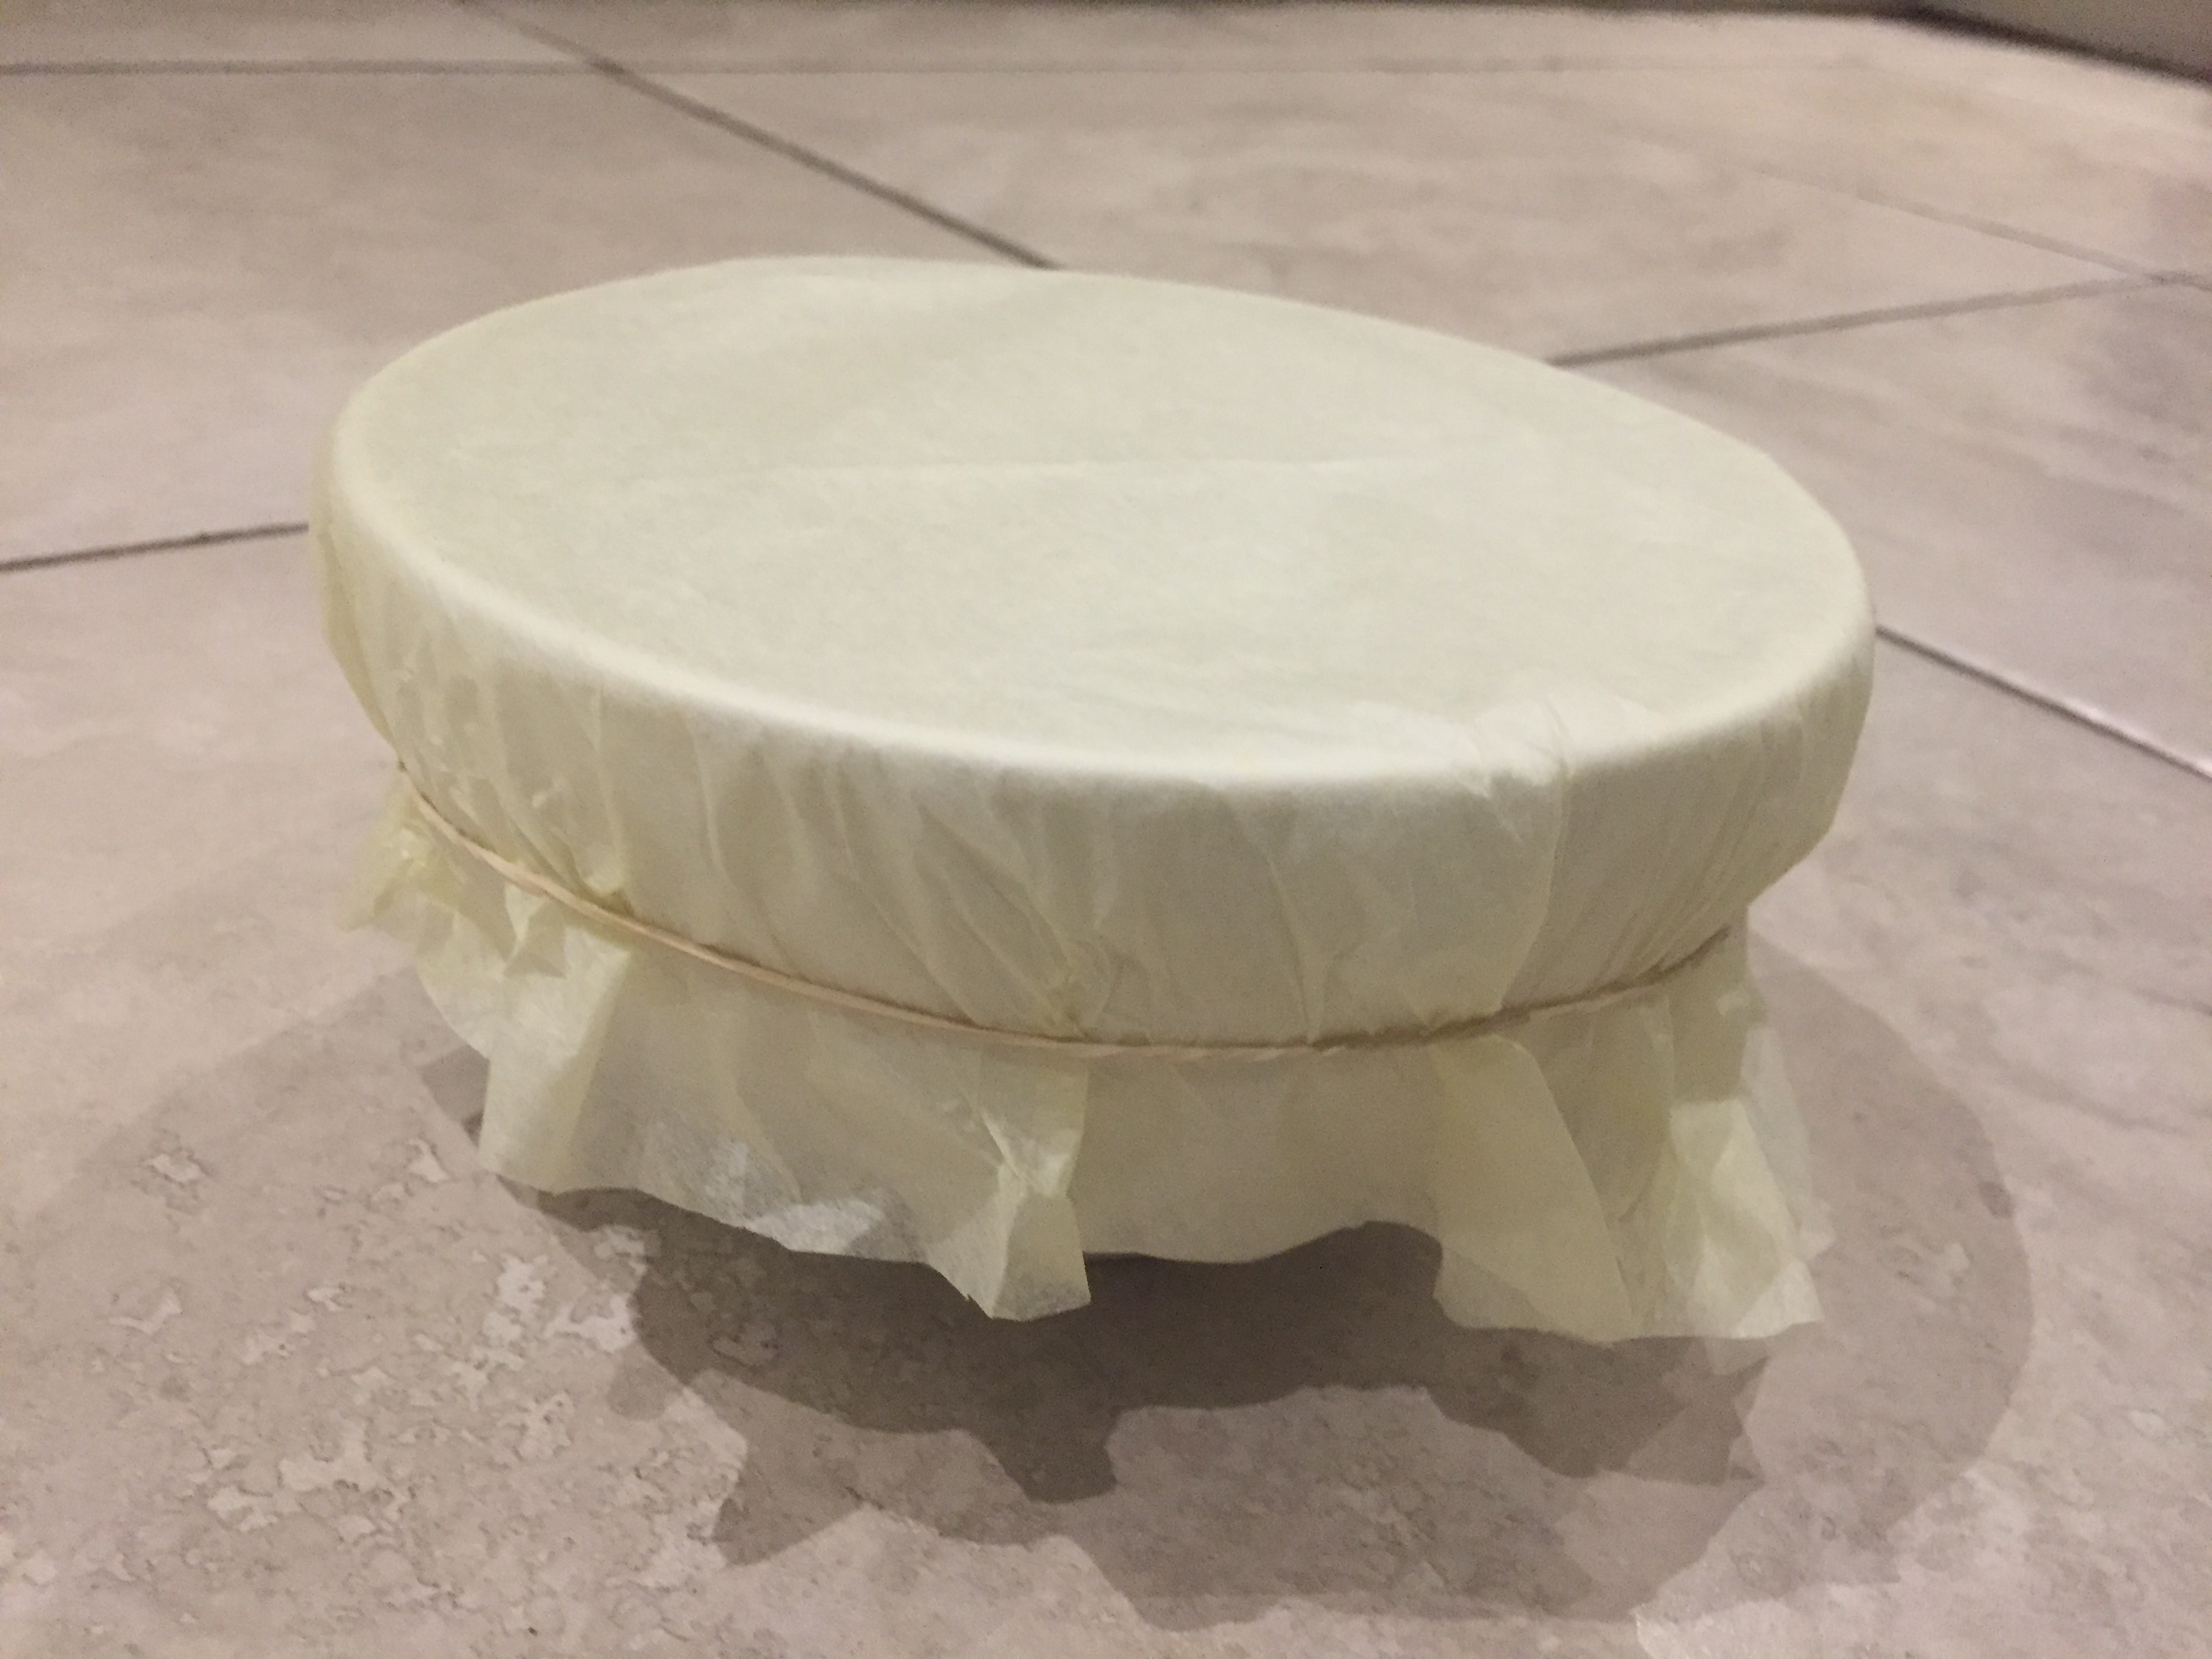
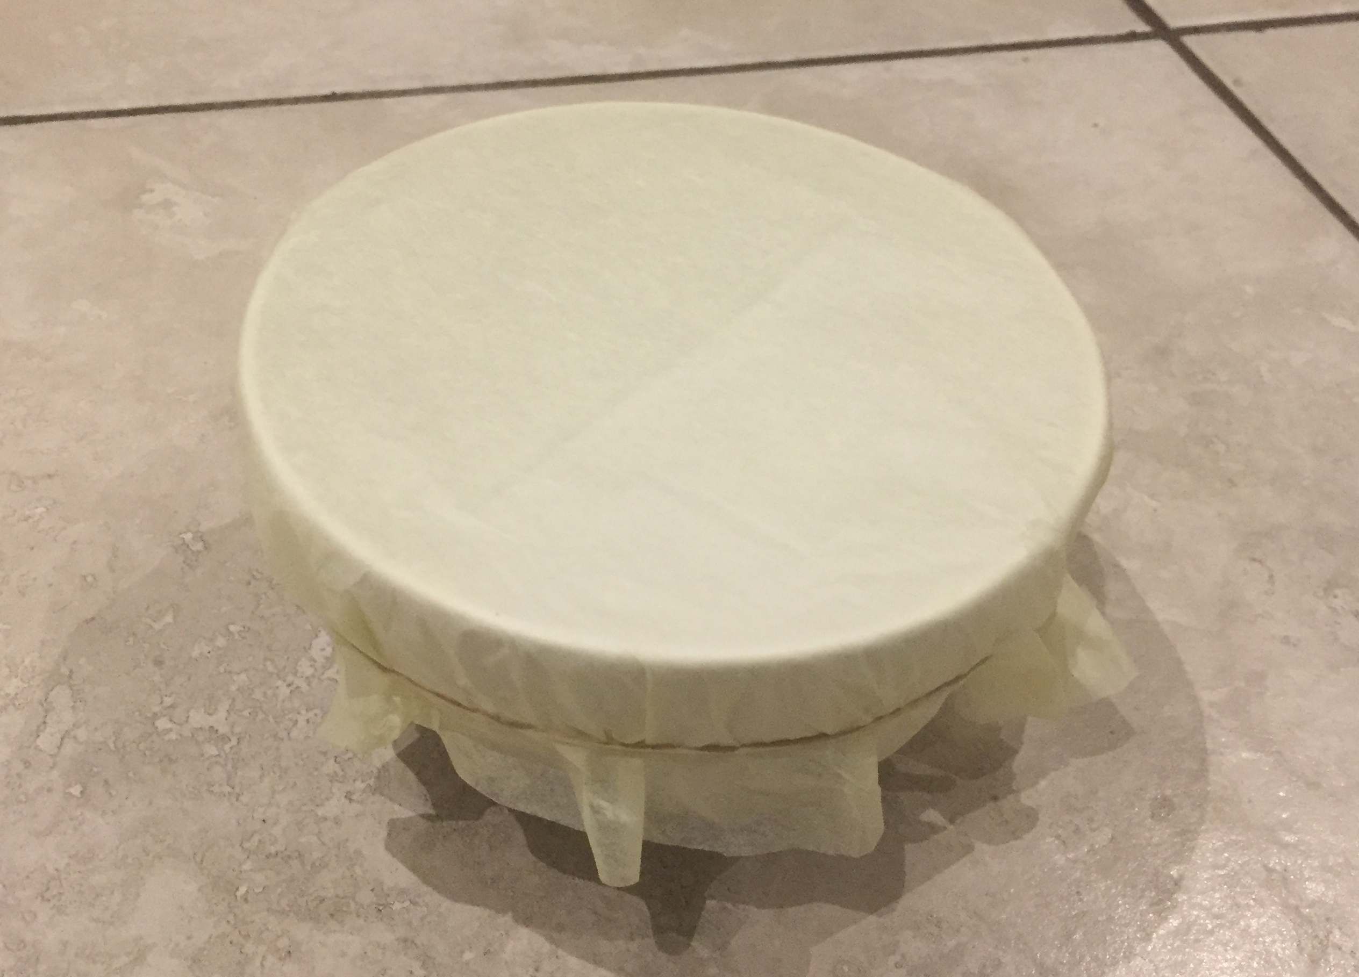
Homemade drum and earmuffs
Making drums and earmuffs from different materials, to test the amount of noise they make and dampen

Slide 2
Making a drum
Cut out your plastic bag into a circle shape. Make sure it is big enough to fold down the sides of your container.
Wrap round an elastic band to hold the plastic bag in place.
Notes:
The plastic bag acts as the ‘skin’ of the drum. Any container, bowl, bucket or other similar object can be used as the body of the drum, as long as it has an open top. The ‘skin’ of the drum should be secured as tightly as possible to achieve the best sound.

Slide 3
Testing your drum
Use your drumsticks to tap the ‘skin’ of the drum a few times. What happens?
Replace the ‘skin’ with different materials. What is the difference in the sound of each material?
Notes:
Learners could think about the difference in loudness, pitch etc of each material. Different materials could include tissue paper, normal paper, different fabrics etc. Pencils or small pieces of wood could be used as drumsticks. Alternatively, learners could tap with their hands.

Slide 4
Making earmuffs
Cotton wool
Cut out a strip of card long enough to go from ear to ear when placed over your head.
At each end of the card glue a circular piece of card.
Glue cotton wool to each circular piece.
Card strip
Cotton wool
Notes:
Learners cold use PVA glue to attach the cotton wool or tape it in place. The earmuffs need to cover the whole of each ear to be effective, so will need to be sized appropriately. Learners could also decorate their earmuffs for extra visual appeal and/or to personalise them.

Slide 5
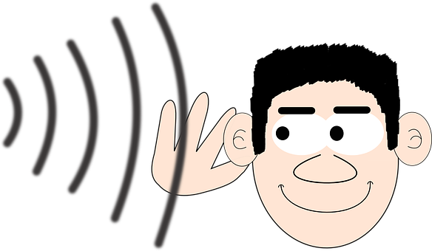
Testing your earmuffs
Place the card strip around the top of your head so that the cotton wool is over your ears.
Clap your hands a few times. What effect do the earmuffs have on the sound?
Try different materials instead of the cotton wool. Which works best and why?
Notes:
The cotton wool should dampen the sound – i.e. it cannot be heard as loudly as when the earmuffs are not being worn. Different materials could include cardboard, foam material or polystyrene. Get learners to think about which materials work well and which don’t, and why that is. E.g. polystyrene does not dampen the sound well because it has holes in it and therefore the sound vibrations can get through more easily. As an extension, get learners to think about different applications for earmuffs.

