Slide 1
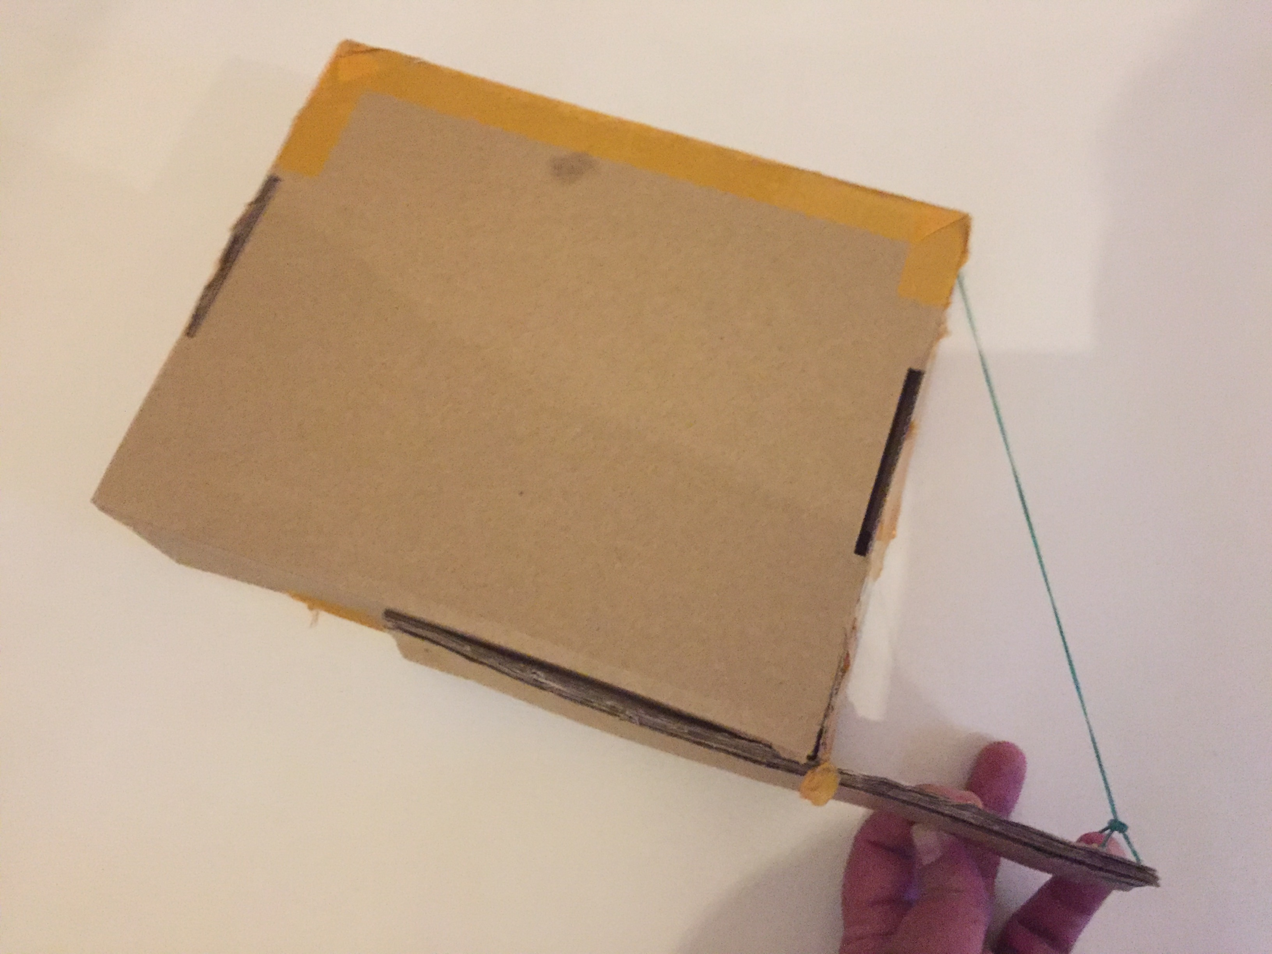
Make a homemade musical instrument
Making a single stringed instrument

Slide 2
Step 1 – Preparing the box
Hole 2
Make a hole in the middle of one side of the box as shown.
Make another hole on the front of the box, but close to the edge as shown.
Hole 1
Notes:
Use a hollow cardboard box. Show a finished example when showing where the holes go so learners can see in 3D.

Slide 3
Step 2 – Making the handle
Card handle (four layers)
Cut a piece of card around the same length as the box.
Use a hole punch to make a hole at either end as shown.
Repeat up to four times and glue the pieces together to make a stiff handle.
Holes
Notes:
Use corrugated card for stiffness.

Slide 4
Step 3 – Attaching the handle to the box
Push a paper fastener through one of the holes in the handle.
Then push the fastener through hole 1 in the box and secure it. This will create a pivot for the handle.
Hole 1
Notes:
Teacher could talk about pivots and how these work, giving examples of their use in mechanical systems.

Slide 5
Step 4 – Attaching the string
Cut an elastic band as shown to form a straight piece.
Tie one end of the elastic band to the free hole in the handle. Tie the other end to hole 2 in the box. Make sure the elastic band is tight.
Straight piece
Cut here
Hole 2
Notes:
The elastic band will form the ‘string’ for the instrument. It can be tied to the box by tying a knot inside the box if the knot is bigger than the hole; alternatively, the elastic band could tie around a matchstick or similar, or a second hole could be made to allow it to loop back to the outside and be tied to itself. This should be tight enough when first fitted so that a clear note is heard when it is plucked, but with some ‘give’ left in it so it can be tightened further without breaking when the handle is lifted.

Slide 6
Step 5 – Testing the instrument
Pluck the elastic band. Write down the pitch of the note that you hear. Is it high or low?
Move the handle upwards so that the elastic band begins to stretch and repeat step 1.
Keep moving the handle upwards and repeating step 1.
What happens to the pitch of the notes produced as the handle is raised. Why is this happening?
Notes:
As the handle is raised the elastic band will become tighter. The tighter the elastic band, the higher the frequency/pitch of the notes produced. The handle is acting like a string tensioner, or tuner. Learners could record testing results in a table or write a paragraph summarising their findings.

Slide 7
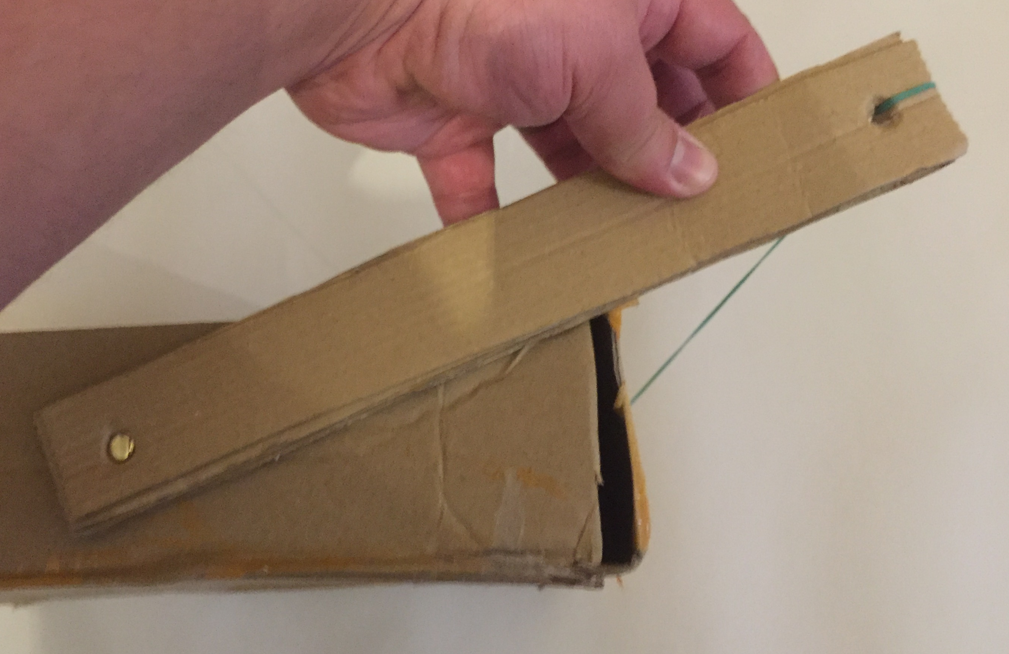
Example made by a student

