Slide 1
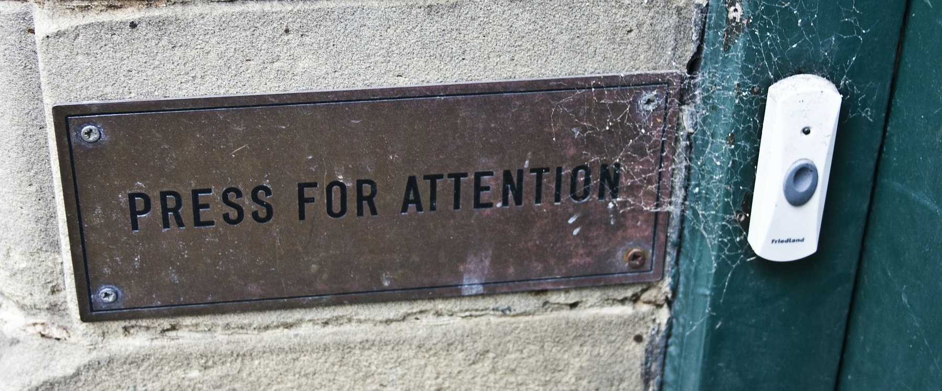
Make a doorbell circuit

Slide 2
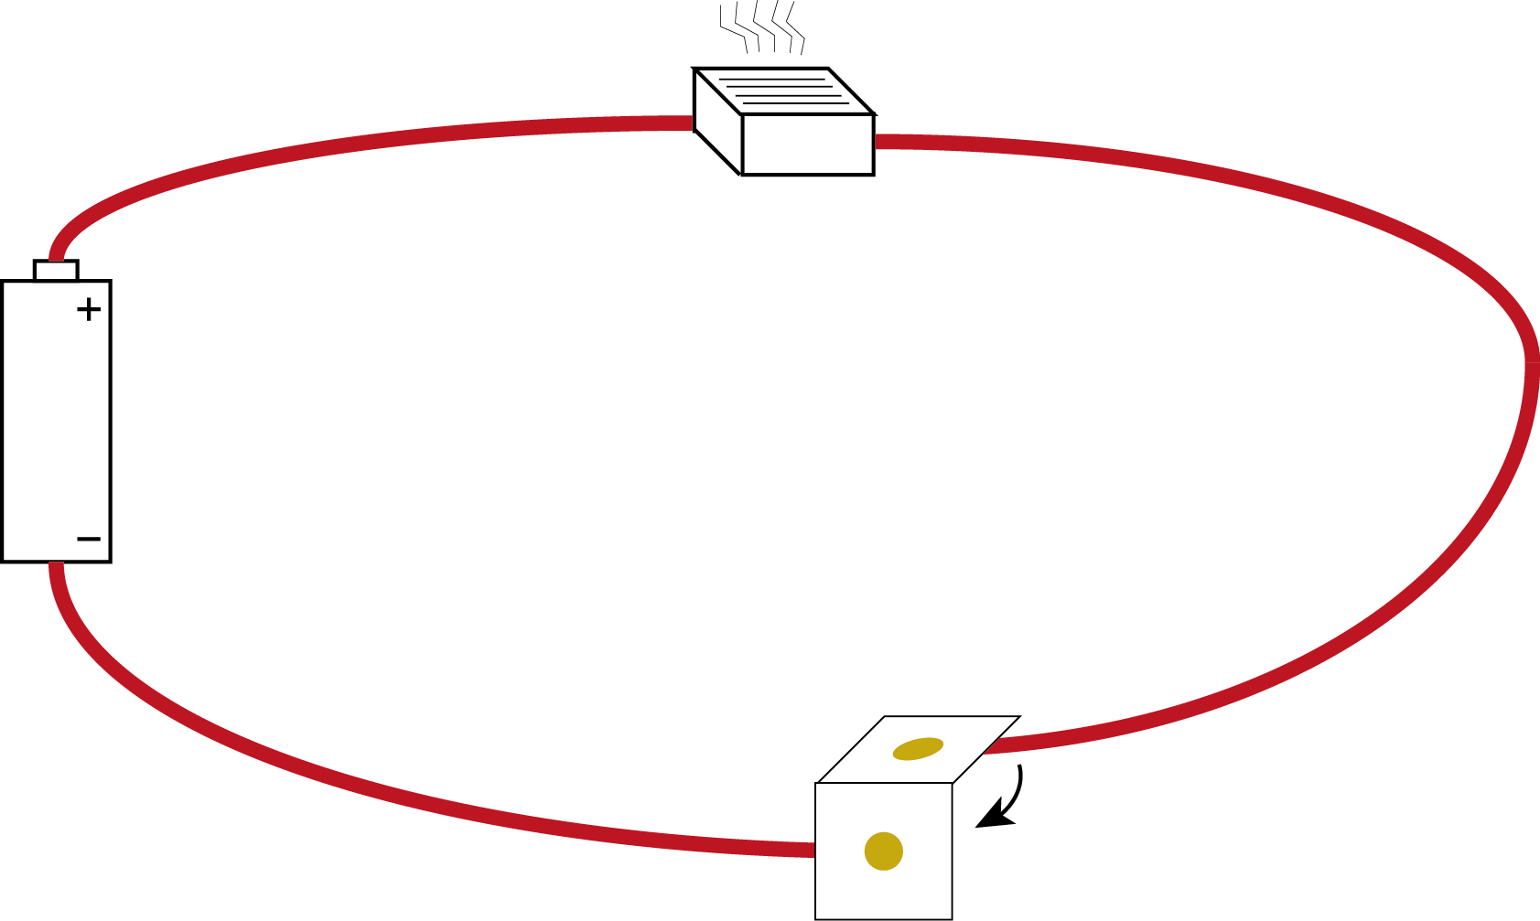
We are going to make this circuit…
buzzer
wire
battery
(in holder)
switch

Slide 3
You Will Need:
1 motor
1 battery holder
1 switch
3 lengths of wire
buzzer
wire
battery
(in holder)
switch

Slide 4
Preparing the wires to make the circuit
Stripped end of wire
Cut the wire to the length needed.
Using wire strippers, take off about 10 mm of plastic coating from the end.
Twist the exposed stands of wire to join them together.
Twist wire this way
wire

Slide 5
Joining two wires together
Twist the exposed wires together
wire
wire
Using wire strippers, take off about 10 mm of plastic coating from the end of each wire.
Twist the exposed stands of wire to join them together.
Wrap sticky tape around the joint.

Slide 6
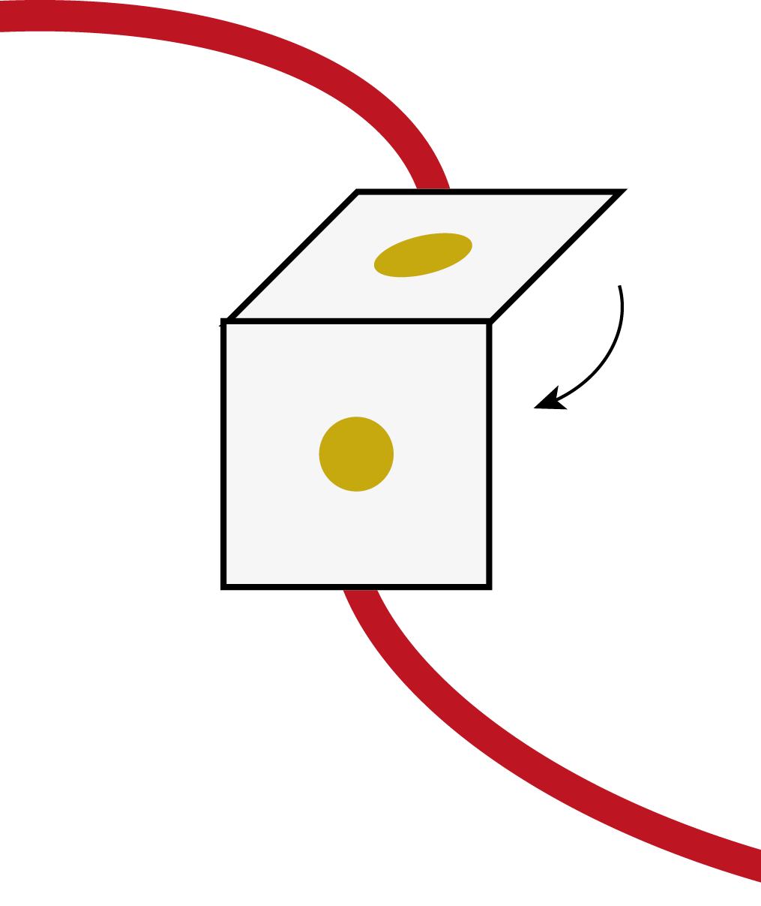
Making a switch from two metal fasteners
wire
Fold the card across the middle.
Push two metal fasteners through the card, one each side of the fold.
Wrap a wire around the back of each metal fastener.
If you fold the card so the two studs touch, it completes the circuit.
stud
stud
wire

Slide 7
The finished circuit…
buzzer
wire
battery
(in holder)
switch

