Slide 1
Maths tea party
Setting the table for the tea party for a celebration
e.g. the coronation of King Charles III

Slide 2
Stay safe
Whether you are a scientist researching a new medicine or an engineer solving climate change, safety always comes first. An adult must always be around and supervising when doing this activity. You are responsible for:
ensuring that any equipment used for this activity is in good working condition
behaving sensibly and following any safety instructions so as not to hurt or injure yourself or others
Please note that in the absence of any negligence or other breach of duty by us, this activity is carried out at your own risk. It is important to take extra care at the stages marked with this symbol: ⚠

Slide 3
Arrange the teacups in the grid so that there is only one of each colour in each row and column.
Notes:
Cups and saucers are being laid out ready for the tea party
To make the table look as interesting as possible, Sam has decided to try and do it so that there is only one cup of each colour in each row or column
Can you do this?

Slide 4
What is the same and what is different about these solutions?
Notes:
Solution

Slide 5
What shapes can you see in the way the colours are arranged?
Notes:
Solutions
Two colours form triangles and the other is a diagonal
What would happen if we had 4 colours of teacup?

Slide 6
Can you make the shapes the same in both images?
Notes:
Solutions
Two colours form triangles and the other is a diagonal
What would happen if we had 4 colours of teacup?

Slide 7
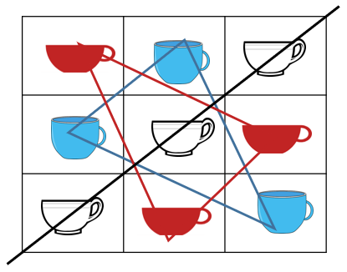
What has happened?
Notes:
Solutions
Two colours form triangles and the other is a diagonal
What would happen if we had 4 colours of teacup?

Slide 8
Arrange the teacups in the grid so that there is only one of each colour in each row and column.
Notes:
What if we had 4 colours and 4 of each cups to place in a 4 x 4 square so that there is one of each colour in each row and column?
Is there a strategy from the last grid that you can use this time?

Slide 9
What was your strategy?
Is your solution the same as your partner’s?
Notes:
What was your strategy?
Is your solution the same as your partner’s?

Slide 10
What shapes can you see this time?
Notes:
What was your strategy?
Is your solution the same as your partner’s?

Slide 11
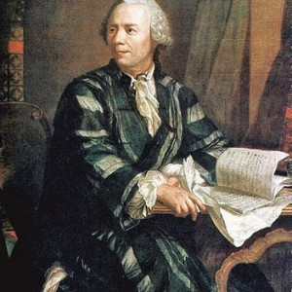
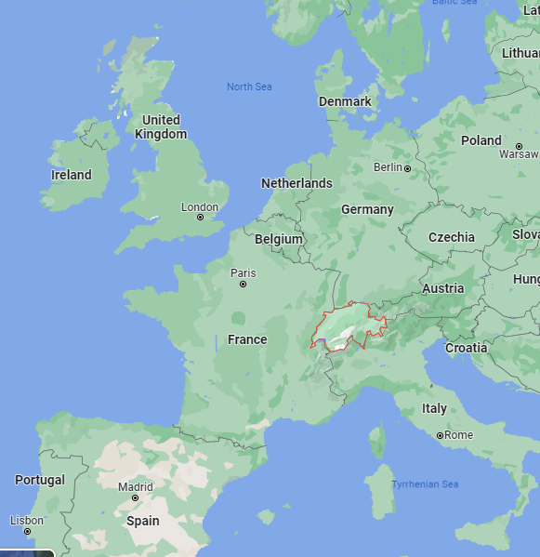
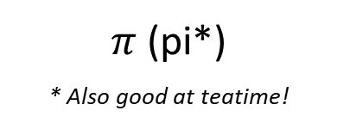
Why are we having tea with Euler?
Mathematician, physicist, astronomer, geographer, logician and engineer
Born in Switzerland in 1707
$π$ (pi*)
* Also good at teatime!
The Officer Problem
Notes:
Image of Euler https://mathemania.com/the-bridges-of-konigsberg/leonhard-euler/
He is regarded as the greatest mathematician of the 1700s
He popularized the use of the Greek letter pi for the constant that we use when calculating circumferences and areas of circles
He set a problem like the cups and saucers (The Officer Problem)
Let’s build up to it!

Slide 12
This time there has to be one of each colour and one of each item in every row and column
Notes:
This time there has to be one of each colour and one of each item in every row and column

Slide 13
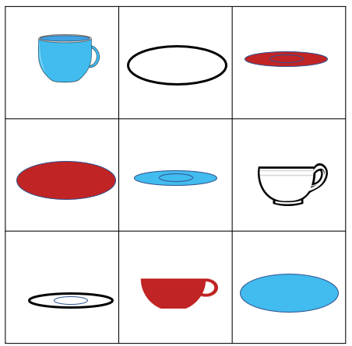
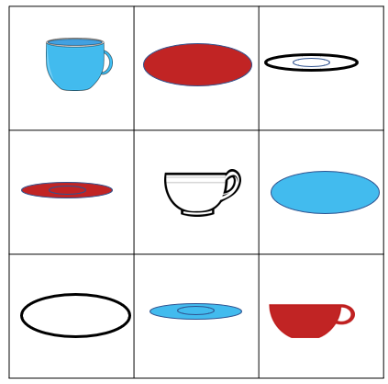
What is the same and what is different about these solutions?
Can you still see the triangles?
Notes:
In one the colour is in the diagonal and in the other the cups are in the diagonal

Slide 14
Can we use what we have learned to put one of each colour and one of each item into every row and column?

Slide 15
What patterns can you see in this solution?
Notes:
Solution
This time there are two diagonals of the same colour and then rectangular patterns of the other two colours.

Slide 16
What patterns can you see in this solution?
Notes:
Solution
Does it work with items on the diagonals?

Slide 17
Euler’s Officer Problem
There are 36 officers
They are in 6 regiments
Each regiment has officers with 6 different ranks or titles*
Can they be arranged into a $6×6$ grid so that there is one from each regiment and one from each rank in each row and column?
*like arranging a cup, saucer, plate, knife, fork and spoon in each colour into a $6×6$ grid
Notes:
Arrange them in a grid of 36 squares so that each row and column has one officer from each regiment and one of each rank.
It isn’t possible in a 2 x 2 grid either
Euler said that it wasn’t possible for any square where the side length could be represented by the formula 4k + 2 so (4 x 1) + 2 for 6
This would have meant that a 10 x 10 would not be possible as it is (4 x 2) + 2

Slide 18
Euler’s Officer Problem
Spoiler alert!
It wasn’t possible!
Can they be arranged into a $6×6$ grid so that there is one from each regiment and one from each rank in each row and column?
*like arranging a cup, saucer, plate, knife, fork and spoon in each colour into a $6×6$ grid
Notes:
Arrange them in a grid of 36 squares so that each row and column has one officer from each regiment and one of each rank.
It isn’t possible in a 2 x 2 grid either
Euler said that it wasn’t possible for any square where the side length could be represented by the formula 4k + 2 so (4 x 1) + 2 for 6
This would have meant that a 10 x 10 would not be possible as it is (4 x 2) + 2

Slide 19
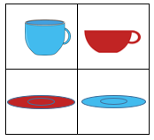

We can use algebra to explain this pattern: $4n+2$
Euler said that it wasn’t possible to solve this sort of problem for squares where the length of a side followed this pattern:
$\left(4×0\right)+2=2$
$\left(4×1\right)+2=6$
$\left(4×2\right)+2=10$
Notes:
It isn’t possible in a 2 x 2 grid either
Euler said that it wasn’t possible for any square where the side length could be represented by the formula 4k + 2 so (4 x 1) + 2 for 6
This would have meant that a 10 x 10 would not be possible as it is (4 x 2) + 2

Slide 20
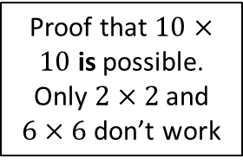
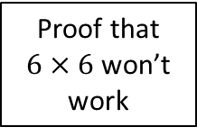
What happened next?
Proof that $10×10$ is possible. Only $2×2$ and $6×6$ don’t work
Proof that $6×6$ won’t work
Euler worked on the problem
1779
1901
1960
It took nearly 120 years to sort out the Officer Problem and another 60 to prove that Euler’s rule was incorrect.
Notes:
Image source http://www.cecm.sfu.ca/organics/papers/lam/paper/html/POLS10/gl10.gif

Slide 21
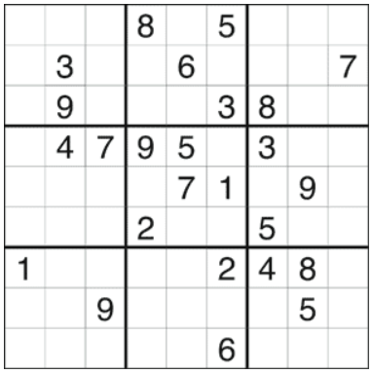
Where do you see this sort of pattern?
Have you ever done a Sudoku?
Notes:
Sudoku from https://www.puzzles.ca/sudoku_puzzles/sudoku_easy_481.html

